Slide 1
Kingdom of Bahrain
Ministry of Health
Informed Healthcare
Tree of Life
The Tree of Life, a 400-year old mesquite tree in Bahrain whose survival in an area completely free of water supply has made it a legend, is currently ranked fourth in the Official New Seven Wonders of Nature campaign.

Slide 2
Agenda
Healthcare agenda
Introduction
Strategy
Provision of Healthcare
Healthcare Achievements
Improvements and Challenges
National Healthcare Information System (I-SEHA)
Definition
Scope
Primary Care project Achievements
Secondary care project Achievements
Project Challenges
2

Slide 3
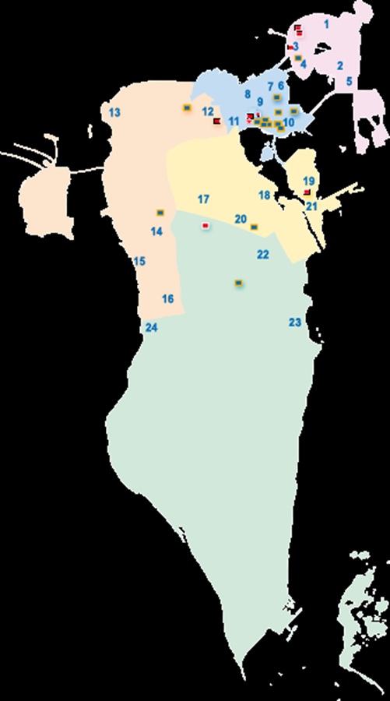
Kingdom of Bahrain
Socio-Economic Indicators 2011
Element | Value
Area | 767.3 sq KM
Population | 1,195,020
Child Dependant Ratio (0-14) | 27.2
Aging Dependency (age 65+) | 2.9
Total Dependency Ratio | 30.1
Crude Birth Rate | 14.8
Crude Death Rate | 2.0
life Expectancy ratio at birth | 75.3
Literacy | 93.5
MoH Expenditure as % of Public Expenditure | 7.4%

Slide 4
Bahrain Constitution
Article 8 [Health Care] of the constitution which states the following:
Every citizen is entitled to health care. The State cares for public health and the State ensures the means of prevention and treatment by establishing a variety of hospitals and healthcare institutions.
Individuals and bodies may establish private hospitals, clinics or treatment centers under the supervision of the State and in accordance with the law.

Slide 5
MOH Vision
All Kingdom of Bahrain Citizen to receive high quality health care services throughout their life cycle.

Slide 6
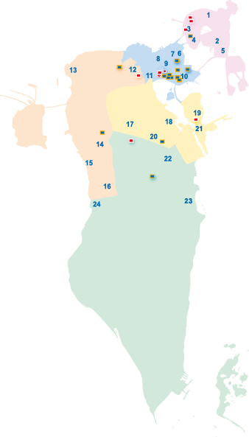
Healthcare in Bahrain 2012
Muharraq Governorate
Capital Governorate
Northern Governorate
Governorate | Health Centers & Clinics | Govt. Hosp. | Private Hosp.
Muharraq* | 5 | 3 | 1
Capital | 7 | 3 | 10
Northern | 5 (1) | 1 | 2
Central | 6 | 1 | 1
Southern | 2 (1) | 1 | 1
Total | 25 (2 Clinics) | 9 | 15
Central Governorate
Southern Governorate

Slide 7
Delivery: Bahrain’s macro level health indicators – Much done, much to do updated
.
71.9*
+1%
Benchmark average 80.7*
Life expectancy at birth
years
-1%
Benchmark average 3.3*
Infant mortality
per 1,000 live births
-9%
Benchmark average 4*
Child mortality rate**
per 1,000 live births
Maternal mortality
per 100,000 live births
Benchmark average 5.8*
-18%
1996
2003
2009
* Benchmarks are: Germany, Iceland, Netherlands, Norway, Singapore, United Kingdom
** Children under the age of five
Source: Ministry of Health Bahrain; Vital statistics, World Health Report 2010

Slide 8
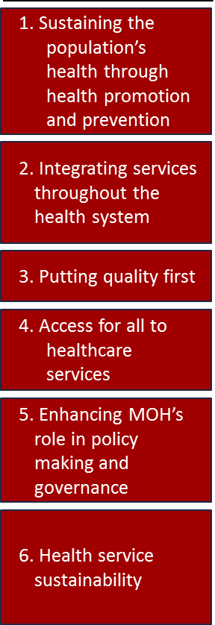
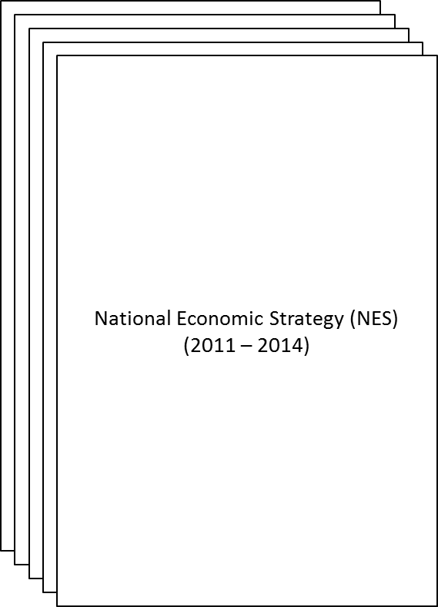
Bahrain’s Healthcare Agenda
Challenges
Health Strategy
National Economic Strategy
Population growth and ageing
Increased demand on helth services
Unhealthy lifestyles
Increased prevalence of chronic Non Communicable Diseases
Shortage of certain categories of health professionals
Continued rise in medical costs
Increase cost of health professionals and their training
Increase cost of overseas treatment

Slide 10
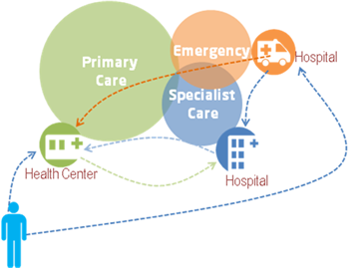
Project Definition
The Ministry of Health is leading an ambitious project to build up an informed healthcare system for the whole Kingdom of Bahrain.
The National Healthcare Information system has the acronym project name as I-SEHA (Seha= Health in Arabic)
I-SEHA will be deployed with Indra as an implementer and partner.
The main objective of I-SEHA is to enhance the quality of patient care and safety as a result of a better flow of information among professionals.
10

Slide 11
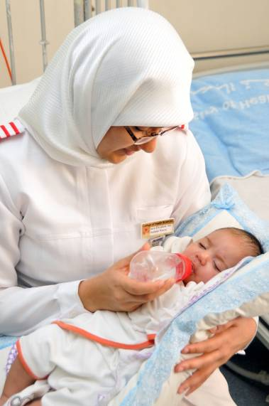
WHAT IS I-SEHA?
Integrated clinical and administrative solution for primary and secondary care, which includes all the patient information (present and previous episodes) in a single Electronic Health Record, available where and when needed.
The system covers requests and referrals and enables to track them.
Supports more than 4.000 healthcare professionals and 1.2 million+ citizens and residents.
11

Slide 12
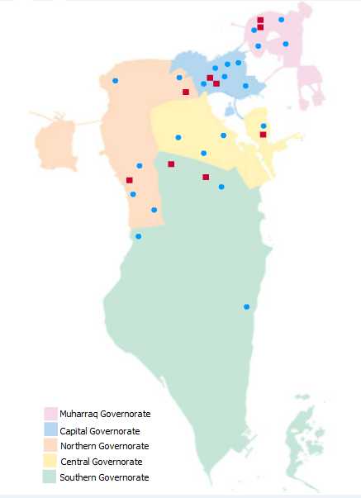
I-SEHA SCOPE
PROJECT OVERVIEW
I-Seha will cover all the Kingdom’s healthcare facilities.
KHUH
Salmaniya Medical
Complex
Peripheral Hospitals
26 Health Centers
12

Slide 13
PROJECT OVERVIEW
I-SEHA COMPONENTS
Module | Professional | What does it include
Electronic Health Record (EHR) | Physicians | Visit sheets, medical orders, results visualization, working list, minor surgery
 | Nurses | Triage sheet, nurse care sheet, treatment room, working list, medical orders, injections, procedures, drug administration
Scheduling & appointment | Clerks | Agendas and appointments management
 | Nurses | Schedule an appointment
 | Physicians | Schedule an appointment
Radiology Information System | Radiologists | Reporting of radiology images
 | Radiology Technicians | Performance of radiology tests
 | Medical secretaries | Transcription of the report of radiological images
Web Viewer | Physicians | Radiology images visualization (filmless)
13

Slide 14
PROJECT OVERVIEW
I-SEHA COMPONENTS
Module | Professional | What does it include
Laboratory Information System | Laboratory Technicians | Test request, analysis and reports generation
Pharmacy | Pharmacists | Dispensation and pharmacy management
 | Physicians | Drugs prescription
14

Slide 15
MAJOR ACHIEVEMENTS
MILESTONES
Filmless and RIS in MoH network. Schedule & Appointment implemented in all HC Schedule & Appointment implemented in 20 OPD clinics in SMC First OPD clinic running EHR in SMC 12 Health Centers running EHR

Slide 16
STATUS – PRIMARY CARE
STATUS AND COMPLETED ACTIVITIES
Schedule & Appointment deployed in all health centers. EHR Primary Care (general clinic, treatment room, triage) implemented in 12 out of the 26 health centers PACs and RIS completed in all MoH network.

Slide 17
STATUS – SECONDARY CARE
STATUS AND COMPLETED ACTIVITIES
PICU (wards 24 and 34) go live took place on October 15th 2012. PACs and RIS completed in all MoH network. Schedule & Appointment deployed in SMC OPD in Al Fateh and Main SMC. EHR deployed in OPD ENT department as a pilot. Current situation analysis for SMC completed

Slide 19
Wide Area Network (WAN) Issues:
1. Limitation of the existing MPLS Layer 2 that does not have the capability of a Star Topology Architecture, therefore we are stuck on a virtual Point to Point Connection.
2. In connection to Item 1. MoH then have to lease additional MPLS connections (100Mbps) to connect to the Main Data Center (CIO Juffair) and the Data Recovery Center (KHUH) to perform a better data flow.
3. A Dark Fiber direct connection is the most reliable and recommendable dedicated link between the Main Data Center (CIO) and the Disaster Recovery Center (KHUH) to perform an Active- Active Servers during fail
4. Since this Technology not readily available, It was decided to go for an Active-Passive solution.

Slide 20
I-Seha Solution on the Issue:
Iseha is working closely with Batelco and CIO for a Vitual Circuit (VC) Switching Solution that will help the congestion of Data Flow until then that the Country is ready for the MPLS 3 solution (MESS or Star Type of Communication Architecture).

Slide 21
Q&A

