Slide 1
Against the shadow: the role of e-Government
Ibrahim Kholilul Rohman
Linda Veiga

Slide 2
Takeaways from Day 1
Mobile industry is the first sector committed to help countries achieving SDGs targets ( Mr. S. Sharma)
Mobile technology will help facilitating countries with digital intelligence, automated cars, 42 largest bank on blockchain, MOOC and other digital innovation (Ms. Haorangsi, APT)
Mobile technology and IoT will help countries embracing (potential) Digital Single Market.
Are there any other anticipated potential impacts?
How about fiscal capacity?

Slide 3
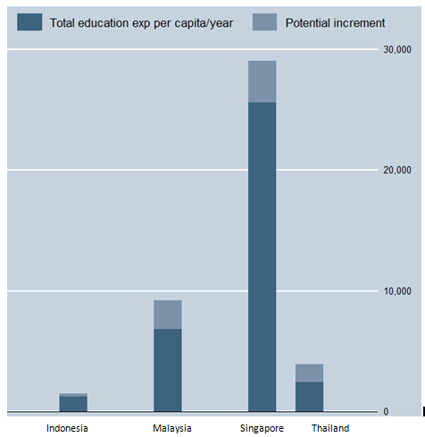
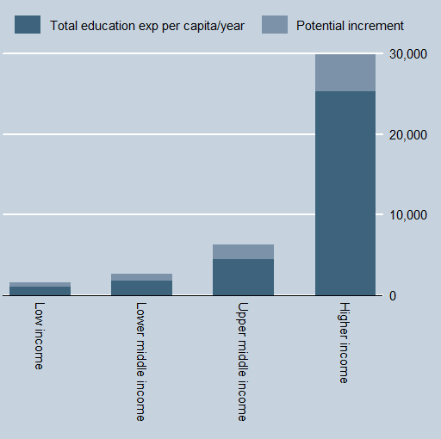
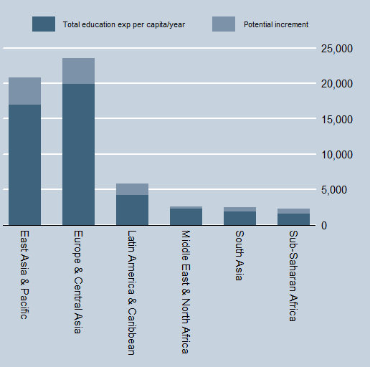
Education : How much do we actually spend?
Estimated from WDI, the World Bank (constant USD 2010) data in 2013, ASEAN (2011)

Slide 4
Shadow economy : definition
All market-based legal production of goods and services that are hidden from public authorities for one or combination of the following reasons:
to avoid payment of taxes, e.g. income taxes or value added taxes,
to avoid payment of social security contributions,
to avoid certain legal labor market standards, such as minimum wages, maximum working hours, safety standards, etc., and
to avoid complying with certain administrative procedures, such as completing statistical questionnaires or other administrative forms.

Slide 5
Shadow economy : why is it dangerous?
Eilat & Zinnes (2002) :once SE is established, it is hard to remove
Shadow economy
Erodes tax base (Mazhar & Méon, 2017)
Increases inflation rate (Prinz & Beck, 2012)
Increases regional public debt (González-Fernández & Velasco, 2014)
Causes unemployment (Dell’Anno &Solomon, 2007; Adriana, 2014)
Hampers country competitiveness and long term economic sustainability (Eilat and Zinnes, 2002)
Deteriorates financial sector (Elgin and Uras, 2013) ; Markellos Psychoyios and Schneider , 2010)
Shadow economy
tax base
Long term debts
Country competitiveness
Higher inflation rate
Financial sector

Slide 6
How can these activities be formalized and how can ICT serve as enabler?

Slide 7
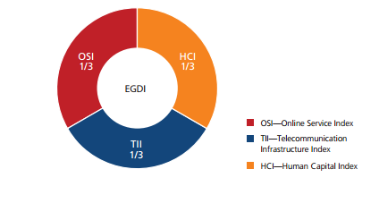
EGOV Index: Definition we are using
The EGDI conducted in all 193 United Nations Member States assessing national websites and how e-government policies and strategies are applied in general and in specific sectors for delivery of essential services.
It is a comparison and not an absolute measurement.
It is a weighted average of three normalized scores
scope and quality of online services (Online Service Index, OSI)
development status of telecommunication infrastructure (Telecommunication Infrastructure Index, TII),
inherent human capital (Human Capital Index, HCI).
EGDI = 1/3 (OSI normalized + TII normalized + HCI normalized)

Slide 8
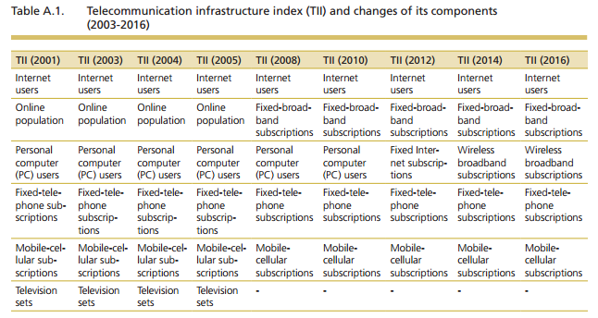
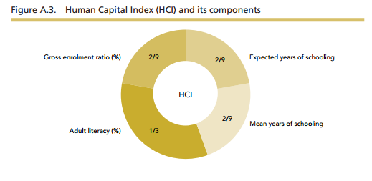
EGOV Index: Definition we are using

Slide 9
Framework analysys
Shadow economy
Administrative burden reduction
Digital government (EGOV)
Eilet and Zines (2002)
“ if institutional and regulatory problems are addressed and improvements are maintained, then one should expect an eventual turn-around of shadow activity. These includes: the importance of oversight, transparency and public participation to avoid an unnecessary time-consuming process
“Governments should attempt to avoid predatory and obstructive regulations and to lower regulatory compliance costs.
Undheim (2007) : the total administrative burden on businesses in the European Union was around 600 billion euros per year:
1.5% of GDP in the UK and Sweden
6.8% of GDP in Hungary, Greece and the Baltic States
Gelauff & Lejour (2006)
2.4% of GDP (in the UK, Sweden, Finland and Denmark)
4.4% of GDP (in Hungary, Greece, Poland and Slovenia).

Slide 10
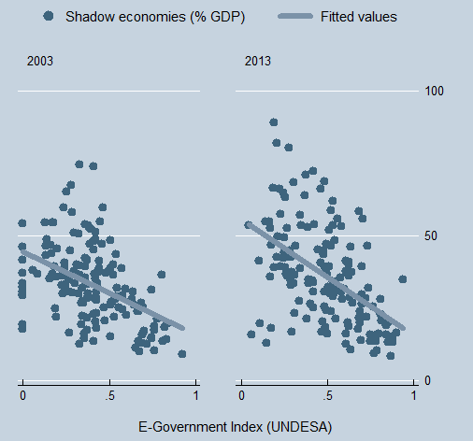
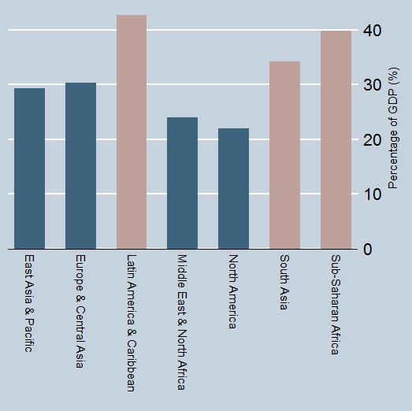
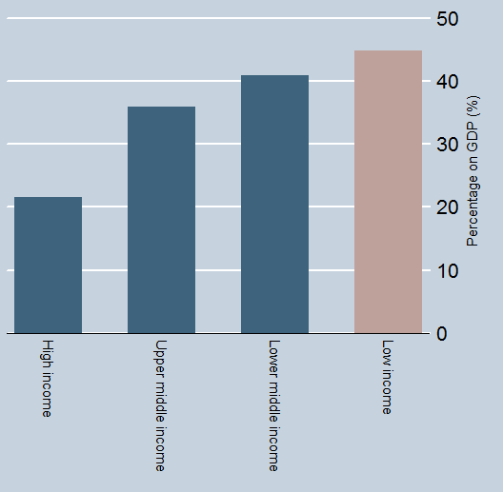
Description of data
The size of shadow economy (% of GDP) and the actual value (Billion UD)

Slide 11
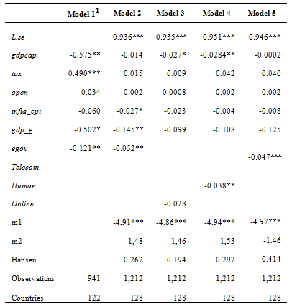
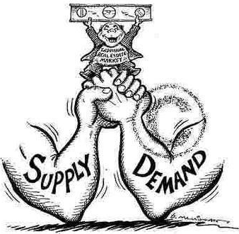
Results : General
Infrastructure
Human skills
Depending on the level of severity, if countries increase the eGov index by 1 pp, they might expect a reduction in SE by -0.05 pp
Off which, telecom infrastructure (supply side) still plays greater role at the moment

Slide 12
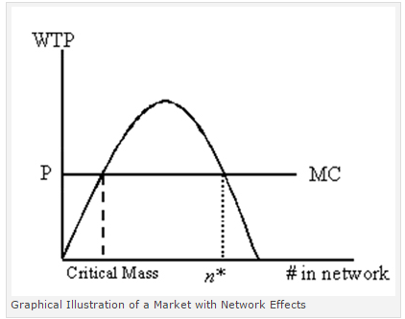
Threshold point (critical mass)
The value of ICT services depends on its network: only if there are enough adopters, the good becomes valuable.
There is a critical mass (Meade and Islam, 2006; Röller and Waverman, 2001)
It was estimated 40% of fixed line in OECD countries
5 and 15 % (i.e. high and low middle income countries).

Slide 13
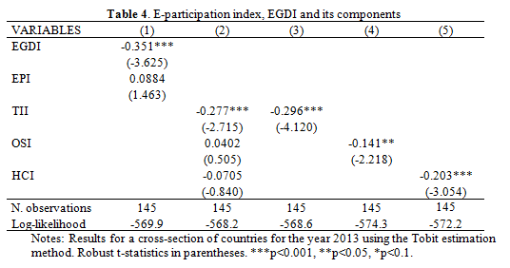
Critical mass
Estimation based on cross section in 2013 using Tobit model.
Telecom infrastructure is the most crucial aspect (infrastructure factor).
The impact is more apparent in high income countries
The impact based on region is seen in Europe and Asia

Slide 14
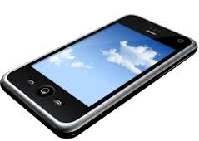
Critical mass (estimated)
Internet users = 77%
Fixed broadband subs = 26%
Fixed telephony = 36%
Mobile telephony = 130%

Slide 15
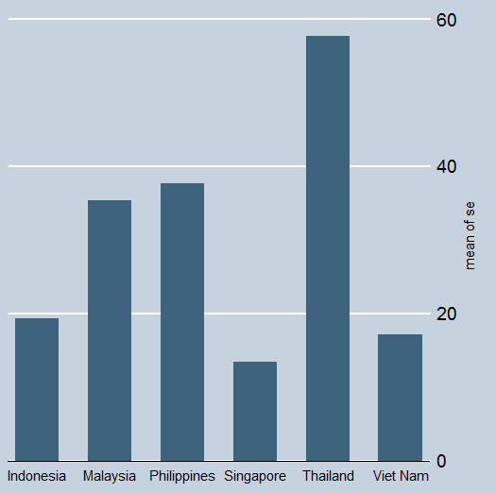
Relevance for Indonesia
The World Bank and and Hassan Schneider (2014) have reported that the ratio of Indonesia’s shadow economy is about 19% of GDP on average during 2003-2013.
This ratio is considered very low compared to other countries classified as lower middle and lower income following the World Bank income classification brackets.
However as the Indonesia’s GDP of Indonesia is the highest in the region, we have a whooping amount of money compared to the neighbors due to scale effect.

Slide 16
Relevance for Indonesia
Based on the latest World Bank data, Indonesia’s GDP was 861.9 billion USD by 2015.
We can estimate that the size of Indonesia’s shadow economy is about 164 billion USD.
With the tax-to-GDP ratio at 11%, the additional government revenue should have reached up to 18 billion USD if these shadow activities are internalized (upper bound) 2.8 billion USD or 37 trillion rupiahs (lower bound)
About half of those collected through the tax amnesty program
The performance of Indonesian e-Gov index is still very low compared to other countries in the region. Indonesia’s e government index of 0.45 ranked the lowest among the neighbors

Slide 17
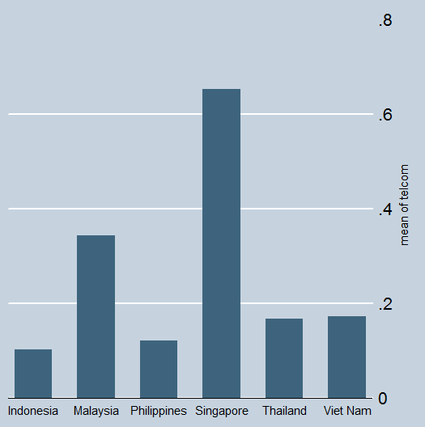
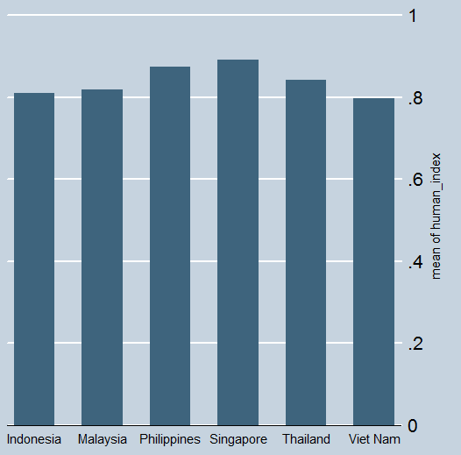
E-Government sub indices
Telecom infrastructure index (2003-2013)
Human capital index (2003-2013)

Slide 18
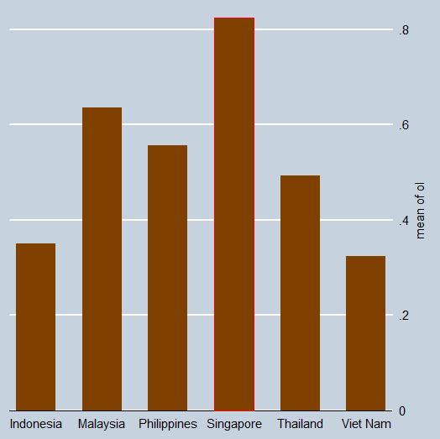
Online service index (Mei Hua and Rohman, 2014)
Online service index
User Experience Design (UED) concerns with the supply and demand of data ' what data is needed and what information is available on a website.
no contact information on most government websites. Users seeking further information may thus need to start from scratch by searching for and contacting the relevant officer by email or phone.
There is also no standard response time for which users might expect the queries to be attended to.
incomplete databases; the availability of long-term data and the commitment to make regular updates on a database are often ignored.
Human resources : Some activities such as web design and development are procured based on government tenders, and thus outsourced.
These contractors work for a temporary period depending on when the budget for the next year is released, thus limiting the sustainability of data information and presentation.
Internally, there are limited skilled human resources to manage it.

Slide 19
Conclusions
The Digital Government landscape is continuously changing. It is important that policymakers, government executives, researchers foresee this dynamic and to anticipate its impact.
We found that :
e-Gov improvements may indeed play an important role in mitigating the shadow economy, which hampers many countries, especially the least developed ones; (
fighting the shadow economy may generate several positive byproduct effects, which range from monetary and non-monetary aspects .
The impacts differ across income and geographic groups of countries, which suggests that it is necessary to achieve a minimum level of economic and eGov development before a country can reap the benefits from the initiative.
The impact of the EGDI on the reduction of the SE to be statistically significant in the high-income group.
Our findings are consistent with previous studies on the need to achieve critical values of ICT before expecting a wider spill of the impacts on the economy and society.
This study stresses the need to implement a more concrete eGovernment road map, especially in developing countries, to reduce the administrative burden cost as the main problem of informality.
Public private partnership

Slide 20
