Slide 1
Service Experience Assured Network (SEAN) Introduction and Demo

Slide 2
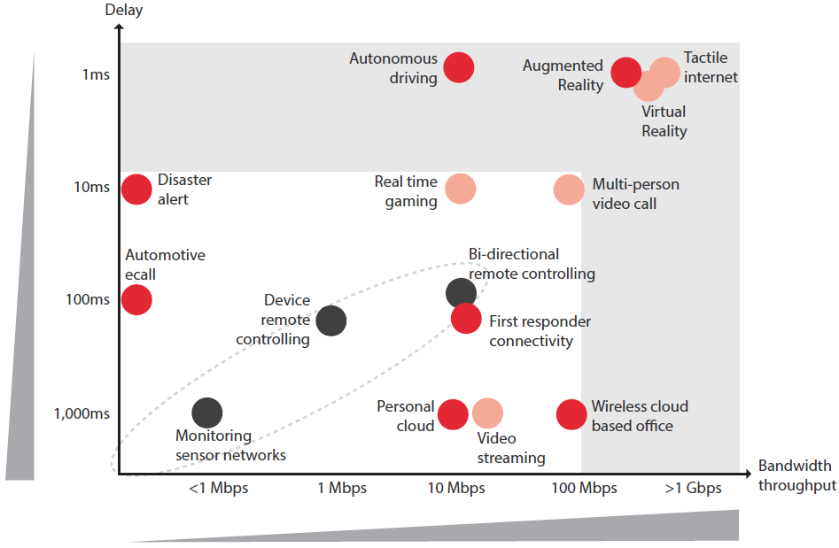
5G Use Case and Requirement
Category | Business | Bandwidth | Latency
Enhanced Mobile Broadband | UHD/Holographic, Virtual Reality & Augmented Reality | DL: 1 Gbps, UL: 500 Mbps | 10 ms
 | Tactile Internet | DL: 50 Mbps, UL: 25 Mbps | <1 ms
Mission Critical IoT | Autonomous Traffic Control / Driving | DL: 50 kbps～10 Mbps; UL: a few bps～10 Mbps | 1 ms
 | Robot Collaboration
 | Remote Motion Control /Telesurgery
 | eHealth: Telemedicine | DL: 10 Mbps, UL: 10 Mbps | 10 ms
 | Public Safety
 | 3D Connection: Packet delivery using drones
Massive IoT | Mobile Monitors | DL: 300 Mbps, UL: 50 Mbps | 10 ms
Maximum bandwidth requirement of single user >1Gbps
Latency requirement of some use cases (tactile internet, autonomous driving, motion control) <1ms

Slide 3
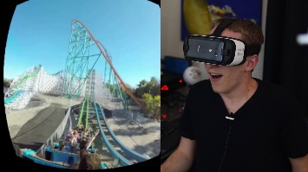
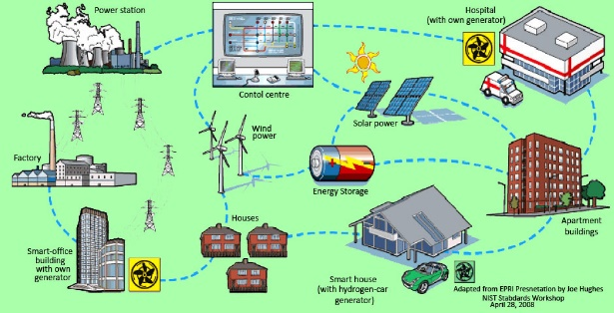
Challenge of New Business
4K/8K Video
VR/AR
Smart Grid
ITU-R BT.2020 4K/UHD video standard support 120p、60p、50p、30p、25p etc.
Bandwidth requirement:
35Mbps for 4K, 75Mbps for Ultra 4K,
140Mbps for 8K, 330Mbps for Ultra 8K
4K video require RTT(Round Trip Time ) below 35ms，even less for 8K video.
People feel dizzy since users’ motion perception is not match with images(Motion sickness), need to get latency down to 20 ms, or possibly much less.
AR are more latency sensitive than immersive VR, because real world objects have no latency and delays of virtual objects can be seen directly.
Smart grid is a generic label for the application of computer intelligence and networking abilities to a dumb electricity distribution system.
Latency requirements for smart grid vary from less than 10 ms for teleprotection, to about 20 ms for some synchrophasors applications, to 100-200 ms for smart grid control, to up to several seconds for smart metering.
Challenge: Need a solution to provide strictly assured service performance in 5G network

Slide 4
SEAN: Ultra-low Latency, Zero Packet Loss
Bandwidth Guarantee
A piece of pipe of zero packet loss and low latency(Router/Switch)
Switch
Fabric
Interface
NPU
TM
Interface
Pipe entrance
Pipe
fore part
Pipe
latter part
Pipe
connection
Heterogeneous NPU
Optimized forwarding Architecture
Latency Aware Traffic Manager
Ultra-low latency queuing technology
Latency Guaranteed Scheduling algorithms
Smart buffer management
Latency optimized switch fabric algorithms
for
strict bandFlex Ethernet width guarantee

Slide 5
Key Technology 1：Flexible Ethernet for
Guaranteed Link Latency and Bandwidth
Channelized FlexE
Channelized FlexEth can provide guaranteed bandwidth, low latency and jitter, and can support “L1 LAG” based high bandwidth interface

Slide 6
Key Technology 2：Optimized NPU
and Forwarding Architecture
Coprocessor
& Memory
Heterogeneous NPU Architecture：
Less instructions and branches for lower latency
Optimized forwarding flow：
Simplified forwarding table design
Forwarding action optimization
Before
After
Inst Exec
Pending
Lookup
Memory
Priority mapping based on application
HP packets are guaranteed to be processed first and not dropped
Processor
Pkt Dist
Pkt Agr
Classification
Pri Proc
Pri
Sch
Data path
By using optimized NPU and forwarding architecture, typical latency for IPv4 packet processing latency can be reduced from 5us to <2us

Slide 7
Key Technology 3：Latency Aware Traffic Manager
Latency Guaranteed Scheduling Algorithms for HQoS
Preemption of HP packets
Bypass data path for low latency application
Guarantee QOS
Traffic Manager
Scheduler
Queue Manager
WRED
Enq
Deq
Smart Buffer：smart management of buffer to provide service guarantee for HP traffic
On chip buffer and off-chip buffer BW reduction algorithms
On chip Cache and Packet Buffer Manager
Packet Memory
Guaranteed 1～5us latency and jitter for E2E FlexE Hard Pipe + low latency traffic manager

Slide 8
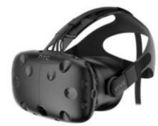
SEAN PoC Environment
Controller
Router-1
Router-2
connector
FlexE Link
VR Servers
TesEngine
(receiver)
TesEngine
(sender)

Slide 9
THANK YOU
Copyright©2016 Huawei Technologies Co., Ltd. All Rights Reserved.
The information in this document may contain predictive statements including, without limitation, statements regarding the future financial and operating results, future product portfolio, new technology, etc. There are a number of factors that could cause actual results and developments to differ materially from those expressed or implied in the predictive statements. Therefore, such information is provided for reference purpose only and constitutes neither an offer nor an acceptance. Huawei may change the information at any time without notice.

