Slide 1
5G Architecture Standardization Landscape in 3GPP
Wei Lu
Nokia Networks
December 2016

Slide 2
3GPP Phasing
Development of a new system architecture including a new core network is a significant standardization effort.
Completion of this task will take multiple 3GPP releases. The goals of the planning include:
Phase 1 - An early availability of basic system that fulfils the goals and expectations set for initial deployments of Next Generation System including the Core Network.
Phase 2 - Building of a complete and feature rich system using the basic system defined as a foundation thereby ensuring backwards compatibility within Next Gen Ecosystem.
To ensure phase 1 is completed in a timely manner, SA2 agreed to prioritization of essential key issues for foundational network.

Slide 3
NextGen System Architecture work status in SA2
Work Status
Ph1 TR conclusion on arch/KIs – November 2016
Ph1 Normative WID* approval – December 2016
Ph1 Normative WID* completion – December 2017
Next Steps
Normative work to be started based on Ph1 WID
Ph2 TR SID to be agreed
(* based on estimation)

Slide 4
NextGen System Architecture: Key Principles (1/2)
Support the new RAT(s), the Evolved E-UTRA, and non-3GPP access types. GERAN and UTRAN are not supported.
Support unified authentication framework for different access systems.
Minimize access and core network dependencies with a converged access-agnostic core with a common AN-CN interface integrating different 3GPP and non-3GPP access types.
Support a separation of Control plane and User plane functions.
Allow a flexible deployment of UP and CP functions, i.e. central location or distributed (remote) location (enabling MEC).
Support multiple simultaneous connections of an UE to multiple network slices via multiple access technologies.
Support modularization of function design to enable, e.g. flexible and efficient network slicing.

Slide 5
NextGen System Architecture: Key Principles (2/2)
Support the separation of Access and Mobility management (AMF) and session management (SMF) which enables independent evolution and scaling.
AMF includes the authenticator role and local key derivation functions (used to be per UE functions in MME)
SMF includes control of the UPF (that was part of S-GW-C and P-GW-C) and termination of NAS SM (used to be in MME) separate from mobility management
Support a flexible information model with subscription and policy separated from network functions and nodes.
Support “stateless” NFs (where the “compute” resource is decoupled from the “storage” resource that stores state as opaque data),
3GPP will specify (possibly by referencing) interfaces from NFs to a data storage function. NFs may use data storage function to store opaque data.
Support for edge computing, including the (re)selection of efficient user plane path

Slide 6
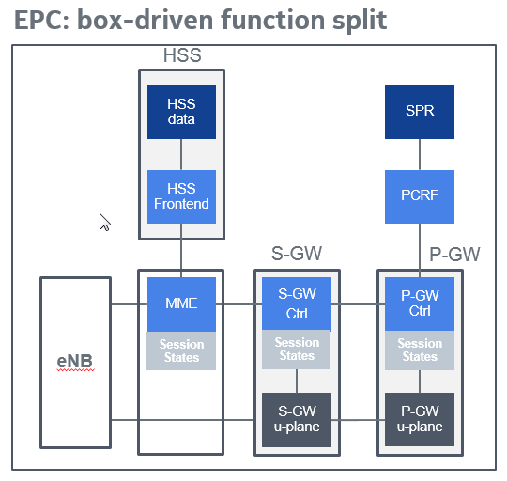
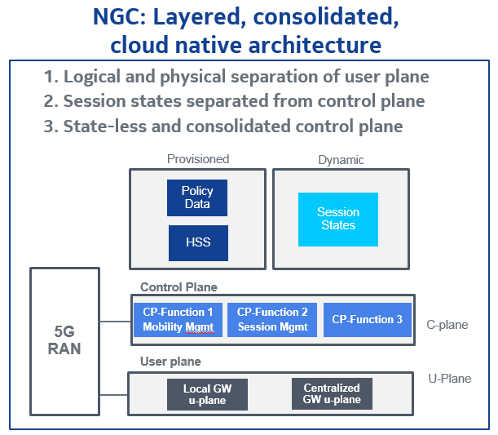
5G architecture study phase 1 completed and work on 5G core to be started
We have clearly made solid progress. We need to carry this momemtum in 2017

Slide 7
Features in scope for 5GS-Phase 1 WID
Network slicing
Use of virtual environments
Service-based architecture
Network capability exposure
Support for edge computing
Access and mobility management
Session management separate from mobility management
(Re)selection of efficient user plane path
Session and service continuity
QoS
Policy framework
Network discovery and selection
Network sharing
Untrusted non-3GPP accesses
Roaming with EPS
Interworking with and migration from EPS
IMS services (including support for emergency calls)
Public Warning System (PWS)
Location services as per related service requirements and in alignment with NG RAN
SMS over NAS

Slide 8
Definitions
NextGen RAN (NG RAN): a radio access network supporting one or more of the following options:
2) Standalone New Radio
4) Standalone New Radio is the anchor with Evolved E-UTRA extension
5) Evolved E-UTRA
7) Evolved E-UTRA is the anchor with New Radio extension
with the common characteristics that the RAN interfaces with the next generation core.
NextGen Access Network (NG AN): a NextGen RAN or a Non-3GPP access network that interfaces with the next generation core.
NextGen System (NG System): NextGen Access Network (NG AN) + NextGen Core

Slide 9
Initial High level Architecture view
NG2: Reference point for the control plane between NextGen (R)AN and NextGen Core.
NG3: Reference point for the user plane between NextGen (R)AN and NextGen Core.
NG1: Reference point for the control plane between NextGen UE and NextGen Core.
NG6: Reference point between the NextGen Core and the data network. This reference point corresponds to SGi for 3GPP accesses.

Slide 10
Deployment scenarios under consideration (1/2)
Figure J.2-1: Deployment Option 2.
Figure J.4-1: Deployment Option 4

Slide 11
Deployment scenarios under consideration (2/2)
Figure J.5-1: Deployment Option 5
Figure J.7-1: Deployment Option 7

Slide 12
NextGen Architecture in p2p reference point representation

Slide 13
NextGen Architecture in service based interface representation
Service Based Architecture needs further work
Procedures (i.e. set of interactions between two NFs) are defined as a service, wherever applicable, so that its re-use is possible and enables support for modularity.
Service granularity, roaming impact to be discussed and specified.
These aspects to be evaluated on a case by case basis when specifying the procedure.

