Slide 1
MyWorkspace and its applications

Slide 2
MyWorkspace and its applications
Early Applications (2017-2018)
MyWorkspace and its first applications
Mailing list
Calendar of events
ITU-T community
Latest Applications (2019 -2020)
Remote Participation Tool
Automatic Translation of Texts
Cloud Service
Events access and networking
Meeting documents and suggestions
Dec. 2017
Jan. 2019
Sep. 2019
Nov. 2020
MyWorkspace
ITU-T Remote Participation Tool
Cloud Service
MyDocuments
2017
2018
2019
2020
2021
Automatic Translation of Texts
MyEvents App
Apr. 2019
Jan. 2020

Slide 3
MyWorkspace and its applications
ITU MyWorkspace – Central access to ITU-T resources at all time
ITU-T Mailing lists – Receiving latest information on topic of interest
ITU-T Community – Connecting staff and experts
ITU Events calendar – View of upcoming events, both onsite and online
ITU MyEvents – Events and networking
ITU Translate – Documents translated in one of the six official languages
ITU MyMeetings – Video conferencing for statutory and non-statutory meetings
ITU MyDocuments – Meeting documents and suggested content
ITU-T Cloud – Storage and sharing of files in the cloud

Slide 4
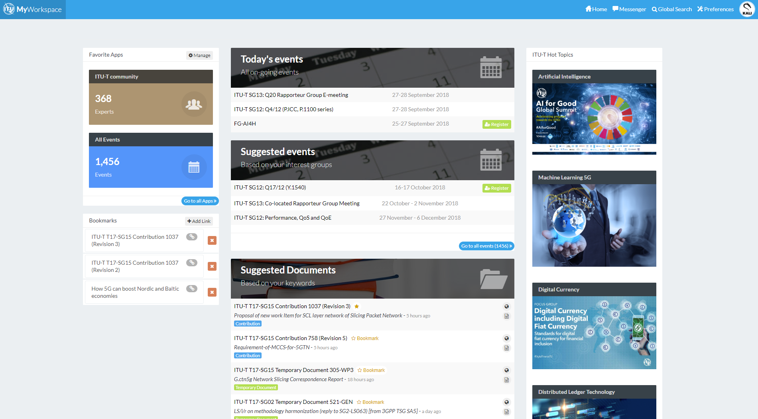
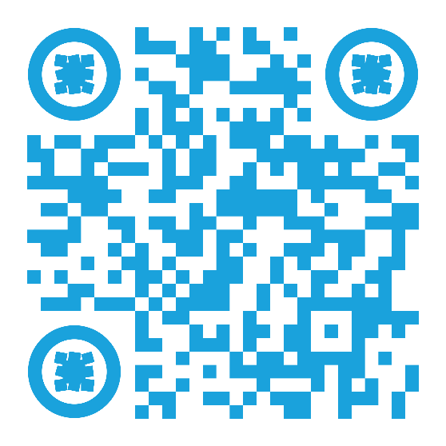
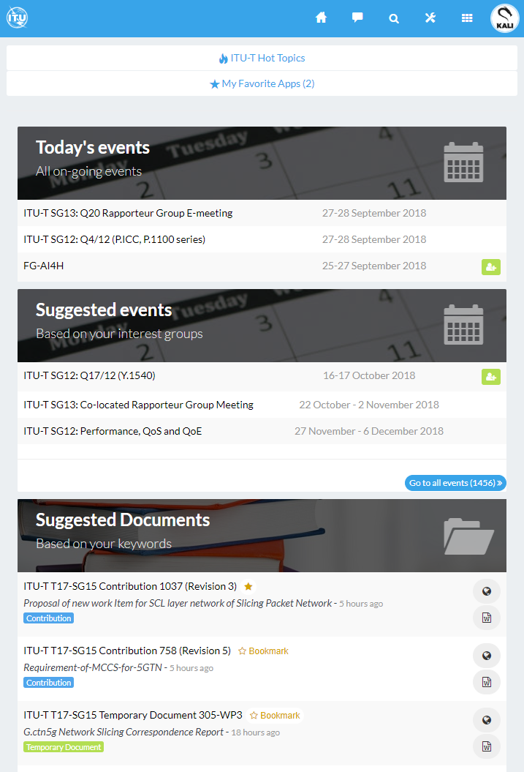
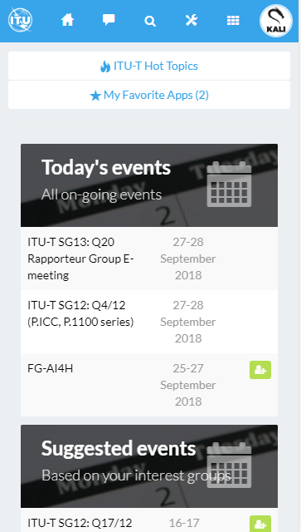
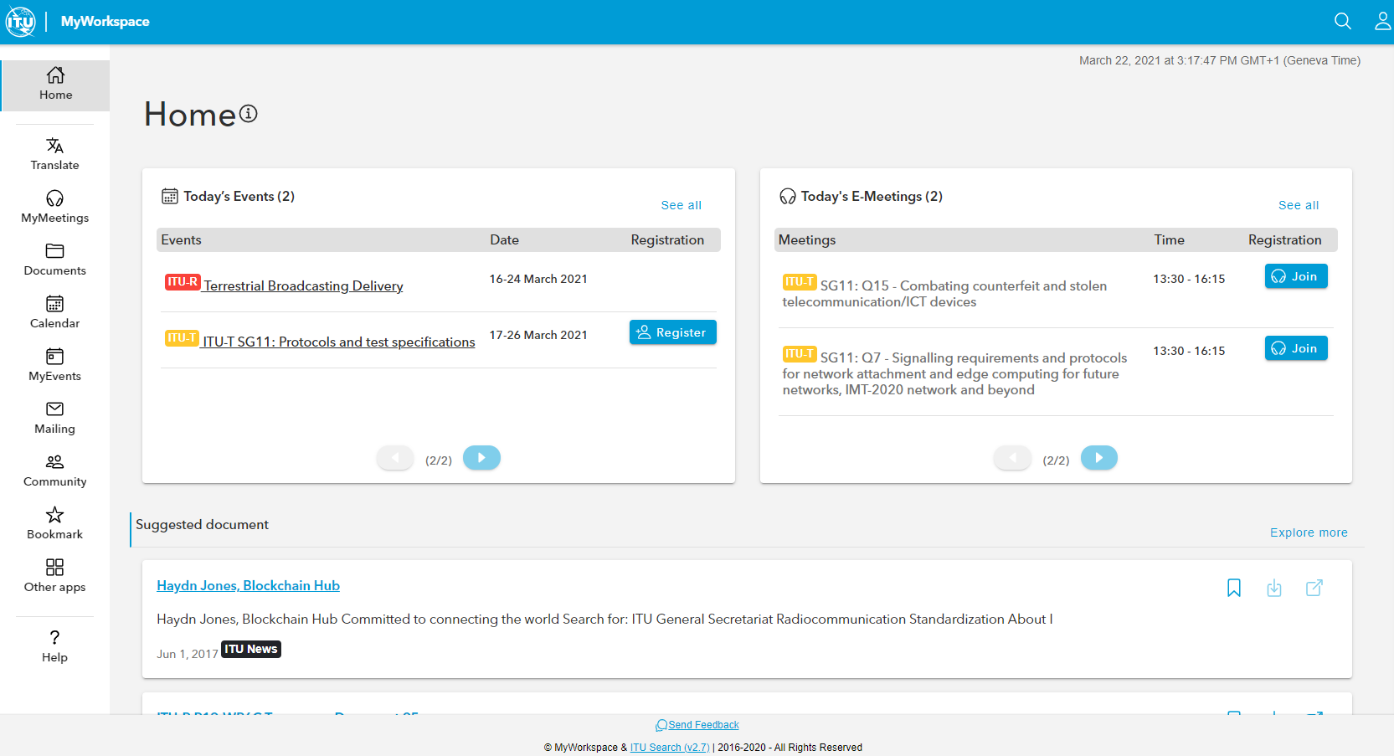
MyWorkspace
Portal to access several TSB IT applications
Personalized working area for ITU-T members
Scalable and flexible
Accessible from ITU-T home page: https://www.itu.int/en/ITU-T/Pages/default.aspx with your ITU account
Available on mobile and desktop
https://www.itu.int/myworkspace/

Slide 5
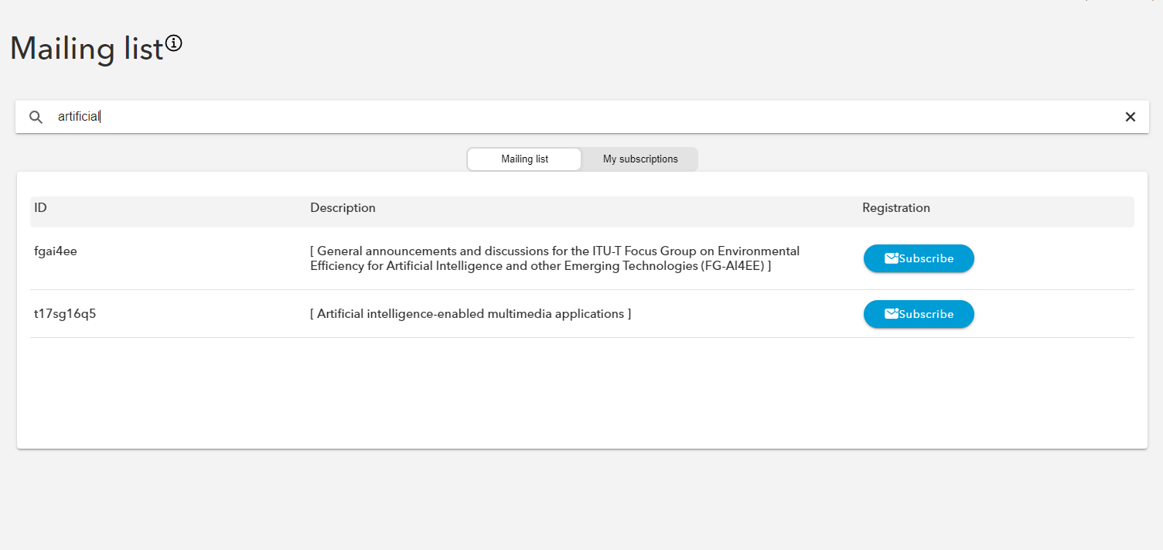
ITU-T Mailing lists
Quick way to subscribe to ITU mailing lists and topics of interest
Easy search
User can manage mailing list subscription and see the requests status
https://www.itu.int/myworkspace/#/Mailing

Slide 6
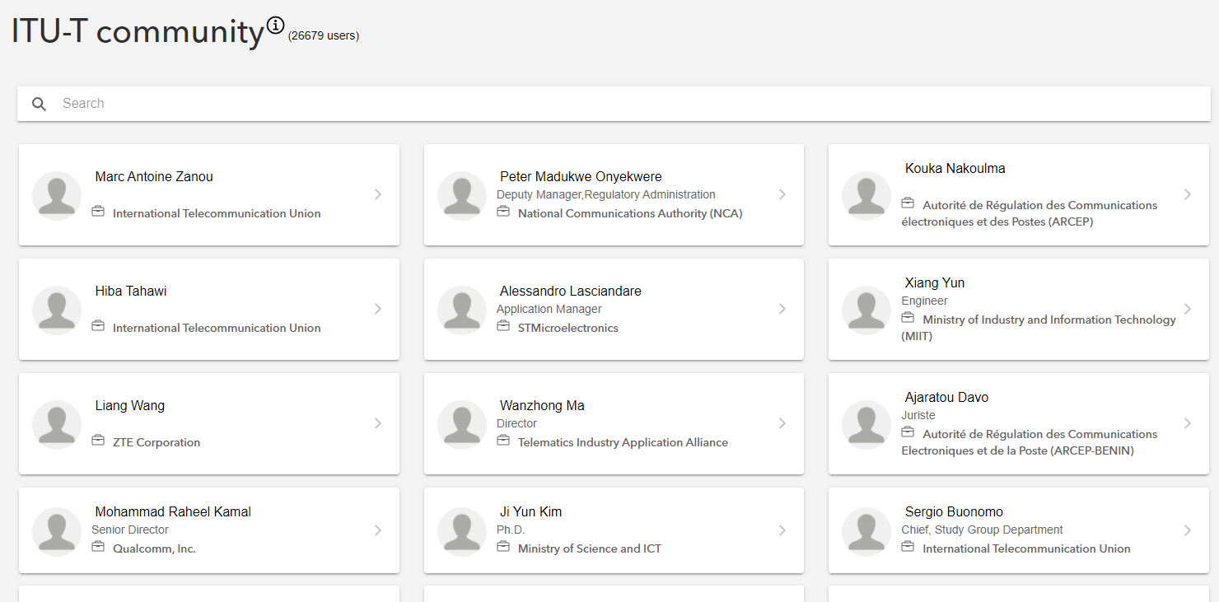
ITU-T Community
Staff and experts profile pages used for networking activities
Displays ITU user profile data (role, interests and attended events)
Real-time communication between members
https://www.itu.int/myworkspace/#/Community

Slide 7
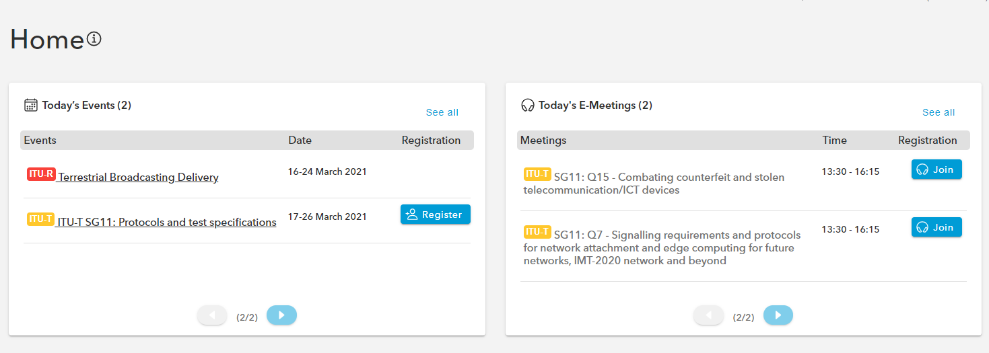
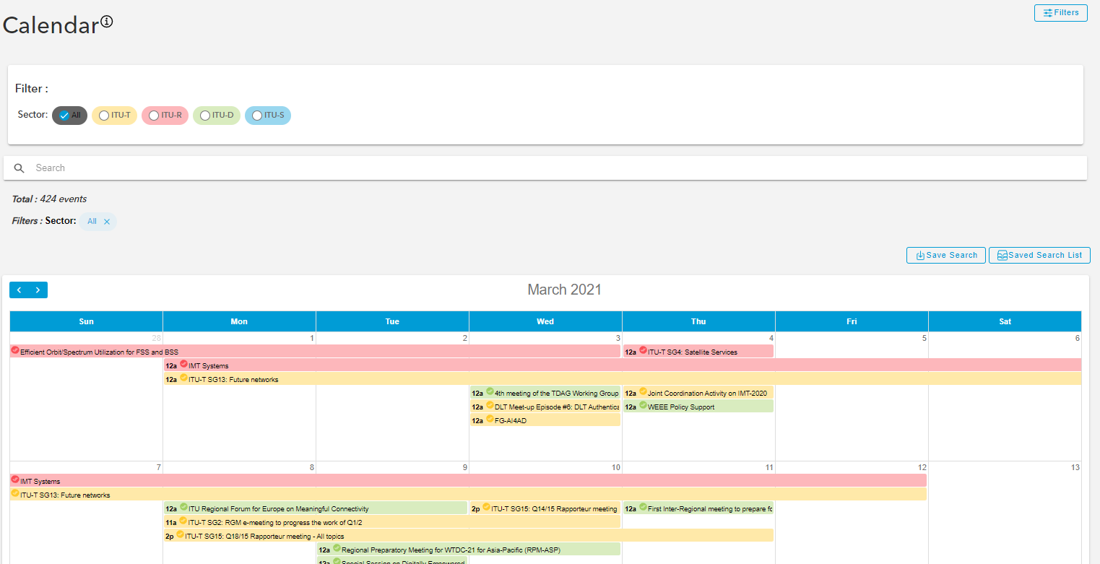
ITU Events calendar
Calendar view of all ITU Events planning
Customizable by sector and event type
Direct access to event registration page
https://www.itu.int/myworkspace/#/Calendar

Slide 8
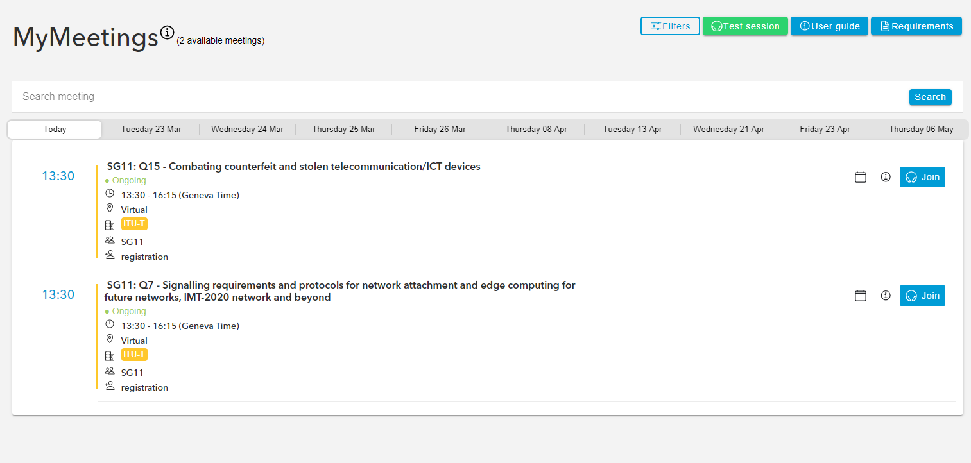
MyMeetings
Open-Source solution (BigBlueButton)
Completely web-based and requires no installation
Accessible by all countries and regions
Full integration with ITU backend systems (ITU user account authentication, CRM Registration for Meetings, ITU-T Work Programme)
Web and mobile access
Flexible, customizable and scalable
ITU-T H.264 video standard
WCGA 2.0 AA certified
https://www.itu.int/myworkspace/#/MyMeetings

Slide 9
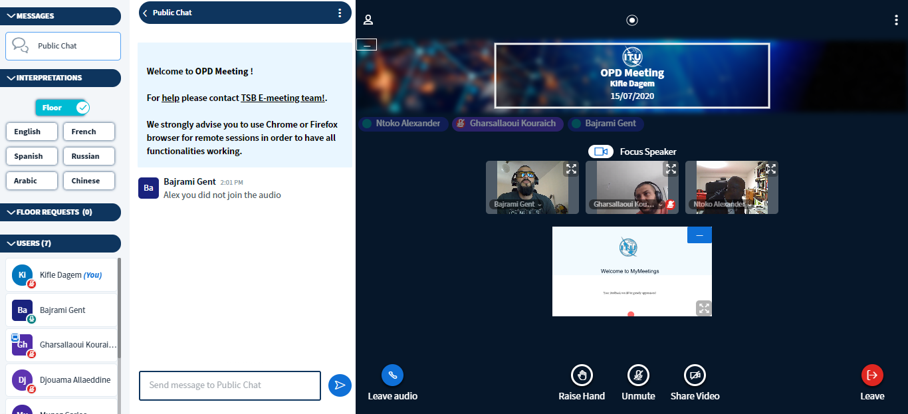
MyMeetings
Existing features:
Interpretation services integrated with ITU interpretation rooms
List of participants with user affiliation
Public and private chat
User-friendly 'Raise hand’ request for all
Captioning (with Caption First)
Floor request visible to chairman, moderator and participants
Meeting recordings monitored by moderators
Timer to indicate length of audio intervention
https://www.itu.int/myworkspace/#/MyMeetings

Slide 10
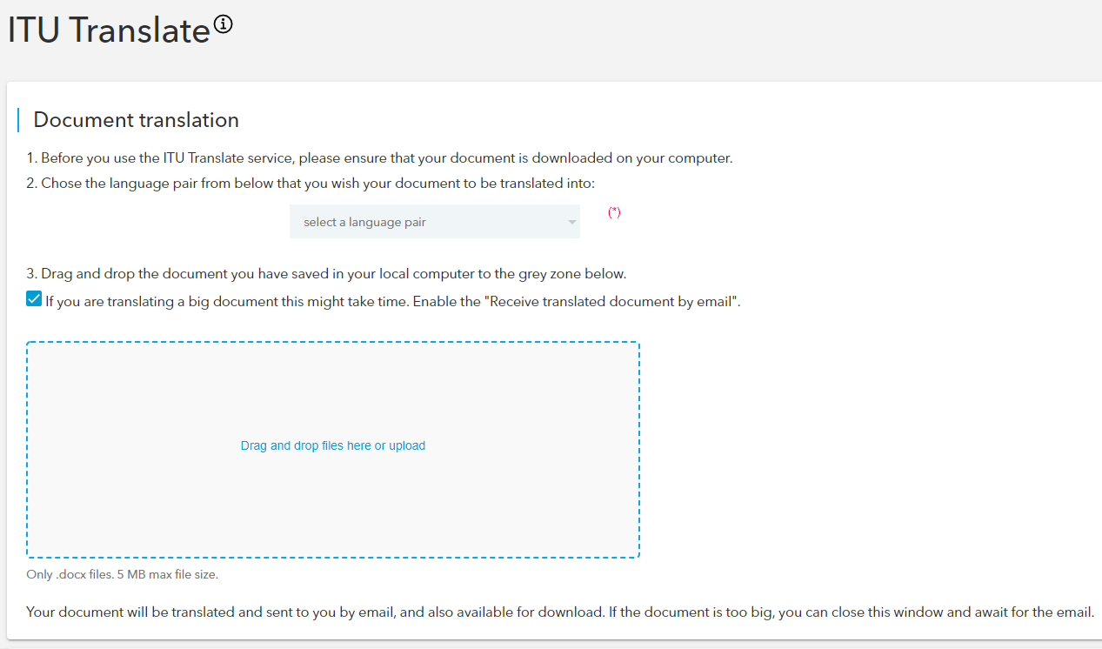
ITU Translate
Integrated with an open-source solution based on AI Neural Network (Machine Learning)
Trained exclusively on ITU documents in all 6 UN languages
Translated documents keep the original format of the original document
https://www.itu.int/myworkspace/#/Translate

Slide 11
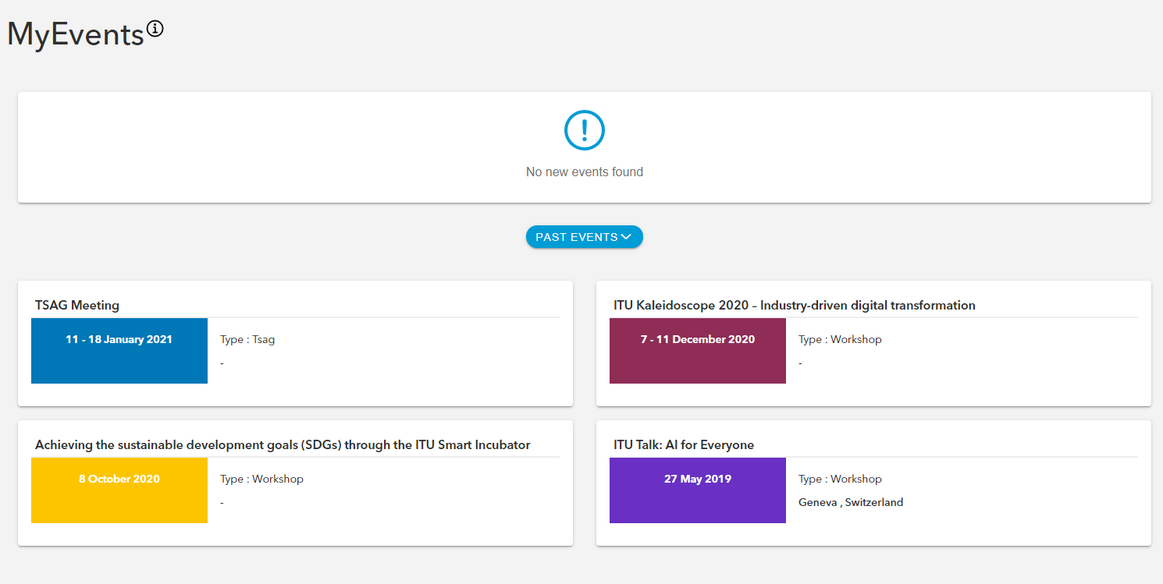
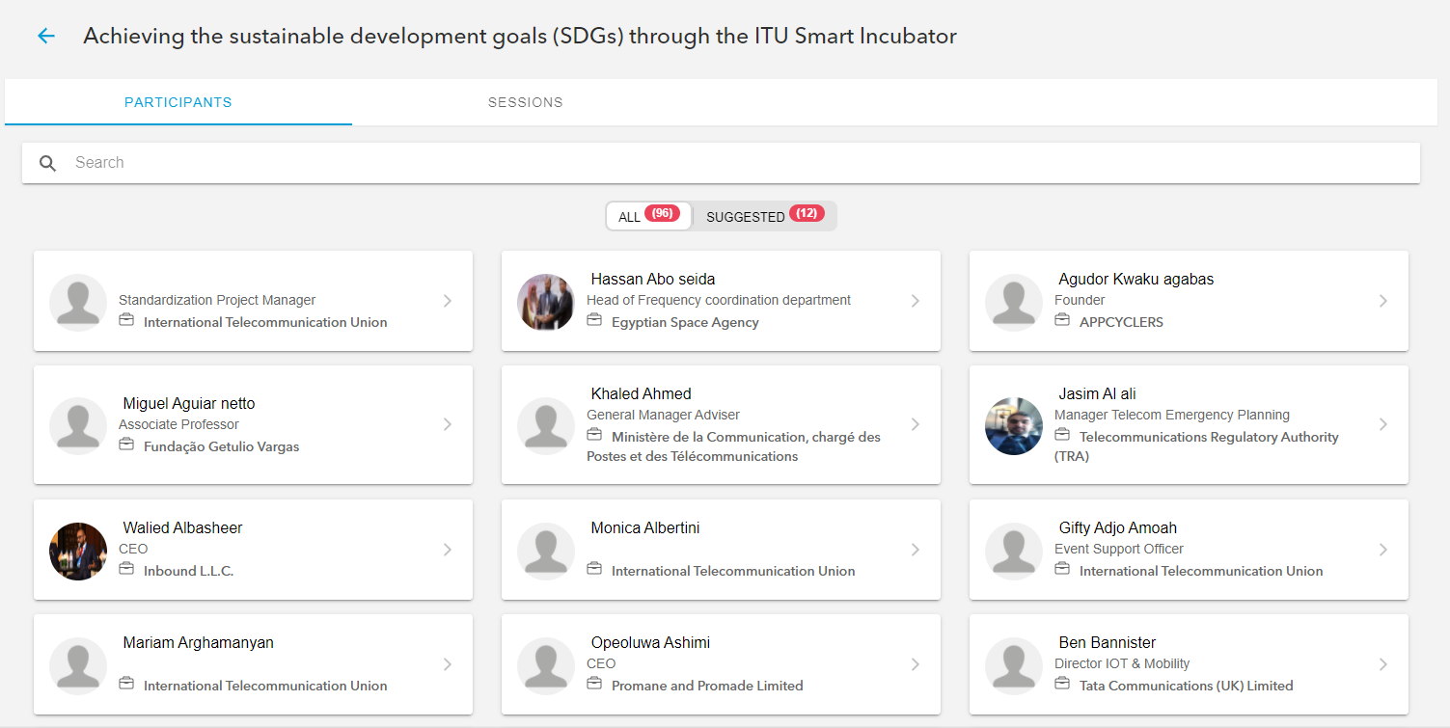
MyEvents
Direct access to participant’s lists
Matchmaking based on user profile
Live agenda with tracking of event status
Realtime notification
https://www.itu.int/myworkspace/#/Myevents

Slide 12
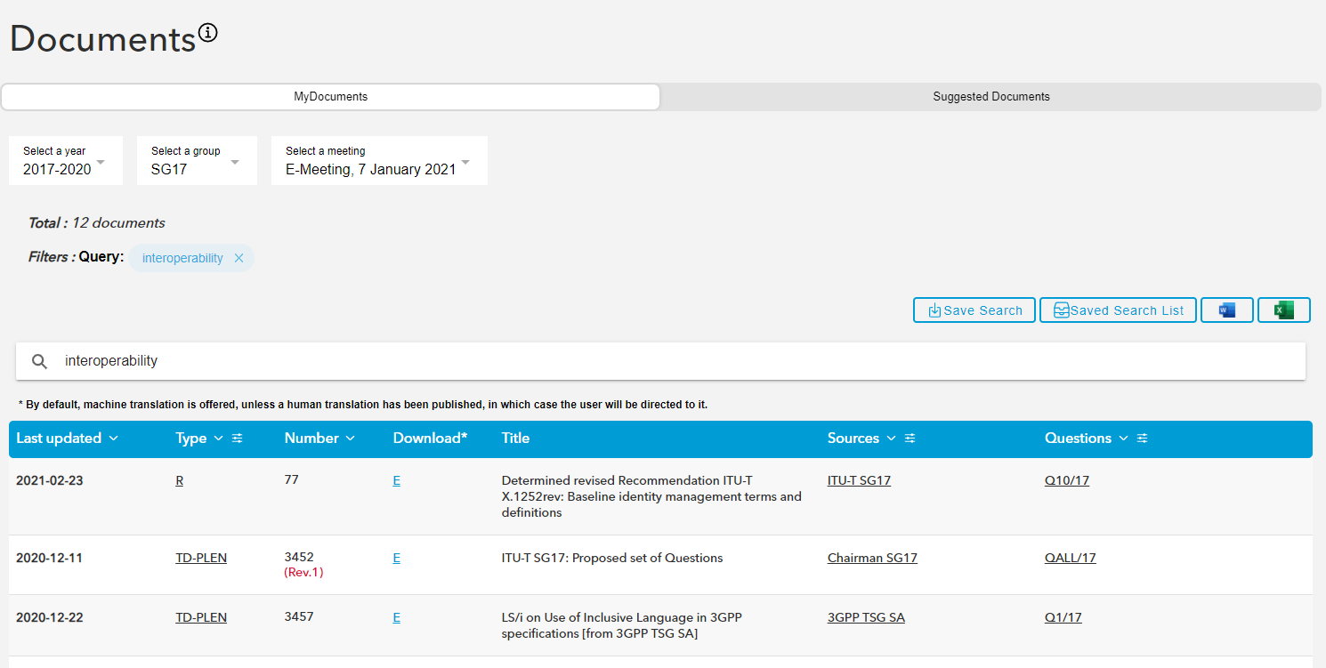
MyDocuments
Quick access to meeting documents and their translated version (if available)
Filtering options based on year, working group and meeting
List of suggested documents (based on profile preferences) with possibility to bookmark
https://www.itu.int/myworkspace/#/Documents/MyDocuments

Slide 13
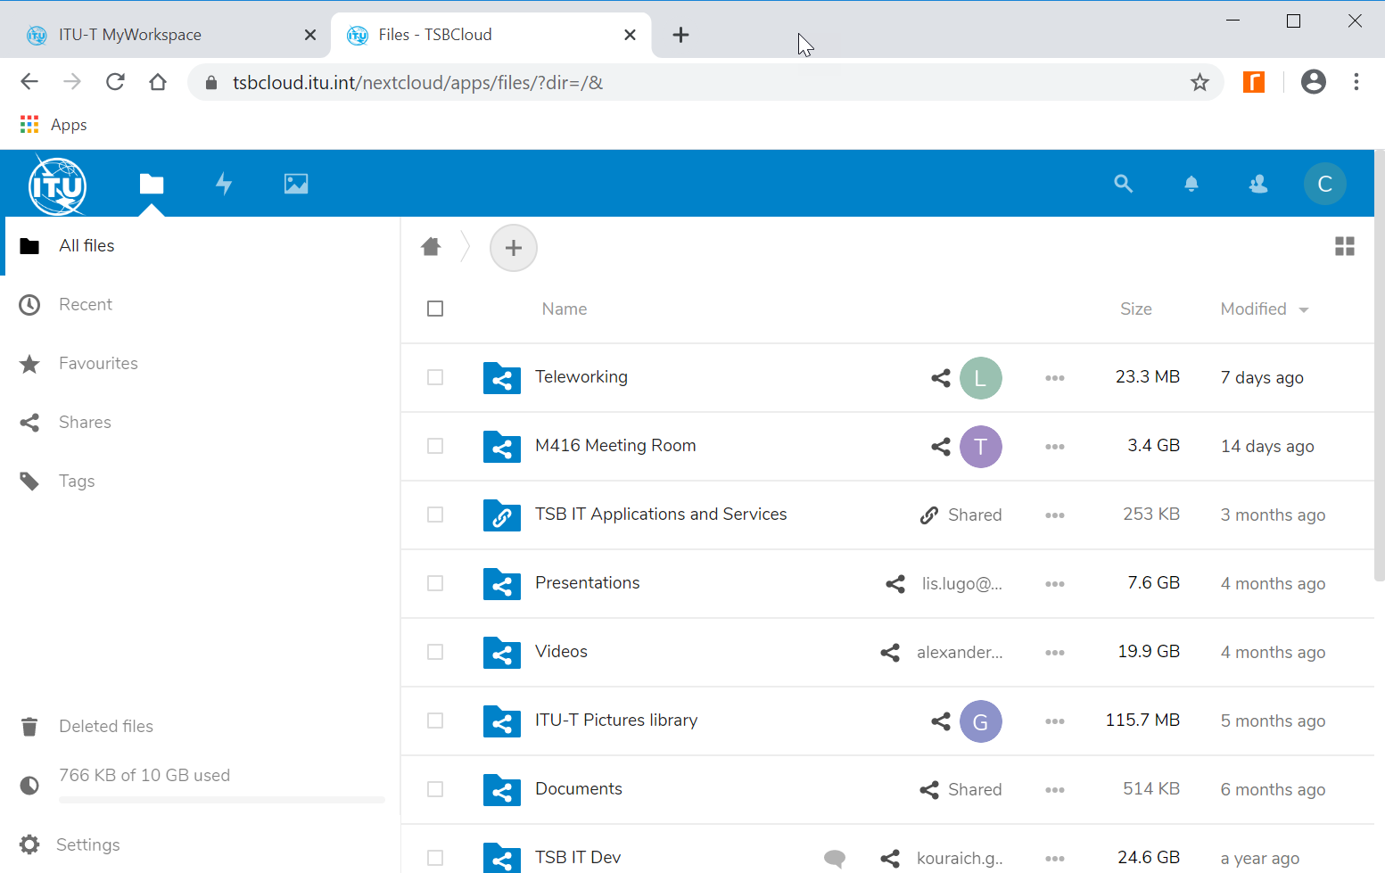
ITU-T Cloud
Open-source solution (NextCloud)
Cloud file sharing and storage solution
Hosted in ITU premises
Web and mobile app
Integrated with ITU authentication system
10 GB per user
Encrypted
https://tsbcloud.itu.int/

Slide 14
Thank You

