Slide 1
The Role of Standards in Bridging The ICT Gap
Mondher MAKNI,
Chief Marketing Officer
TELNET GROUP
Email: Mondher.Makni@Groupe-Telnet.net
Global Standard Symposium Dubai, UAE, 19 November 2012

Slide 2
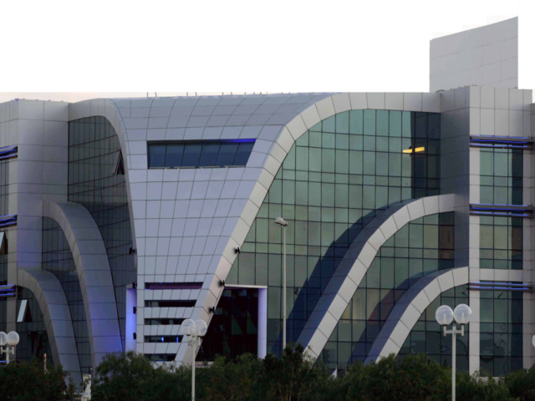
TELNET GROUP OVERVIEW
TELNET, an International Product Engineering & Services Group Specialized in Consulting, Innovation and High Technologies.
Created in 1994, TELNET has rapidly became a Leading Regional and International actor in the R&D of High Technolgy and Mission Critical Application Development covering many sectors.
Since its creation, TELNET has continuously been expanding its skills in order to guarantee to its customers a high-quality engineering services based on ethics and the full compliance of intellectual property right protection.
TELNET is considered as a major actor in innovation and high technologies in Africa & Middle East and holds a strong reputation and technological expertise image.

Slide 3
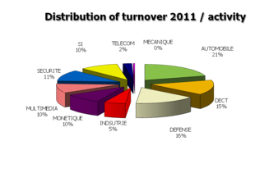
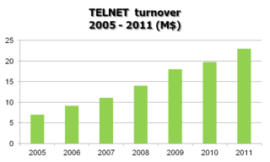
TELNET GROUP OVERVIEW
$24 million annual revenue in 2011
Average yearly growth rate of 25% for the past 5years
Listed on Tunis Stock Exchange since April 2011.
Planned to be listed on major European Stock Exchange in Q2 2013.

Slide 4
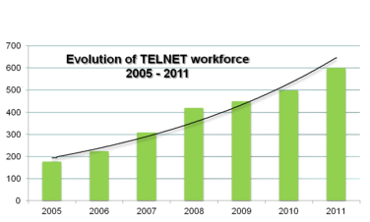
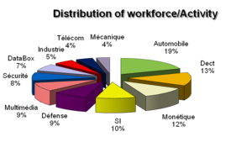
TELNET GROUP OVERVIEW
600 employees with 550 engineers.
Engineers graduated from the best engineering schools in Tunisia, Europe and America.
TELNET focus its devolopment on partenerships with its customers as well as skills, personal qualities and the ambitions of it employees.
Capability of fast ramp-up.
International mobility.

Slide 5
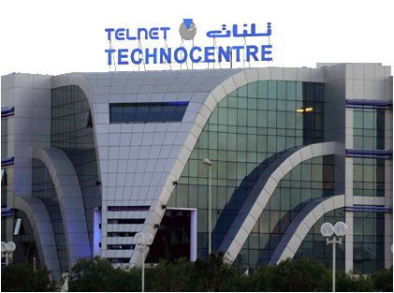
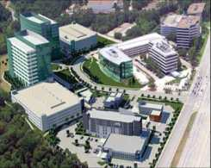
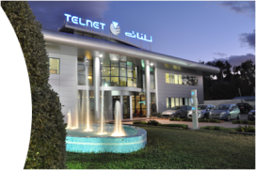
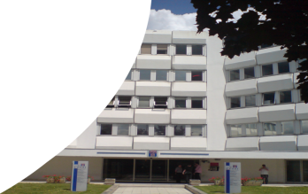
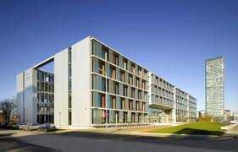
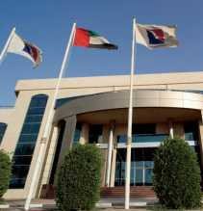
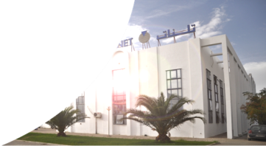
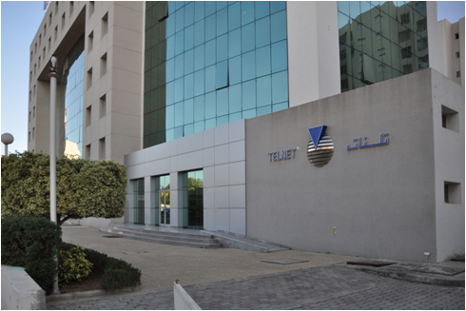
TELNET GROUP OVERVIEW
- 2 Front Offices in Europe (France & Germany)
- 1 Branch office in USA (Houston)
- 1 Branch Office in UAE (Dubaï)
- 1 Branch Office in Algeria
- 4 R&D back office facilities in Tunisia

Slide 6
TELNET GROUP POSITIONING
- Global provider in product engineering development based on Offshore/Nearshore business model
- Front-Office Approach(Europe) / Back-Office
(Tunisia) for a better customer service support.
- TELNET is known for its stability, ethics and its Shareholder value.

Slide 7
TELNET Quality Management Systems
- Certified Development Centers : CMMi L5 in 2006
& ISO 9001 version 2008 – New Certification by
Application domain is currently in process.
- Certification EN9100 (Aerospace) in progress
- Certification SPICE (Automotive) in progress
- Certification TL9000 (Telecom) in progress

Slide 8
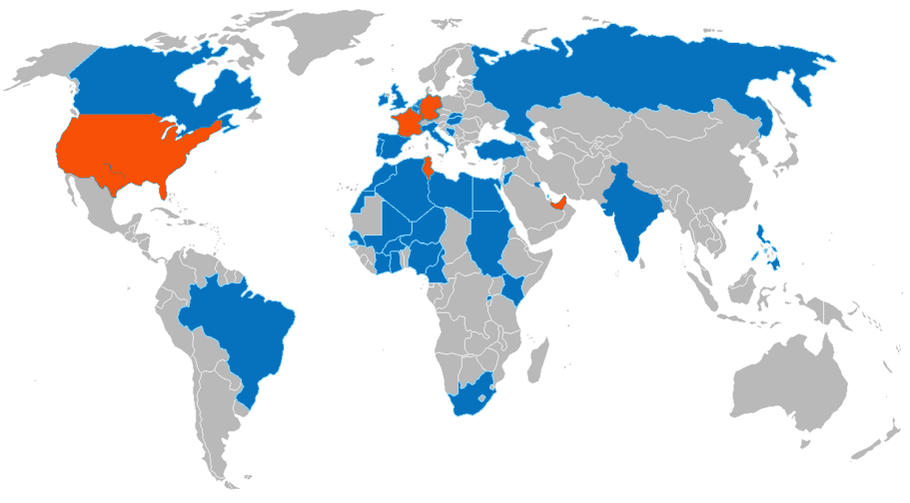
TELNET Global Foot Print
- TELNET legal presence (Branch Offices & Affiliated Companies)
- 3 sites inTunis and 1 site in Sfax (Presence through projects)

Slide 9
Expertise in Product Engineering

Slide 10
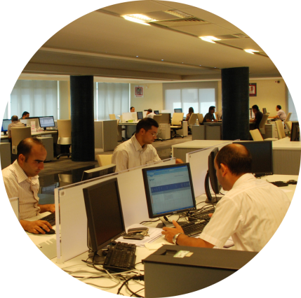
Expertise - Services
- - Hardware & Software Embedded Systems.
- Integrated Systems Development &
Computing Platforms.
- Design and Prototyping in Electronics and
Microelectronics both Analog & Digital.
- Mechanical Engineering.

Slide 11
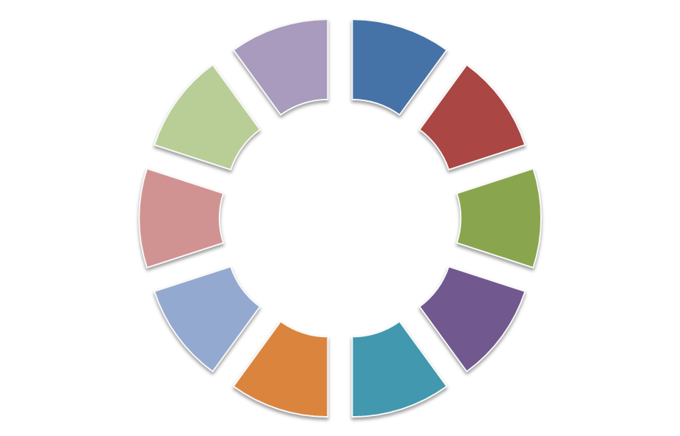
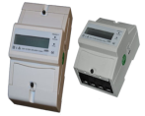
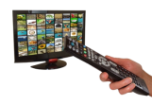
Application Domains
e-Money & smart cards
Automotive &
Transportation
Industry
Multimedia
Networks
Mechanical
Information Systems
Security
Telecommunications
Defense & Avionics

Slide 12
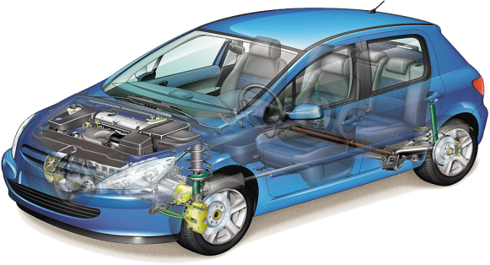
Automotive & Transportation
- Embedded development of ECU engine control & cabin equipments
ECU engine control for petrol/ GPL / GNV / Flex Fuel.
ECU for energy management in the Electrical motor(energy converters).
Embedded development of multimedia equipments.
Embedded development of automotive Instrument Clusters.
Embedded development for ECU
(petrol drive / Electric drive / GPL / GNV)
Embedded development for Suspension Unit / ABS

Slide 13
Defense & Avionics
- Embedded Development, Simulators & Tests Benches :
Avionic Reports (A380 – A350).
Software ECU of braking / steering landing gear .
Development on control units of inertial units (CDU).
Creation and execution of unit tests(DO178-B) Simulators for avionics.
Software development of test benches for avionics ECU.
Development of tools for analysis of the flight data.
Simulator development
Processing of flight data
Embedded Devolopment- CDU

Slide 14
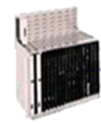
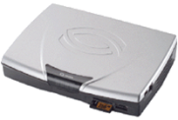
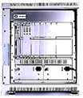
Telecommunications Network Testing, Validation & Deployment
- Development & Validation of Telecommunication equipments:
Embedded development of business gateways (Voice/ Data).
Embedded development of Protocol stacks.
Embedded development of supervisory officiers(CNMP-NMS).²
Development of new routing techniques.
Evolutionary maintenance under different accounts(SNTA, EDF etc.)
Mobile Qualification(2G/3G)
Business gateways (Voice/ Data).
Interoperability testing
Multi-protocol switching routers
Modems & Residential Gateways (XDSL)

Slide 15
Worldwide Telecom Projects
Main Projects in Carrier Networks done in Europe, Middle East and Africa (EMEA) in partnership with Tekelec:
Installation, testing and commissioning of network management and Monitoring for fixed and mobile2G; 2.5G and 3G during 2003-2012 in Europe, Middle East and Africa in collaboration with Tekelec mainly in:
Europe | France (Orange, SFR & Bouygues Telecom) Monaco (Monaco Telecom) Italy (TIM) Spain (UNI2) Portugal (Optimus) Luxembourg (P&T) | Belgium (Mobistar) Germany (T-Mobile & O2) Austria (Colt) Baltic (Bosnia Telecom & Iskratel) Turkey (AVEA, Turk Telecom , Vodafone) Russia (Megafone) Leichtenstein (Mobilkom)
Africa/ Middle -East | Tunisia (Orascom Tunisia Telecom) Morocco (Maroc Telecom) Algeria (Orascom Algeria) Libya (Libyana) Egypt (Mobinil) Jordan (JTC) Kuwait (Watanya) UAE (Etissalat) Bahrain (Viva) | Mali (Ikatel) Ivory Coast (OCI) Burkina Faso (Onatel) Senegal (Sonatel) Cameroun (Orange) Nigeria (ZAIN) Ethiopia (ETC) Ghana (Airtel) Kenya (Airtel & Orange)
WorldWide | Brazil (Telemig) USA (Ericsson) Nicaragua (Claro) Martinique, Guadeloupe French Territory (OMT ZTE) Philippines India (BHARTI)

Slide 16
Telecom Carriers References
Implemented Projects
Notes:
16

Slide 17
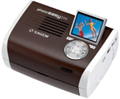
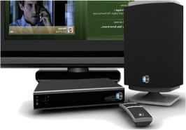
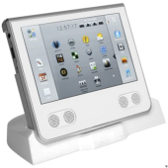
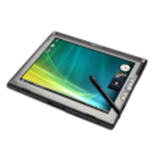
MultiMedia R&D and Validation
- Development of Set Top Boxes (STB) & VIDEO Processing
- Development of a Professional decoder (HW & SW development)
4 channels HD/SD (MPEG2 & H264)
Live Smooth Streaming reader (H264 & VC1)
- Inputs: ASI and Giga Ethernet
-Outputs: ASI et SDI
Set Top Boxes development
Digital printers Development
(HW/SW) development of encoding/decoding Audio / Video equipments.

Slide 18
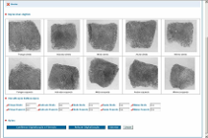
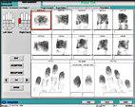
Biometrics & Security
- Civil Security Systems & border Monitoring .
Development of civil security systems.
Development of border Monitoring systems.
Development of generic components used in sub security systems.
Sub security systems Validation.
Development of border Monitoring systems.
Development of civil security systems.

Slide 19
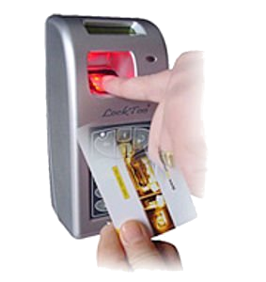
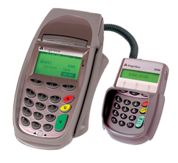
Payment & Smart Cards Solutions
- Chip Card Solutions Development
Chip Card Solutions : E-Government, E-Health, E-Passport, E-ID, etc.
Banking Applications: JCB-EMV, Diners, KNET, Sovac, Sovac Fidelity, Credipar, Fintrax, FranFinance, Moneo, Proton, CB, Sofinco, Moneo, Proton ….
Access Control & Biometric Identification : Morpho Touch 2nd Generation, Time attendance Applications, Morpho SDK 2nd Generation, MEMS System…
Applications Desktop : Smart Card Personalization Tool, Smart Card Configuration Tool, Authentification tool, Simulation and Testing tools, Reporting Tools…
Access Control & Biometric Identification
Banking Applications
Chip Card Solutions

Slide 20
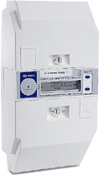
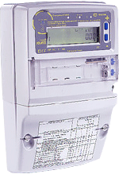
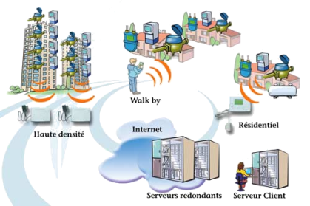
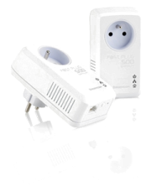
Smart Energy Metering
- Solution Development for Smat Energy Metering
Residential Meteer: Pre-Paid, low-cost, multi-tariff
Commercial and Industrial Meter: Hi-class with HTTP server.
PLC Data Concentrator: Power Line Communication Equipements.
Gateways and Interface Connverters: Remote Reading, Firmware Update, Services etc.
Power Line Communication Equipment.
Industrial/Commercial Meter
Residential Meter

Slide 21
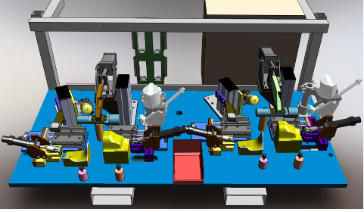
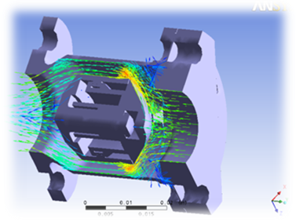
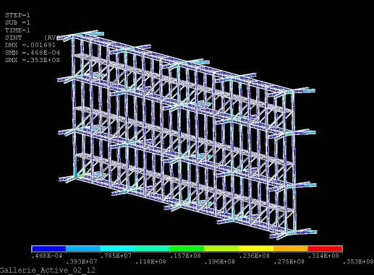
Product Life-Cycle Management
EXAMPLES
CAD & Simulation : Special machine design, …
CAM & Industrialization: Aircraft structures, …
CAE :
Numerical simulation of aircraft braking systems;
Calculation and simulation in the field of Energy;
Notes:
21

Slide 22
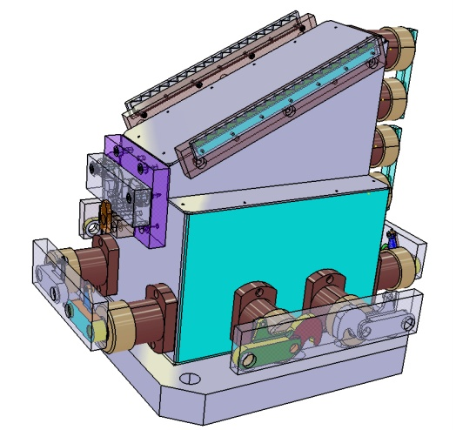
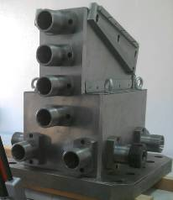
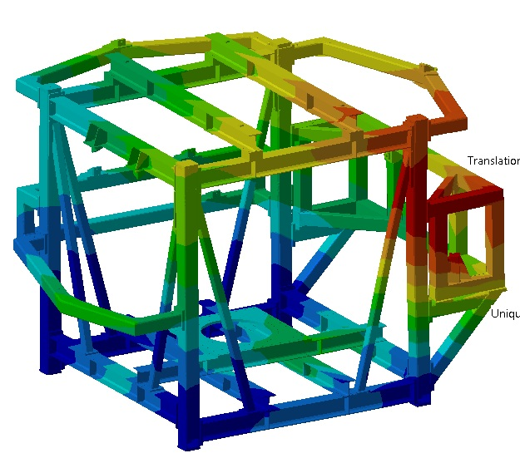
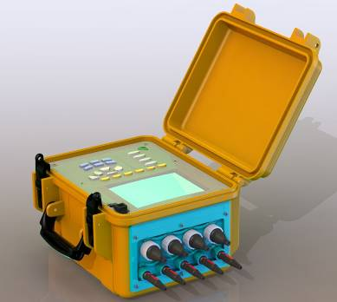
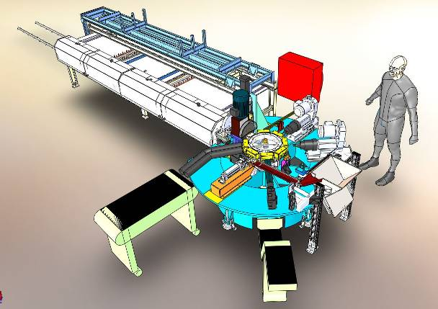
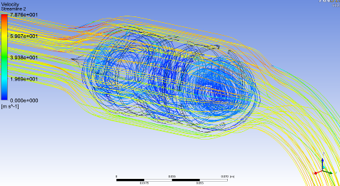
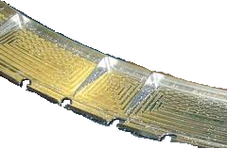
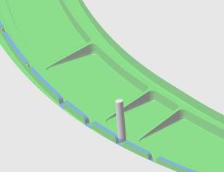
CAD, CAM, SIMULATION & INDUSTRIALISATION
Mechanical Design & Engineering Styling Design Meshing Structural Analysis Rheological Simulation CFD Simulation Digital Mock-up & animation | Special Machines Design & Manufacturing Design & Manufacturing of Production Tools Multi axis CAM Simulation
Static Analysis of the CSO Satellite test bed
Milling Fixture for Aeronautic Parts
Design of electronic
equipment housing
Transfer Machine
5 axis CAM Simulation of Aerospace Structure
CFD Analysis
of a Silencer
Notes:
22

Slide 23
Telnet Activity Within ITU-T
ITU-T Member since 2009.
Active participation in ITU-T SG 15; 16, 17 & M2M eHealth Focus Group
ITU-T Event participations:
ITU-T SG 16 participations Geneva 20-23 July, 2010 :
1. ITU-T Inter-operability Event on IPTV
2. ITU-T WP3/SG16 JCT-VC Meeting
ITU-T SG 16 participations Geneva 16-23 March, 2011: ITU-T WP3/SG16 JCT-VC Meeting .High Efficiency Video Coding standard (HEVC)
Joint ITU - AICTO Workshop on “Interoperability of IPTV in the Arab region, Dubai Sept 2011
ITU Telecom World, Geneva Oct 2011
ITU-T SG – 16 Participation Geneva 21-30 Nov, 2011: ITU-T WP3/SG16 JCT-VC Meeting High Efficiency Video Coding standard (HEVC), :
ITU-T Focus Group M2M for healthcare services, Sept 2012
ITU & EU FP7 Probe-IT Workshop on “Internet of Things for Africa”, Tunisia, Sept 2012
ITU & CERT Forum on “Conformance and Interoperability” for the Arab and African Regions, Tunisia Nov 2012
Notes:
23

Slide 24
Global Economy Requires New Standards and Creates New Opportunities
Shifting from from Local to Global Economies sets the need for new standards related to security & safety, health, banking & finance, energy, etc….
Many State Monopoly sectors are been deregulated (telcom, energy, media, etc…) and new entrants have to adopt standards to correctly interoperate with each other locally and globally.
In many developed countries, new health challenges are been addressed through ICT due to aging populations and the reduced number of healthcare professional staff.

Slide 25
Communication, Mobility and M2M
Mass transportation Systems (land, sea and air ) are becoming more and more accessible and different management systems need to correctly interoperate for better planning and safety concerns. i.e. Airbus predicts that by 2020 the world demand for aircrafts will reach 20,000 units.
Telecommunication and Multi Media are key factors driving the e-Economies in both developed and developing countries. In fact, more and more intelligent devices are available to consumers thanks to constant development in embedded hardware and software technologies.
We are increasingly been surrounded by many communicating devices i.e. Machine to Machine. It is forecasted that by 2020, there will be an estimate of 20 to 30 billion smart devices (home, work, public places, transportation, schools & universities, etc….) that will create more challenges for communications protocols

Slide 26
Smart Grid, Environment & Energy
Developed Countries are financing projects for energy production facilities in developing countries to reduce cost of energy production that can be exported to (solar farms, wind, gaz turbine, etc…)
Developed countries are deregulating energy distribution & transportation thus the need to adopt new standards for smart grid interconnection. Case studies for North & South Mediterranean countries.
The need to develop a new generation of smart meters and energy efficient products within a smart living/smart grid approach (house automation).
Naturals resources are depleting because of demographic growth and environmental issues are imposing new constraints (energy consumption & efficiency, carbon emission, dual energy vehicles, etc….)

Slide 27
ICT & Standards: Ingredients for Innovation & Business Opportunities
- Many Developing Countries are launching major eGOV projects related to multi service smart card application that are cloud based (Health, Education, Transportation, Banking, etc….).
Global Economy is imposing a new bread of biometric based intelligent personnel identification documents (Driver license, ID cards, passport, bank card) that can be processed globally.
Developed Countries are outsourcing their data processing and DataCenter needs in developing countries (accounting, bank transactions, airline tickets clearence, etc…)
BPO and Call Centers are concrete examples of Outsourcing activities that are thriving in Africa & Middle East for major vertical sectors (finance & insurance, customer support, etc…)

Slide 28
Interoperability & Standard Compliance. New Business Opportunities
New mission critical standards (D0178, DO254) are been adopted to develop a new breed of intelligent transportation systems such as railway, vehicles and airplanes
Non Regression Testing of smart devices is becoming more and more rigorous (DO160) to insure compliance and interoperability
Accreditation, test Labs, Certification, Regulations and Mutual Recognition Agreements ( MRAs) are becoming more and more critical.
New domain specific QMS are imposed by equipments manufacturers and service providers (CMMi, EN9100, SPICE, TL9000, ISO27000, etc….)

Slide 29
Thank You for Your Attention
TELNET TECHNOCENTRE, Tunisia
Address : TELNET TECHNOCENTRE, Rue du Lac Léman - 1053 - Les berges du Lac - Tunis - Tunisia
Tel. : +216 71 860 233
Fax : +216 71 860 069
Email info : info@groupe-telnet.net

