Slide 1
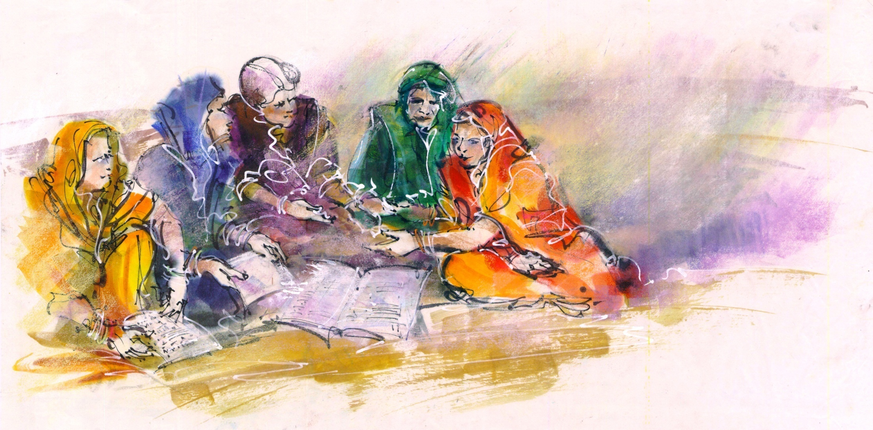
With
Development of National e-Agriculture Strategy
In collaboration with

Slide 2
Unavoidable upscaling questions
What are the priorities and what is the roadmap?
Who is supposed to adopt e-agriculture?
Who should pay for it?
Who should decide on investments?
How can we evaluate its impact?
How can we ensure consistency and consolidation of efforts, rather than competing or duplicating?
What overall policies are required?
Who should steer and govern?
How to make sure that the solutions respond to the problems?

Slide 3
Land Acquisition
Investment
Farm Inputs
Social Safety Nets
Pre Production
Production stage
Post Production
Access to Credits
Government Policies
Access to Credits
Access to Seeds, Fertilizers
Social safety nets
Transaction facilities
Farm Machinery
Insurance Subsidy
Land authority information & approvals
Insurance facilities
Labour, Workforce
Disaster Risk Mitigation
Investing Partners
Natural resources
Advisory services
Advisory services
Risk Management
Access to Data (Traceability)
Advisory services
Advisory services
Farm inputs
Monitoring & Analysis
Capacity Development
Access to Fertilizers, Pesticides
Monitoring and Information Gathering
Knowledge Transfer and Information services
ICT facilitated Services
Farm Machinery
Access to Data & Analysis
Advisory services
ICT driven Services
Labour & Workforce
Disaster Risk Mitigation
Natural resources
Knowledge, Advisory and Information services
Advisory services
Access to Markets
Sales and Financing
Livelihood Development
Disaster Management
Transportation
Credit Management
Investment Management
Disaster Risk Management
Storage
Transaction Facilities
Risk Management
Monitoring & Assessment
Pricing information
Insurance facilities
Advisory services
Subsidy Transaction Facilities
Good Agriculture Practices
Knowledge, Advisory and Information services
Advisory services
Advisory services
E-Markets
Traceability

Slide 4
Ag sector cluster – demand driven approach
Financial Services
Data Collection &
Analysis Services
Agriculture Knowledge Management
Supply Chain Management Services
Service Type A (Services requiring no support)
Beneficiary: ……..
Service Provider ………
Lead Agency ……….
Business Opportunity (Unconditional) … (Yes / No)
Action required (with timeline)
a) ………..
Land Info & Acquisition
Labour, Workforce
E-Markets
Transportation
Natural Resources
Storage
Farm Machinery
Access to Seeds, Fertilizers, Pesticides
Access to Credits & Credit Management
Service Classification and Prioritization
Service Provider ………
Lead Facilitating Sector … (Agriculture, Telecom, Finance…)
Lead Agency(ies) ……….
Facilitating Agency……
Service Type B (Services requiring indirect support)
Beneficiary: ……..
Service Provider ………
Lead Agency ……….
Business Opportunity with policy & regulatory facilitation.
Action required (with timeline)
a) ………..
Insurance Facilities
Disaster Risk Mitigation
Transaction Facilities
Investment Management
Monitoring and Information Gathering
Access to Data & Analysis
Traceability
Monitoring & Assessment
Service Type C (Services requiring government direct support / delivery)
Beneficiary: ……..
Service Provider ………
Lead Agency ……….
Action Required (with timeline)
a) ………..
Advisory services
Market information
Knowledge Transfer and Information services
ICT facilitated Services
ICT driven Services

Slide 5
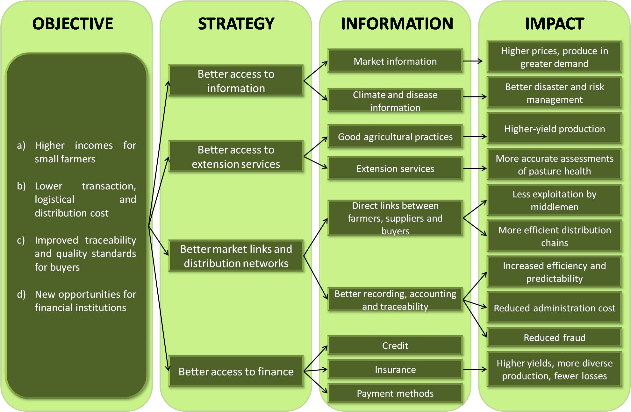
Information Flows in Agriculture sector
Source: World Bank (2011)

Slide 6
Why a national strategy
Force to consider ICT as a strategic tool to transform/reform the Agriculture sector
Set the vision of what changes should be achieved by e-Agriculture
Used as an overarching framework to guide all e-Agriculture efforts in the country and align stakeholders
Build country enabling environment
Ensure government leadership and ownership

Slide 7
Why a national strategy
Ensure short versus long term balance
Communication tool for stakeholders, funding agencies, partners, etc.
Prioritize and maximize return on (limited) investments
Move to national deployments rather than pilots
Many issues (standards, Legislations, evidence, infrastructure, capacity building, etc.) can be better dealt with at national level

Slide 8
Approach to Develop a National e-Agriculture Strategy
National
Agriculture
Master plan
e-Agriculture
Vision
Action Plan
Monitoring & Evaluation
National
e-Agriculture
Strategy
Part 1
Part 2
Part 3
ICT sector leverage opportunity
Leveraging inter-sector developments
The final outcome is a National Strategy on e-Agriculture comprising of three parts.

