Slide 1
ICT@SOPAC
By: Siaosi Sovaleni
SOPAC ICT Adviser – Outreach
siaosi@sopac.org

Slide 2
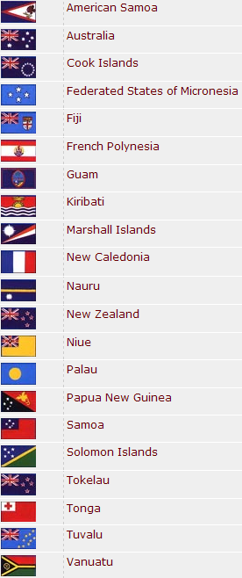
About SOPAC
Pacific Islands Applied Geoscience Commission (SOPAC)
Inter-governmental regional organisation
Membership: 21 Pacific Islands countries and territories
Three technical programme:
Community Lifelines: Energy, water, ICT;
Community Risk: Disaster risk reduction and management
Oceans and Islands: Management of non-living resources in oceans and island systems
Based in Fiji (www.sopac.org )

Slide 3
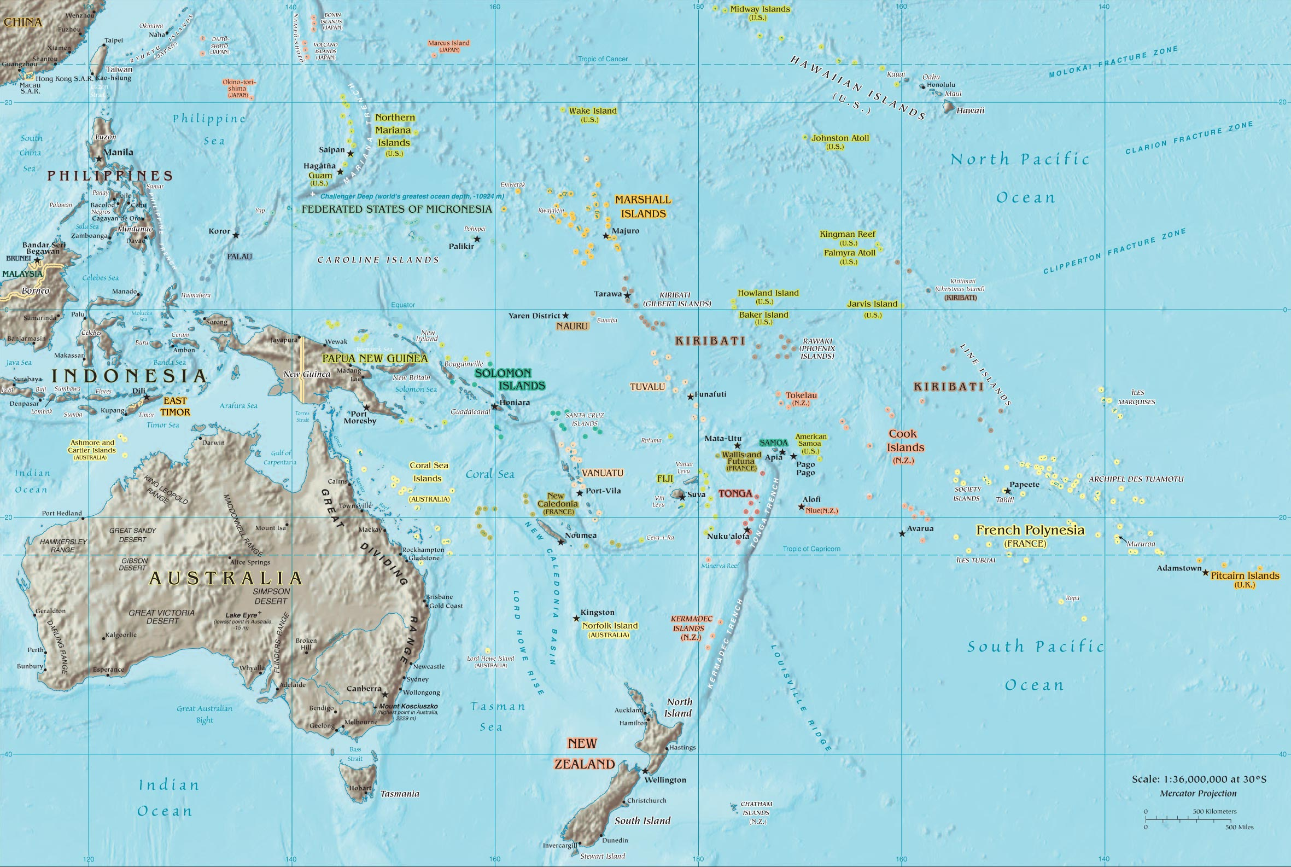
The Pacific

Slide 4
Pacific Plan
The Pacific Plan endorsed by Forum Leaders in 2005.
The Objectives of the Pacific Plan:
Promote economic growth
Sustainable Development
Good governance
Security
ICT, while not an end in themselves, are essential for social development, economic growth, as well as good governance.
Pacific Regional Digital Strategy (PPDS) is an integral component of the Pacific Plan.
www.pacificplan.org

Slide 5
Pacific Plan Digital Strategy (PPDS)
The PPDS establishes the following priorities:
Improving access to communications technology;
Reducing costs;
Establishing higher bandwidth to the global ICT ‘backbone’;
Removing inappropriate regulatory environments in order to foster higher levels of investment; and
Strengthening ICT skills/Capacity building.
Communication Ministers: Wellington Declaration 2006:
Indicators/e-Readiness;
E-Government;
ICT Policy;
Capacity Building;

Slide 6
Pacific Plan Digital Strategy (PPDS)
ITU Pacific ICT Ministerial Forum – Tonga, Feb 2009
Affordable access – domestic and international connectivity;
Enabling environment;
Cyber security;
Emergency communications; and
Human capacity building.
Review of the PPDS
Identifying gaps
Draft PPDS II

Slide 7
ICT@SOPAC
ICT Policy
E-Government
Capacity Building
Awareness Programme

Slide 8
ICT@SOPAC and PPDS
Wellington
Declaration
SOPAC Supporting Activities
Focus
Areas:
b)
c)
d)
E-Readiness Assessment of PICs
(UNDP, CROP ICT WG.
SOPAC 9 PICs)
Pacific Plan’s
Digital Strategy
ICT Policy
(Review & Assist Development,
ROC)
E-Government
(SOPAC, UN-APCICT,
Korean Government)
Telecenter Support
Pacific Telecenter Online Community
(PACTOC),
(FDC, telecenter.org)

Slide 9
ICT Policy
Technical assistance to:
FSM
Tuvalu
Kiribati
Cook Islands

Slide 10
E-Government
E-Readiness Assessment of:
E-Government activities:
SIDS: Kiribati, Tuvalu, 1 (2?) North PICs
Portal and web development
Partners: Korean Government/PIFS
Tonga | Kiribati
FSM | Tuvalu
Palau | Niue
RMI | Cook Islands

Slide 11
Capacity Building-Strategic Direction
Policy/law makers and government leaders need to be educated and be more informed about ICT to regulate and legislate more effectively;
Users need to understand the benefits and costs of ICT
ICT Access for
the Poor/
e-Parliament
Technical and
Policy Advice
Online/Accessible
Resources
Establishing
Networks
Training
Workshops
Policy Makers/
Government Leaders
ICT Awareness
Legislators
Academy of ICT
Essentials for
Gov Leaders
Users

Slide 12
Capacity Building-Strategic Direction
ICT Professional – up-skilling and keeping up to date with ICT development
International Open
Source Network
(IOSN)
Open Source-
Linux, CMS
Cyber security
Establishing
Networks
ToT
Workshops
ICT Professional and
Support officers incl.
Web and Database
Developers, System
Administrators and
Engineers
UN APCICT’s
Academy
PICISOC/
PacINET
PITA/PacNOG

Slide 13
Capacity Building-Academy
Developed by UN APCICT (ESCAP Institute)
The Academy consists of a core ICT4D curriculum with eight modules:
The Linkage between ICT Applications and Development
ICT for Development Policy, Process and Governance
e-Government Applications
ICT Trends for Government Leaders
Internet Governance
Network and Information Security and Privacy
ICT Project Management in Theory and Practice
Developing Diverse Funding Structures or Options for funding ICT4D

Slide 14
Brief on APCICT
APCICT
a regional Institute of UN-ESCAP (established in June 2006)
Located in Incheon, Republic of Korea
Mission
Strengthening ICT Human and Institutional Capacity of ESCAP member and associate members to use ICT for their socio-economic development
14 ICT@SOPAC
Notes:
14

Slide 15
Underlying Principles of Work Programme
Foster socio-economic
development and help achieve the MDGs
Build Human and Institutional Capacity
of members and associate
member states of ESCAP in the use of ICT
Advisory
Services
Training
Research
15 ICT@SOPAC

Slide 16
Capacity Building-Academy
M1- The Linkage between ICT Applications and Meaningful
Development
M2- ICT for Development Policy, Process and Governance
M3- e-Government Applications
M4- ICT Trends for Government Leaders
M5- Internet Governance
M6- Network and Information Security and Privacy
M7- ICT Project Management in Theory and Practice
M8- Options for Funding ICT for Development
16 ICT@SOPAC
Notes:
16

Slide 17
Capacity Building-Academy
New modules under development
ICT for Effective Disaster Management
ICT and Climate Change
Milestones
Letter of Exchange (LoE) between SOPAC and UN-APCICT (September, ‘08)
Regional Academy Workshop in Cook Islands (September, ‘08)
National Academy Workshop in Tonga (February, ’09)
National Academy Workshop in Tuvalu ( June 2009)
Sub-Regional workshop in Samoa (July 2009)
National Academy Workshop in Kiribati ( September 2009)

Slide 18
Academy in the Pacific
Academy in the Pacific
SOPAC’s Approach → In-country Workshops
More effective in reaching wider audience
More flexible in setting target participants and duration
More room for customization according to the national priorities e.g national ICT Policies, tele-centre/ e-Centre
More focus localization to fit environment, languages, and cultures e.g case studies

Slide 19
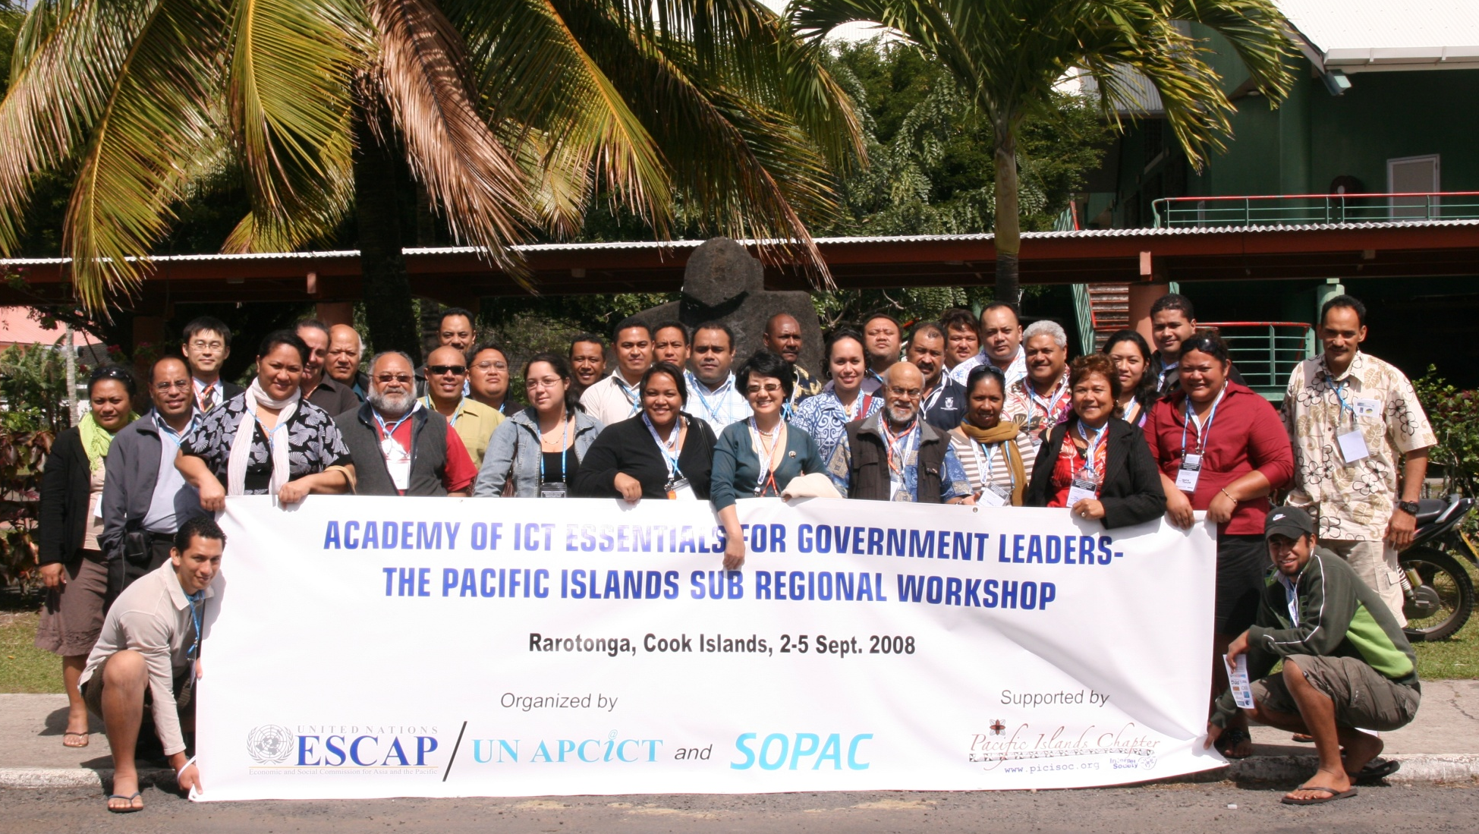
Educating Policy Makers and Government Leaders

Slide 20
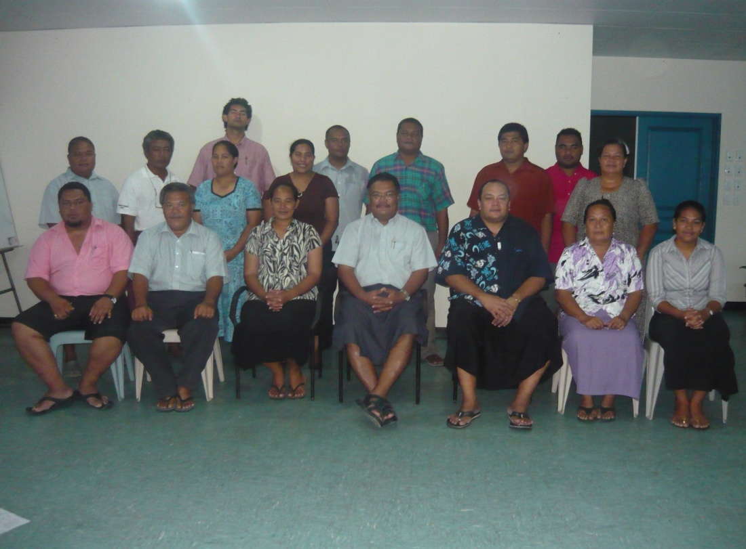
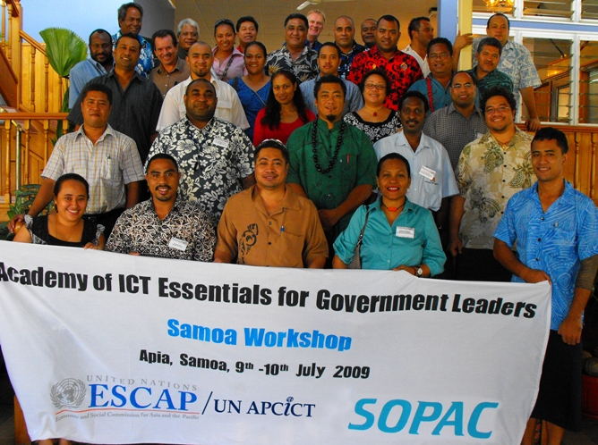
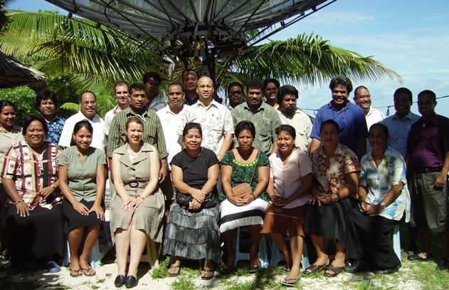
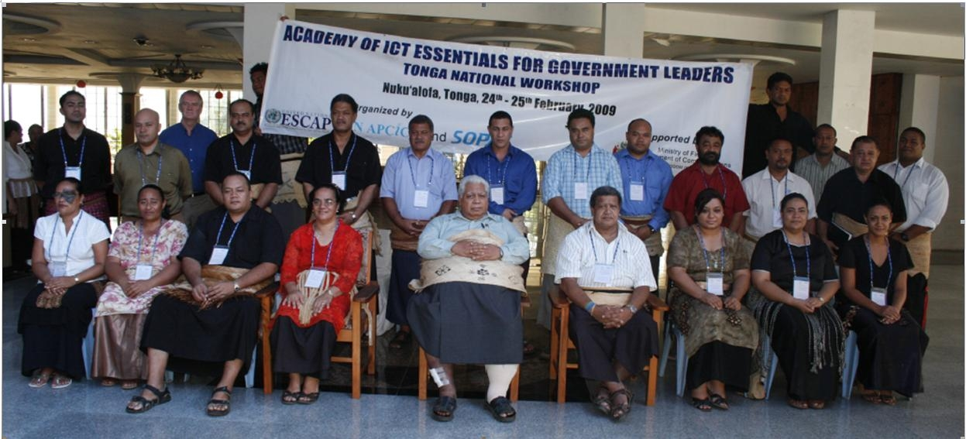
Tuvalu
Cook Islands
Kiribati
20
Notes:
20

Slide 21
Future of Academy in Pacific
Workshops in ICT4D for 5 PICs
Workshops on Module 6 (Cyber security) & 7 (Project Management)
To partner with regional and local institutes to improve delivery capacity and localisation

Slide 22
Internet Awareness – Users need to be aware of the benefits and also the threats posed by the Internet.

Slide 23
Open Source & Capacity Building
Regional Workshops
Tonga & Kiribati
International Open
Source
Network (IOSN)-PIC
& SOPAC
FOSS Awareness
Workshops in PICs
FOSS Application
Development
PacINET
(with PICISOC)
GeoCMS (Mapserver)
EDF8 & EDF9
& SOPAC
Linux & CMS
Workshops in 14 PICs

Slide 24
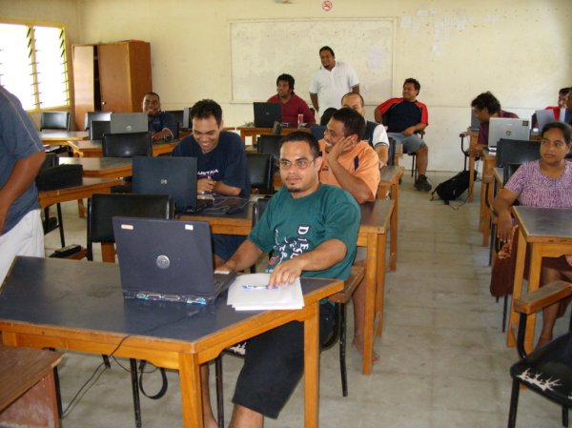
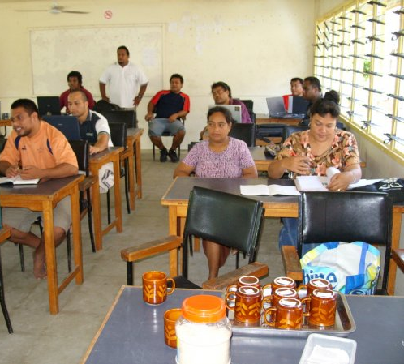
Linux Workshop-Kiribati

Slide 25
Pacific Regulatory Environment
 | National ICT Policy/Plan | Open Telecom Market | Cybercrime Legislation | e-Government Plan
Cook Islands | Y | N | N | Y*
Niue | N | N | N | Y*
Tuvalu | N | N | N | N
Tonga | Y | Y | Y | Y
Samoa | Y | Y | N | N
Vanuatu | N | Y | N | Y
PNG | Y | Y | N | N
Solomon Isl | N | N | N | N
Nauru | N | N | N | N
Kiribati | N | Y | N | N
Marshall Isls | N | N | N | N
FSM | N | N | N | N
Palau | N | N | N | N
Fiji | N | Y | Y | Y

Slide 26
Pacific Connectivity
 | Fixed | Mobile | Dial-up | Broadband
Cook Islands | 36 | 22 | 27.5 | 0.3
Niue | 62 | 38 | 50 | 0.0
Tuvalu | 10 | 0 | 5 | 0.5
Tonga | 13 | 59 | 2 | 1.1
Samoa | 9 | 51 | 2.1 | 1.6
Vanuatu | 3 | 15 | 0.5 | 0.5
PNG | 1 | 12 | 0.1 | 0.0
Solomon Isl | 1.7 | 4.4 | 0.3 | 0.2
Nauru | 1.5 | 0 | 0.2 | 0.0
Kiribati | 5 | 10 | 2.2 | 0.0
Marshall Isls | 10 | 19 | 1.4 | 0.0
FSM | 9 | 26 | 1.2 | 0.3
Palau | 37 | 53 | 5.8 | 0.0
Fiji | 15 | 60 | 0.2 | 2.9

Slide 27
Mobile vs Fixed

Slide 28
Relevancy and Impact
Use the Academy to:
Educate policy makers – “hard to effectively regulate what one does not understand”
Engage participants on the need for ICT Policies and for bridging the Digital Divide;
Raised awareness and needs for Cyber crimes/legislation; and
Provide the platform for e-Government discussions.

Slide 29
ICT Access for the Poor
Secured funding from EU-ACP @CP- ICT Programme
Duration: 2 Years
Implementing agency: SOPAC
Objective
Improve access to ICT services for the poor by improving and adopting relevant government policy and legislation
Facilitate and enable members of Pacific ACP parliaments to be better informed about ICT access issues.
Inform and enable parliamentarians to learn about successful legislation and interventions.

Slide 30
ICT Access for the Poor
Activities
Conduct a survey and evaluation of Parliaments in Pacific ACP countries;
Capacity building interventions to all Pacific ACP Parliaments (14) based on Academy of ICT Essentials for Government Leaders;
Establish database and network of Pacific ACP parliamentarians;

Slide 31
ICT Access for the Poor
Activities cont.
Develop an online resource centre and legislative toolkit for the Pacific ACP parliamentarians.
Provide Technical and Policy advice to Parliaments in Pacific ACP countries.
Convene regional hearings to share experience, learn from successful legislation and interventions, have access to experts and establish networks.

Slide 32
ICT Access for the Poor (ICT4P)
Foster socio-economic development
through better access to ICT
Appropriate ICT (Cyber) Policies and Legislation
Better informed Legislators
Appropriate ICT Infrastructure
Better equity access especially for the Poor
ICT4P
Online and offline
resources
Networking and
Knowledge
Sharing
ICT Assistance
Capacity
Building
Advisory
Services

Slide 33
Regional Communication/ICT Programme
Secretariat of Pacific Community (SPC)
Members:22 Pacific countries and territories.
Largest technical Pacific regional organisation.
SOPAC to merge with SPC
ICT Outreach activities merge to form the Pacific Regional ICT Programme;
Strengthen outreach activities by pooling resources;
Greater coordination and less duplication.

Slide 34
Regional Communication/ICT Programme

Slide 35
Tentative area of responsibilities and partners

Slide 36
Summary
Planned Capacity Building Activities 2010
ICT Interventions (including seminar/ workshop) to Parliaments in 7 Pacific ACP Countries;
Regional Hearing (Meeting) for Pacific ACP Parliamentarians
Web development in 3 PICs assisting e-Government efforts
Academy (ICT4D) workshops in 5 PICs

Slide 37
Potential joint activities with ICB4PAC
National workshops
Legislators and Policymakers in 7 PICs: Awareness and ICT4D
Web Development in 3 PICs
ICT4D in 5 PICs
Official and Ministerial meetings (mid 2010)
Harmonization of cyber legislation
Review and adoption of Digital Strategy II
Potential Partners: ITU/EC, European Council
Database of experts/point of contacts
Cyber Security Point of Contacts (PacCERT)
Legislators/ICT Champions (ICT4Poor)

Slide 38
Thank you
감사합니다
Vinaka Vakalevu

