Slide 1
CWG on Strategic and Financial Plans
- Review of Strategic Targets
- Proposed Strategic Targets
INFO-DOC: Review of the status and background information on the proposed Strategic Targets CWG-SFP-3/INF-1

Slide 2
ITU at a glance
Our Strategy
Goals & Targets
GROWTH
INCLUSIVENESS
SUSTAINABILITY
INNOVATION & PARTNERSHIP
Enable and foster access to and increased use of telecommunications/ICTs
Bridge the digital divide and provide broadband for all
Manage challenges resulting from telecommunication/ICT development
Lead, improve and adapt to the changing telecommunication/ICT environment
50% of households with Internet access in developing, 15% in LDCs
55% of households should have access to the Internet
40% improvement in cybersecurity readiness
50% of individuals using the Internet in developing, 20% in the LDCs
Telecommunication/ICT environment conducive to innovation
60% of individuals should be using the Internet
Affordability gap reduced by 40%
50% reduction in volume of redundant e-waste
Broadband services cost max 5% of monthly income in developing world; 90% of rural population covered
Effective partnerships of stakeholders in telecommunication/ICT environment
30% decrease in Green House Gas emissions per device generated by the telecommunication/ICT sector
40% Telecommunications/ICTs should be 40% more affordable
Gender equality online
Accessible ICTs for persons with disabilities

Slide 3
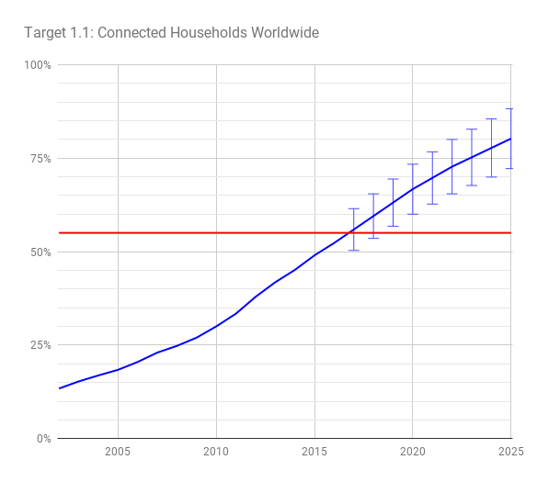
Target 1.1
Worldwide, 55% of households should have access to the Internet by 2020
Target is expected to be achieved
The worldwide number of households connected to the internet benefits in particular from a strong rise in the number of connected households in developing countries and LDCs (included as separate targets 2.1.A & 2.1.B respectively)
Source: ITU ICT Statistics | Household Survey

Slide 4
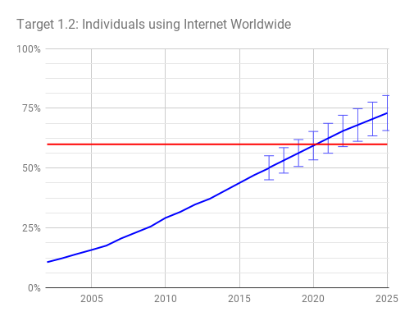
Target 1.2
Worldwide, 60% of individuals should be using the Internet by 2020
Target expected to be achieved
The target may be achieved before 2020, this is in particular due to the strong growth in developing countries and LDC (included as separate targets 2.2.A & 2.2.B respectively).
Relatively slow growth (well below saturation) in developed countries suggests that socio-economic factors inhibit further growth.
Source: ITU ICT Statistics | Household Survey

Slide 5
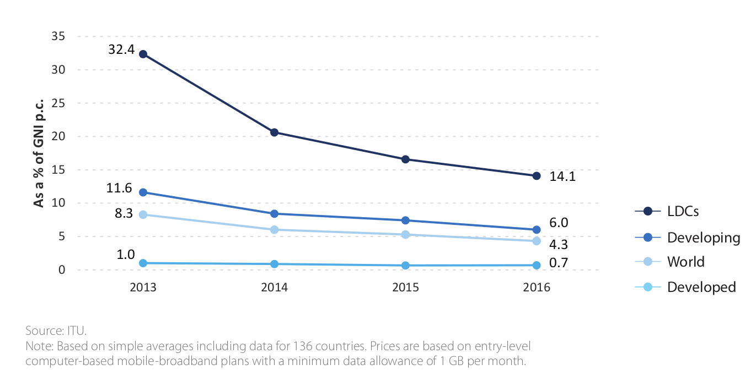
Target 1.3
Worldwide, telecommunication / ICT should be 40% more affordable by 2020
developed countries trend suggests mobile to be around 32.52% more affordable by 2020
developing countries trend suggests mobile to be around 33.01% more affordable by 2020
Costs of internet access are falling, however relatively slow growth in GNI per capita makes this target difficult to achieve
Mobile Broadband Prices at % of GNIpc
Source: ITU Stats | Regulator Survey

Slide 6
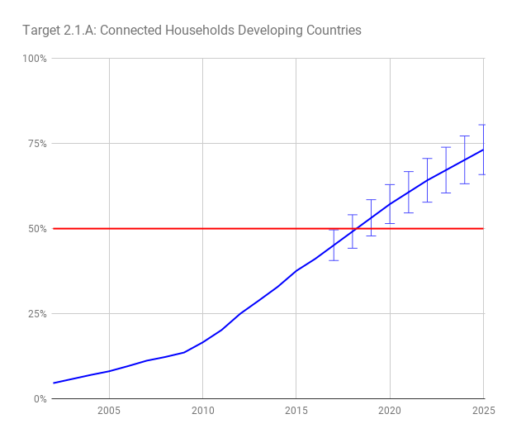
Target 2.1
2.1.A: In the developing world, 50% of households should have access to the Internet by 2020
Target expected to be achieved
2.1.B: In the least developed countries (LDCs), 15% of households should have access to the Internet by 2020
Target expected to be achieved
Good indications since 2015 that LDC adoption is accelerating
Strong growth in all developing countries, the target for developing countries is more ambitious than the worldwide target and is expected to be achieved a bit later (but still before 2020)
Source: ITU ICT Statistics | Household Survey

Slide 7
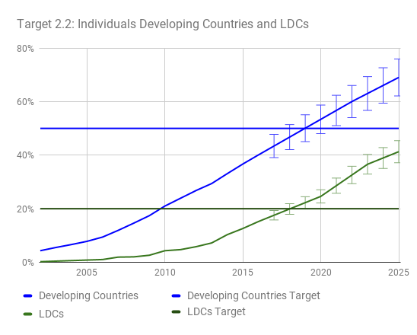
Target 2.2
2.2.A: In the developing world, 50% of individuals should be using the Internet by 2020
Target expected to be achieved
2.2.B: In the least developed countries (LDCs), 20% of individuals should be using the Internet by 2020
Target expected to be achieved
Of the targets focused on connecting individuals, LDCs target looks to be achieved first, followed by the developing countries targets, followed by the worldwide target.
Source: ITU ICT Statistics | Household Survey

Slide 8
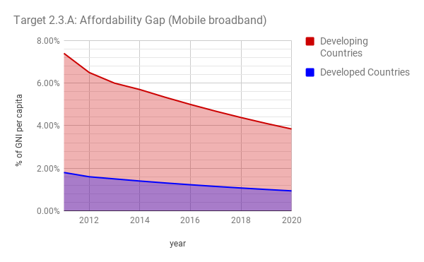
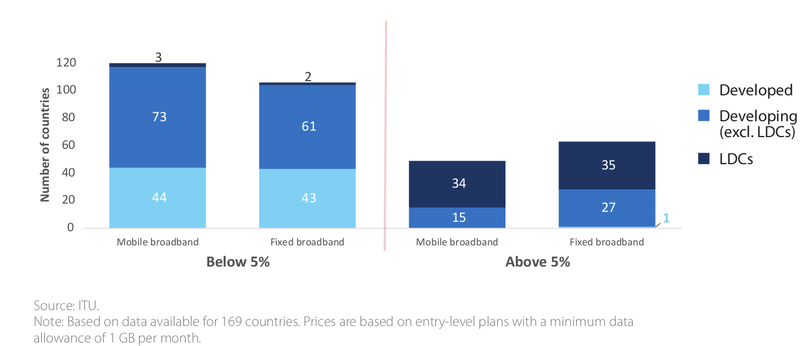
Target 2.3
2.3.A: The affordability gap between developed and developing countries should be reduced by 40% by 2020
mobile broadband affordability gap expected reduction around 32.37%
2.3.B: Broadband services should cost no more than 5% of average monthly income in developing countries by 2020
currently achieved by 120/160 countries or 75% (2016)
The fall in prices in developing countries continues at the pace observed since around 2012, reducing the gap. GNIpc growth was limited in all countries, therefore having a limited effect on the gap.
Meeting Target of 5% of GNIpc
Source: ITU Stats | Regulator Survey

Slide 9
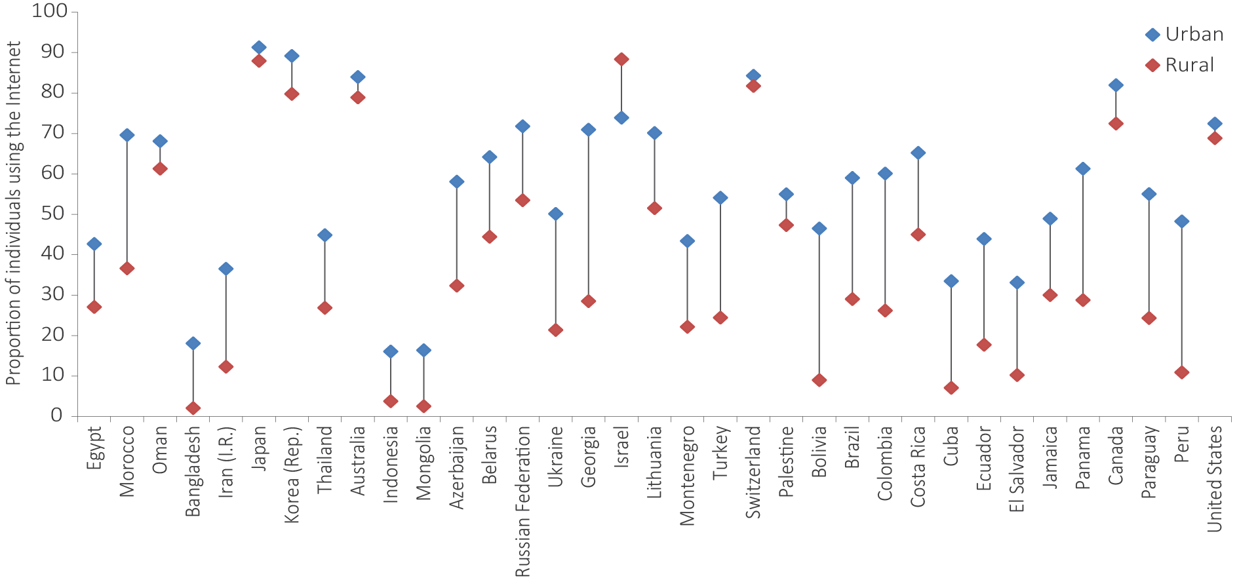
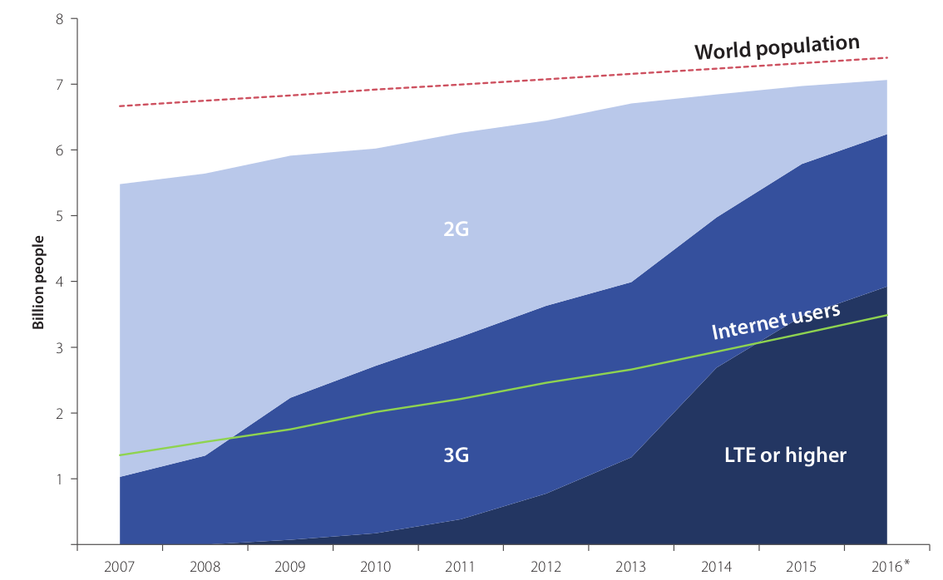
Target 2.4
2.4: Worldwide, 90% of the rural population should be covered by broadband services by 2020
Mobile Coverage of the rural population is high
Latest data (2015) show low rural 3G coverage
2G to LTE upgrade will increase coverage
Source: ITU ICT Statistics | Household Survey

Slide 10
Target 2.5.A
Achieving gender equality in access to broadband by 2020
Internet usage growing faster among men, to be expected considering fast growth in developing countries and particular in LDCs, where the data shows first adopters are likely men.
Latest data (2016) show that the divergence is slowing down, i.e. the difference between male and female adoption is still increasing, but at a decelerating pace
Gender gaps by region and classification
Source: ITU ICT Statistics | Household Survey

Slide 11
Target 2.5.B
Enabling environments ensuring accessible telecommunications/ICTs for persons with disabilities should be established in all countries by 2020
Question introduced to survey in 2015
48 out of 64 reporting countries have an accessibility strategy (2016 data), or 75% percent of the reporting countries
Increased from 40 out of 98 reporting countries in 2015 (41% of reporting countries)
Source: ITU Stats | Regulator Survey

Slide 12
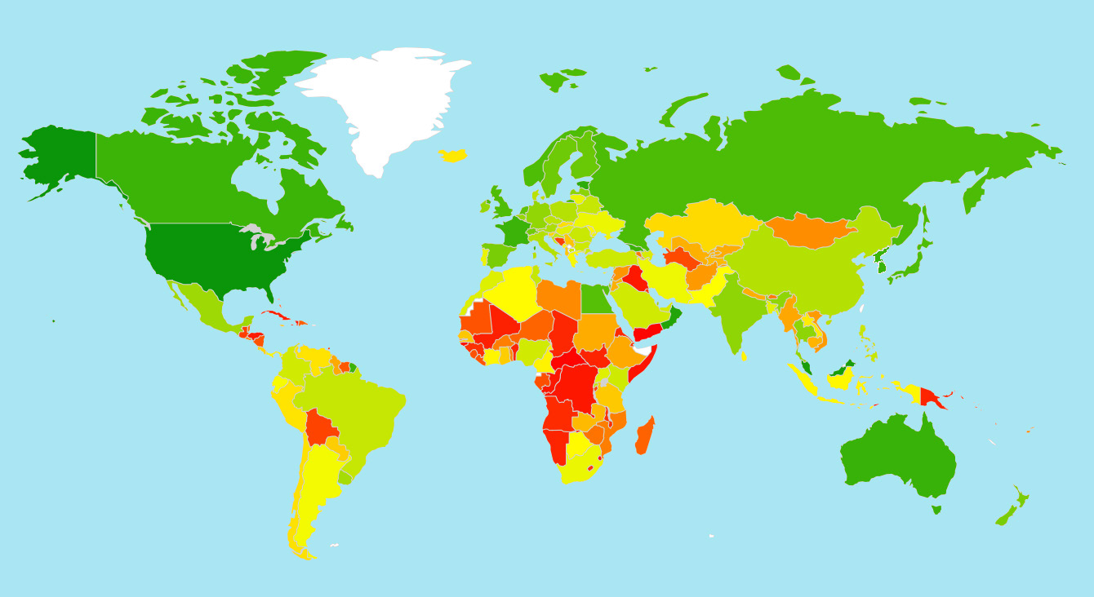
Target 3.1
Cybersecurity readiness should be improved by 40% by 2020
To measure improvement in cybersecurity within the context of the Connect 2020 Agenda, ITU proposes to combine the Global Cybersecurity Index (GCI) results with key indicators of cybersecurity vision and capabilities at the country level: the existence of a national cybersecurity strategy and a national Computer Incident Response Team (CIRT).
By combining the growth in the average GCI scores with the growth in the number of national cybersecurity strategies and national CIRTs, it will be possible to determine if the 40% improvement target in cybersecurity between 2014 and 2020 has been achieved.
(ITU Annual Report 2016)
GCI heatmap 2017

Slide 13
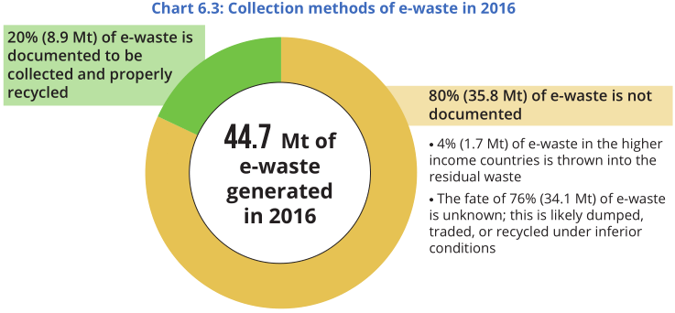
Target 3.2
Volume of redundant e-waste to be reduced by 50% by 2020
In 2016, 44.7 million metric tonnes of e-waste were generated.
20% (8.9 Mt) of e-waste is documented to be collected and properly recycled
target can be rephrased in terms of growth in recycling: e.g.: “50% increase in recycled e-waste”
the advantage of rephrasing is that, statistics on e-waste recycling generally start being collected around the time that countries actively pursue e-waste recycling, looking at the increase therefore is more convenient from a data point of view
Source: Global E-waste monitor 2017 (UNU/ITU/ISWA)

Slide 14
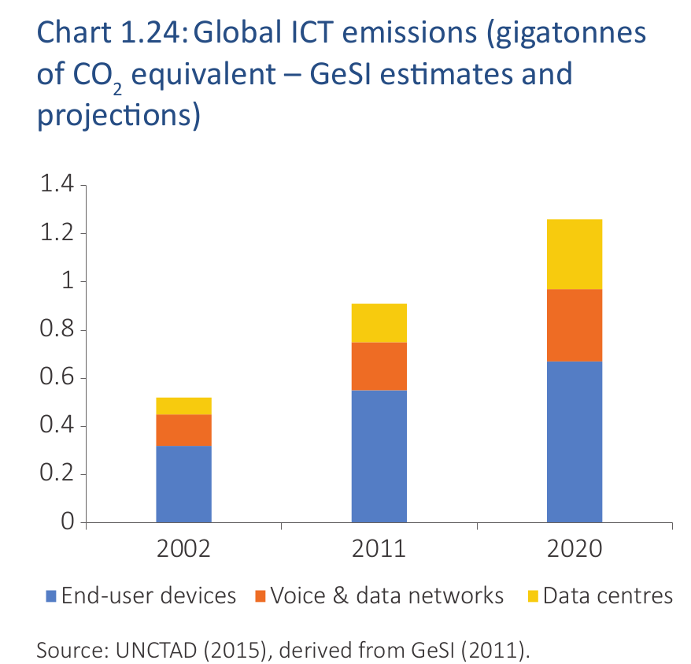
Target 3.3
Greenhouse Gas emissions generated by the telecommunication/ICT sector to be decreased per device by 30% by 2020
Due to the increased share of mobile devices, target most likely well achieved

Slide 15
Target 4.1 & 4.2
4.1: Telecommunication/ICT environment conducive to innovation
"Today OECD countries are no longer alone in developing national strategies for science, technology and innovation. Brazil, the People's Republic of China and India have developed national innovation strategies as part of their longer-term economic development strategies. More recently, middle-income and developing countries such as Argentina, Colombia and Vietnam are developing strategies to diversify their economies and mobilise innovation to improve their competitiveness. Several policy trends emphasised since 2010 are discussed below." (OECD)
In Sub-Saharan Africa, the number of innovation/tech hubs has increased about 15% since 2014 (World Development Report 2016: Digital Dividends)
4.2: Effective partnerships of stakeholders in telecommunication/ICT environment
Under the current formulation, there is no quantitative indicator to measure this.
Source: ITU

Slide 16
ITU Strategy
ITU proposed strategic targets

Slide 17
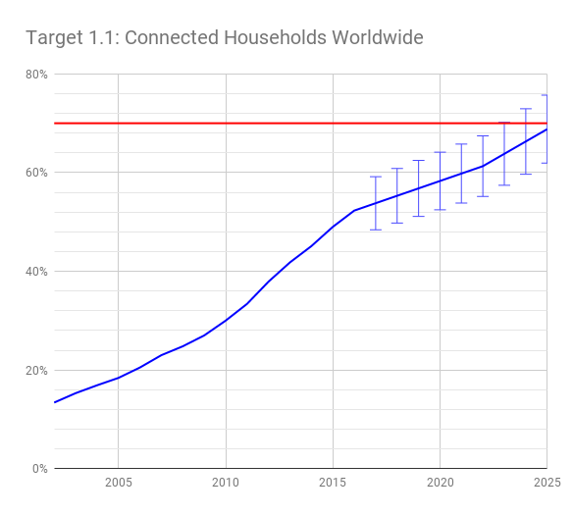
Target 1.1
Connected Households
by 2025, 70% of households worldwide should have access to the Internet
Much growth expected in developing countries
EXISTING TARGET
Source: ITU Statistics | Household Survey

Slide 18
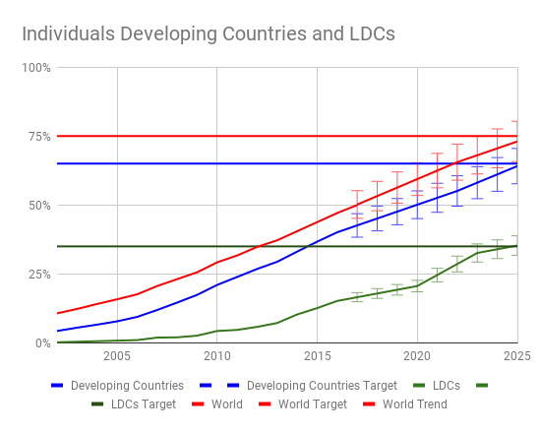
Target 1.2
Connected Individuals
by 2025, 75% of individuals worldwide should have access to the Internet
EXISTING TARGET
Source: ITU Statistics | Household Survey

Slide 19
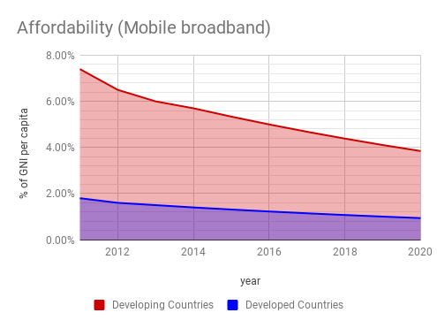
Target 1.3
ICT affordability
by 2025, internet access should 30% more affordable compared to 2016
EXISTING TARGET
Source: ITU Statistics | Household Survey

Slide 20
Target 1.4
Digital Agenda
by 2025, all countries should adopt a digital agenda/strategy
PROPOSED TARGET
Source: ITU | Regulator Survey

Slide 21
Target 1.5
Small- & Medium-sized Enterprises online
by 2025, x% percent of SMEs should be selling products or services online
Potentially breakdown by sector and country
Alternative: overcome the connectivity in MSMEs by half (by sector)
PROPOSED TARGET
Source: UNCTAD

Slide 22
Target 1.6
Fixed broadband: subscriptions
by 2025, increase by x% the number fixed broadband subscriptions
Related to SDG 17.6.2: Fixed broadband, by speed
PROPOSED TARGET
Source: ITU Statistics | Household Survey

Slide 23
Target 1.7
Fixed broadband: 10Mb/s
by 2025, x% of countries to have 50% of the fixed broadband subscriptions more than 10 Mbit
Related to SDG 17.6.2: Fixed broadband, by speed
PROPOSED TARGET
Source: ITU Statistics | Household Survey

Slide 24
Target 1.8
Interacting with government services online
by 2025, x% of the population should be interacting with government services online
Requires two-way communication
E.g. filing taxes, properties transfers, etc.
PROPOSED TARGET
Source: ITU Statistics | Household Survey

Slide 25
Target 1.9
e-Banking mobile financial services
by 2025, x% of the population should be using digital financial services
Related to SDG 8.10.2 “Proportion of adults (15 years and older) with an account at a bank or other financial institution or with a mobile-money-service provider
e-Banking or mobile banking is an effective and scalable method of including persons in the formal sector
Having a means of digital payment is a key enabler of participation in e-commerce
PROPOSED TARGET
Source: World Bank

Slide 26
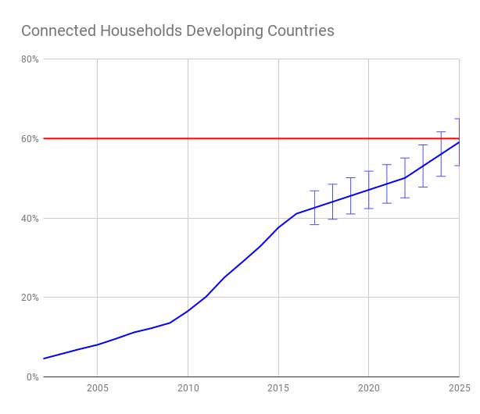
Target 2.1
Connected households in the developing world
by 2025, in the developing world, 60% of households should have access to the Internet
EXISTING TARGET
Source: ITU Statistics | Household Survey

Slide 27
Target 2.2
Connected households in Least Developed Countries
by 2025, in least developed countries, 35% of households should have access to the Internet
EXISTING TARGET
Source: ITU Statistics | Household Survey

Slide 28
Target 2.3
Connected individuals in the developing world
by 2025, in the developing world, 65% of individuals should be using the Internet
EXISTING TARGET
Source: ITU Statistics | Household Survey

Slide 29
Target 2.4
Connected individuals in the Least Developed Countries
by 2025, in the least developed countries, 35% of individuals should be using the Internet
EXISTING TARGET
Source: ITU Statistics | Household Survey

Slide 30
Target 2.5
Affordability gap – developed / developing
by 2025, the affordability gap between developed and developing countries should be reduced by 30% (baseline year 2020)
EXISTING TARGET
Source: ITU | Regulator Survey

Slide 31
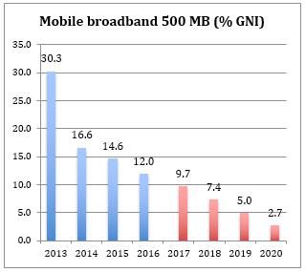
Target 2.6
ICT / GNI per capita
by 2025, broadband services should cost no more than 2% of average monthly income in developing countries
EXISTING TARGET
Source: ITU | Regulator Survey

Slide 32
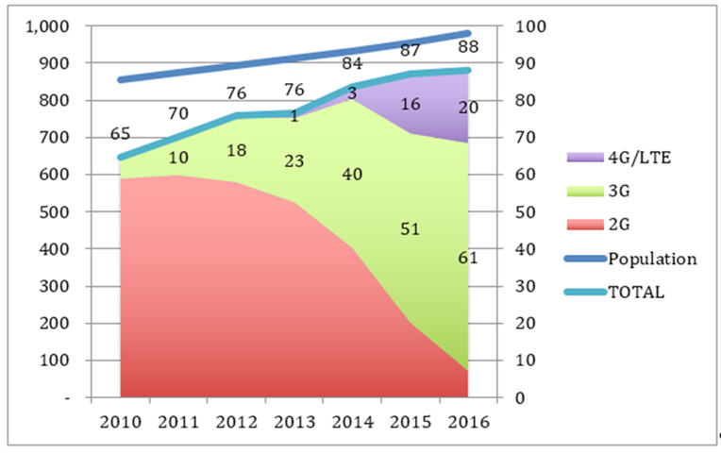
Target 2.7
Population covered by broadband services
by 2025, 98% of world population should be covered by broadband services
LDCs
EXISTING TARGET
Source: ITU | Regulator Survey

Slide 33
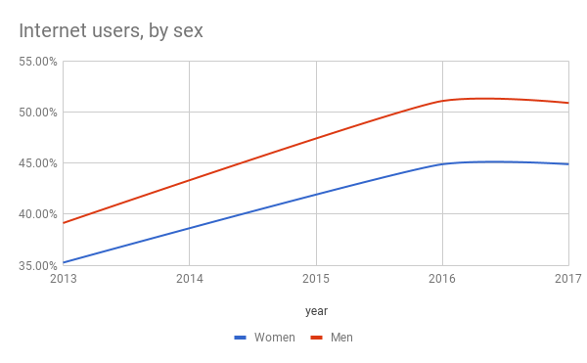
Target 2.8
Gender equality
by 2025, gender equality in broadband access should be achieved
EXISTING TARGET
Source: ITU Statistics | Household Survey

Slide 34
Target 2.9
Strategy accessibility persons with disabilities
by 2025, enabling environments ensuring accessible telecommunications/ICTs for persons with disabilities should be established in all countries
EXISTING TARGET
Source: ITU | Regulator Survey

Slide 35
Target 2.10
Youth/adults with ICT skills
by 2025, improve by x% the proportion of youth/adults with ICT skills
Related to SDG 4.4.1
Addresses need for capacity building
Provides a ground-up perspective on innovation (in particular in developing countries)
PROPOSED TARGET
Source: ITU Statistics | Household Survey

Slide 36
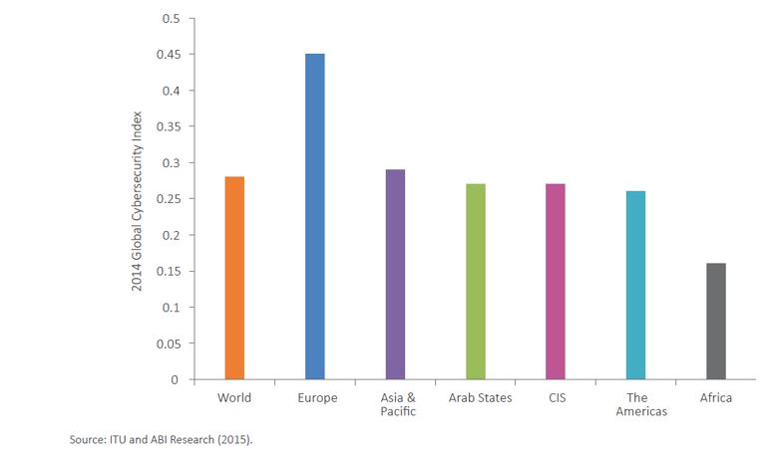
Target 3.1
Cybersecurity preparedness
by 2025, improve cybersecurity preparedness of countries (with key capabilities: presence of strategy, national computer incident/emergency response teams and legislation)
EXISTING TARGET
Source: ITU

Slide 37
Target 3.2
Recycled e-waste
by 2025, increase the global e-waste recycling rate should have increased to 50%
EXISTING TARGET
Source: Global E-waste monitor 2017 (UNU/ITU/ISWA)

Slide 38
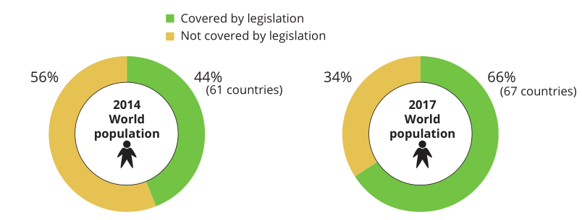
Target 3.3
e-waste legislation
by 2025, raise the number of countries with an e-waste legislation to 50%
PROPOSED TARGET
Source: Global E-waste monitor 2017 (UNU/ITU/ISWA)

Slide 39
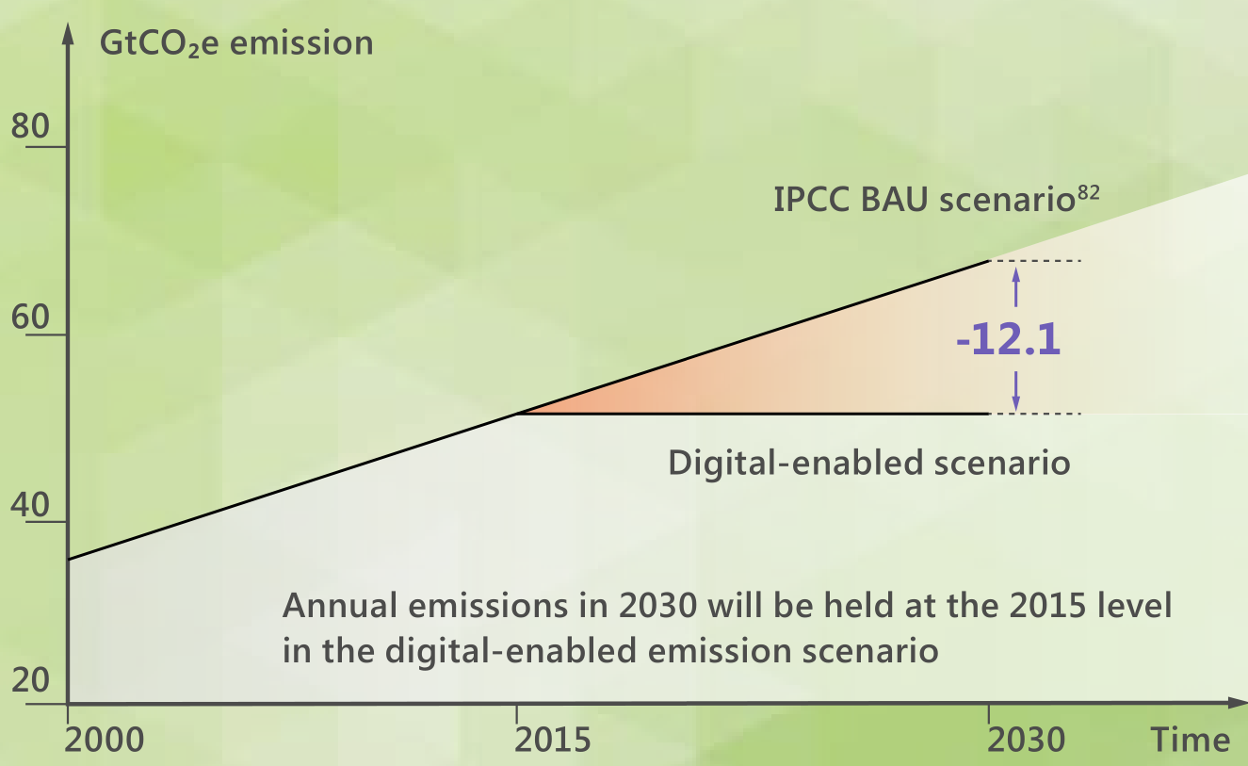
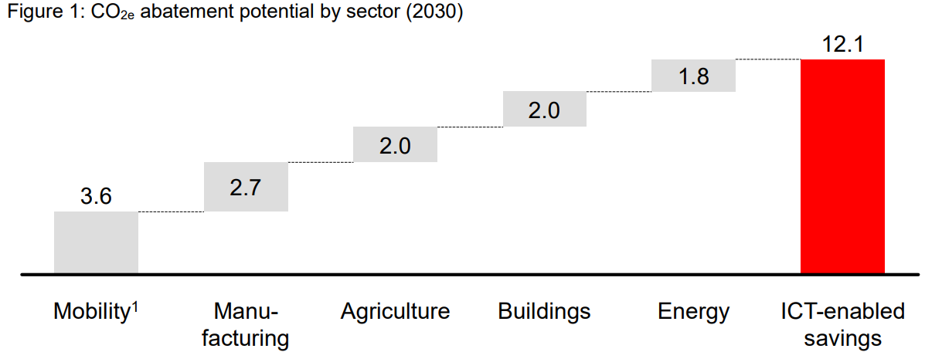
Target 3.4
Net Greenhouse gas abatement
by 2025, net ICT-enabled Greenhouse Gas abatement should have increased by X% compared to the 2015 baseline
PROPOSED TARGET
Source: IPCC

Slide 40
Target 3.5
National Emergency Telecommunications strategy
by 2025, all countries should have a National Emergency Telecommunication Plan as part of their national and local disaster risk reduction strategies
PROPOSED TARGET

Slide 41
Target 4.1
Innovation
by 2025, increase by x % the proportion of countries that have a policy/strategy fostering ICT centric innovation
PROPOSED TARGET
Source: ITU

Slide 42
Target 5.1
Partnership
by 2025, increased ICT-related funding/development programmes, projects and initiatives
PROPOSED TARGET
Source: ITU

Slide 43
Thank You

