Slide 1

Council 2022 information session on the new OneITU website, 24 March, 14:00
March 2022

Slide 2

Why a new website?
Why a new website
  All agree for business continuity, business security, cybersecurity (International Committee of the Red Cross hacked in January 2022).
  Council/Council Working Group mandates, user/member-centric.
  Multilingual, on-the-fly translation technology.
  Uniform access to common information and services across corporate and Sectoral websites, where common ground.
  Green/faster download in countries with slow connectivity; accessible for people with disability/special needs (new ITU policy); mobile-friendly.
  Integration with ITU social media platforms for two-way communication and engagement.

Slide 3

Progress to date
Progress to date
Selected technology platform, hosting vendor identified through ITU procurement.
Developed web templates with green and accessible programming code as well as design based on industry best practices.
Stepped up from prototype to live websites: WTPF, GSS, Partner to Connect, PP-22 and WRC-23, for example, have been developed on the new platform.
Migrated 1000+ of ITU News blogs and magazines and key publications to the new platform.
Developed OneITU web guidelines.
Trained content owners on multilingual and accessibility, Google search and reporting, as well as search engine optimization.

Slide 4
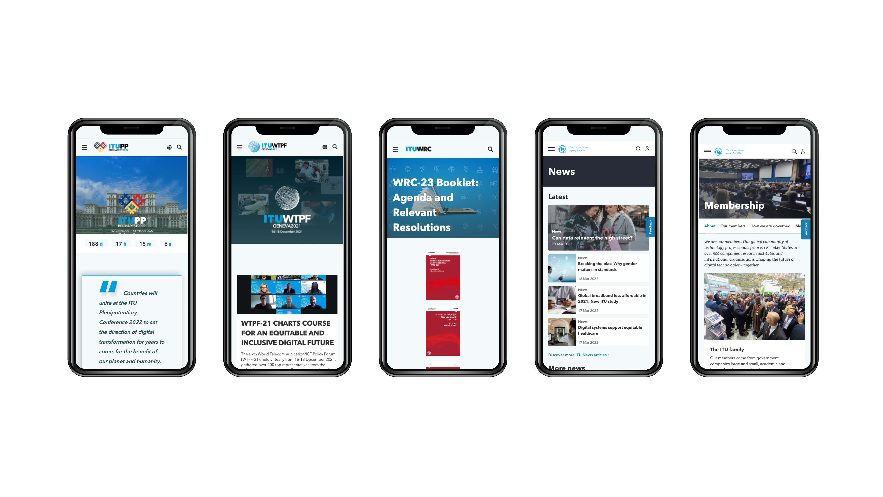


OneITU web pages

Slide 5

Progress to date and next step
Progress and next step
Identified the top tasks ITU members, delegates and staff come to the website for (“Top Tasks”). A big thank you to the close to 200 members that have participated in the survey 3 months ago.
Events are the Top Task #1.
Confusing menus and links and poor search results are by far the most frustrating issues for ITU members. These are symptoms of a badly designed information architecture.
There is no quick fix. Crucially, the top tasks of the ITU Sectors are very similar. Hence, it would be possible to design a common classification, navigation and information architecture for Level 0 and 1 of the website for the entire ITU. Developing the architecture for the Events Top Task would be the proof of concept.

Slide 6
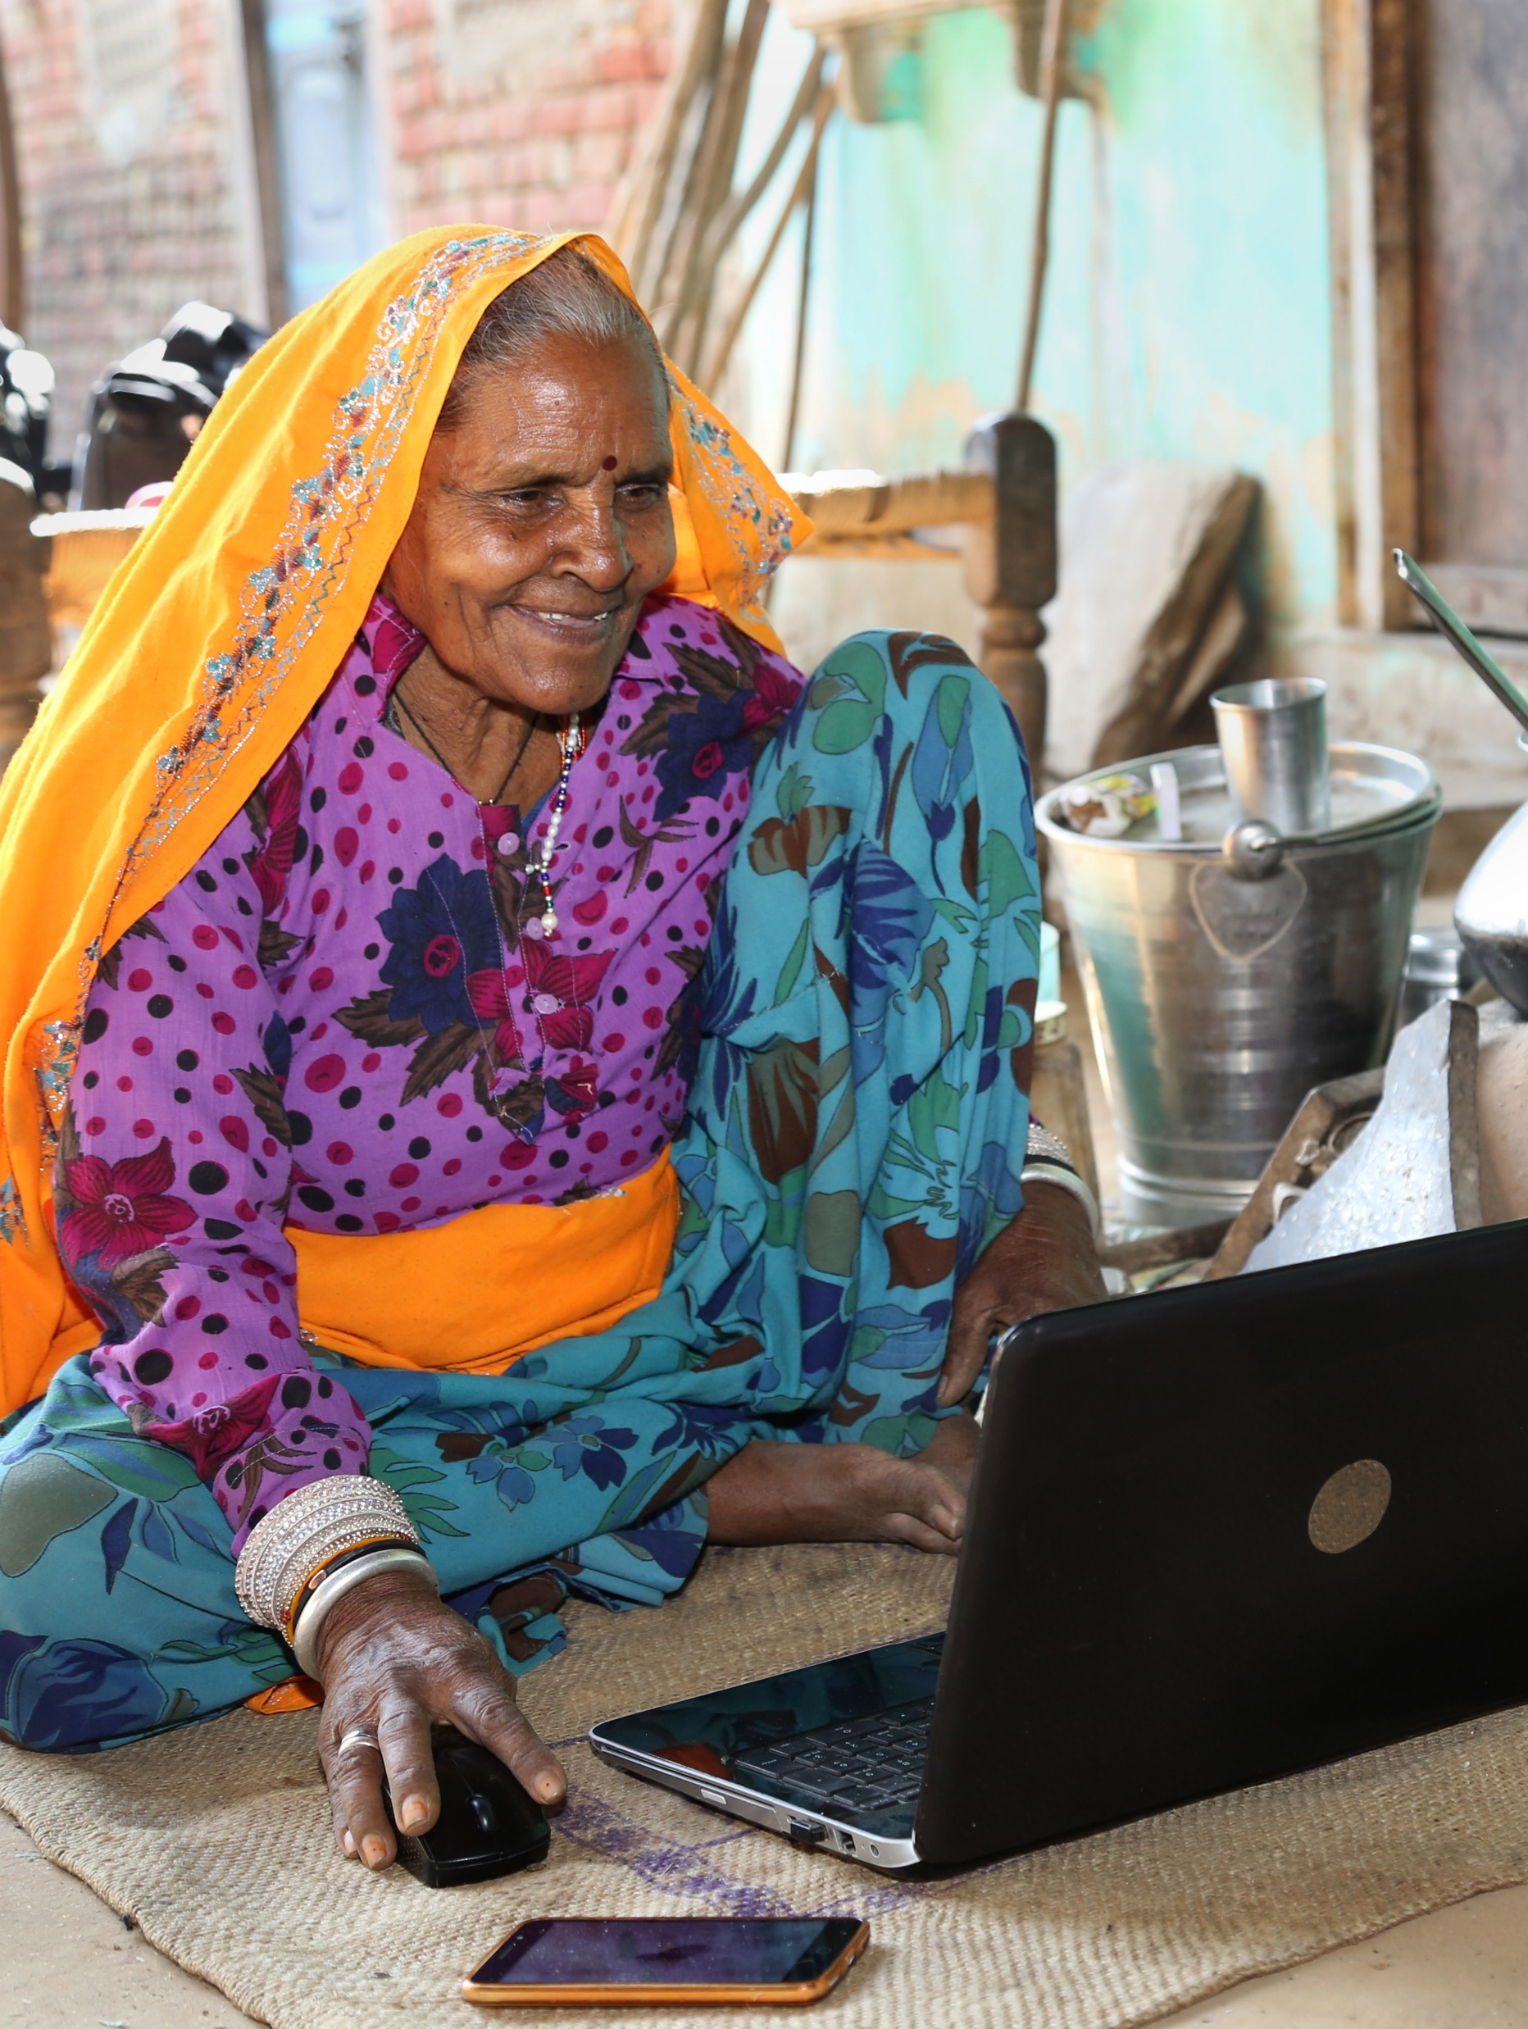
Barrier to faster, comprehensive implementation across the entire website
Barrier
  Council did not approve of the CHF 2 million required and requested by the ITU Secretariat (over 5 years, 2022-25) WHO has invested CHF 5 million + in their new website.
  The ITU Secretariat spent some savings (due to COVID-19) on the progress to date. It also used the communication budget at the expense of other communication activities such as media partnerships.
  The lack of funding slows down, if not prevents, the scaling-up of the technology to corporate and Sectoral web pages.

Slide 7
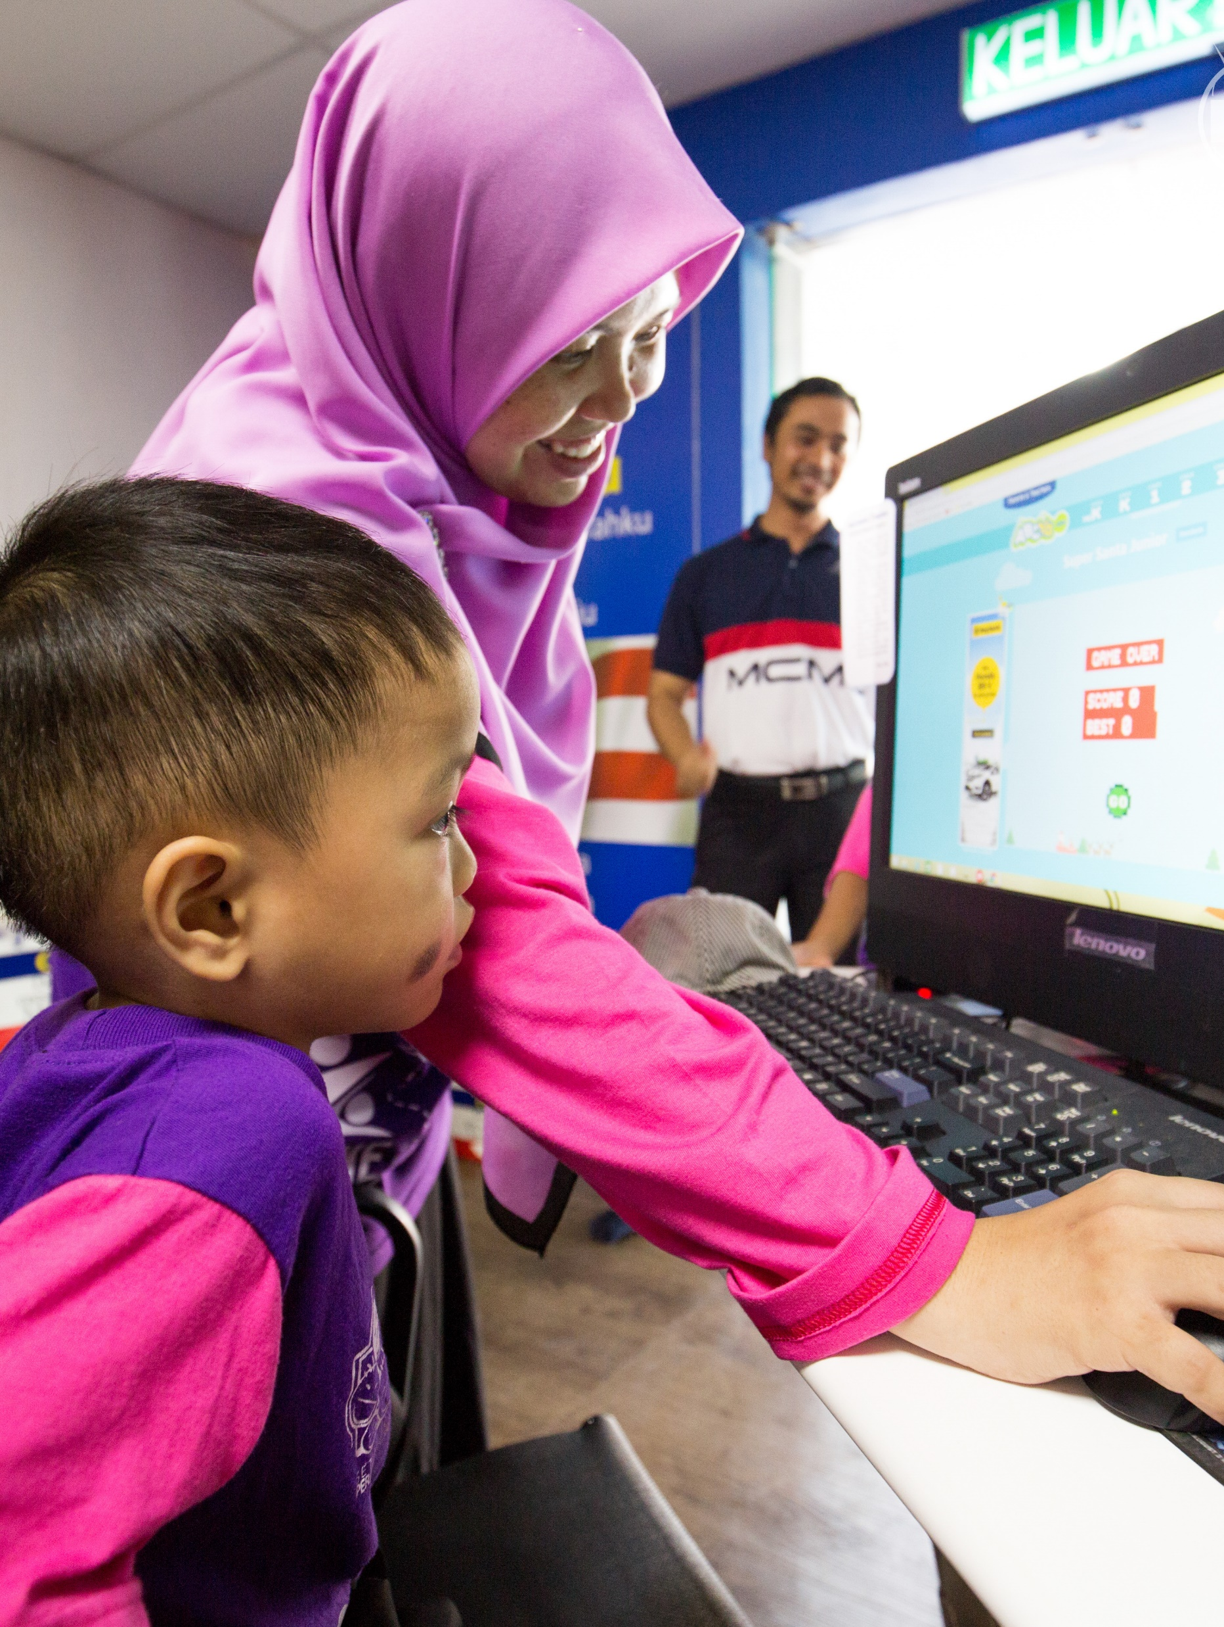
Solution
Solution
As the United Nations specialized agency for ICT, ITU works to bring digital connectivity to everyone.
The ITU Secretariat is calling for voluntary, extra-budgetary donations, up to CHF 2 million total.
The requested budget in the order of CHF 2 million is included under Unfunded Mandatory Activities in the 2024-2027 Strategic and Financial Plan.

Slide 8
Thank you for your attention and support!
Q&A
March 2022

