Slide 1

Council Working Group
on Child Online Protection
Twentieth meeting - From 22 to 23 January 2024
Document CWG-COP-20/INF/15
22 January 2024
English Only
Report by International Centre for Missing & Exploited Children (ICMEC)
FINANCIAL COALITIONS AGAINST CHILD SEXUAL EXPLOITATION (FCACSE)
Purpose
ICMEC Financial Coalitions Against Child Sexual Exploitation bring leaders in the financial industry together to disrupt the economics of the child sexual abuse material (CSAM) business. It is a groundbreaking alliance between private industry and the public sector in the battle against commercial child sexual exploitation, to advocate for, support, and sustain the efforts of financial services companies to better protect children.
Action required
This report is transmitted to the Council Working Group on Child Online Protection for information.
References
https://www.icmec.org/financial-coalitions/
https://www.icmec.org/apfc-asia-pacific-financial-coalition-against-child-sexual-exploitation/
https://icmec.org/fcacse/

Slide 2


Role of Financial Industry
Transaction Typologies / Indicators
Offender Profiles
Forensic Accounting
Data Analytics
Industry Partnerships
LEA Partnerships
Partnerships with NGOs & Academia
Financial Coalitions against Child Sexual Exploitation
A powerful alliance of leading financial organisations, law enforcement and regulators working to address commercial child sexual exploitation
U.S. Coalition established in 2006 by NCMEC & ICMEC | APAC Coalition established in 2009 by ICMEC
ONE Goal: disrupt the economics of the trade
What can the financial industry do to lead
investigations against child exploitation?
What can financial information tell us about online
child sexual exploitation?
How can financial information support online child
sexual exploitation investigations?
ARTIFICIAL INTELLIGENCE AND THE LAW

Slide 3
Role of Financial Industry
How ICMEC works together with FIs against OCSE offenders
Financial Coalition Forums- US & APAC
Over 50 organizations
Focus on increasing awareness of best practice responses, external data sources, research findings and offshore insights.
In Australia, since 2020 identified opportunities to collaborate on data-driven initiatives
Collaboration Working Groups
Smaller subset of the Forum
Country-specific WGs bring together diverse stakeholder group to create greater awareness and political will to address the issue
Regular focus on different ways to collaborate and share insights
Benefits of a collaborative approach
Greater insights into techniques for identifying CSE activity
Real improvements in detection capabilities
Access to external data sets
Strengthening personal and organisational relationships
Building trust and exploring opportunities
ARTIFICIAL INTELLIGENCE AND THE LAW

Slide 4
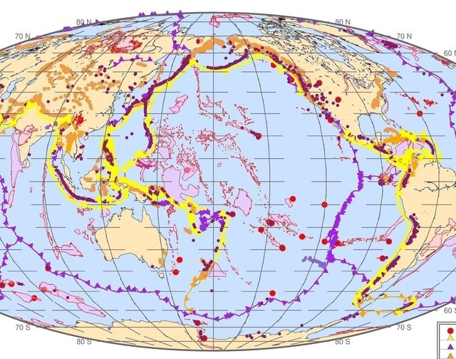
2. Role of Industry - Challenge of increased CSE activity
Even Regulator (FIUs) have seen a surge in CSE activity
The Philippines FIU, AMLC has seen a steady surge in the number of STR submissions related to OSEC as reported in their April 2023 study - 10,627 STRs in 2019 to 92,200 in 2022.
The Australian FIU AUSTRAC, saw a 945% increase in SMRs from its reporting entities of suspected child related offending since the establishment of the Fintel Alliance in 2017 through 2021. And a 13.9% increase in FY 2022-2023.
In New Zealand since 2020, the reporting of OCSE activity by FCPN members has increased by 130% through 2022. And the number of proactive financial intelligence requests to NZ FIU by investigative units increased by 108%.
The US financial industry regulator FinCEN saw a 147% increase in OCSE-related reports between 2017 and 2020
AI / ML
Goal is to improve SMR quality
Greater collaboration needed
Are we making the best use of available data?
Legal challenges:
AML/CTF tipping off provisions
data privacy laws
ARTIFICIAL INTELLIGENCE AND THE LAW

Slide 5

3. Supporting Legislation and Policy
Philippines –
  Anti-Online Sexual Abuse and Exploitation of Children Act;
  Anti-Money Laundering Council Information Sharing Protocol (ISP) with REs and STR Analysis Reports
  Bangko Sentral ng Pilipinas Memorandum on ‘Guidance Paper on Managing Money Laundering Risks Related to Online Sexual Exploitation of Children’
ARTIFICIAL INTELLIGENCE AND THE LAW

Slide 6
Simone Bevans
Jewel Dela Cruz
Thank You
sbevans@icmec.org
jdelacruz@icmec.org
www.icmec.org
icmec_official

