Slide 1
Director’s report
TSAG, 26 February – 2 March 2018
~ Chaesub Lee, TSB Director

Slide 2
TSB Director’s report
ITU-T membership
ITU-T achieved a net increase of 14 new memberships in 2017, including 9 new Sector Members and 21 new Associates.
260
142
134
SECTOR MEMBERS
ASSOCIATES
ACADEMIA
New ITU-T memberships taken up by the automotive and insurance industries, as well as emerging market segments in IoT and M2M

Slide 3
TSB Director’s report
Video coding
ITU-T receives another Primetime Emmy Award
HEVC (ITU H.265 | ISO/IEC 23008-2) honoured by Primetime Emmy Award in October 2017
Follows 2008 Primetime Emmy Award for HEVC’s predecessor, ITU-T H.264 | MPEG-4 AVC
The 5th edition of HEVC was completed in October 2017
Future video coding
A new collaboration has been formalized after an exploratory phase: the “Joint Video Experts Group” aims to deliver a new standard by 2020 with significant performance gains over HEVC

Slide 4
TSB Director’s report
Broadband
G.fast to go faster
G.fast is capable of up to 2 Gbit/s over copper and coax
BBF G.fast certification building industry confidence
MGfast is a project aiming to achieve 5-10 Gbit/s by 2020
FTTH connections
ITU-T L.404 fibre connector enables field technicians to install FTTH connections fast and with great flexibility
Rural broadband
ITU-T L.1700 and L.110 aim to bring broadband to rural communities
Lightweight optical fibre with a focus on ease of deployment, cost-efficiency and reliability

Slide 5
TSB Director’s report
IMT-2020/5G: SGs 5, 11, 12, 13, 15 and 17
Networking aspects of 5G
SG13: New standards address terminology, network management & orchestration, network sofwarization, fixed-mobile convergence
5G optical transport
SG15: New Technical Report on transport network support of IMT-2020/5G
5G environmental requirements
SG5: Priority assigned to studies of 5G resistibility, EMC, EMF, power feeding and energy efficiency

Slide 6
TSB Director’s report
IoT and smart cities
SG20 is building collaboration with oneM2M
14 ITU-T standards based on oneM2M specs have achieved consent; one determined; one approved
ITU, ISO and IEC organize the annual World Smart City Forum
Also collaborating on Smart City Terminology
New ITU-T case study on Singapore’s ‘Smart Nation’ strategy
ITU-T case studies evaluate Dubai and Singapore’s progress in meeting smart city objectives
Evaluated using ITU-UNECE Key Performance Indicators for Smart Sustainable Cities

Slide 7
TSB Director’s report
Intelligent transport
SG17 has established new Q13/17 on security aspects of Intelligent Transport Systems
New ITU-T standard provides for secure over-the-air software updates to connected cars
Strong collaboration with UNECE WP.29
New global regulation on vehicle emergency calls, ‘Automatic Emergency Call Systems’, references ITU voice-quality performance standard (ITU-T P.1140)
‘UN Task Force on Over-the-Air Issues’ is developing 18 security threat mitigations, reporting to UNECE WP.29
8 March 2018: ITU-UNECE Symposium on the Future Networked Car, followed by Collaboration on ITS Communication Standards (9 March)

Slide 8
TSB Director’s report
Security and trust
New Questions established in SG17
Q13/17: Security aspects of Intelligent Transport Systems
Q14/17: Security aspects of Distributed Ledger Technologies
New ITU-T standards:
Trust-centric network domains
Code of practice for protection of PII
Protection of telebiometrics data and e-commerce data
Security for MVNOs
IoT encryption procedure
Countering IM spam
Countering SMS phishing and smishing

Slide 9
TSB Director’s report
Performance, QoS and QoE
WTSA-16 Resolution 95: ITU-T initiatives to raise awareness on best practices and policies related to service quality
Strong momentum in SG12 standards work to address Res 95
New questionnaire on service quality regulatory frameworks
New ITU-T standards
Conversational speech quality analysis
Gaming QoE
New QoS/QoE studies
Effect of SIM-boxing on QoS/QoE
QoS/QoE of Digital Financial Services
ITU-T Software Tool Library (ITU-T G.191) now on GitHub, enabling the wider community to use, improve and contribute to the code

Slide 10
TSB Director’s report
e-Health
Eight new ITU-T standards have resulted from latest edition of Continua Design Guidelines (CDG) contributed to ITU by PCHA
CDG adopted by countries including Norway, Denmark and Sweden following adoption of CDG as ITU-T standards (ITU-T H.810 series)
New ITU-T standard
Communication platform for multimedia brain information
New ITU-T Technical Paper
Specification for trial implementation of new observation upload technology ‘FHIR’ being prototyped by HL7

Slide 11
TSB Director’s report
VoLTE/ViLTE
ITU-T work on VoLTE/ViLTE includes the deployment of signalling protocols for VoLTE interconnection, relevant numbering issues, QoSconsiderations, and emergency calls on VoLTE-based networks.
New ITU-T standards
Framework of interconnection of VoLTE/ViLTE-based networks
VoLTE/ViLTE interconnection testing for interworking and roaming scenarios

Slide 12
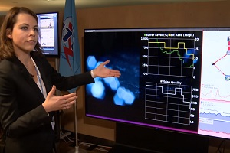
TSB Director’s report
ITU-T Focus Groups
Machine learning for future networks including 5G
Next meeting: Xi’an, China, 24-27 April 2018
Data processing and management for IoT and smart cities
Next meeting: Cairo, Egypt, 1-3 May 2018 (TBC)
Digital currency including digital fiat currency
Next meeting in July 2018, venue TBC
Application of distributed ledger technology
Next meeting TBC

Slide 13
TSB Director’s report
Conformity and interoperability
ITU-T Conformity Assessment Steering Committee continues to collaborate with existing Conformity Assessment Systems and Schemes such as IEC and ILAC
New “ITU Requirements” Task Force set up by IECEE Certification Management Committee
ITU ‘ICT product conformity database’ contains more than 500 entries covering e-health devices, mobile phones, Ethernet services and accessible IPTV products

Slide 14
TSB Director’s report
Academia
Kaleidoscope 2017: Challenges for a data-driven society
Nanjing University of Posts and Telecommunications, Nanjing, China, 27-29 November 2017
First prize to e-health research from Yonsei University, Korea
Kaleidoscope 2018: Machine learning for a 5G future
Universidad Tecnológica Nacional, Santa Fé de la Vera Cruz, Argentina, 26-28 November 2018
New ITU Journal: ICT Discoveries
First special issue: “The impact of Artificial Intelligence on communication networks and services”
Second special issue will focus on “Data for Good”

Slide 15
TSB Director’s report
Collaboration
United for Smart Sustainable Cities Initiative
Advocates for ICT standards to play a definitive role in smart cities
Supported by 17 UN bodies
Financial Inclusion Global Initiative
Led by ITU, World Bank and CPMI, supported by Bill & Melinda Gates Foundation
3 working groups; 3 country case studies; 3 annual symposia (first FIGI symposium in Bangalore, India, 29 Nov - 1 Dec 2017)
AI for Good Global Summit
Identifies practical applications of AI with the potential to accelerate progress towards the SDGs
2nd AI for Good Global Summit: ITU Headquarters, 15-17 May 2017

Slide 16
TSB Director’s report
CTO consultation meetings
CTO consultation meetings bring together industry executives to highlight their business priorities and supporting standardization strategies
9th CTO meeting in Busan, Korea, 24 September 2017, at ITU Telecom World 2017
Highlighted importance of standardization in supporting evolution of ICT networks and contribution of Artificial Intelligence to ICT networking
CxO meeting in Dubai, UAE, 7 December 2017, at Telecom Review Summit
Discussed security and privacy by design, open APIs, network virtualization, identity and authorization, analytics and accessibility
5G systems and Artificial Intelligence highlighted as key to a smarter society

Slide 17
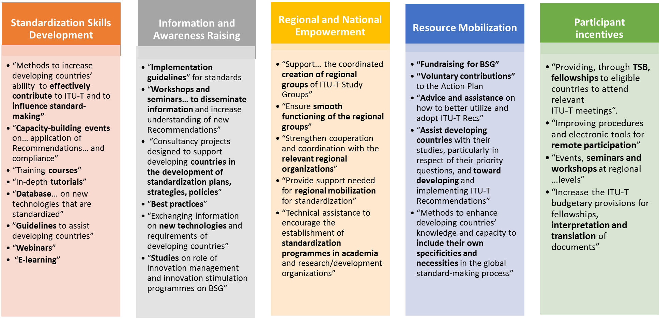
TSB Director’s report
5 strategic pillars of BSG (WTSA Res 44)

Slide 18
TSB Director’s report
BSG ‘hands-on’ training
New ITU-T training programme (Res 44) for delegates from developing countries
TSB has held 24 BSG hands-on training sessions: 431 delegates trained, representing 73 countries and 89 organizations

Slide 19
TSB Director’s report
Regional Groups
Regional Groups within ITU-T Study Groups have proven effective mechanisms to assist in bridging the standardization gap.
ITU-T now has 23 Regional Groups:
x8 Africa (Study Groups 2, 3, 5, 12, 11, 13, 17 and 20)
x4 Americas (Study Groups 2, 3, 5 and 20)
x5 Arab States (Study Groups 2, 3, 5, 17 and 20)
x2 Asia and the Pacific (Study Groups 3 and 5)
x1 Europe and the Mediterranean Basin (Study Group 3)
x1 Eastern Europe, Central Asia and Transcaucasia (Study Group 20)
x2 Regional Commonwealth in the field of Communications / Commonwealth of Independent States (RCC/CIS in Study Group 3 and RCC in Study Group 11)

Slide 20
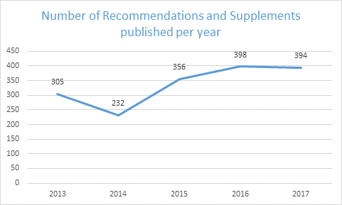
TSB Director’s report
Publications
Over 10,800 pages of ITU-T Recommendations and Supplements were published between May 2017 and January 2018
Over 270 new and revised ITU-T Recommendations approved
The ITU database of "ITU-T Recommendations and selected Handbooks" continues to be distributed on a quarterly basis as a USB key
TSB continues to translate all Recommendations approved under TAP, as well as all TSAG reports in all 6 official languages of the Union. TSB translated 60 AAP Recommendations in the reporting period.

Slide 21
TSB Director’s report
ITU-T web areas
MyWorkspace is a personalized webpage for TIES users that provides easy access to the information and services most valued by ITU-T delegates, including:
Meeting documents
Mailing list subscriptions
Calendar of current and future events
Advanced search features (including TIES-protected content, and keyword-based resources)
Personalized profile and links
Provide feedback to tsbitdev@itu.int
New search engine continues to be enriched enriched with the full collections of ITU documents, publications and web pages.
http://tsbtech.itu.int/ is a new service announcements platform that updates the ITU-T community on the latest tools and service enhancements

Slide 22
TSB Director’s report
Remote participation

Slide 23
TSB Director’s report
Implementation of WTSA-16 Resolutions
WTSA Resolution 22 instructs the TSB Director to provide each TSAG meeting with a report on the implementation of WTSA resolutions and actions to be undertaken pursuant to their operative paragraphs
The WTSA-16 Action Plan (TSAG TD 025) assigns action items to the operational provisions of the Resolutions and reports on progress of these action items

Slide 24
TSB Director’s report
Implementation of ITU-T A-series Recommendations
WTSA-16 Resolution 22 instructs the TSB Director to report to TSAG on the experience in the implementation of the A-series Recommendations
Regarding the liaison template in ITU-T A.1, TSB has noted that the "For Comment" field of liaison statements should be discontinued, as was agreed by TSAG 2016. However, this issue was not brought to WTSA-16, hence the need to correct ITU-T A.1 accordingly
The conclusion of two Focus Groups (DFS and IMT-2020) was accompanied by positive experiences with the implementation of ITU-T A.7, in particular with the streamlined transfer of deliverables from FGs to parent SGs, evidencing the value of ITU-T A.7 Appendix I

Slide 25
www.itu.int

