Slide 1
TSB digital transformation Streamlining standardization
Operations and Planning Department (OPD)
January 2024

Slide 2
Tailor-made digital transformation
In addition to ITU's overall digital transformation, standardization working methods have been continuously transformed by solutions developed using ITU development resources enabling :
Adaptation to WTSA Resolutions & ITU-T Recommendations
Improved data quality & completeness
Integration of day-to-day ITU office tools
Scalability & flexibility
Cost effective & Efficient resource allocation

Slide 3
Standardization process overview
1. Work Item Proposal by Member
2. Rapporteur Group and Study Group Activities
3. Standards Approval Process
4. Editing and Publication of Standards
5. Evaluation of Standards Contribution
AAP: at least 28 days
TAP: at least 3 months
WTSA: instantaneous
At most
9 months
9 months – 2 years
1 – 2 months
Work item is proposed by one or more members in the form of a Contribution and submitted to the relevant Question within a Study Group (SG).
Study Group (SG) experts decide whether or not to initiate work item, either as submitted or with modifications.
Work items are developed over time in meetings and correspondence activities.
Once the text is mature, Study Group experts initiate the Approval process.
Four types of approval process are used depending on nature of the work item:
Traditional Approval Process (TAP).
​Alternative Approval Process (AAP).
Agreement for non-normative work items​.
WTSA if considered necessary by the study group.
Prior to publication, Approved Recommendations are reviewed by TSB for logical consistency, clarity, page style and graphics.
TSB may seek clarification from the experts via communication with the Editor.
Contribution of ITU-T Recommendation for organizations and UN SDGs is evaluated.

Slide 4
Digital transformation in standardization
1. Work Item Proposal by Member
2. Rapporteur Group and Study Group Activities
3. Standards Approval Process
4. Editing and Publication of Standards
5. Evaluation of Standards Contribution
Direct Document Posting (DDP)
Online submission mechanism for contributions.
Events Dashboard Streamlining activities for meeting preparations.
Alternative Approval Process System
Online approval process of standards.
Editing Workflow Streamlining editing and publication of standards.
ITU-T Recommendation
Maintain and access all in force and superseded Recommendations, with associated materials.
SharePoint Websites
Web-based document collaboration platform.
ITU-T Work Programme Managing and accessing all work Items and their status.
IPR & Terminology Database
Registering and accessing all IPR and ITU-T Terms.
ICT Standards
Online management and search features on shared activities with other SDOs.
MyMeetings Customized ITU-T remote collaboration tool.
ITU Translate
Rapid and reduced cost machine translation of documents in 6 languages.
SDG Mapping
Machine based evaluation of standards contribution to SDGs.
MyDocuments
Quick access to ITU-T meeting documents with full text search.
ITU-T Liaison Statement Liaison Statements management and follow up.
MyWorkspace
One stop-shop for ITU-T applications.
ITUSearch
Search on all ITU resources.
PowerBI
Automatic generation of activities KPI, analytics and reports.
https://www.itu.int/en/ITU-T/ewm

Slide 5
ITU-T Work Programme process management
ITU-T Work programme in figures ^{(*)}
12 Study Groups (including TSAG), 41 Working Parties, 25 Regional Groups, 133 Questions, 7 Focus Groups
331 Chairs & Vice-chairs, 274 Rapporteurs, 2’124 Editors
1’087 work items under study associated with 1’372 meeting documents
22 TSB Study Group department counsellors, advisors & assistants
3 Web applications: Work Programme, AAP and Liaison Statements
Year on year trends ^{(**)}
 | 2021-10 to 2022-09 | 2022-10 to 2023-09 | Trend
Database updates | 13’503 | 14’684 | + 10%
Rapporteur group Meetings | 366 | 550 | + 50 %
RGM MyMeetings Sessions | 498 | 634 | + 27 %
Liaison Statements | 749 | 904 | + 20 %
Submitted A.5 justification | 179 | 226 | + 26 %
Submitted Contributions | 2’196 | 2’270 | + 3 %
Published TDs | 5’926 | 6’256 | + 5 %
Active mailing lists (IWM) | 369 | 403 | + 9 %
Active subscriptions (IWM) | 50’373 | 60’030 | + 19 %
^{(*)} Source TSB database, extracted on 13 October 2023
^{(**)} Source I W M, DMS & TSB databases

Slide 6
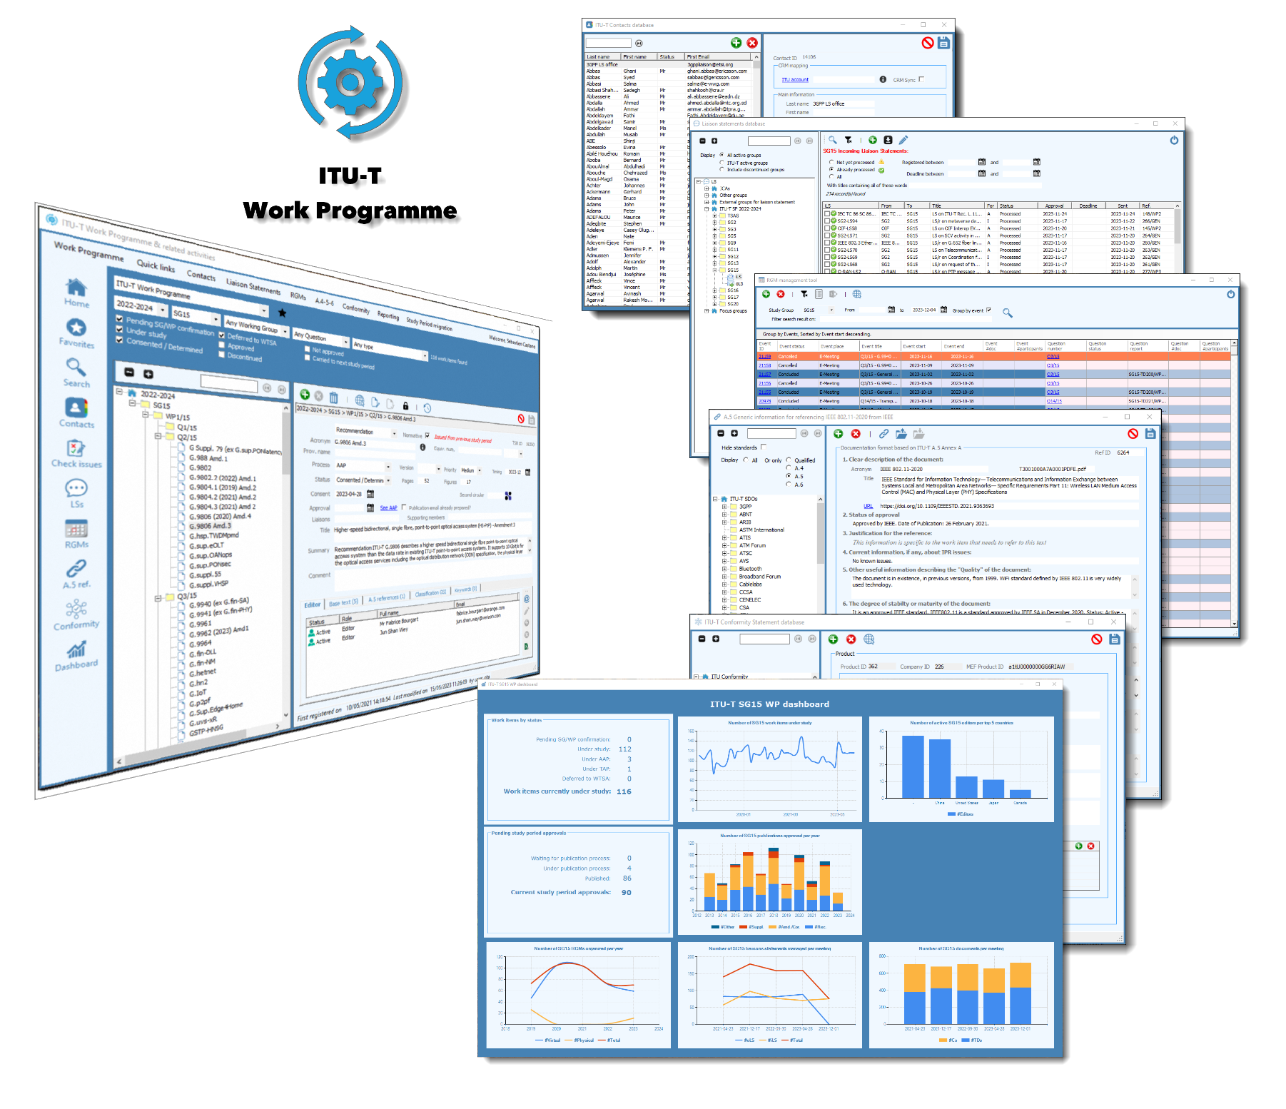
ITU-T Work Programme
Version 4 (current version)
First delivered in 2006, the software is regularly updated & enhanced with new features, enabling TSB SG Department to manage & monitor ITU-T standardization data & processes, including the following interdependent data:
ITU-T study periods, working groups, work programme & contacts
ITU-T A.4/A.5/A.6 SDOs & references
ITU-T Rapporteurs Group Meetings
ITU-T Liaison Statements
Conformity statements
Pre-Editing and Editing requests
With underlying reporting and administration features, strengthening secretariat capacity over the years and improving data quality in the meantime.
And a real-time availability on the public facing ITU-T Website.

Slide 7
ITU-T Publications process management
ITU-T Publications in figures ^{(*)}
5’288 Recommendations, 412 Supplements, 81 Implementer’s guides, 137 Technical papers & reports and 51 handbooks
53 days is the average time between initial request for publication and final Web publication
Editing managed by 2/3 staff in TSB OPD Editing unit, with occasional support of consultants
4 Web applications: ITU-T Recommendations, Terms & definitions, Patent declarations and Test Signals.
Year on year trends ^{(*)}
 | 2021-10 to 2022-09 | 2022-10 to 2023-09 | Trend
#Publications posted online | 293 | 314 | + 7 %
#Pages to be edited | 13’600 | 16’090 | + 18 %
#Drawings to be processed | 4’986 | 5’728 | + 14 %
#Extracted terms & definitions | 5’108 | 5’486 | + 7 %
^{(*)} Source TSB database, extracted on 13 October 2023

Slide 8
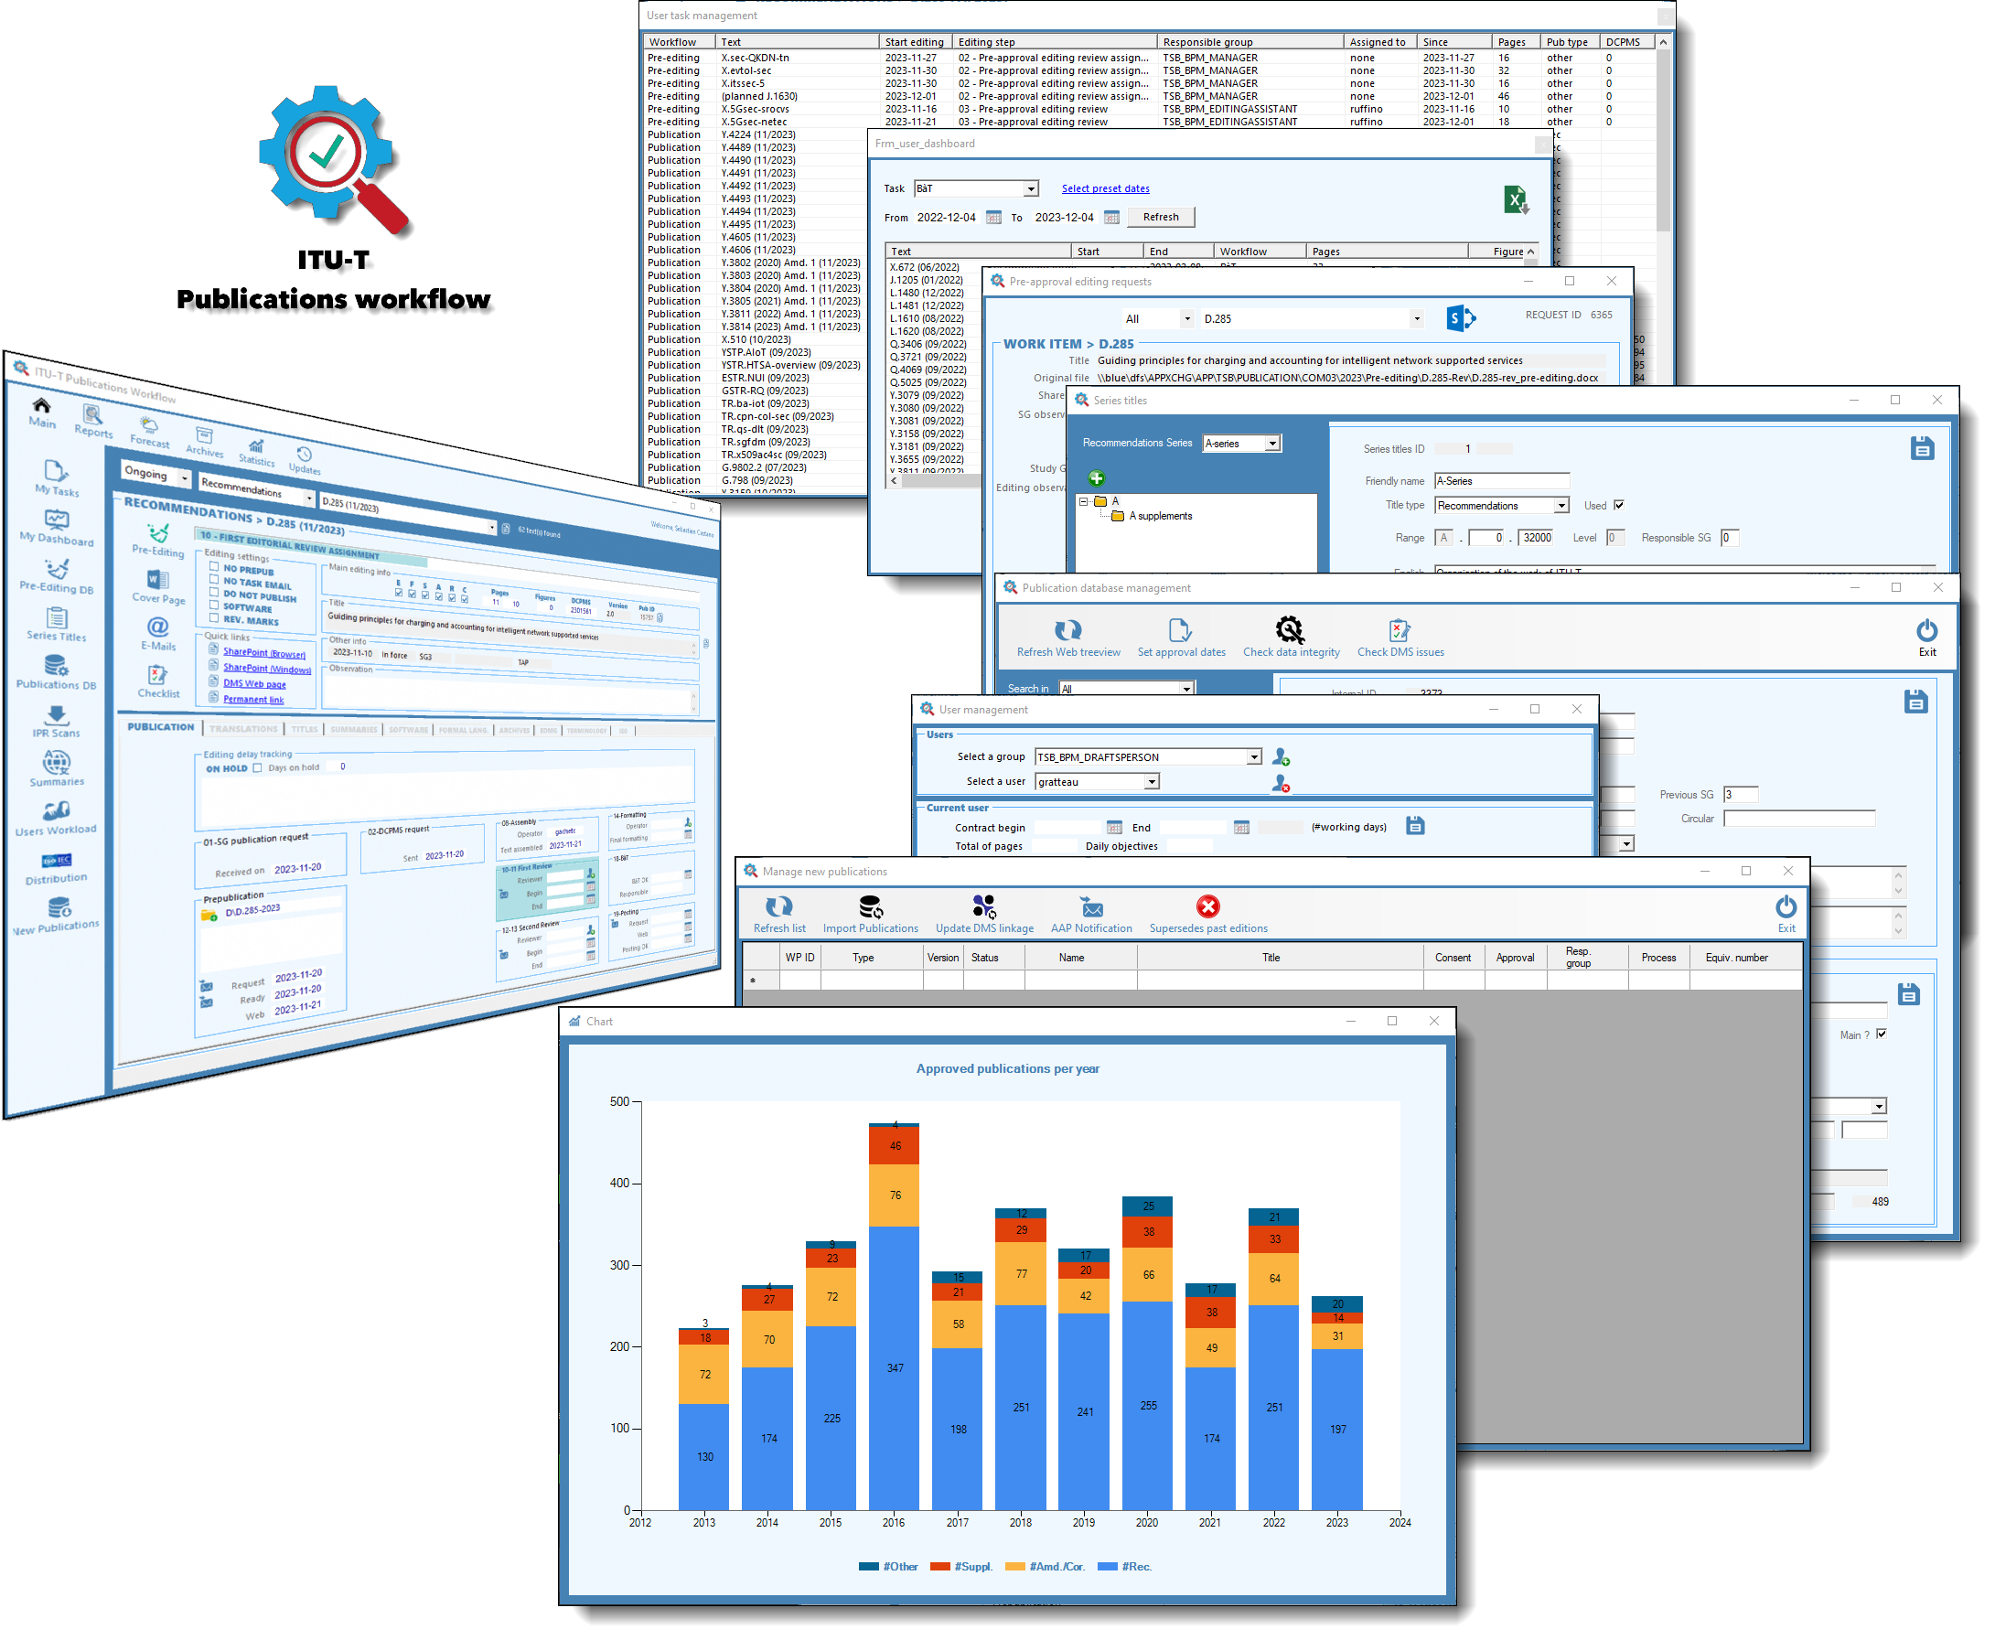
ITU-T Publications
Version 10 (current version)
First delivered in 2002, the software enables the TSB Editing unit and involved ITU services to manage and process ITU-T Publications with:
Pre-approval editing of draft texts
Editing, posting & archiving of final texts
Extraction & publication of terms & definitions
Publication of formal languages parts
Translation of AAP texts summaries & titles
Scanning & publication of IPR documentations
Publication of joint texts with ISO/IEC
Related e-mails referencing & archiving
Workload forecasting
Users task management & assignment
Publication cover page generation
Reporting & data quality control
Contributed to the steady decrease of the publication delays from almost one year in 2009 to less than 2 months today with a reduced workforce and an increased quality.

Slide 9
MyWorkspace background
As stimulated by WTSA Resolution 32, TSB is investigating continuously on electronic working methods improvement.
Since online services could be difficult for members to find, TSB began centralizing them in one place in 2016, increasing at the same time:
Accessibility
Remote collaboration
Networking
ITU Events visibility
First version was ready to use in April 2017.

Slide 10
MyWorkspace major release dates
MOBILE FIRST DESIGN
ENHANCE NETWORK FEATURES
IMPROVED USER EXPERIENCE
NEW APP MYDOCUMENTS
2017
2019
2018
2022
ACCESS TO MEETING DOCUMENTS
EVENTS & EXPERTS' PROFILES
NATIVE MOBILE APPS DESIGN
MATCHMAKING FOR EVENTS

Slide 11
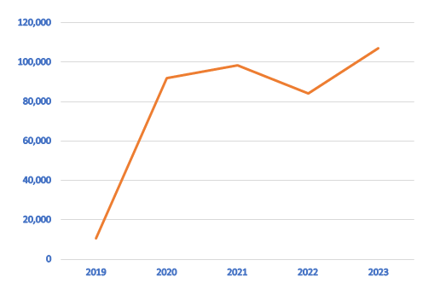
MyWorkspace key figures & facts ^{(*)}
6 years of experience
~110’000
connexions to e-Meetings
in 2023
~800 clicks
per month
~1’000 users' profiles
customized on MyWorkspace
1
single & simple URL
itu.int/myworkspace
~6’200 users
logged on at least one time
in 2023
^{(*)} Source: ITU SQL databases & Google analytics, extracted on 12 December 2023

Slide 12
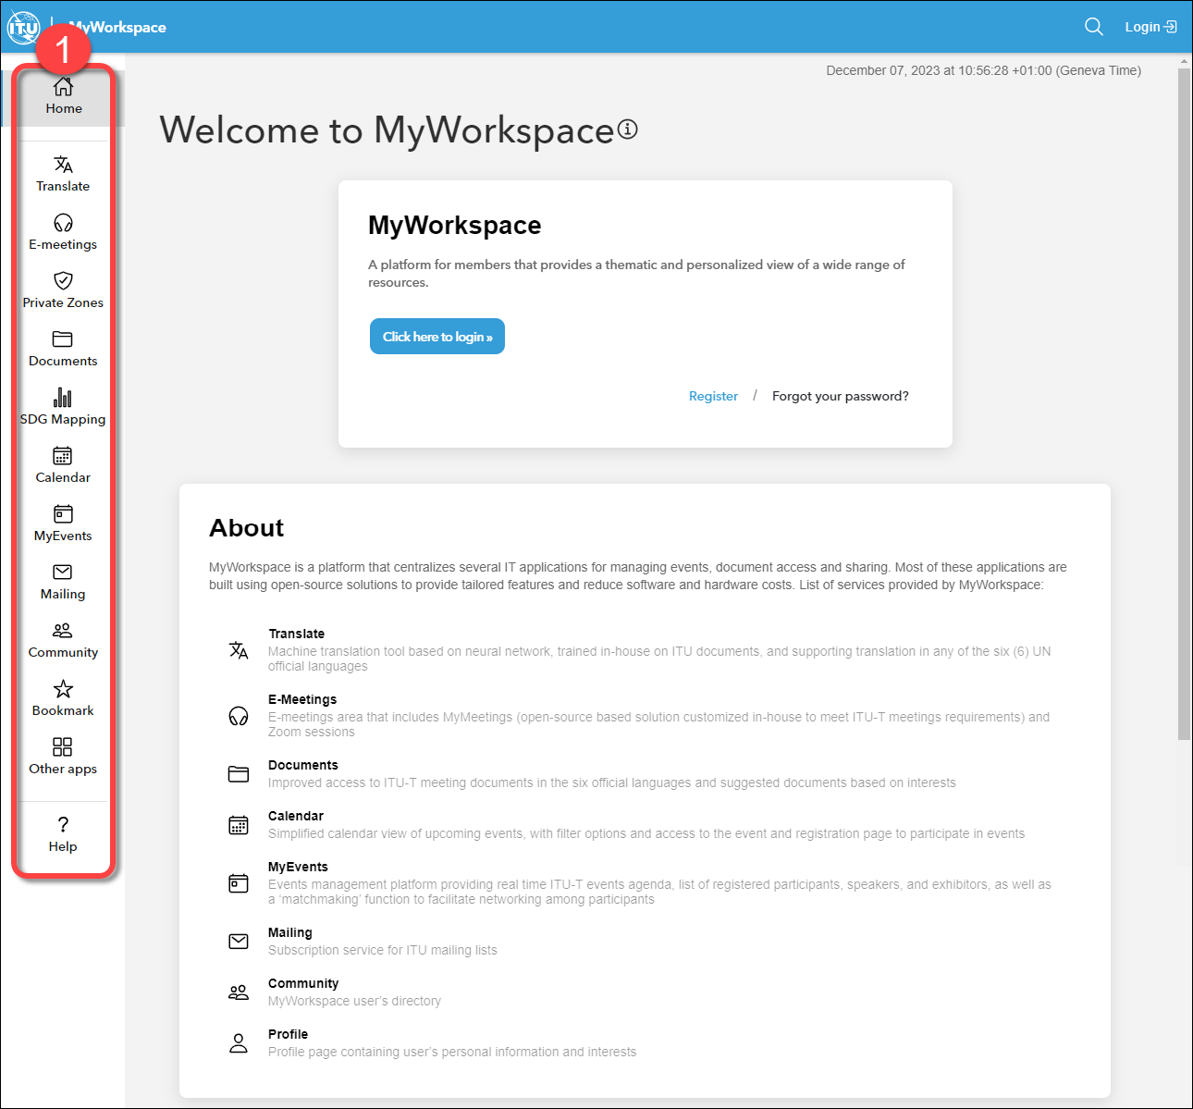
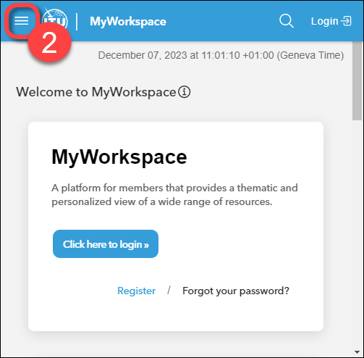
MyWorkspace layout & design
Aligned with ITU branding
Mobile-friendly
Accessible
Cross-browser compatible
Applications available from side menu (1) on desktop or reduced menu (2) on mobile devices

Slide 13
MyWorkspace - Networking
Profile & preferences: https://www.itu.int/myworkspace/#/profile
Set your own picture
Manage biography, accomplishment
Share links of your favourite social networks
Manage your centre of interests
Get a list of ITU events you've attended
ITU-T Community: https://www.itu.int/myworkspace/#/Community
See the whole community of ITU-T users
Search users on keywords

Slide 14
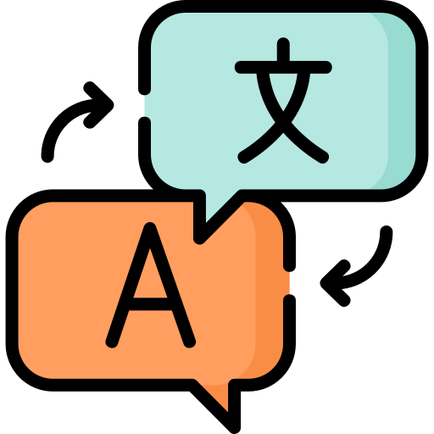
MyWorkspace – Meeting documents
Documents: https://www.itu.int/myworkspace/#/Documents
Access by meeting
Filter and save results search
Full text search
Automatic translation
Export result in MS Word & Excel
Translate: https://www.itu.int/myworkspace/#/Translate
Automatic document translation
From English to the 5 other ITU official languages
From the 5 ITU official languages to English
Support docx files up to 5 MB

Slide 15
MyWorkspace – Experts mailing lists
Mailing: https://www.itu.int/myworkspace/#/Mailing
Automatic subscriptions based on user roles
~ 400 mailing lists available
Manage your mailing lists subscriptions
Direct validation of subscription requests according to your rights
Search mailing list by keywords

Slide 16
MyWorkspace - Events
Calendar: https://www.itu.int/myworkspace/#/Calendar
Filter by Sector
Search by keywords
Calendar view
Save you search
E-Meetings: https://www.itu.int/myworkspace/#/E-meetings
Access to all E-Meetings (Zoom & MyMeetings)
Filtering & admin features
One click button to join the session
Add it to your calendar (iCalendar)
Access to past archives
Online certificate

Slide 17
MyWorkspace 2024: Enrich the toolbox
Continue centralizing & modernizing even more services in MyWorkspace:
Self-service for mailing lists subscriptions
Direct Document Posting
ITU-T Work Programme
ITU-T Recommendations
Liaisons Statements

Slide 18
Conclusion
Thanks to ongoing efforts to streamline processes, TSB digital transformation evolved over the past 20 years in harmony with ITU-T working methods & technologies, allowing a growing data workload management with a reduced workforce, and improved data quality.
With its wealth of experience and data collected over the years, TSB can confidently prepare for the ITU's next technological evolution, integrating AI and supporting cloud migration.

