Slide 1

ITU and Smart Grid
7 September 2011
Reinhard Scholl
ITU, Telecommunication Standardization Bureau

Slide 2
Outline
Market and expectations
Standards
ITU and Smart Grid

Slide 3
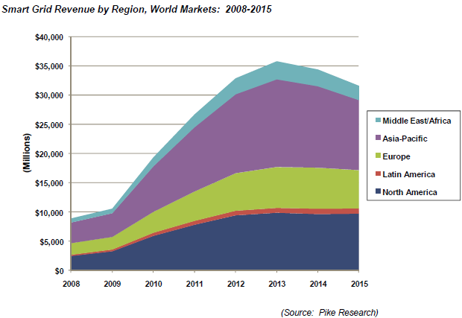
Scope
Smart Grid investment to total $200 billion worldwide by 2015
At 100% Smart Grid deployment in U.S.: 12% reduction in annual electrical energy production and resulting CO2 emissions by 2030
Sources: Pike Research, Pacific Northwest National Laboratory / U.S. Department of Energy
Notes:
Over the last 2 to 3 years we have seen that governments and industry leaders worldwide are coming together with a newfound urgency to drive an overhaul of the old grid infrastructure.
According to a report from Pike Research, these efforts will yield cumulative global spending of $200 billion on Smart Grid technologies during the period from 2008 to 2015.
The report forecasts that grid automation initiatives will capture 84% of global Smart Grid investment through 2015, compared to just 14% for advanced metering infrastructure (AMI) and 2% for electric vehicle management systems.
Another report, commissioned by the US Department of Energy, estimates that by making the grid smart, and reaching 100 % penetration of smart grid technologies, the annual electric energy use and utility sector carbon emissions in the US could be reduced by at least 12 % by 2030.
As you can see in the chart, major parts of the spending is expected to happen in Europe, North America and Asia, where huge Smart Grid initiatives have been started in China, Japan and Korea.

Slide 4
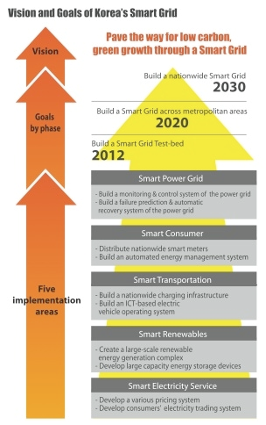
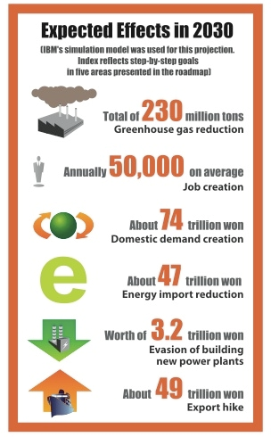
Smart Grid in Korea
Source: Korea Smart Grid Institute (KSGI)
Notes:
At a recent meeting between the Director of the ITU Telecommunication Standardization Bureau, Malcolm Johnson, and private sector executives and CTOs, with participation of many companies present in today’s event, a paper on Smart Grids was presented by Korea Telecom, which proposed Smart Grid standardization as an urgent priority for ITU-T.
On this slide, you can see visions and goals of Korea’s Smart Grid, and the expected outcome. This includes environmental effects, economic benefits, and a huge impact on Korea’s job market.
A $65 million Smart Grid test-bed, integrating 6000 households, wind farms and distribution lines, will be built on the country’s largest island Jeju.

Slide 5
Smart Grid for sub-Saharan Africa
In 2009: 70% of Sub-saharan Africa population had no access to electricity
Green field approach: leapfrog traditional power systems
  In short term: leapfrogging to occur for components based on ICT
Details are at: http://ourworld.unu.edu/en/smart-and-just-grids-options-for-sub-saharan-africa/
Notes:
Smart Grid is not only for developed countries. Developing countries could also receive benefits from Smart Grid. I would like to show an activity in sub-Saharan Africa area.
In 2009, an estimated 585 million people had no access to electricity in sub-Saharan Africa, according to the World Energy Outlook 2010 by the International Energy Agency. Unlike many other regions of the world, under current assumptions, that figure is expected to rise significantly by 2030 to about 652 million — an unsustainable and unacceptable situation.
To solve or at least alleviate this situation, there is an effort to provide electricity to as many people as possible in sub-Saharan Africa.
If there is no electricity, a green field approach is possible. They can start with the latest technology without deploying conventional ones.
Energy efficiency nature of Smart Grid might help providing more people with electricity in more reliable manner.
More information is available at the link at the bottom of this slide.

Slide 6
Smart Grid benefit: cut peak load
… through AMI (Advanced Metering Infrastructure) – two way communication
Demand/response: cut energy use during times of peak demand
Dynamic pricing: encourages to reduce power consumption voluntarily during peak period
Notes:
I would like to indicate some benefits of Smart Grid. One of the most important one is that it enables to cut the peak load.
AMI, Advanced Metering Infrastructure enables utility companies to collect detailed information on customers electricity usage. In addition, it allows utilities to send information to customers. With this capability, utility could instruct customers to consume less electricity during peak demand. It also allows dynamic pricing. Utility could notify the customers of the price of each moment. This encourages customer to reduce power consumption voluntarily during peak period. These capabilities help cutting peak load. Since power grids need to be designed based on the peak load, cutting the peak load help avoiding too large grids.
Italy is the # 1 in the world with respect to smart meters. 30 million households, or the equivalent of 85% of Italian homes, have smart meters installed. The Italian utility Enel reports annual cost savings of USD 750 million from their investments in the smart meter technologies, which were characterized by a payback period of technology, allowing it to recoup the infrastructure investment in just four years (according to report of Imperial College, London)

Slide 7
Smart Grid benefit: Integrating renewable energy
Output of renewable energy sources (wind, solar ...) varies
  makes integration with conventional power grid difficult
Smart Grid:
  Wide-Area Situational Awareness
Electric vehicles-to-grid (load and electric storage)
Notes:
Another important feature is its capability to integrate renewable energy sources.
With conventional power grid, it is difficult to integrate renewable energy source to a large extent because it could de-stabilize the power grid. In general, renewable energy sources (wind, solar, thermal power, etc.) are not stable. Their output varies. To operate the grid stably, it is critical to generate the same amount of power which is demanded by customers. As such, the main generator has to control its output monitoring the output from the renewables. It is difficult with the conventional grids. However, thanks to the wide-area situational awareness capability of the Smart Grid, it enables to integrate renewable energy sources. With Smart Grid, each renewable energy source could be monitored and main generator could complement them. With this, Smart Grid could be operated stably.

Slide 8
Outline
Market
Standards
ITU and Smart Grid

Slide 9
The need for Smart Grid standards
“The recent surge in enthusiasm for the Smart Grid is fine… but if it is not implemented with discipline and cooperation it will struggle even to reach mediocrity.”
“Plug-and-Work” architecture needed, based on
  open standards,
  functional requirements,
  best practices,
  business policies,
  reference designs and implementations
Standards and interoperability are vital
Notes:
But, as some commentators point out: Cooperation between all the stakeholders involved is necessary to make Smart Grid a success.
In the absence of standards, there is a risk that the diverse Smart Grid technologies will become prematurely obsolete or, worse, do not interoperate or be implemented without adequate security measures. This will not be tolerated by governments or the responsible regulators.
Given that some Smart Grid devices, such as smart meters, are moving beyond the pilot stage into large-scale deployment, there is a need for urgent and coordinated action.
For smart meters and all other components of the Smart Grid, “Plug-and-Work” capability is needed, and this should be based on open standards, functional requirements, and some other principles.
When speaking of open standards we mean standards which are developed and maintained through a collaborative, consensus-driven process that is open to participation by all relevant and affected parties, and not dominated by a single organization or group of organizations.
As important, the standards resulting from the standardization process should be readily and reasonably available to all.

Slide 10
Smart Grid Overview - A conceptual model
Source: National Institute of Standards and Technology (NIST)
Notes:
This figure, extracted from the NIST Smart Grid Framework and Roadmap V1 document, shows a conceptual model of Smart Grid, consisting of seven major functional areas, which are called domains and the information flows between these domains, as well as the flow of electricity from power sources through transmission and distribution system to the customers.
The conventional power grid consists of the four elements at the bottom . Top three elements and communication flows between the elements realize the functions of Smart Grid.
Conventional power grid is passive, electric power flows generator to customer via transmission and distribution. Smart Grid is more active, controlled intelligently thanks to the communication channel between each element.
An important new capability for Smart Grid not explicitly shown in this model is the distributed power generation that may occur in the Customer, Distribution, and Transmission domains. If the generation facility exists in the Customer domain, a new paths for electrical and communication flows need to be shown; similarly for generation capabilities in the Transmission and Distribution domains.

Slide 11
Smart Grid Overview -Key areas for standardization
Source:ITU
Notes:
This figure shows key areas for Smart Grid standards:
Information and communication infrastructure to provide energy intelligence, control and security
Applications and services for the coordination of the energy system on the business level
Security control and management with the different level of requirements for Smart Grid
Intelligent grid management at the power transport and distribution level
Smart meters and AMI
Technologies for automated energy management and decentralized power generation in customer premises, including home, building, and factories

Slide 12
Interfaces to be standardized
5 domains+5 reference points
RP 1—Interface between grid Domain and the Service Providers domains
RP 2—For metering information exchange
RP 3—Interface between operators/service providers and customers
RP 4--services and applications to all actors
RP 5—optional, between Smart metering and Customer domain
Source: ITU
Notes:
This figure shows elements of the Smart Grid. Reference points shown in this slide could be the interfaces between these elements. These interfaces need to be standardized to ensure interoperability of the elements.
RP 1--enables exchange of information and control signals between devices in the Grid Domain and the Service Providers domains
RP 2--enables exchange of metering information and interactions with customers in the Customer domain
RP 3--enables interactions between operators and service providers in the Service Provider domain and devices in the Customer domain
RP 4--enables communications between services and applications in the Service provider domain to all actors in other domains
RP 5—optional, between Smart metering and Customer domain, through energy service gateway

Slide 13
Priority areas in Smart Grid standardization as identified by NIST
Demand response and consumer energy efficiency
Wide-area situational awareness
Energy storage
Electric transportation
Advanced metering infrastructure (AMI)
Distribution grid management
Cybersecurity
Network communications
Source: NIST, http://www.nist.gov/smartgrid/
Notes:
It is likely that Smart Grids will require hundreds of standards.
In the US, the National Institute for Standards and Technology was mandated to create a framework that includes Smart Grid standards and protocols. The framework identifies 8 priority areas for Smart Grid standards.
On this slide, I highlighted the ICT-related domains in which ITU-T has extensive expertise and is looking forward to using this expertise to the development of Smart Grid standards in collaboration with its members.
5) Advanced metering infrastructure uses communications hardware that creates a two-way network between advanced meters and utility business systems; enabling collection and distribution of information to customers and other parties, such as the competitive retail supplier or the utility itself.
7) Cybersecurity standards enable measures to ensure the confidentiality, integrity and availability of the electronic information communication systems and the control systems necessary for the management, operation, and protection of the Smart Grid infrastructure.
8) ITU-T has expertise in standardization of network communications, which includes identification and performance metrics, core operational requirements for public and private communication networks, wired and wireless, used by Smart Grids.
2) We develop standards for Ubiquitous Sensor Networks, which can be used for monitoring and display of power-system components and performance over large geographic areas in near real time.
The other priorities identified are equally important, but they will be addressed in other organizations, such as the International Electrotechnical Commission IEC.
---others---
1) Mechanisms and incentives for utilities, business, industrial, and residential customers to cut energy use during times of peak demand or when power reliability is at risk.
3) Means of storing energy, directly or indirectly.
4) Refers, primarily, to enabling large-scale integration of plug-in electric vehicles.
6) The anticipated benefits of distribution grid management include increased reliability, reductions in peak loads, and improved capabilities for managing distributed sources of renewable energy.

Slide 14
Outline
Market
Standards
ITU and Smart Grid

Slide 15
Advanced Metering Infrastructure
“… 100 million new smart meters are planned to be installed worldwide within the next five years. Almost half of these will have a Home Area Network (HAN) gateway for in-home energy management programs and services.”
One available technology:
  ITU-T G.hn (‘HomeGrid’) – works over any type of wire
* Source: http://www.onworld.com/html/newssmartmeter.htm
Notes:
I mentioned advanced metering infrastructure before.
100 million new smart meters are expected to be installed in the near future, many of them with home area network capabilities.
ITU-T G.hn – International standard for home networking, that supports networking over phone lines, coaxial cables, and power lines.
Because G.hn can operate over any type of wire (including AC and DC power lines), it can provide the communication infrastructure required for Smart Grid applications in residential, commercial and industrial environments.

Slide 16
ITU-T Focus Group on Smart Grid
Creation of the FG:
Established in February 2010
Activities:
Had 8 meetings so far
Developing 5 deliverables:
  Overview
  Use cases
  Requirements
  Architecture
  Terminology
Details are at: http://www.itu.int/en/ITU-T/focusgroups/smart/Pages/Default.aspx
Notes:
Given the number of global stakeholders involved, Smart Grid interoperability standards should be developed and implemented internationally, whenever practical.
This is one of the reasons that at the 2010 meeting of ITU’s Telecommunication Standardization Advisory Group (TSAG) the membership initiated ITU-T work on Smart Grids, by establishing a Focus Group on the issue.
The objectives of the Focus Group include to identify potential impacts on standards development, and to further investigate standards for the items I just outlined and beyond.

Slide 17
ITU-T Focus Groups
Quick development of specifications in chosen areas
Addressing industry needs
Participation is open
Recent FG success story: Focus Group ICT & Climate Change (July 2008-April 2009)

Slide 18



Collaboration is essential
Avoid duplication of effort
More than 25 related organizations invited to the first meeting, e.g.
  National Institute of Standards and Technology (NIST),
  Institute of Electrical and Electronics Engineers (IEEE),
  International Electrotechnical Commission (IEC)

Slide 19
Next steps
Focus Group finalizes deliverables end of 2011.
Future direction will be decided early 2012
  Mechanism/organization to progress standardization
  Items for standardization
  Collaboration with other organization

Slide 20
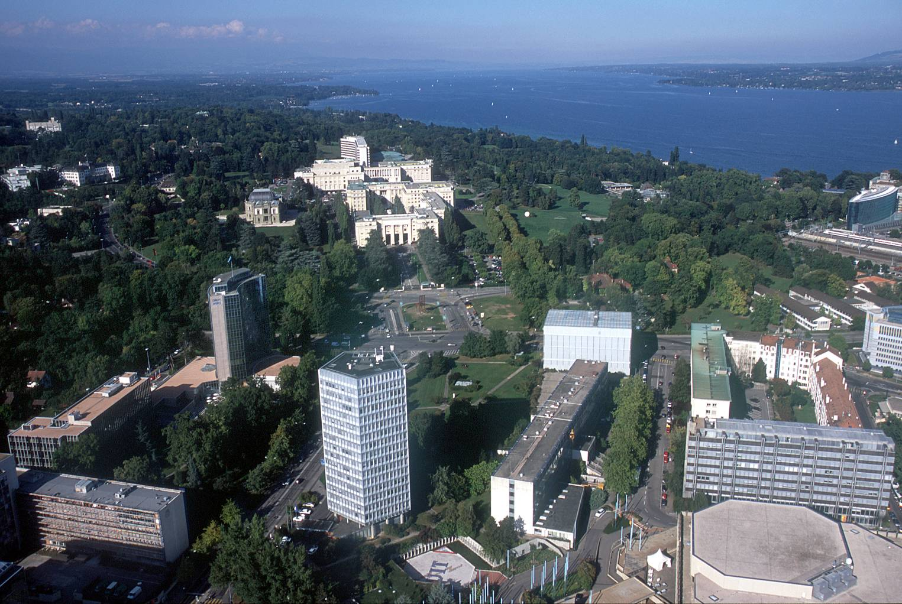
Grazie mille !
reinhard.scholl@itu.int

Slide 21
Backup

Slide 22
Establishment of FG Smart Grid
When?
ITU-T TSAG agreed at its meeting in Geneva, 8-11 February 2010 to establish ITU-T Focus Group on Smart Grid (FG Smart)
Management Team
Title | Name
Chairman | Mr Les Brown (Lantiq, Germany)
Vice Chairman | Ms Li Haihua (MIIT, China)
Vice Chairman | Mr Hyungsoo Kim (Korea Telecom, Korea)
Vice Chairman | Mr Yoshito Sakurai (Hitachi, Japan)
Vice Chairman | Mr David Su (NIST, USA)
TSB Secretariat | Mr Hiroshi Ota
TSB Assistant | Ms Emmanuelle Labar

Slide 23
Organization of FG Smart
FG Smart
Deliverable:
Smart Grid Overview
Deliverable:
Terminology
Ad hoc
Editor: Yuan Guangxiang (CATR, China)
Editor: Gyu Myoung Lee (ETRI, Korea)
Plenary
WG1
Use cases
WG2
Requirements
WG3
Architecture
Chair: Hyung-Soo Kim (KT, Korea)
Editor: Gyu Myoung Lee (ETRI, Korea)
Editor: Jeong Yun KIM (ETRI, Korea)
Chair: David Su (NIST)
Editor: Tsuyoshi Masuo (NTT, Japan)
Editor: Yoshihiro Kondo (NTT, Japan)
Chair: Yoshito Sakurai (Hitachi, Japan)
Vice-chair: Haihua Li (CATR, China)
Editor: Shingo Soma(Mitsubishi, Japan)
Editor: Jian Li (CATR, China)
Deliverable:
Smart Grid
Architecture
Deliverable:
use cases for smart grid
Deliverable:
Requirements of communication for smart grid
3 Working Groups, 5 deliverables

Slide 24
FG Smart Current Activities
Meetings
1st meeting: 14-16 June 2010, Geneva
2nd meeting: 2-5 Aug 2010, Geneva
3rd meeting: 11-15 Oct 2010, Geneva
4th meeting: 29 Nov-3 Dec 2010, Chicago, USA
5th meeting: 10-14 Jan 2011, Yokohama, Japan
6th meeting: 4-8 Apr 2011, Sophia Antipolis, France
7th meeting: 9-15 Jun 2011, Jeju Island, Korea
8th meeting: 22-26 August 2011, Geneva
9th meeting: 18-21 December 2011, Geneva
Related information is at:
http://ifa.itu.int/t/fg/smart/docs/
http://www.itu.int/en/ITU-T/focusgroups/smart/Pages/Default.aspx

Slide 25
Current ITU-T SG activities directly related to Smart Grid
Items | SGs and aspects
(1) M2M | SG13 | Q3/13 USN, MOC Q12/13 Ubiquitous networking (object to object communication)
 | SG15 | Q1/15 IP home network
 | SG16 | Q25/16 USN applications and services
(2) Smart metering | SG16 | Q25/16 Smart metering
(3) Vehicle communication | SG13 | Q12/13 networked vehicle
 | SG16 | Q27/16 Vehicle gateway platform for telecommunication/ITS services /applications
(4) Home networking | SG13 | Q12/13 Next generation home network
 | SG15 | Q1/15 IP home network Q2/15 access network QoS Q4/15 wideband (G.hn - G.9960, G.9961) and narrowband (G.hnem – G.9955, G.9956) home networking transceivers
 | SG16 | Q21/16 home network services
(5) Energy saving network | SG13 | Q21/13 Future network

