Slide 1
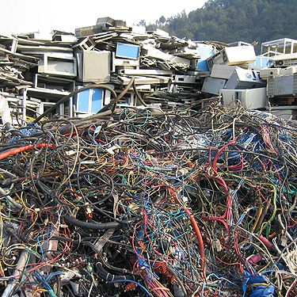
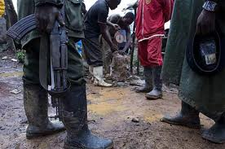
Exploring linkages between E-waste (recovery of minerals), conflict minerals and Green ICT supply chain
Dr. Sunita Purushottam
Principal Consultant
Infosys

Slide 2
Two problems
Conflict minerals & E-waste

Slide 3
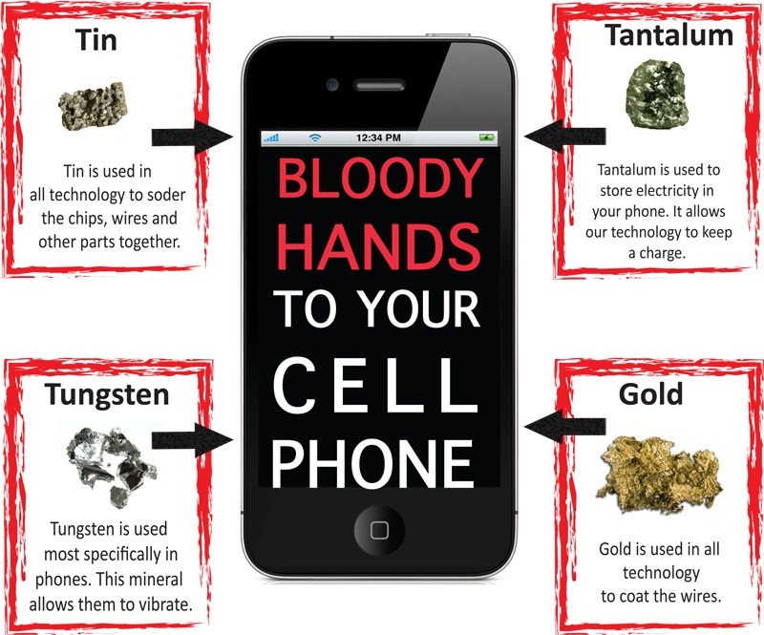
The problem statement: Conflict Minerals
The Conflict Minerals Trade Act : Regulation issued by the SEC on last week of August 2012, Disclosing the Use of Conflict Minerals, was greeted with a decidedly mixed response by sustainable investors and other stakeholders. The regulation requires US corporations to disclose whether their products contain conflict minerals, including tantalum, tin, gold, and tungsten, which have been smuggled out of the Democratic Republic of the Congo (DRC). As armed groups use payments for materials to fund a conflict which has resulted in the loss of more than five million lives.
Notes:
Spurred by - Consumer activism, provision in Dodd Frank Wall Street Reform and CPA.

Slide 4
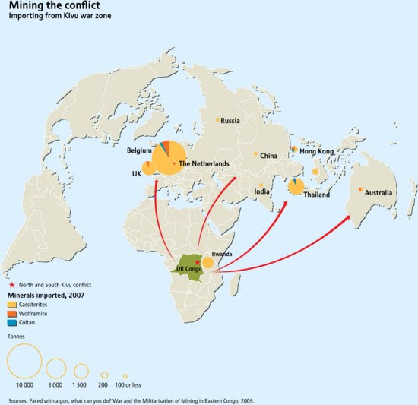
Where and What?
15% and 20% of the world’s supply of tantalum,
5% of its tin,
about 1% of its gold
a small portion of its tungsten.
These elements are integral to electronics manufacturing.
5 million dead
Child labor
Human Rights/ Sexual Abuse
Notes:
Mitigation :
1. Traceability and raising awareness for humane mining
2. Recovering the minerals from IT disposal could lessen the demand from this deadly source.

Slide 5
The problem statement: E-waste
Huge waste volumes
Biggest and fastest growing manufacturing waste.
Landfilling of E-waste
Informal recycling
Trans-boundary E-waste dumping
Closing the loop
USA generated 3.16 million tons
Only 430,000 tons or 13.6 % was recycled,
Trashed – in landfills or incinerators or send overseas
Notes:
Electronic waste, or e-waste, is an emerging problem as well as a business opportunity of increasing significance, given the volumes of e-waste being generated and the content of both toxic and valuable materials in them. The fraction including iron, copper, aluminium, gold and other metals in e-waste is over 60%, while pollutants comprise 2.70%.
2008 in USA
E‑WASTE: “Any device that for functional reasons is dependent on electric currents or electro-magnetic fields in order to work properly. It becomes e‑waste when the holder discards, intends or requires to discard”
Morselli, et al. in their 2009 publication “Waste Recovery, Strategies, Techniques and Applications in Europe”

Slide 6
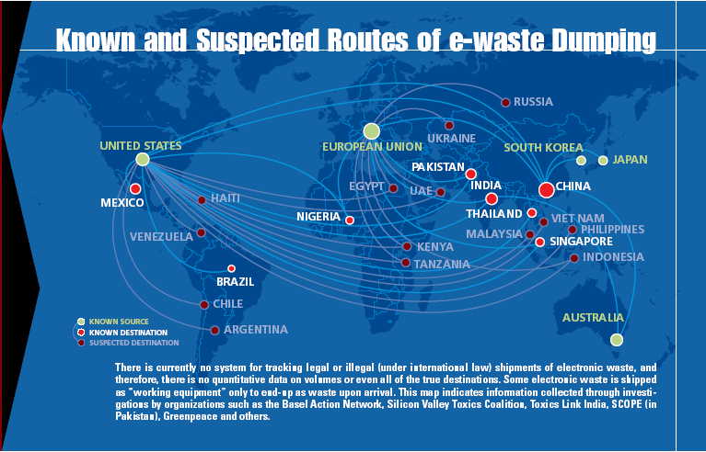
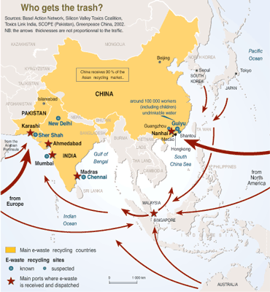
Challenges in proper E-waste recycling in developing world
Trans-boundary dumping is common and largely unregulated. Dealing with imported E-waste and rising domestic E-waste
Goods move from developed nations to known and unknown destinations in developing world
Improper dismantling leads to soil pollution is among the other detriments of improper and unorganized e-waste management and handling.
Operation of unorganized recycling – scrap dealers
Little or no regulatory checks on scrap dealers
Notes:
Urban Mining
$16 billion in gold
$5 billion in silver
Today barely 15% is recovered
E-waste contains precious metal deposits that are 40-50 times richer than ores mined from ground
E-waste to rise from
676 million cubic feet in 2010
To 1,465 million cubic feet by 2025
E-waste recycling
To rise to 789 cubic feet by 2025
By 2020 more electronics will be recycled than will become e-waste
Experts from the Bonn-based United Nations University provided a financial estimate that the 'urban mining' of e-waste could generate: $21 billion each year ($16 billion in gold and $5 billion in silver). There is more. At present, barely 15% of these precious metals are recovered from the e-waste. The clincher was that e-waste now contains precious metal deposits'' that are 40 to 50 times richer than ores mined from the ground. The UN meet's main focus was on recycling. E-waste is emerging as one of the biggest modern-day challenges.
Electronic waste, or e-waste, is an emerging problem as well as a business opportunity of increasing significance, given the volumes of e-waste being generated and the content of both toxic and valuable materials in them. The fraction including iron, copper, aluminium, gold and other metals in e-waste is over 60%, while pollutants comprise 2.70%.
The Pike study forecasts the amount of e-waste rising from 676 million cubic feet in 2010 to 1,465 million cubic feet by 2025. During that same time, the study anticipated an uptick in the amount of electronics being recycled, from 122 million cubic feet per year in 2010 to 789 million cubic feet by 2025. And, by 2020 it says more electronics will be recycled than will become e-waste.

Slide 7
Sustainable Supply Chain
E-waste and Conflict minerals
Exploring linkages

Slide 8
Business Ethics and Sustainability issues pertaining to mining – Gone for a toss?
Unscientific extraction
Water pollution- toxic
Land pollution – toxic waste dumping
Worker under gunpoint
What Climate Change?
Mine establishment and closure
Non existent Stakeholder Engagement
Human Rights violation
Community suppression
Gun culture
Militant profitability
Land Management
Water Management
Waste Management
Worker Safety
Climate Change
Mine establishment and Closure
Stakeholder Engagement
Human Rights
Community Development
Supply Chain Management
Transparency and accountability
Business Sustainability

Slide 9
Sustainability issues mapped across the value chain
Value Chain
Upstream Scope 3
Suppliers
Own Operations
Scope 1 and Scope 2
Downstream Scope 3
Customers/End of Life
Ethical
Legal
Labor
Health and Safety
Resources
Waste disposal
Air Emissions
Waste Water
Renewables
Supplier Tier 2
Supplier Tier 1
Sustainable Supply Chain criteria:
Supply Chain performance and risk management
Procurement : Ethical and responsible sourcing
Product design improvements and environmental friendly materials
Material compliance and EOL management
Logistics Management
Common across the value chain
Supply Chain
Extraction/ Raw Material
Suppliers
Transportation
Producer
Distribution
Retailer
User
End of Life / Disposals
Reputation
Product Compliance
EHS Compliance
Litigations
Over packaging
Emissions
Inefficiencies
Reverse Logistics
Product selection
Labeling
Local communities
Working condition
Waste management
Use (TCO)
Take back systems
Recycle and reuse
Compliance
Value chain Issues
Over extraction
Violations
Biodiversity
Labor Issues
Inefficiencies
Audits
Emissions
Inefficiencies

Slide 10
Increasing demand for Supply Chain Sustainability Disclosure
EICC Supply Chain
CDP Supply Chain
GRI Sustainability Reporting
EU Waste Directive, WEEE and REACH
End of Life Reporting, EPR
Vodafone, BT Supplier assessments
Conflict minerals disclosure (SEC ruling)
FMD
Wal-mart Questionnaire
EPEAT
Supplier Scorecards
Disclosures
Increasing adoption of SA8000 standards and other supply chain standards
Consolidating disparate disclosure information across all countries for easy retrieval and analysis to inform supply chain performance
Note : Mandatory disclosures highlighted in dark

Slide 11
Conflict Minerals and E-waste linkages for a sustainable supply chain
Conflict minerals
E-Waste
Source : UNEP 2007, E-waste Management Manual Volume II

Slide 12
E-waste Value Chain
Producer of EEE
Purchase of EEE
Generation
Stockpiling and Collection
Handling and Brokering
Processing
Households
Businesses
REUSE
Step 1
End of life
Aggregators
Step 2
Purchase & Resale
Segregators
Step 3
Manual Dismantling
Recyclers/ Smelters
Refining and Conditioning
Step 4
Distributors of Recovered Materials

Slide 13
Life Cycle Analysis of Materials
Six key metals - aluminium, cobalt, copper, gold, palladium, and tin – are used in the electronic industry.
Published data on embodied carbon and energy is available in the ICE (Inventory and Carbon and Energy) database for Aluminium, Copper and Tin.
Conclusion: mining of metals is energy and carbon intensive and therefore it is more efficient to recycle metals for use in the electronics industry.
Material |  | Embodied Energy (MJ/kg) | Embodied Carbon (kgCO2/kg) | Reduction of embodied carbon in recycled compared to Virgin
ALUMINIUM | Virgin | 218 | 11.46 | 85%
 | Recycled | 28.8 | 1.69
COPPER | Virgin | 70 | 3.83 | 75%
 | Recycled (High grade scrap) | 17.5 | 0.96
TIN | Virgin | 250 | 13.7
 | No published data for Recycled
13

Slide 14
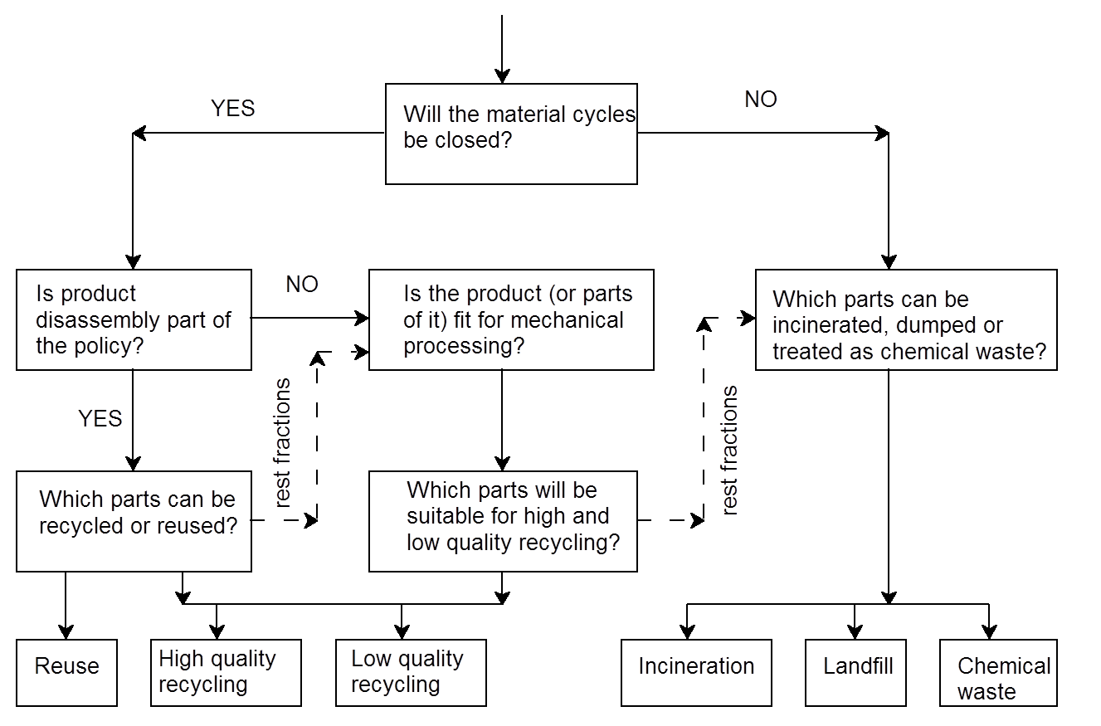
Guidelines for Producer - End of Life destination
*Adopted from end of life destination used for automotive sector
Notes:
*Adopted from end of life destination used for automotive sector

Slide 15
Building the Sustainable Supply Chain

Slide 16
A phased approach to Sustainable Supply Chain
Waste volumes taken back
Percentage of materials sourced from conflict zones
Recyclability and reparability
Support and service, extended warranty, upgradability
Supplier Audits
Supplier education and awareness
Working with certified suppliers
Reporting
Monitoring / Tracking
Engagement
Identification
Setting Goals

Slide 17
Sustainable EEE Value Chain
Supply Chain Risk Management
Raw materials inputs
Packaging Design
Packaging Manufacture
Product Manufacture
Distribution
Retail
Use
End of Life
Analytics and Reporting
Ethical and responsible sourcing
Support sustainable forestry and mining
Green procurement policy
Identify sustainable material selection`
Product design improvements
Material compliance (as defined for food safe packaging)
Alternative materials
Define KPIs for use of recyclable content/compostable material for new products
Product and packaging manufacturing
Identify methods for carbon reduction in facilities
Identify waste and water reduction measures
Material reduction
Packaging dimensions
Define KPIs for waste, energy, water, carbon in facilities,
Distribution and transportation
Identify methods for carbon reduction
Identify alternate fuel/ modes for transportation
Identify methods to reduce emissions (both carbon and criteria pollutants)
Logistic optimization – synchronize truck loads.
Track and monitor carbon during distribution
Influencing Consumers
Educating consumers
Exercising sustainable choice of packaging
End of life disposal options
Work with end users to collect and recycle packaging material
Carbon and Energy Management
Supply Chain Performance
Assess suppliers to get into the compliant suppliers pool.
Awareness and training,
Supplier self assessment and full audit
Managing the compliant suppliers' pool.

Slide 18
Steps to conflict –free electronics
Leading electronics companies are making progress in eliminating conflict minerals from their supply chains, but still cannot label their products as being conflict free.
Tracing
Auditing
Certification
Tracing - Finding the source of minerals in products – mapping smelters in the supply chain
Auditing – Smelters audited by third party through conflict free smelters(CFS) program
Certification – Certification by local government body
Increase traceability and raising awareness for humane mining
Recovering the minerals from IT disposal could lessen the demand from this deadly source.

Slide 19
Leading ICT companies – On Conflict Minerals
Committed to uphold the EICC code of conduct for suppliers. Direct suppliers to set public goals to reduce GHG impacts. Commitment to the IDH Sustainable Electronics program FOR Innovative workforce management
Intel was the first company to publicly commit to making a fully conflict-free product within a deadline—a conflict-free micro-processing chip by 2013.
Intel chairs the review committee for the smelter audit program
Co-chairs the industry association work group on conflict minerals, has visited 50 smelters, Co-founded a program with HP and GE to pay for smelter audits
Visited eastern Congo to better understand how the company can have a positive impact.
HP has been active at multiple levels.
Require its suppliers to use conflict free minerals
Co-founded the smelters incentive program.
Is helping Congo develop a clean minerals trade,
It also signed onto the multi-stakeholder group on strong SEC regulations.
Notes:
Leading electronics companies are making progress in eliminating conflict minerals
from their supply chains, but still cannot label their products as being conflict free.
Intel Motorola Apple and HP
Delay in rule making
HP has been active at multiple levels.
When enough smelters are available it will require its suppliers to use only audited, conflict-free smelters.
Co-founded the smelters incentive program.
Is helping Congo develop a clean minerals trade, serving on the governance committee of the PPA, purchasing minerals
from Congo, traveling to eastern Congo to see local systems firsthand, and being the most active corporate participant in a diplomacy work group on Congo.
It also signed onto the multi-stakeholder group on strong SEC regulations

Slide 20
Leading ICT companies – On E-waste and EPR
Dell offers free recycling in most places where it does direct business
Dell provides information for recycling for its consumers in other geographies
Its takeback program is especially effective in USA
HP offers hardware recycling services for business consumers all over the world (in 46 countries of its operations)
HP offers Consumer Buyback in USA
Nokia was one of the founders of the Electronics Coalition, which identified four key areas of concern in relation to the proposed directives:
Producer responsibility.
Industry responsibility for historic waste.
Responsibility for free riders and orphan products. L
Looking at substance legislation from a sound scientific perspective.

Slide 21
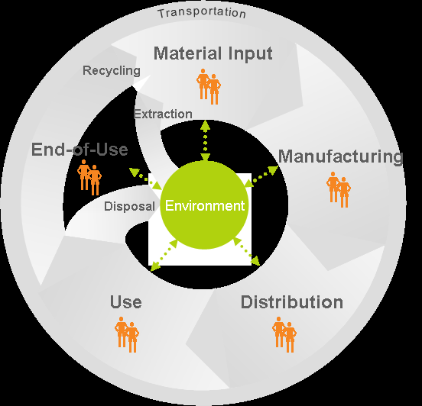
Closing the loop – Life cycle of EEE
At every stage in the life-cycle of specific products there are social and environmental impacts, or externalities, on the environment and on people. In addition, governance, or the accountability of organizations to their stakeholders for their conduct, is important at every stage and throughout the supply chain.
Refurbished product
Retailer
Producers of EEE
Regulator
Consumer and generator
Recycler
Retailer
Refurbisher
Recycler
Consumer
Collection Centers

Slide 22
Future of EEE from different stakeholder perspectives
Present Situation
Future Situation
Resource rich consumption processes
Less importance to reuse
EPR laws formulated
Design for dump
Conflict minerals awareness
Emphasis on process efficiency
Designed for recycling and DFE
EPR laws functional
Sourcing conflict free minerals
Industry
Expectation of profits
Difficulty in recycling
Absence of reverse logistics
Rise of recycling increasing profitability
Wide scale reverse logistics
Recycling centers
Recycler
High consumption
Use and throw
Landfill of E-waste
Rising awareness of E-waste
Rising sustainability awareness
Conscious consumption
Proper recycling
Aware about conflict minerals
E-waste management and high awareness of end of life disposal
Consumer

Slide 23
Steps to bridging the gap Conflict minerals and E-waste * - recovery and recycling
Industry
Government
Recycler
Adopting product specific approach
Adopt green PLM*
Green procurement and sourcing from conflict free zones
Assessment of end of life disposal in design phase
Industry specific approach
Strengthen reverse logistics
Embrace EPR and product stewardship
Strengthening take back programs
Alignment of Marketing Strategies
Market recycled products
Increase vendor and customer awareness
Promote discounts for customer returns
Increased marketing of green raw materials and green production processes
Appropriate regulations and global standards for E-waste disposal and recovery
Job generation in the recycling sector by supportive policies
Streamlining operations of scrap vendors by awareness and incorporation into government authorized vendor list
Sound end of life management technology adoption – authorized recycler list
Regulated refurbishing and reuse practices
Follow sound EOL management
Adhere to EOL regulations
Works towards strengthening reverse logistics
Creates jobs
Creates awareness
Works with industry for take back programs
Customers
Greener electronics – conflict free
Local corporations to institute take back programs
Conscious consumption
E-waste handed to authorised recyclers
Notes:
Market recycled products : this would ensure a market for refurbished or second hand usable products
Increase vendor and customer awareness
Promote discounts for customer returns on end of lifecycle products (e.g. while buying new goods, provide discounts on new items and offer to take back used products).
Increased marketing of green raw materials and green production processes would help producers embrace Green PLM pathway.

Slide 24
Ecosystem for Sustainable Supply Chain
Need for Global ICT standards which helps to cut e-waste and make the ICT supply chain greener
PRODUCER
PRODUCER - DESIGN
WASTE RECYLCER - RECOVERY
Set waste recovery targets
Provide permanent collection infrastructure
Remanufacture and reuse - Work with recyclers
Required by law to disclose source of minerals in products
Amend supply chain policy for conflict-free sourcing
Getting smelters audited
Buying from conflict free smelters
Help Congo develop a clean trade – ensuring conflict – free is not Congo free
Support livelihood projects to help mining communities
Moving beyond law for the next “supply chain issue”
Adopt proactive and not reactive stance to sustainable supply chain
Systems to address and mitigate supply chain risks
Avoid regulated and restricted materials
Design for disassembly
Use recycled materials where possible
Reduce number of material types
Eliminate incompatible non- separable materials
Improved E-waste Collection
Efficient collection infrastructure
Adopting efficient processing
Advanced sorting technology
Improved technology for recovery
COLLABORATION
GOVERNMENT - REGULATIONS
Designer, producer and waste management to define sustainability aspects of product design
Engage in multi-stakeholder forum on conflict minerals and E-waste to adopt and learn from similar industries
Join hands with other industries and consortiums
Promote policies which support recyclers
Remove subsidies on virgin material use
Introduces SOPs for recycled material use
Define roles and responsibilities for stakeholders in E-waste management and recovery
Enforcement of regulation
Notes:
Sust aspects – keeping in mind the recovery of materials

Slide 25
THANK YOU
www.infosys.com
The contents of this document are proprietary and confidential to Infosys Limited and may not be disclosed in whole or in part at any time, to any third party without the prior written consent of Infosys Limited.
© 2011 Infosys Limited. All rights reserved. Copyright in the whole and any part of this document belongs to Infosys Limited. This work may not be used, sold, transferred, adapted, abridged, copied or reproduced in whole or in part, in any manner or form, or in any media, without the prior written consent of Infosys Limited.

