Slide 1
The role of the ITU: Standards, Radio, Spectrum, Development
Workshop on
Engagement of Sudanese Universities in ITU activities
Khartoum 23 October 2012
Malcolm Johnson, Director of the
Telecommunication Standardization Bureau
International Telecommunication Union

Slide 2
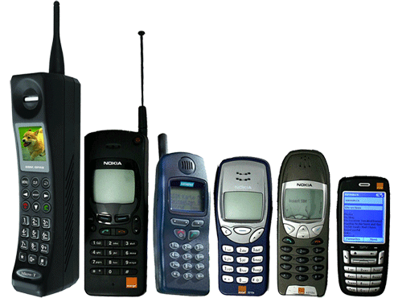
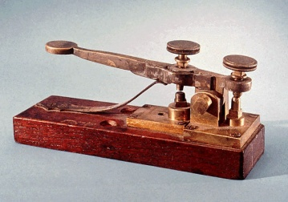
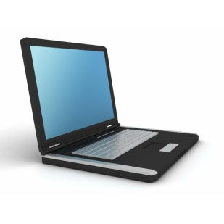
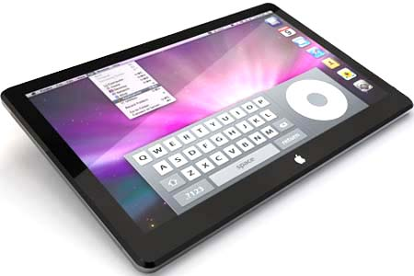
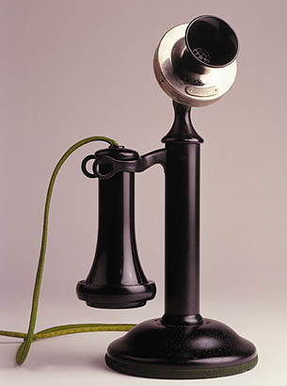
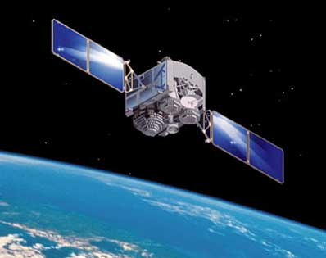
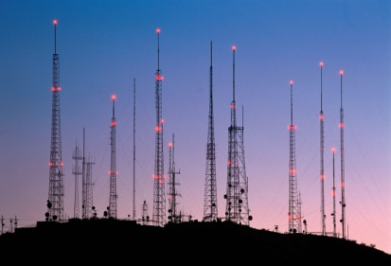
ITU : enabling communication since 1865
1865 2015
Notes:
ITU was founded in Paris in 1865 as the International Telegraph Union. It took its present name in 1934, and in 1947 became a specialized agency of the United Nations.
Now ITU is the UN specialized agency that promotes global collaboration for a connected world
Although its first area of expertise was the telegraph, the work of ITU now covers the whole ICT sector, from digital broadcasting to the Internet, and from mobile technologies to 3D TV.

Slide 3
ITU: a unique Membership
193 Member States and regulatory bodies
700 companies
Business associations
International organizations
NGOs
50 Universities
Research
Establishments

Slide 4
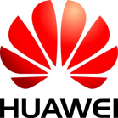
Leading Private Sector Members

Slide 5
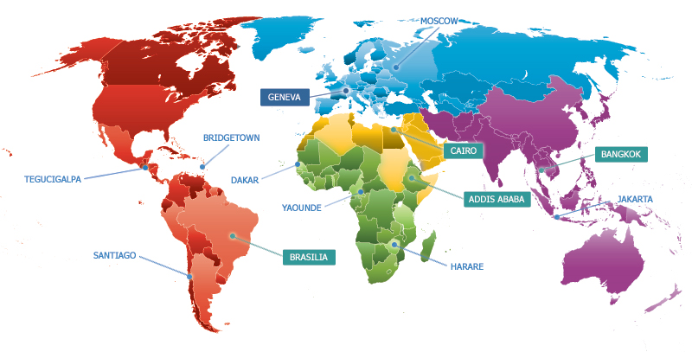
ITU truly International and has Global presence
760 Staff from 80 Countries
6 UN Official Languages: Arabic, Chinese, English, French, Russian, Spanish
Headquarters in Geneva with Liaison Office in New York
Regional offices in Addis Ababa, Bangkok, Brasilia, Cairo
Area offices in Bridgetown, Dakar, Harare, Jakarta, Moscow, Santiago, Tegucigalpa, Yaoundé

Slide 6
ITU Structure
ITU-R coordinates global wireless communication
(which uses limited resources)
ITU-T produces interoperable technical ICT standards
ITU-D provides assistance to the un-connected
The GS provides intersectoral coordination for the whole organization

Slide 7
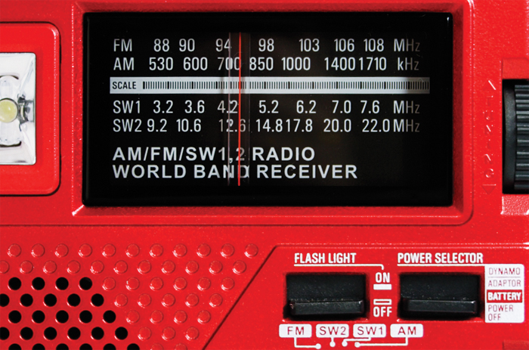
Key Issues in ITU-R: The Radiocommunication Sector
Management of limited natural resources: Radio-frequency spectrum and satellite orbits
Notes:
The ITU Radiocommunication Sector (ITU-R) plays a vital role in the global management of the radio-frequency spectrum and satellite orbits - limited natural resources which are increasingly in demand from a large and growing number of services such as fixed, mobile, broadcasting, amateur, space research, emergency telecommunications, meteorology, global positioning systems, environmental monitoring and communication services - that ensure safety of life on land, at sea and in the skies.
ITU-R’s mission is to ensure the rational, equitable, efficient and economical use of the radio-frequency spectrum by all radiocommunication services, including those using satellite orbits, and to carry out studies and approve Recommendations on radiocommunication matters.

Slide 8
ITU-R plays a key role managing radiocommunications
Allocates spectrum for communications (including mobile and broadcasting)
Satellite communications
Spectrum for advanced aeronautical communications
Global maritime communications – distress channels, ship-to-shore
Protects frequencies for Earth-exploration satellites to monitor resources, emergencies, meteorology and climate change
Radio astronomy, space exploration
Notes:
ITU’s plays an essential role in the area of radiocommunications and mobile technologies. The World Radio Conference in 2012 will tackled issues of significant importance to the ICT industry and society overall, including:
Search for additional spectrum for future mobile communications
Protection of frequencies for emergency communications
Spectrum for advanced aeronautical communications
Requirements for the Global Maritime Distress and Safety System
Requirements for global broadband satellite systems – internet access for remote and underserved areas

Slide 9
Key Issues in ITU-D: The Development Sector
Assisting developing countries in putting into practice competitive ICT markets
Building capacity in developing and least developed countries
Measuring the advance of the Info. Society (ICT Development Index)
Executing agency of UN for ICT projects, working with governments and industry partners
Mobilizing resources and partners for project implementation

Slide 10
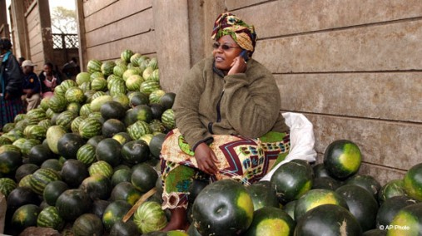
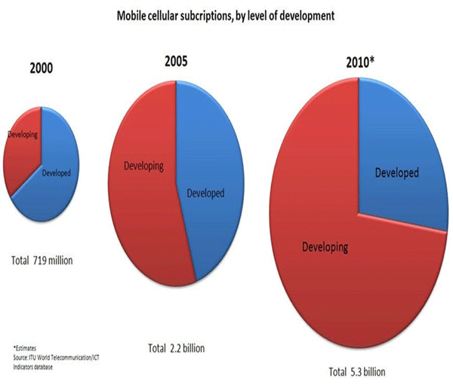
Bridging the Digital Divide and Connecting the Unconnected
Spread equitable, sustainable and affordable access to ICTs
Mobilize technical, human, financial resources needed for the implementation of ICTs in developing countries
Notes:
6 billion people now have a mobile phone.
The Digital Divide is a result of the global development divide but we are experiencing fast growth…
Even the simplest, low-end mobile phone can do so much to improve healthcare in the developing world.
Good examples include sending reminder messages to patient’s phones when they have a medical appointment, or need a pre-natal check-up. Or using SMS messages to deliver instructions on when and how to take complex medication such as anti-retrovirals or vaccines. It’s such a simple thing to do, and yet it saves millions of dollars — and can help improve and even save the lives of millions of people.
Concerning mobile banking, rapid growth in mobile cellular subscriptions has meant that there are now large numbers of people worldwide, especially in developing countries, who have a mobile phone subscription but no bank account — and increasingly, subscribers are using their phones for banking.
ITU is the main source of internationally comparable data and statistics on ICT. The Market Information and Statistics Division of the Telecommunication Development Bureau (BDT) collects, harmonizes and disseminates more than 100 telecommunication and ICT indicators from over 200 economies worldwide. Data are accessible online through the ICT Eye portal, on CD and in print publications. ITU regularly publishes analytical reports illustrating the latest trends in the sector. It also monitors the development of the digital divide and has developed widely used benchmarking tools, such as the ICT Development Index (IDI).

Slide 11
ITU-T’s strategic goals
To develop interoperable, non-discriminatory international standards (ITU-T Recommendations)
To assist in bridging the standardization gap between developed and developing countries
To extend and facilitate international cooperation among international, regional and national standardization bodies
Notes:
ITU is behind many of the global standards that drive the telecommunications and information technology industries.
ITU standards work done mostly in Study Groups. We have 10 in total. These groups produce recommendations, which in turn become standards. Examples include G992.1 (ADSL), G993.1 (VDSL).
The study groups operate on a global basis, with a consensus decision-making process.
Standards are approved by 193 Member States + 700 Sector Members. Processes are very flexible to meet emerging needs such as Internet of Things, Cloud computing, ITS, Smart grid, Accessibility, Climate Change, IPTV, etc. We have fast, transparent procedures and a trusted brand name.

Slide 12
One-Stop Shop for Global ICT Standards
Study Groups cover a wide area of topics:
Operational aspects of service provisioning
Tariff and accounting
ICT, environment and climate change
Test specifications
Performance, QoS and QoE
Future networks
Access and transport network infrastructures
Multimedia systems and applications
Security
Internet of things
Notes:
ITU standards work done mostly in Study Groups. We have 10 in total. These groups produce these Recommendations.
ITU’s role as creator of the global ICT standards dates back as far as the organization itself. Since its inception in 1865, the Union has been brokering industry consensus on the technologies and services that form the backbone of the world’s largest, most interconnected man-made system.
Around one new and revised standards (ITU-T Recommendations), is created for every working day of the year covering everything from core network functionality and broadband to next-generation services like IPTV.
ITU is behind many of the global standards that drive the telecommunications and information technology industries.
This work represents a unique partnership between the private sector and government. In fact, the private sector plays a major role in helping determine global standards, since it is they who will ultimately operate in this environment. No other standards organization brings together the public and the private sectors in this way.
The study groups operate on a global basis, with a consensus decision-making process. They are very flexible to meet emerging needs and operate according to fast, transparent procedures

Slide 13
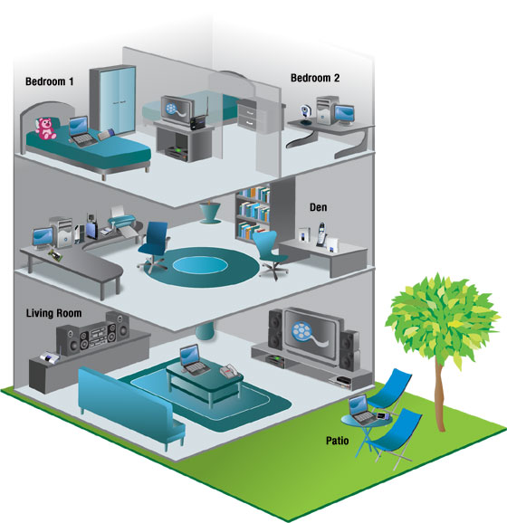
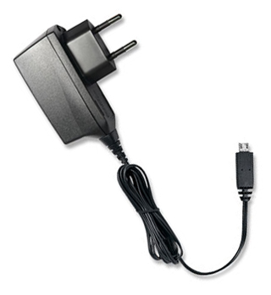
Recent ITU-T Success Stories
Notes:
Without ITU standards you couldn’t make a telephone call… you couldn’t surf the Internet.
ITU-T H.264: Emmy Award-winning video compression standard, also known as MPEG4. Most YouTube videos are encoded in H.264. If you have an iPhone or iPad it is using h.264 for video
ITU-T G.992: ADSL standards. In fact if you have an Internet connection at home chances are it is standardized in ITU
ITU-T G.hn: high speed home networking over power lines, phone lines and coaxial cable
Optical transport networks – more than nine-tenths of Internet traffic now travels through undersea fibre-optic cables
Green ICT: Methodologies to measure the impact of ICT on climate change, e.g., universal charging solution – reducing energy consumption, costs, eWaste

Slide 14
Bridging the standardization gap
Workshops and seminars anywhere in the world
Voluntary BSG Fund
Fellowships (travel and/or hotel)
SG vice-chairmen from developing countries
Reduced fee for Sector Members from developing countries

Slide 15
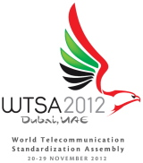
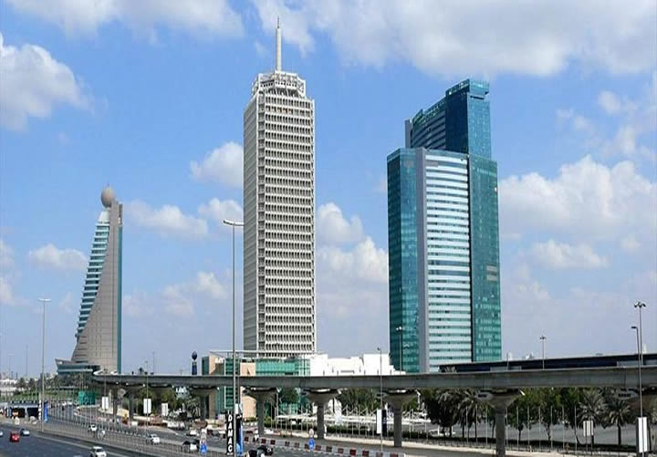
World Telecommunication Standardization Assembly (WTSA-12)
Dubai World Trade Centre, UAE
20-29 November 2012

Slide 16
What is WTSA?
Sets direction, policy, structure for ITU-T
Meets every four years
Defines the general policy for the Sector
Establishes ITU-T study groups
Approves work program of study groups
Appoints chairs and vice-chairs of study groups
Reviews existing WTSA Resolutions (49)

Slide 17
Main objectives
Underline ITU-T’s role as the most effective venue for international standardization
Pick up new work on emerging technologies
Increase efficiency in order to make best use of delegate time and resources
Avoid duplication and overlap of work
Increase participation and relevance

Slide 18
Stronger presence in certain areas
e-Health
Accessibility
ICTs and climate change
Internet of Things/M2M
Intelligent Transport Systems
Cybersecurity including Identity management
IPTV, cloud computing and smart grid
Conformity and interoperability

Slide 19
WTSA Side Events and Exhibition
Three Side Events:
e-Health
ICT innovation and standards
Network resilience and disaster relief
Academia event
Showcasing
10 companies
IPTV, home networking, etc.

Slide 20
Global Standards Symposium
Monday, 19 Nov 2012
Intersection of the ICT sector with other vertical sectors such as health care, utilities, and transport
Collaboration with other standards bodies
Chairman will present conclusions to WTSA

Slide 21
World Conference on International Telecommunications (WCIT)
Dubai World Trade Centre, UAE
3-14 December 2012

Slide 22
ITRs the only global telecoms treaty
Current ITRs provided the foundations for the ‘mobile miracle’ and Internet.
Revised treaty can create a ‘broadband miracle’

Slide 23
Need to revise the ITRs
The international telecom environment has significantly evolved, since ‘88 both from technical and policy perspectives
Advances in technology mean an increased use of IP-enabled infrastructure
Member States need to adapt policy and regulatory approaches

Slide 24
Key topics
Mobile roaming; prevention of fraud; misuse of the telephone numbering system; incentives for investment in the telecommunication network; and the empowerment of consumers.

