Slide 1


Network Security Evaluation for IPv6 Deployment
Khartoum June 2022

Slide 2



About Me
Eng. Hiba Alamin
Information Security Specialist
Network and Information Security Department Manager
12 years’ practical experience in planning, implementing, monitoring and protecting organizations’ security systems
Implement different Training session and courses in information security
BSc. Electronic Engineering – SUST
MSc . Computer Security - University of Essex (United Kingdom)
Certifications:
  ISO/IEC 27001 Lead Implementer
  EC-Council Certified Security Specialist
  ITIL Foundation in IT Service Management

Slide 3

What we are going to Discuss
Overview about the security Concepts
How to perform Network security Assessment
Help the organisation to mitigate the Network security risks
Network Security Awareness and Recommendation

Slide 4
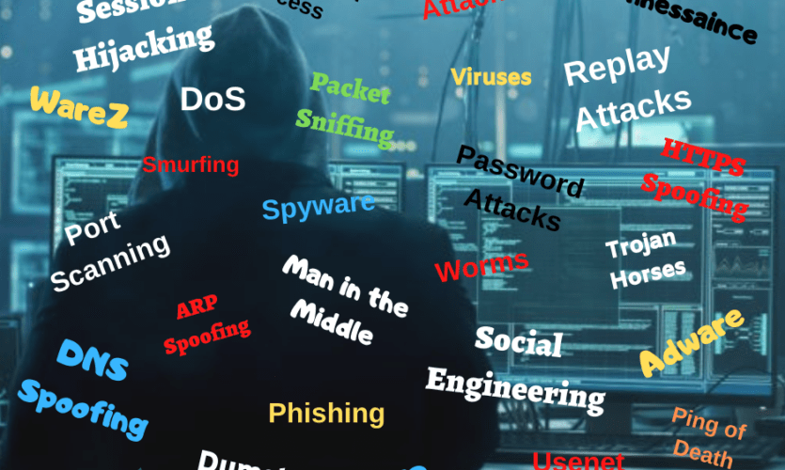
Network is Part of Business and Personal Life
What Happens in Seconds
www. ipcisco.com

Slide 5
Elements of Information Security
Confidentiality
Assurance that the information is accessible only to those authorized to have access.
Integrity
The trustworthiness of data or resources in term of prevention from improper and unauthorized changes.
Availability
assurance that the systems are accessible when required by authorized users.
Authenticity
characteristic of a communication, document, or any data that ensures the quality of being genuine
Non-Repudiation
Guarantee that the sender/ recipient of a message cannot deny having sent/ received the message.

Slide 6
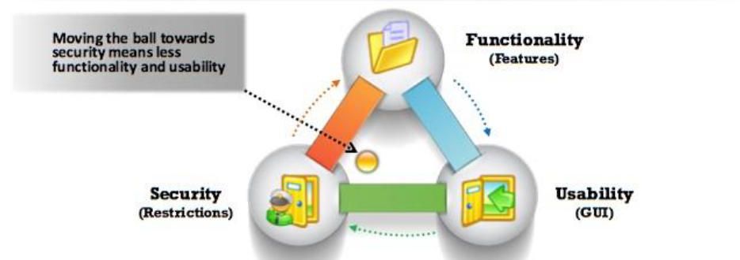
The Security, Functionality, and Usability Triangle

Slide 7
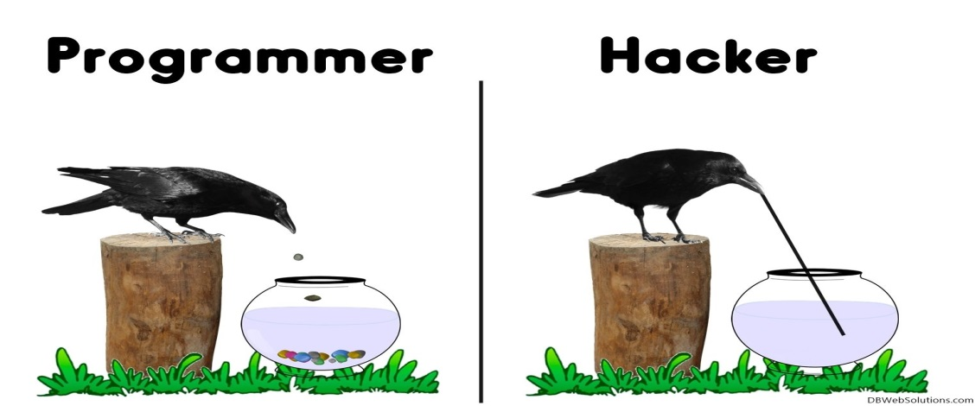
Why Security Evaluation is Necessary?
To prevent hackers from gaining access to organization's information systems
To uncover vulnerabilities in systems and explore their Potential as a risk
To analyze and strengthen an organization's security posture including policies, network protection infrastructure , and end user practices.
To provide adequate preventive measure in order to avoid security breaches
To help safeguard customer's data available in business transactions
To enhance security awareness at all levels in a business
To beat a hacker, you need to think like one!

Slide 8


Security Assessment
Security Audit
checks whether the organization is following a set of standard security policies and procedures.
Vulnerability Assessment
focuses on discovering the vulnerabilities in network , no indication if the vulnerabilities can be exploited.
Penetration Testing
apply vulnerability assessment and demonstrates if the vulnerabilities can be successfully exploited by attackers.
Blue team
Red team

Slide 9
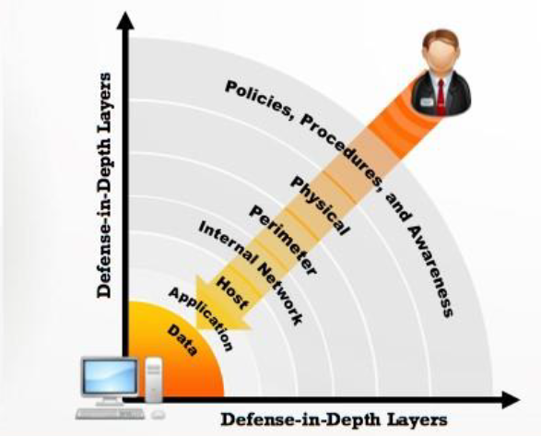
Defense-in-Depth
Defense in-depth is a security strategy in which several protection layers are placed throughout an information system
It helps to prevent direct attacks against an Information system and data because a break in one layer only leads the attacker to the next layer

Slide 10

Phase of Security Assessment
Pre-assess phase
Assess phase
Post-assess phase
Planning
Preparation
methodology
designing
Gathering information
Report
Clean up
scanning
Discover vulnerabilities
execution
Security team performs security assessment of organization with the permission of concerned authorities.

Slide 11

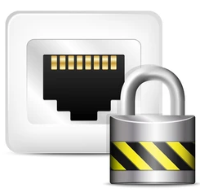



Steps to Evaluate the Security of the Network
Obtain network information
Check the Implemented access control
  External Assessment
Internal Assessment
Review and check the network design and architecture
Recommend or check the used security appliances
Check the implemented security Policy
Write Security assessment report

Slide 12
Evaluate the Security of the Network
Obtain network information
Network Information
System Information
Organization Information
  Example:
  Domain
  sub-domains
  Network blocks
  IP addresses
  DNS records
  Example:
Operation System types.
Service types and ports
Background of the organization
Used technologies

Slide 13
Evaluate the Security of the Network
Check the Implemented access control (Scanning)
  External Assessment
Internal Assessment
Objectives of Network Scanning
  discover live hosts.
  IP address.
  open ports of live hosts.
  discover operating system and system architecture.
  discover services running on hosts.
  discover vulnerabilities in live hosts.
Types of scan
Port Scanning
Network scan
Vulnerabilities scan

Slide 14
Evaluate the Security of the Network
Review and check the network design and architecture
Check the network segmentation
Check the setup network connectivity (example: VLANs, branches, DR site )
Check if security appliances implemented
Apply check for inbound and outbound traffic from/to network

Slide 15
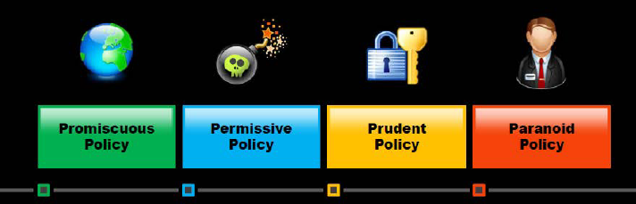
Evaluate the Security of the Network
Check the implemented security Policy
No restrictions on usage of system resources
Policy begins wide open and only known dangerous services/attacks or behaviors are blocked
It provides maximum security while allowing known but necessary dangers
It forbids everything , no Internet connection, or severely limited Internet usage

Slide 16
Writing the Report
writing reports explains findings, recommendations, analyze risk and impact
Common Vulnerability Scoring System (CVSS) is a published standard that provides an open framework for communicating the characteristics and impacts of IT vulnerabilities
Severity | Base Score Range
None | 0.0
Low | 0.1-3.9
Medium | 4.0-6.9
High | 7.0-8.9
Critical | 9.0-10.0
Risk= Probability X IMPACT

Slide 17
Network Security Recommendations
Apply IP/port scanning against hosts on the network to determine whether the firewall accurately detects the port scanning activity.
Keep as few ports open as necessary and filter the rest.
Review inbound and outbound traffic in network
Use strong password and Restrict the remote access to the Gateways, use banner warning
###############################################################
# WARNING: Unauthorized access to this system is forbidden and will be prosecuted by law. By accessing this system, All connections are monitored and recorded
# Disconnect IMMEDIATELY if you are not an authorized user! # ###############################################################

Slide 18
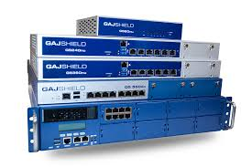
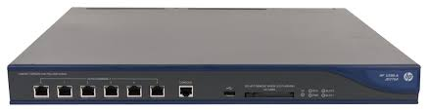
Network Security Recommendations
Ensure that the router, IDS, and firewall firmware are updated to their latest releases/version Unified Threat Management (UTM)
IPS/IDS (Intrusion Prevention/Detection System)
DOS and DDOS (Denial of Service and Distributed Denial of Service)
Application Proxy Filtering on the application layer
Spam filtering
URL filtering
Anti-Phishing
Anti-spyware
Anti-Virus
Application control
Network Access Control
VPN

Slide 19
Network design-Network Security Zoning
Network security zoning mechanism allows an organization to manage a secure network environment by selecting the appropriate security levels for different zones of Internet and Intranet networks
It helps in effectively monitoring and controlling inbound and outbound traffic
Internet Zone
Uncontrolled zone, as it is outside the boundaries of an organization
Intranet Zone
Controlled zone with no heavy restrictions
Internet DMZ
Controlled zone, as it provides a barrier between internal networks and Internet
Production
Network Zone
Restricted zone, as it strictly controls direct access from uncontrolled networks
Management
Network Zone
Secured zone with strict policies

Slide 20
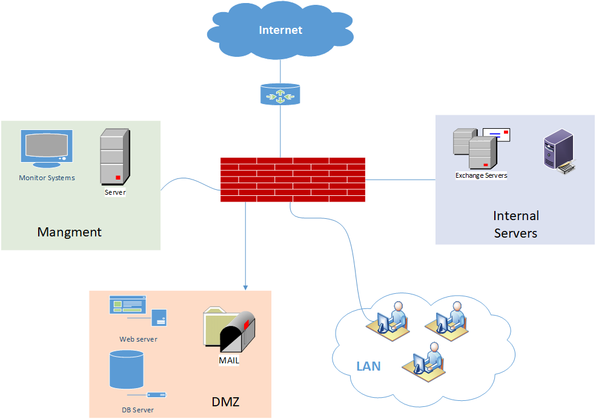

Slide 21
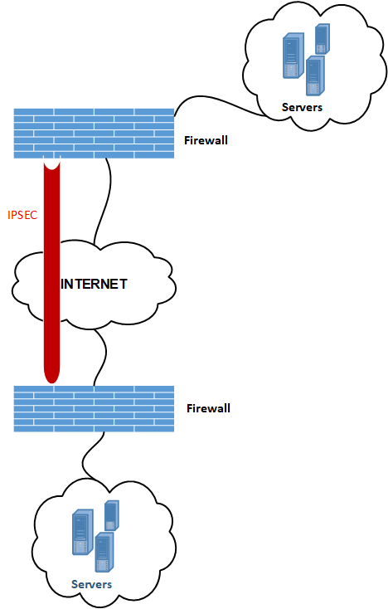
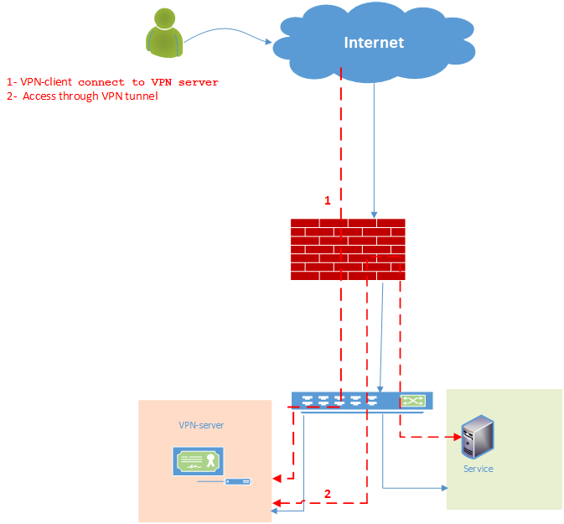
Remote Access Security
VPN (IPSEC)
VPN (SSL)

Slide 22

Logs and Monitoring Systems
Hardware resources such as:
CPU
Memory
Disk
I/O
Network interface
Send and receive traffic
Services Logs such as :
Web service
Database
FTP
Attacker covering track:
Disable Auditing
Clearing logs
Manipulate logs
system Logs such as
Kernel logs
Error and warning
Log shipping

Slide 23
Vulnerability Assessment
Limitations of security Assessment
Vulnerability assessment is limited in its ability to detect vulnerabilities at a given point in time.
Vulnerability assessment must be updated when new vulnerabilities are discovered or improvements are made to the software being used.
assessment become effective if its perform periodically.

Slide 24
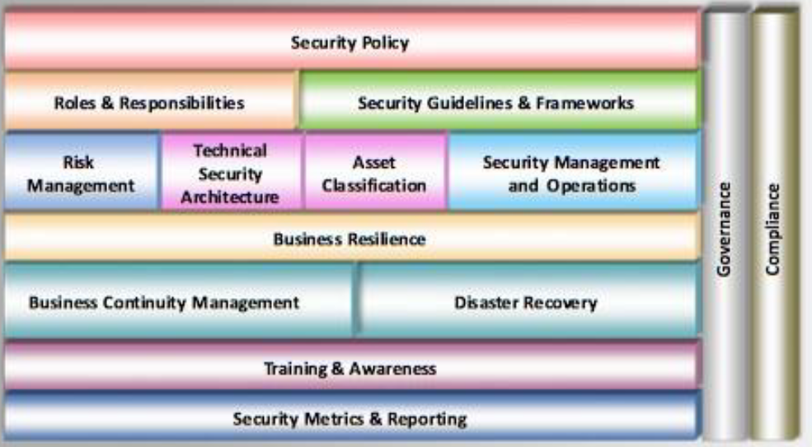
Information Security Management Program
It is a combination of well-defined policies, processes, procedures, standards, and guidelines to establish the required level of Information security

Slide 25

Discussions !

