Slide 1
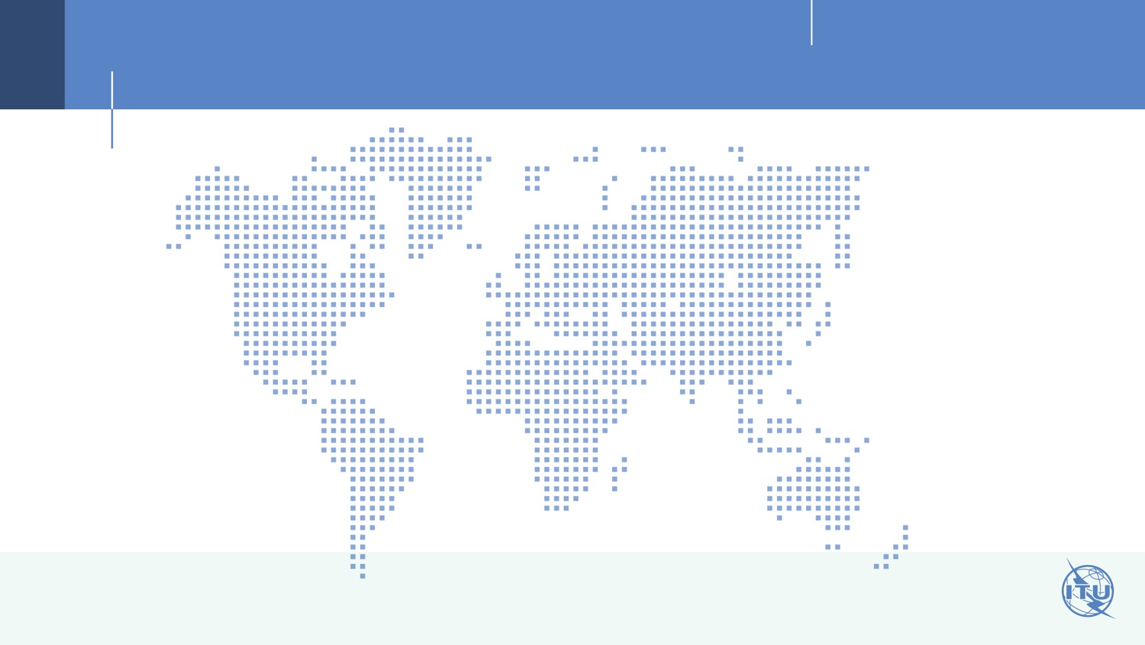
Session 3: ASP RI 1: Special Consideration For LDCs, SIDSs, Including Pacific Island Countries, And Landlocked Developing Countries
Asia-Pacific Region
38 Member States
134 Sector Members,
Associates
25 Academia
Land Locked Developing Countries (5)
Least Developed Countries (12)
Low-Income States (10)
The Rest (10)
Afghanistan
Bangladesh
Bhutan
Cambodia
Lao, PDR
Nepal
Myanmar
Timor Leste
Fiji
Maldives
Marshall Islands
Micronesia
Nauru
Tonga
Australia
Brunei
China/Hong Kong
Iran
Japan
Malaysia
New Zealand
R.O. Korea
Singapore
Thailand
Kiribati
Solomon Is.
Tuvalu
Vanuatu
Fiji
Maldives
Marshall Islands
Micronesia
Nauru
Tonga
PNG
Samoa
D.P.R. Korea
India
Indonesia
Mongolia
Pakistan
Philippines
Sri Lanka
Vietnam
Small Islands Developing States (12)

