Slide 1
Harnessing Digital Opportunities
Manila, 7th June 2016
Tomas Lamanauskas
Group Director Public Policy

Slide 2
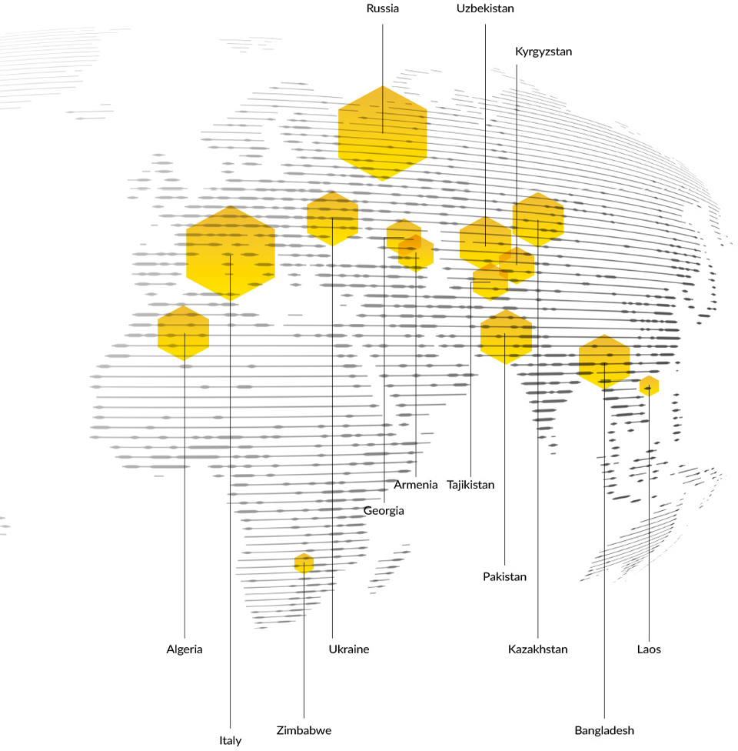
VimpelCom: a global communications and technology company
Amsterdam
VimpelCom
#1
#2
38
million
32
million
217 million subscribers
$9.6 billion revenues
59 thousand employees

Slide 3
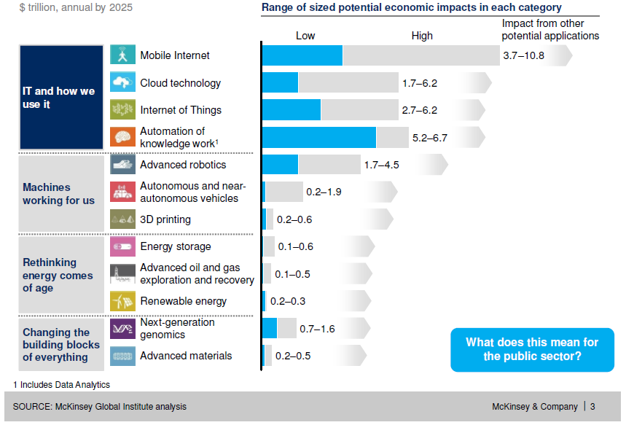
New technologies bring significant economic benefits
Source: McKinsey Global Institute analysis

Slide 4
Factors determining successful digitalization
Access to Infrastructure
Access to Devices
Digital Literacy and Skills
Relevant Content
Sustainable Business Models
Enabling Policy Environment
ICT-Empowered Communities and Individuals

Slide 5
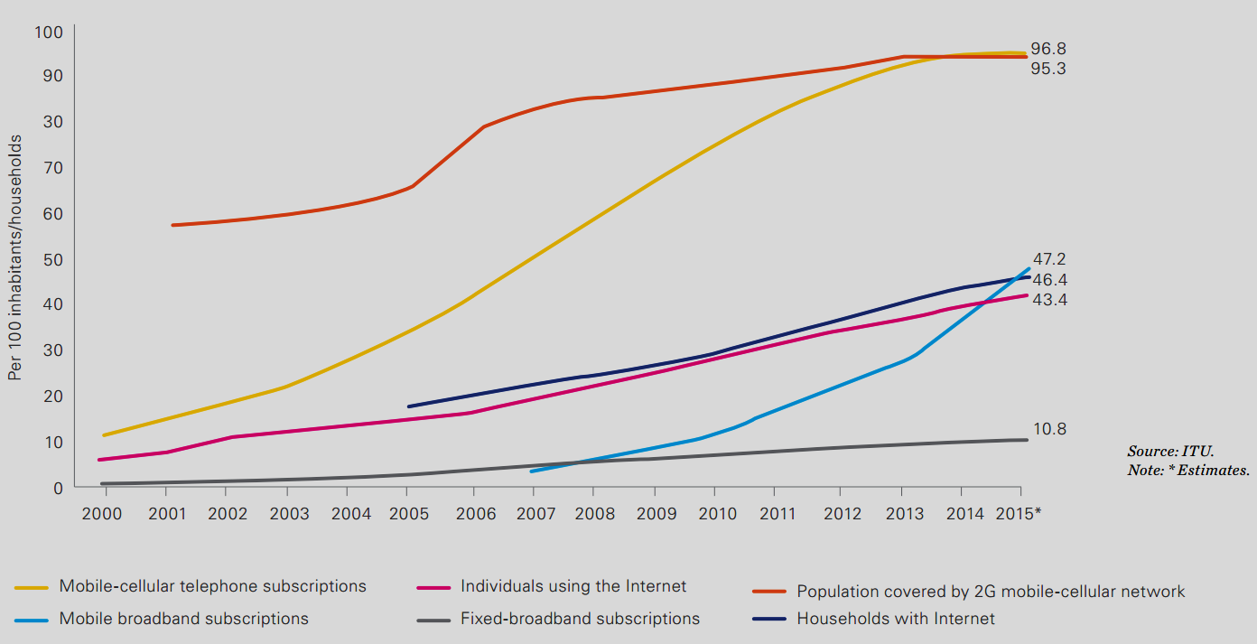
Connectivity is increasing

Slide 6
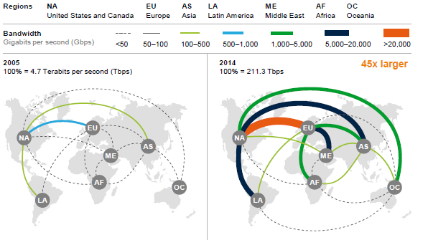
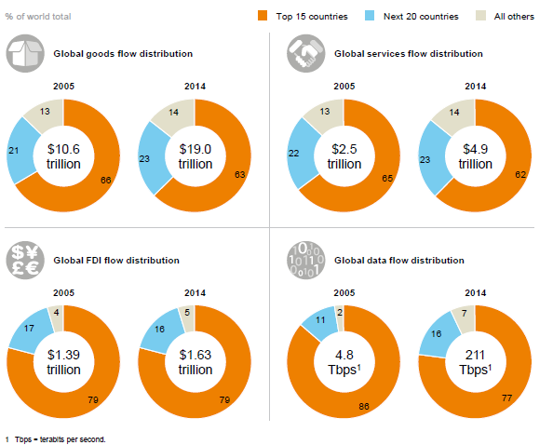
Cross border data flows are surging
Used cross-border bandwidth
Regional distribution of global flows
Lines represent interregional bandwidth (e.g. between Europe and North America) but exclude intraregional cross-border bandwidth (e.g. connecting European nations with one another).
Source: TeleGeography, Global Internet Geography; McKinsey Global Institute analysis, 2015

Slide 7
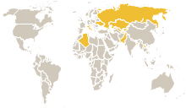
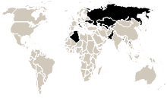
However, the majority of the world population remains unconnected
Pakistan + Bangladesh
World
VimpelCom
Connected
3.2 billion (43.3%)
237.9 million (33.5%)
34.8 million (10.1%)
Unconnected
4.1 billion (56.7%)
472.1 million (66.5%)
309.4 million (89.9%)
Source: ITU IDI Index, 2015
Notes:
In VIP markets (excl. Tajikistan & Uzbekistan) average online access 38.5% with a potential of 462.8 million of unconnected people in our markets
Biggest opportunity in Pakistan (173mln, 13.2%) and Bangladesh (158mln, 6.5%)
% Households with Internet Access (source ITU):
Ukraine 43
Armenia 46.6
Italy 72.61
Russia 69.89
Pakistan 13.2
Kyrgyzstan 12
Bangladesh 6.5
Algeria 25.94
Kazakhstan 58.8
Georgia 41
Lao 5.23
Tajikistan = group average 35.9
Uzbekistan = group average 35.9

Slide 8
Regional differences remain
~57%
~60%
Source: ITU, 2015
Notes:
Arab States and CIS left out for easiness to read.
Asia Pacific almost similar to Arab States.
Growth Asia Pacific: factor ~3.5 and factor 6

Slide 9
We continue to invest in connectivity as we see surging demand
600%
VimpelCom offers 4G in the majority of our markets
In May we received our 4G license in Algeria
Notes:
We see demand exists (as phase 1 of the ecosystem maturity at previous slide suggests).
Data from quarterly report – not confidential
82% is 9 markets out of 11 (excluding Lao and Zimbabwe, including Algeria, Kazakhstan, Kyrgyzstan and Uzbekistan.

Slide 10
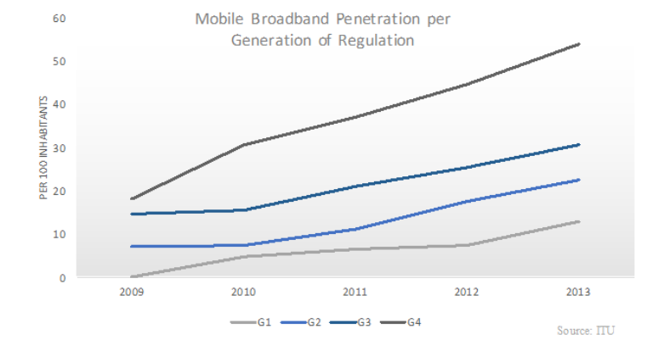
Enabling policy-environment is key for increasing connectivity
“Successful reforms must take into account the need for comprehensive changes that cut across traditional technological and commercial boundaries”
(World Bank)

Slide 11
Enabling policies: Cost savings through network sharing
Source: Network Sharing at Vodafone

Slide 12
Towards digital services
Smartphone Penetration
Digital Literacy
World
47%
13%
44%
Digital Illiteracy
Low Income*
Age (65+)
Illiteracy
43%
15%
3%
8%
Asia Pacific
36%
VimpelCom
31%
Developing
World
*low income: $1.90 per day
Source: GSMA, 2016
Source: World Bank, 2016
Notes:
31% in VIP markets is weighted average
Smartphone penetration in emerging markets is growing (based on sample of 21 countries):
2013 – 21%
2014 – 28%
2015 – 37%
Source: Pew Research
http://www.pewglobal.org/2016/02/22/smartphone-ownership-and-internet-usage-continues-to-climb-in-emerging-economies/
Globally, there are over 750 million illiterate adults with ten countries – India, China, Pakistan, Bangladesh, Nigeria, Ethiopia, Egypt, Brazil, Indonesia and the DRC – accounting for 75 percent of the total illiterate population worldwide. But digital literacy is also an issue in many developed world markets, particularly those with ageing populations.

Slide 13
VimpelCom aims to unlock digital opportunities for everyone
Smartphone penetration
Digital Literacy
2015 smartphone penetration
Together with UNESCO and the Buyad Foundation we developed an mLiteracy program to educate rural women, a group mostly excluded from the conventional educational system in Pakistan.
The program combines technology with on-site education and has received the prestigious Global Mobile Award in 2013.
2020 smartphone penetration
Notes:
Pakistan – we have introduced US$28 smartphones
Still barriers for smartphone importation

Slide 14
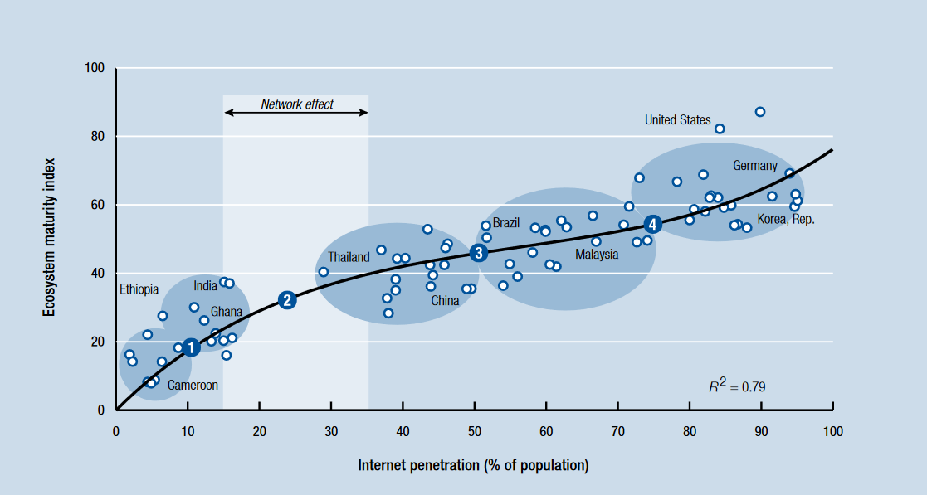
Lack of content means less people will go online
Source: World Economic Forum, 2015
Notes:
Recap of network effect: The more people use a certain service, the more valuable it becomes. Decisive factor for the success of platforms. Characterized by ‘chicken and egg’ problem: no content means no users, no users means less attractive to provide content.
Ecosystem maturity is defined as a function of both the depth and the diversity of the different content categories within a certain country. The greater the depth of available, relevant content, and the more diverse the types of available content, the higher the maturity ranking of the ecosystem. It consists of six content categories: entertainment, information, utilities, business services, sharing platforms (i.e. Facebook), and communications. Four transition phases were identified:
Content Foundation. Evolution in the initial stages of development is supply driven, suggesting that if you build an ecosystem, users will start to go online in increasing numbers. The primary forms of content that motivate people to get connected are information and entertainment, but the secondary motivators include utilities, such as e-government services.
Network effect. Internet penetration rates typically follow an S-curve path, suggesting there is a point of critical mass after which adoption accelerates significantly.
Monetization. In this transition phase, a sizeable online user base is reached. We witness a more or less consistent increase in content across all categories of reasons to get connected. Business services still rank relatively lower than other reasons. Content developers look for ways to make their content profitable and the market for digital advertisements begins to grow during this phase.
Content diversification. This transition is about intensified content diversification through business services. With a large base of online users, businesses now see value in offering Internet services—either as a way of enhancing the scale and productivity of existing business models or as a way of creating new Internet business models.
Three key groups of stakeholders are involved in creating a vibrant and sustainable content ecosystem:
The government—both in its role as a policymaker and as a provider of essential services online;
The content developers, which range from the small startups in the country to large global companies; and
The enablers—the operators and brands that provide either the distribution or, in some cases, the monetization models to sustain the content ecosystem.
Source: World Economic Forum, 2015
http://www3.weforum.org/docs/WEF_GITR_Chapter1.3_2015.pdf

Slide 15
We are moving beyond mere connectivity
From
To
Traditional Telecom
Customer-centric digital service provider
Calls
Texts
Data
Communication
Mobile Education
e-Commerce
Mobile Finance
Mobile Agriculture
Mobile Health

Slide 16
Example: Mobile Financial Services
30m MFS users
40m monthly transactions
465m underbanked within VimpelCom’s footprint
Gender empowerment: 40% of our MFS operations are headed by women
Source: Global Findex 2014

Slide 17
And also…
Healthcare
Agriculture
Education
In Bangladesh, we provide services aimed at people suffering from stress or mental issues, and in Pakistan we provide a personal safety app. In Kazakhstan we give people access to information on diagnosing and treating common types of diseases.
VimpelCom provides a portfolio of services for the farmers of Bangladesh. These include a specialist call center, and a ‘voice-based’ virtual agricultural market place for buying and selling produce. In Armenia we aim to integrate digital and agricultural education at the grass-roots level.
We engage with a wide variety of NGOs, typically those focused on development issues such as education and those working with marginalized communities. We provided access to ICT equipment to a number of schools in our markets for example.
Notes:
Education
Connecting schools to the internet and providing hardware in Kazakhstan (benefiting 5,000 children in 15 institutions
Djezzy has launched ‘iMadrassa’, a new digital tutoring service, aimed at helping high school students in Algeria prepare for their graduation
We provide internet connectivity to a secondary school in Tajikistan
We donated hardware to create a computer class in a study center in Armenia
Healthcare
We continue to develop and distribute mHealth services. In Kazakhstan, our ‘Dariger’ app provides information on diagnosing and treating some of the more common types of disease. It has now been downloaded over 25,000 times on Android and over 3,200 times on IOS. In Russia, there is a strong focus on improving accessibility for people with disability.
Agriculture:
In 2015, we entered a partnership with the International Food Policy Research Institute (IFPRI) funded by USAID. Under this project the IFPRI acquired 500 handsets and SIMs for farmers. Farmers receive data or talk-time as a reward for completing surveys for the IFPRI.

Slide 18
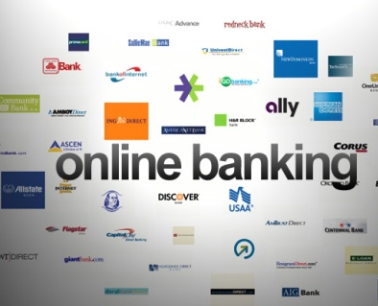
Need for sustainable business models in a transforming market…
Drivers for fixed and mobile data growth
Revenues are shifting towards OTT players
Telco services market revenues (bn US$)
OTT services market revenues (bn US$)
+699%
Forecasts
+35%
580
600
624
649
675
702
753
519
540
560
526
257
368
94
117
137
158
180
2013
2014
2015
2016
2017
2018
2019
2020
2021
Source: IDATE World Internet Services Markets, 2013
Profitability trap for traditional Telcos
Some challenges for traditional telecoms operators
Data traffic is growing exponentially and significant network investments are needed to meet the future demand
The needed investments can not (yet) be recovered by data revenues and traditional voice revenues continue to shrink
In addition, OTT players re-shuffle the market balance by focusing on the content offering rather than traffic
Operator profit margins significantly decrease over time and require innovative solutions to address these challenges
Revenues
OPEX
30,000
CAPEX + Depreciation
25,000
20,000
15,000
10,000
Shrinking
margins
EBIT
negative
EBITDA
negative
5,000
0
Source: Strategy Analytics (2014) - Wireless Operator Performance Benchmarking Q1 2014

Slide 19
…and balanced “like-for-like” policies and regulation
Regulatory parameters | Telecom operators | OTTs
Licence costs | High | N/a
Spectrum costs | High | N/a
Telecom tax/royalty | Sometimes high | N/a
USO funding | Sometimes high | N/a
Corporate tax | 20 – 35% | Often avoided
Customer care | Mandatory | Not mandatory
Municipal permissions | Required | Not required
Emergency services | Required | Not required
QoS parameters | Stringent | N/a
Security | Mandatory | Not mandatory
Rollout obligations | Often stringent | N/a
Interoperability | Interconnection required | Not required
Network neutrality | Often required | N/a
Source: Rory Macmillan, 2016

Slide 20
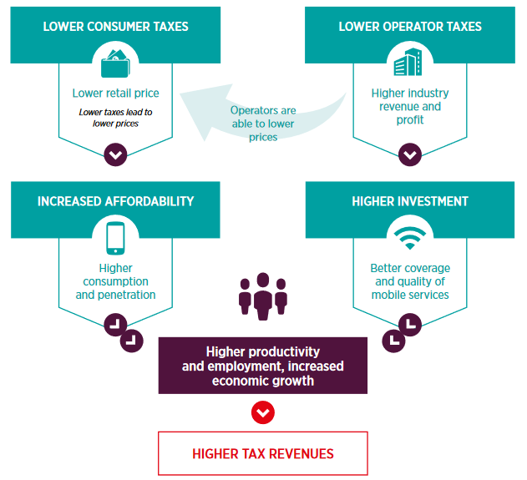
Impact of macro-economic policies remains significant
The impact of tax rebalancing on the economy
Consumer taxes as a proportion of TCMO* have increased over the years, from 17% in 2007, to 18% in 2011 to 20% in 2013
* Total cost of mobile ownership
Source: GSMA & Deloitte, 2015

Slide 21
Policy environment becomes increasingly complex…
Cloud Services
Big Data / Data Analytics
Platforms / OTT
Privacy / Data Transfers
Cybersecurity
Media / Video
…
E-Health
Industrial Internet
eID
E-Commerce
MFS
Internet of Things / M2M
SDN / NFV / Converging Networks
Network Integration
5G / Spectrum
Broadband for Development
New National Security Challenges
Traditional areas are still important: licensing, infrastructure, competition, interconnection, international bandwidth, universal services/access, retail regulation, taxation…
Notes:
How having an all-digital strategy propels VIP into a range of different policy areas.
Copyright important too – but this comes under Media / Video

Slide 22
…and requires innovative approaches
Outcome-based regulation
Speed of technological change demands forward-looking, principles-based regulations with clear intent, rather than prescriptive regulations
Co-regulation
Rules and codes developed by the industry, in consultation with the government, and with legislative backing should be considered as alternatives to direct regulation
Self-regulation
Where appropriate, self-regulation may be adopted, for which industry itself is responsible for enforcement
Notes:
Source: Malcolm Webb
Addition to outcome-based regulation:
Prescriptive regulations risk becoming out of date very quickly, which can lead to uncertainty among operators and reluctance to invest. Forward-looking, principles-based, broad regulation is a new approach and is an area that would also significantly benefit from stakeholder engagement.

Slide 23
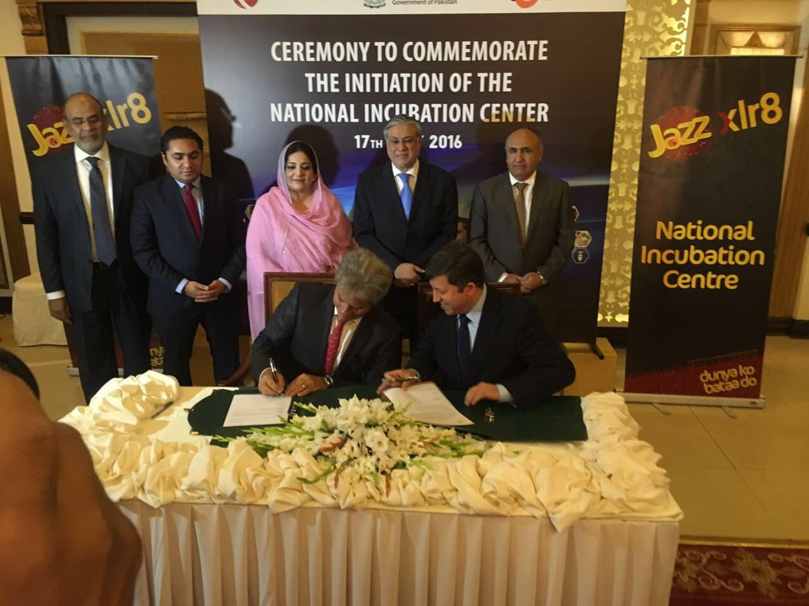
Key: Partnerships to empower communities and individuals
Our flagship programme
Partnerships for growth
Mobilink has launched an incubator facilitating start-ups in May. Jazz’s ‘National Incubation Center’ is set up under the National ICT R&D Fund and aligns with the government’s vision of a Digital Pakistan.
The goal of MYM is to empower young people to make a positive difference, through increased access to education and through inspiring social entrepreneurship, particularly in the digital arena.
Learn more:
http://www.vimpelcom.com/Responsibility/Make-your-mark/
In partnership with the Bangladesh Government, Banglalink will launch a Digital Incubator Center in July, supporting local entrepreneurs
Mobilink CEO signs the launch of the National Incubation Centre

Slide 24
“Our Vision is for our business to play a key role in the socio-economic success of the communities where we operate by providing high quality services to our customers, behaving as a responsible corporate citizen, and leveraging our technology to support development.”
Alexey M. Reznikovich
Chairman of the Supervisory Board
Tomas Lamanauskas, Group Director Public Policy
Tomas.Lamanauskas@vimpelcom.com

