Slide 2
Farmers’ needs
PREVENT RISK OF
PEST & DESEASES
OPTIMIZE
MANAGEMENT COST
&
PRODUCTION PROCESSES
CLIMATE
CHANGE
REDUCE THE USE OF
INPUT & RESOURCES
MONITOR & OPTIMIZE
MANAGEMENT DATA

Slide 3
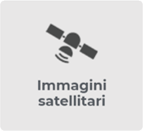
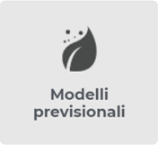
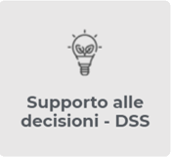
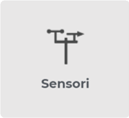
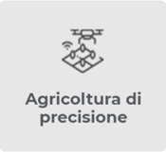
Innovative technologies for agriculture
AVAILABLE IN A SINGLE SAAS CLOUD PLATFORM AND MOBILE APP
Field
mapping
Satellite Imagery
Forecast models
Crop
Scouting
Sensors
Precision farming
DSS
Proprietary technologies, developed by Agricolus' agronomists and IT experts.
Notes:
Manca monitoraggio

Slide 4
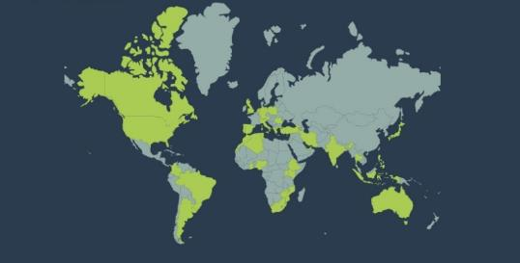
Numbers
Versamenti imminenti
2.304.000/month
+2.200
Global Partners
37
SATELLITE IMAGES
CERTIFIED PROFESSIONALS
International Projects
+10
10
66 COUNTRIES
7
5
LANGUAGES
OFFICIAL RESELLERS

