Slide 1
How to go about it…

Slide 2
The ITU-D Study Group Case Study Library:
Is available at:
http://www.itu.int/en/ITU-D/Study-Groups/2010-2014/Pages/case-study-library.aspx
May be accessed simply with a TIES account.
2
www.itu.int/ITU-D/study-groups

Slide 3
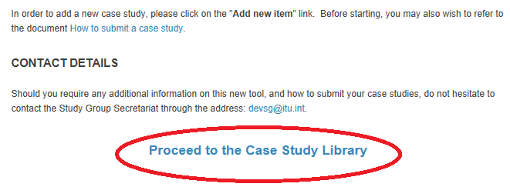
On the Case Study Library page, you have plenty of information that you may find useful, as well as the link that will take you to the library:
3
www.itu.int/ITU-D/study-groups

Slide 4
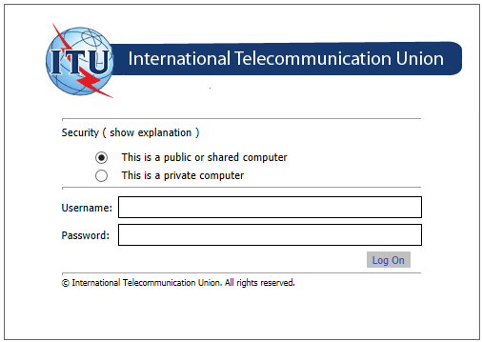
On the login page, enter your TIES username and password:
4
www.itu.int/ITU-D/study-groups

Slide 5
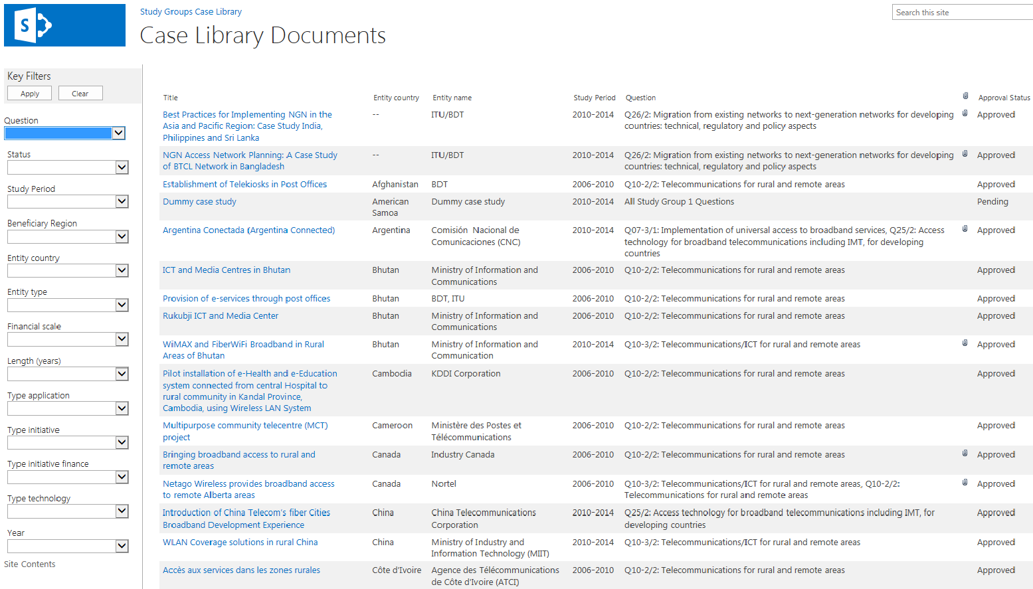
You will reach the library where all case studies are sorted by alphabetical order of the entity country:
5
www.itu.int/ITU-D/study-groups

Slide 6
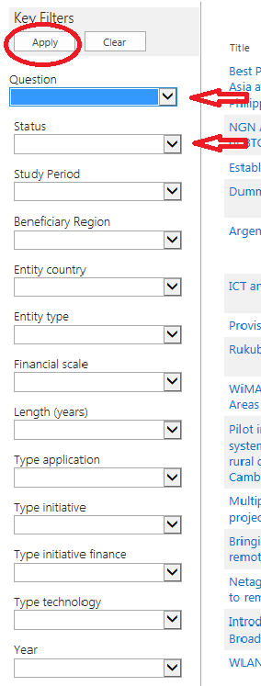
You will be able to search the cases posted using a list of filters on the left-hand-side of the menu and clicking “Apply”.
Once you are done, or if you want to filter using different criteria, simply click “Clear”.
6
www.itu.int/ITU-D/study-groups

Slide 7
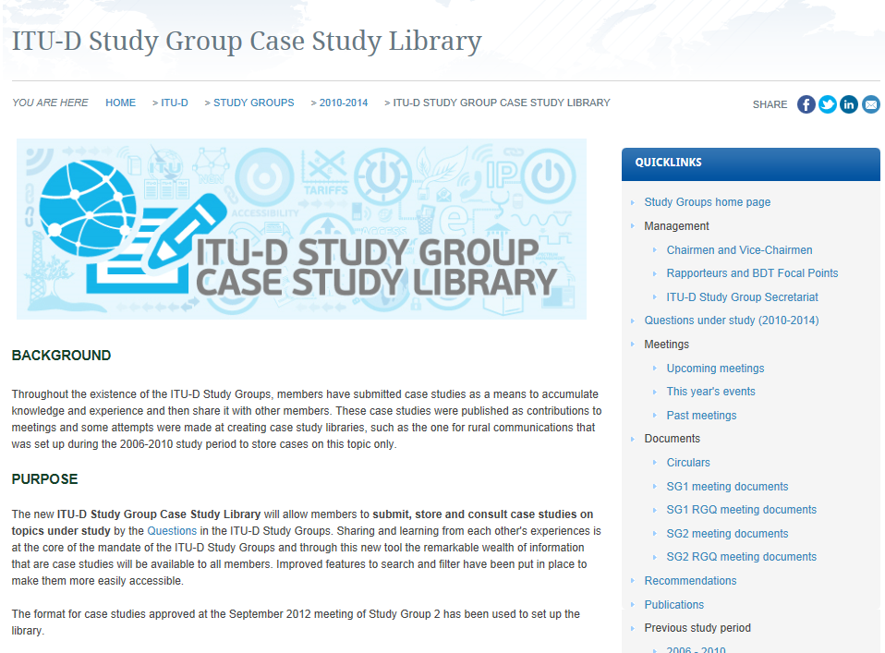
Before you decide to enter a new case study to the Library, please take the time to read the information displayed at: http://www.itu.int/en/ITU-D/Study-Groups/2010-2014/Pages/case-study-library.aspx
7
www.itu.int/ITU-D/study-groups

Slide 8
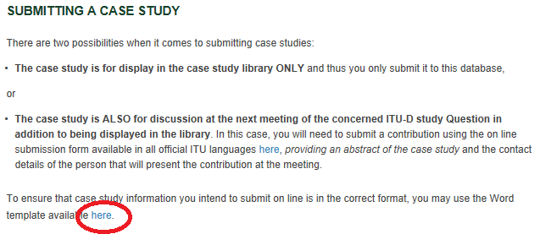
In order to easily enter a case study into the Library, it is necessary to map the information on the case study according to the Word template available on the website (http://www.itu.int/en/ITU-D/Study-Groups/2010-2014/Pages/case-study-library.aspx)
8
www.itu.int/ITU-D/study-groups

Slide 9
Once your case study has been mapped out, proceed to the Library and click on “Add new item”
9
www.itu.int/ITU-D/study-groups

Slide 10
Fill in the on line form one page at a time.
For the time being, the “Submit button” is only available on the last page (page 10).
10
www.itu.int/ITU-D/study-groups

Slide 11
In order not to lose the information should you be disconnected, you may decide to proceed to the last page (page 10) and submit the form once you have completed all the mandatory fields (indicated with a red asterisk*).
Note: The last mandatory field is on page 3.
11
www.itu.int/ITU-D/study-groups

Slide 12
12
www.itu.int/ITU-D/study-groups

Slide 13
13
www.itu.int/ITU-D/study-groups

Slide 14
You will then need to go back to the library’s main page and edit the case study you just submitted.
14
www.itu.int/ITU-D/study-groups

Slide 15
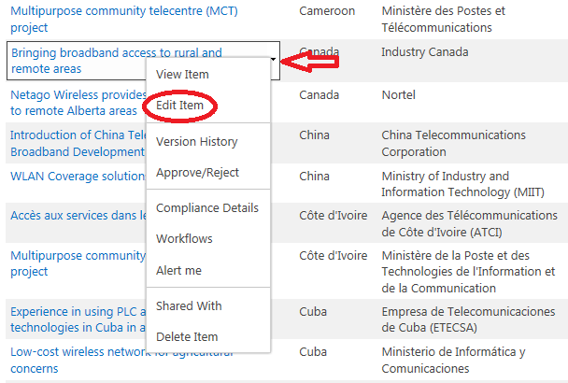
Hover over the title of your case study with the cursor and click on the arrow. On the drop-down menu, choose “Edit item”.
15
www.itu.int/ITU-D/study-groups

Slide 16
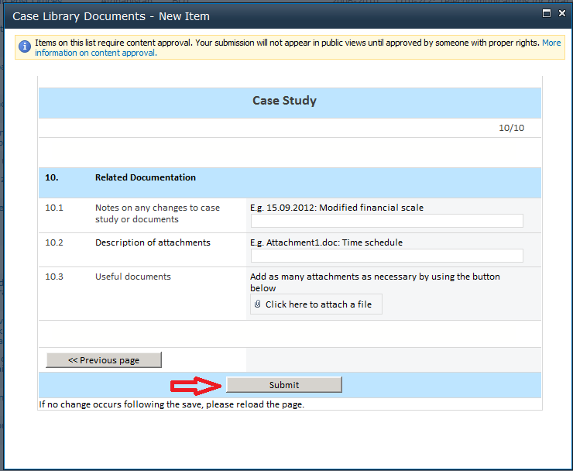
As before, once you get to the last page, click on the “Submit button”.
16
www.itu.int/ITU-D/study-groups

Slide 17
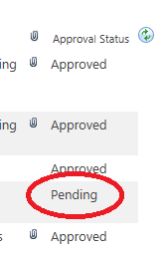
The way the system is currently set up, cases are not visible in the library to anyone but the submitter when they are saved, until BDT changes their status to “Approved”.
To the submitter, the new case will appear with the status “pending”.
17
www.itu.int/ITU-D/study-groups

Slide 18
Case studies are also not visible to persons other than the submitter once the “Submit” button is clicked after editing, until BDT changes their status to “Approved”.
18
www.itu.int/ITU-D/study-groups

Slide 19
We trust this will assist you when using the ITU-D Study Group Case Study Library.
For any questions, do not hesitate to contact the secretariat at:
devsg@itu.int
19
www.itu.int/ITU-D/study-groups

