Slide 1
Conformity and Interoperability for AFR Region Type Approval testing for mobile Terminals, Homologation Procedures And Market Surveillances
Electronic Procedures of type approval for mobile terminals: Tunisian approch
Presented by: Chammem Abdelkarim
Chammem.abdelkarim@cert.mincom.tn

Slide 2
Plan
1
Introduction
2
Procedure
3
Business Application
4
One Stop Shop Online Services
5
Statistics
6
Conclusion
Presented by: Chammem Abdelkarim Decembre 2015

Slide 3
Plan
1
Introduction
2
Procedure
3
Business Application
4
One Stop Shop Online Services
5
Statistics
6
Conclusion
Presented by: Chammem Abdelkarim Decembre 2015

Slide 4
1- Introduction
Control and examination organisms play a major role in security of property and of persons. They are involved in many areas of control such as: Industrial, electrical installations, welding, snap-on apparatus, food processing industry, health, environment, building, tourism, information technology.
In this context the One-Stop Shop of Information Technology and Communication has been created by decree 2639 on 21 July 2008 in order to provide administrative authorizations dealing with import operations and marketing systems.
Presented by: Chammem Abdelkarim Decembre 2015

Slide 5
Plan
1
Introduction
2
Procedure
3
Business Application
4
One Stop Shop Online Services
5
Statistics
6
Conclusion
Presented by: Chammem Abdelkarim Decembre 2015

Slide 6
2- Procedure
Procedure is an orderly and formal description of series of operations and instructions to make the system consistent shared reliable and credible. It specifies in particular
Different tasks and their modalities of execution,
The respective responsibilities of the different dealers or operators,
The methods of establishment of the different documents necessary for administrative, financial, accounting, operational and technical management,
Control modalities at every stadium of the system information.
Presented by: Chammem Abdelkarim Decembre 2015

Slide 7
2- Procedure
Written procedures, validated and integrated in our business applications allows each agent to:
Act with Perfect knowledge of the system,
Process documents according to the pre-defined conventions easily,
An efficient tool of training for newly recruited, transferred or appointed provisionally employee,
A written support for the execution of daily’s agent tasks,
Monitoring tool for internal and external auditors.
Presented by: Chammem Abdelkarim Decembre 2015

Slide 8
Plan
1
Introduction
2
Procedure
3
Business Application
4
One Stop Shop Online Services
5
Statistics
6
Conclusion
Presented by: Chammem Abdelkarim Decembre 2015

Slide 9
3- Business Application
The One-Stop Shop has develop a specific business application in order to:
Computerize and automate approval and technical control processes,
Ensure the effectiveness and speed of processing customer requests,
Ensure transparency of approval procedures and technical control,
Reduce the time required for the clearance of samples,
Guarantee an adequate service and a better quality,
Favour communication between colleagues,
Presented by: Chammem Abdelkarim Decembre 2015

Slide 10
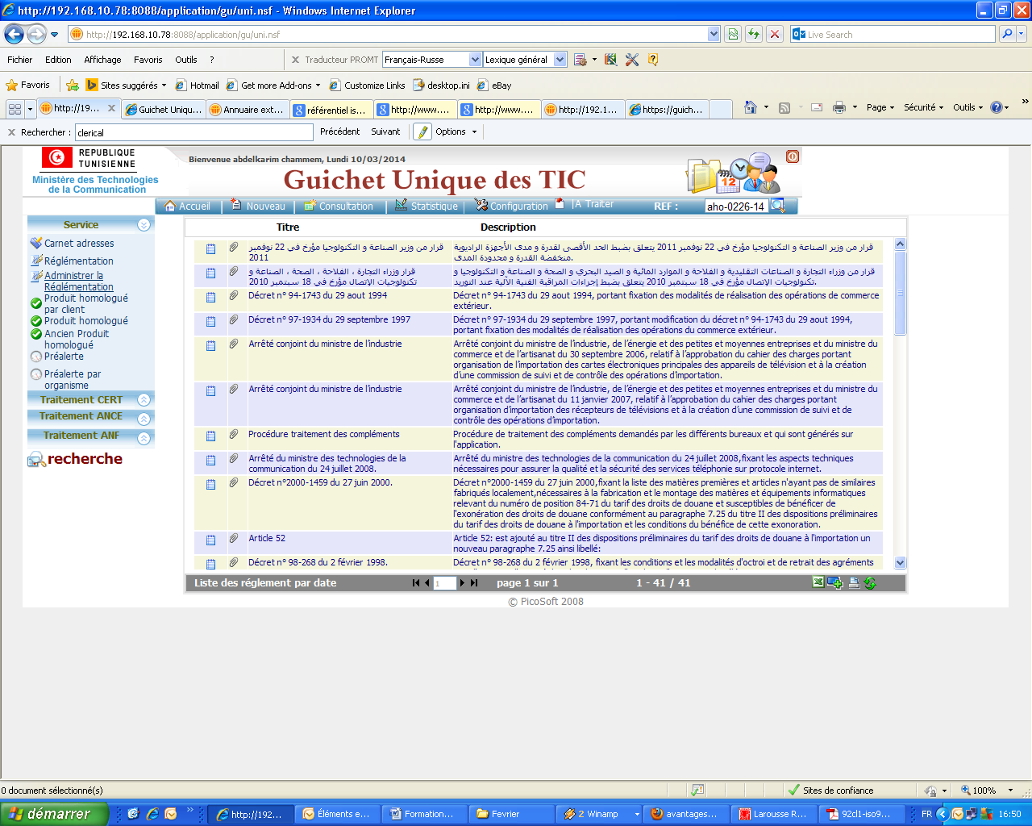
3- Business Application
Consultation and regulation
Presented by: Chammem Abdelkarim Decembre 2015

Slide 11
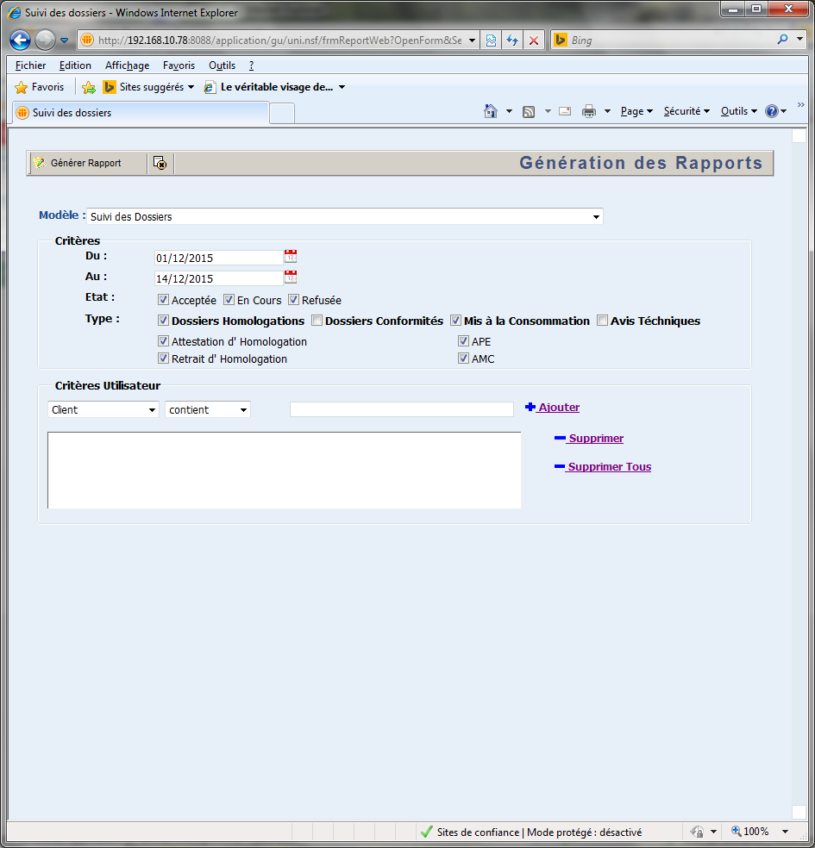
3- Business Application
Statistics and reporting
Presented by: Chammem Abdelkarim Decembre 2015

Slide 12
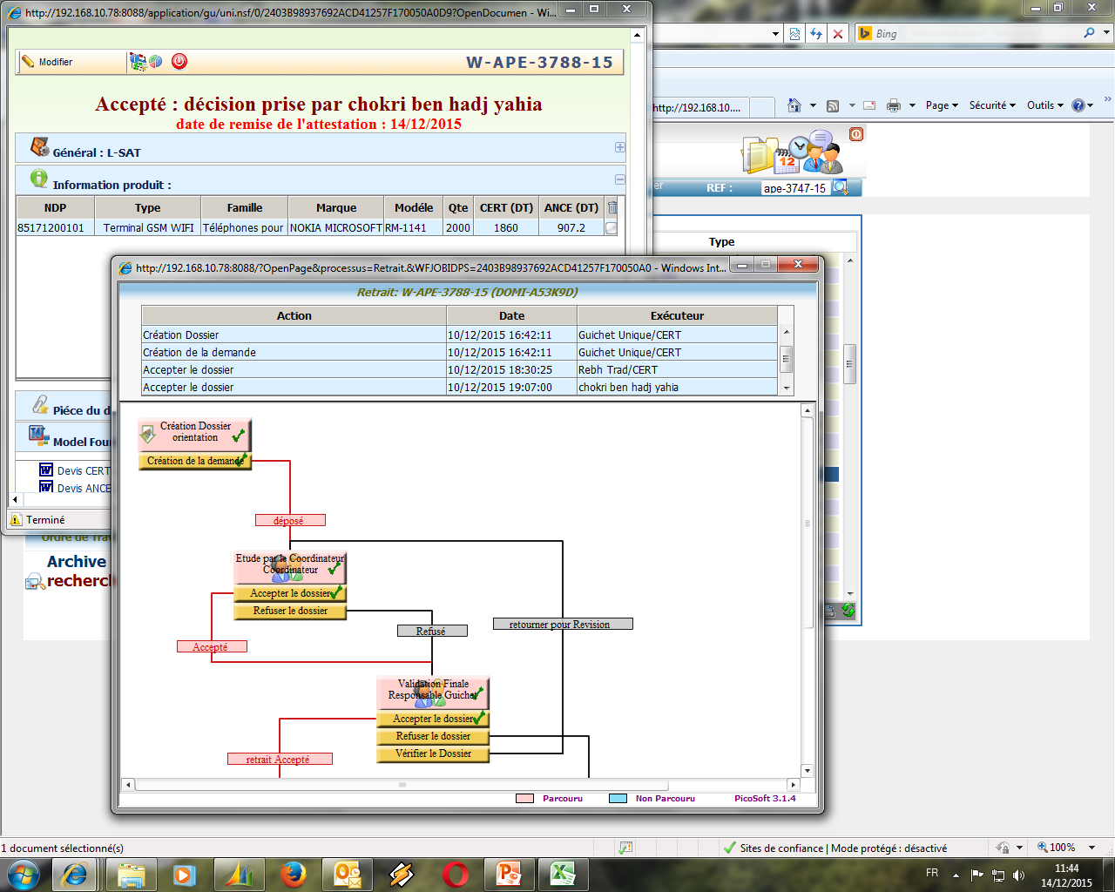
3- Business Application
Workflow to ensure traceability
Presented by: Chammem Abdelkarim Decembre 2015

Slide 13
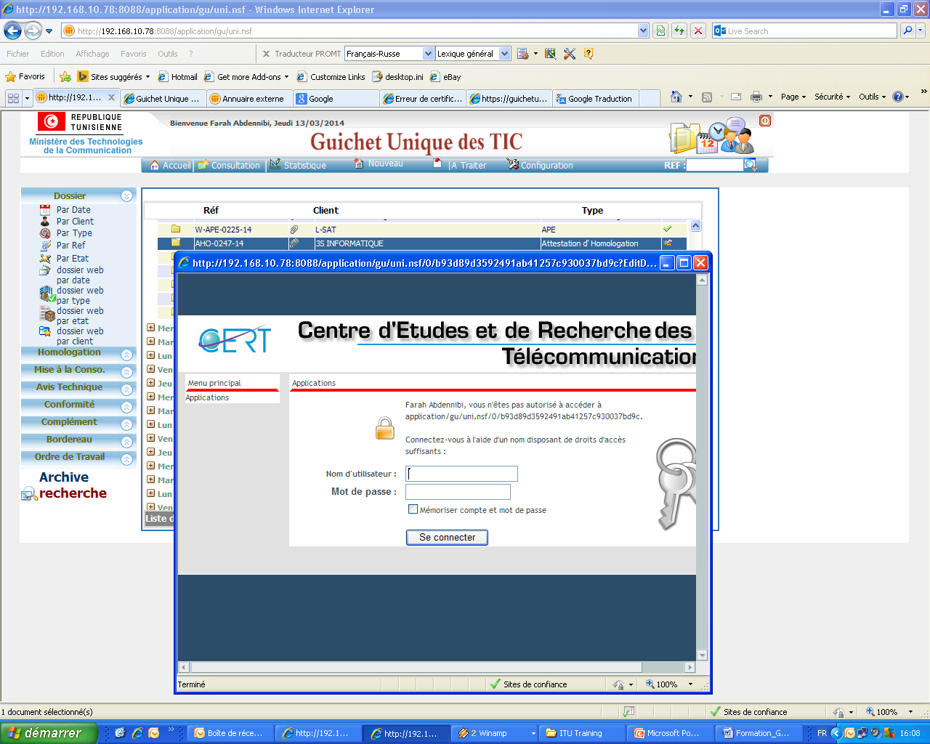
3- Business Application
Security
Presented by: Chammem Abdelkarim Decembre 2015

Slide 14
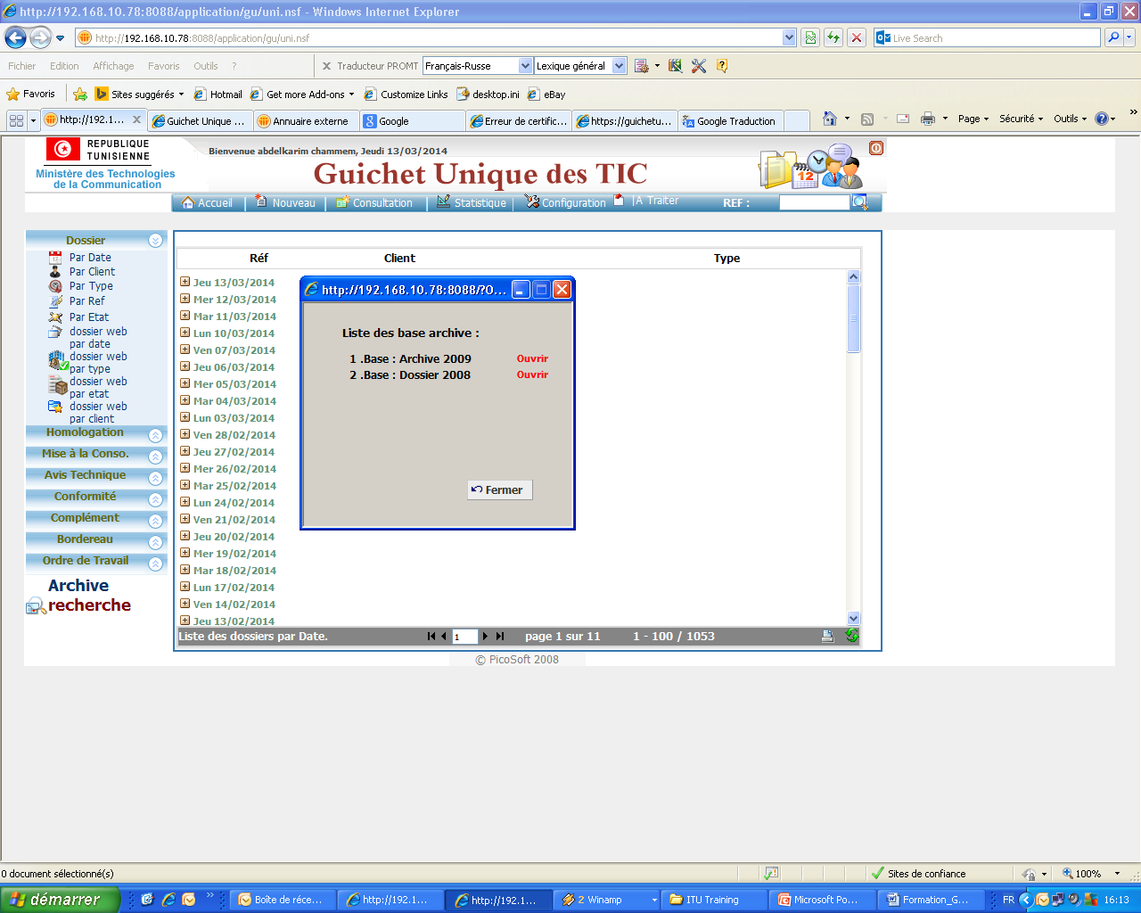
3- Business Application
Backup
Presented by: Chammem Abdelkarim Decembre 2015

Slide 15
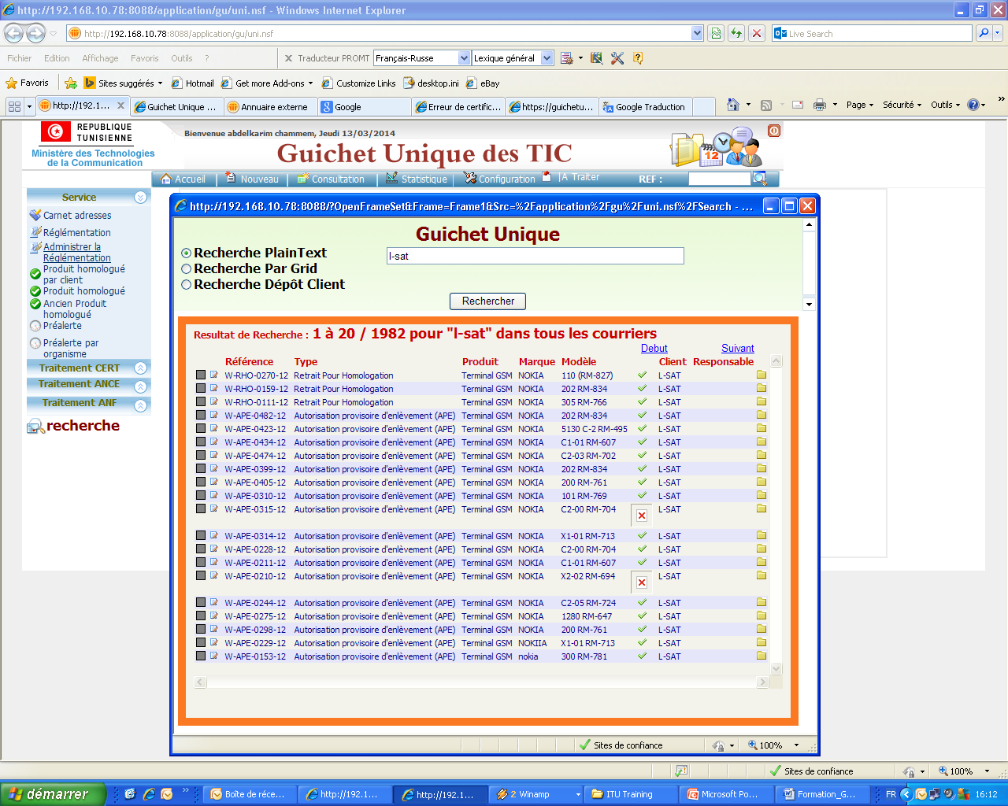
3- Business Application
Search module
Presented by: Chammem Abdelkarim Decembre 2015

Slide 16
3- Business Application
Modules to be integrated
Consultation and regulation,
Statistics and reporting,
Workflow to ensure traceability,
Risk management,
Security,
Backup,
Search,
Presented by: Chammem Abdelkarim Decembre 2015

Slide 17
Plan
1
Introduction
2
Procedure
3
Business Application
4
One Stop Shop Online Services
5
Statistics
6
Conclusion
Presented by: Chammem Abdelkarim Decembre 2015

Slide 18
4- One-Stop Shop online services
The one-stop shop of technologies of information and of communication instituted in the Centre of Studies and of Research of Telecommunications (CSRT) gives to his customers and to the various partners (control organism) a multitude of benefits and of services across client services, partner and job included at the level of its site web https://guichetunique-tic.cert.tn.
He assures besides a big suppleness and simplicity of use for the store of requests client, their consultation and their coherent.
Presented by: Chammem Abdelkarim Decembre 2015

Slide 19
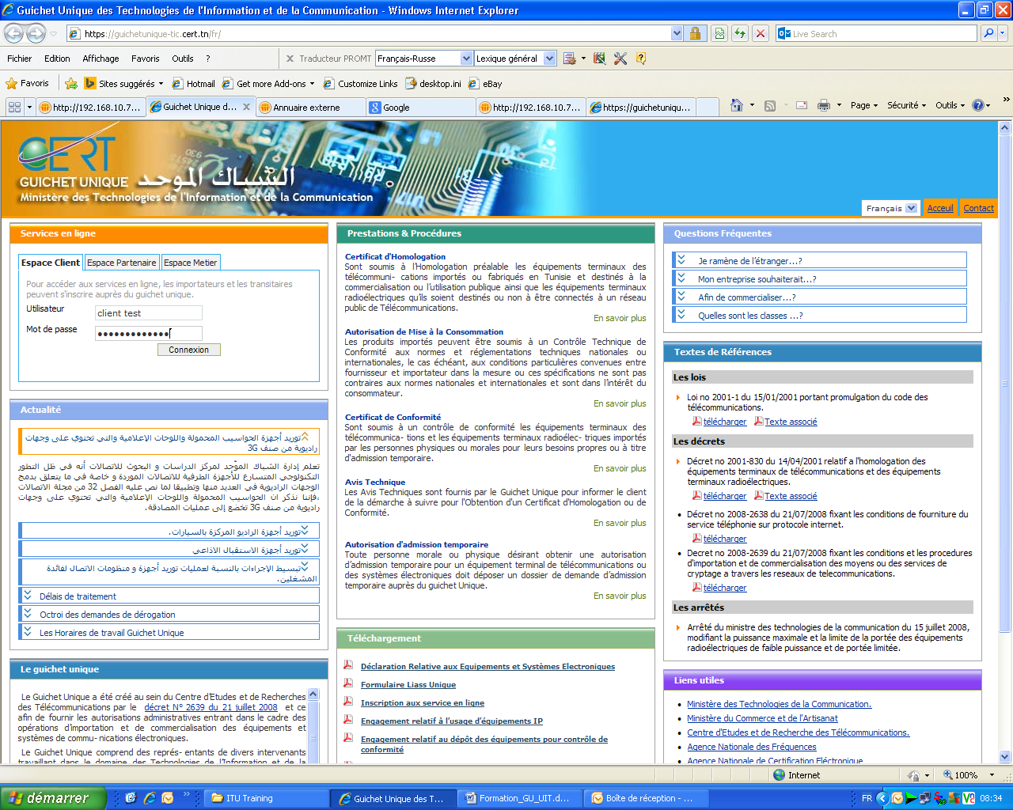
4- One-Stop Shop online services
Authentification
Presented by: Chammem Abdelkarim Decembre 2015

Slide 20
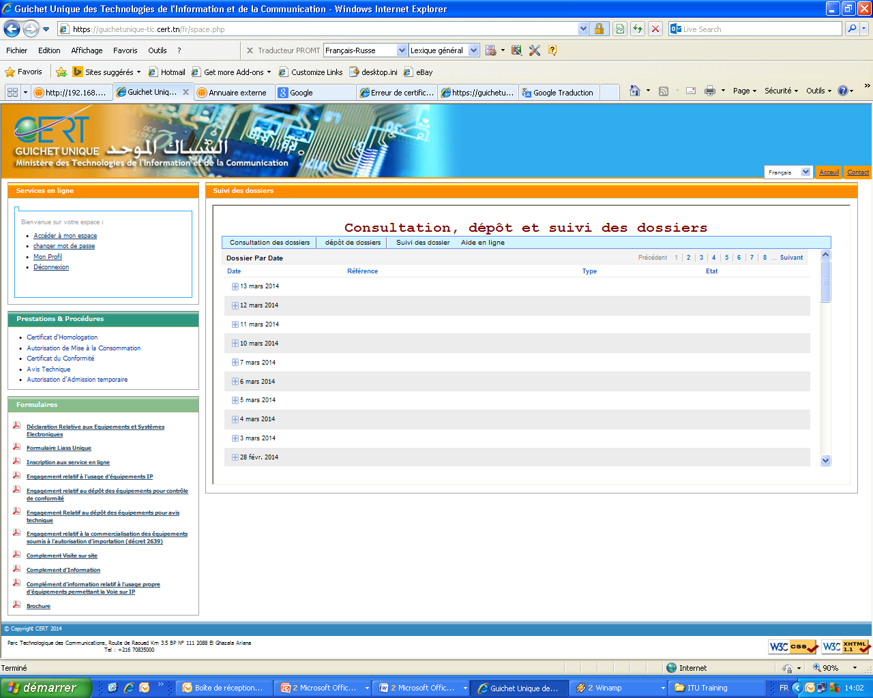
4- One-Stop Shop online services
Consultation
Presented by: Chammem Abdelkarim Decembre 2015

Slide 21
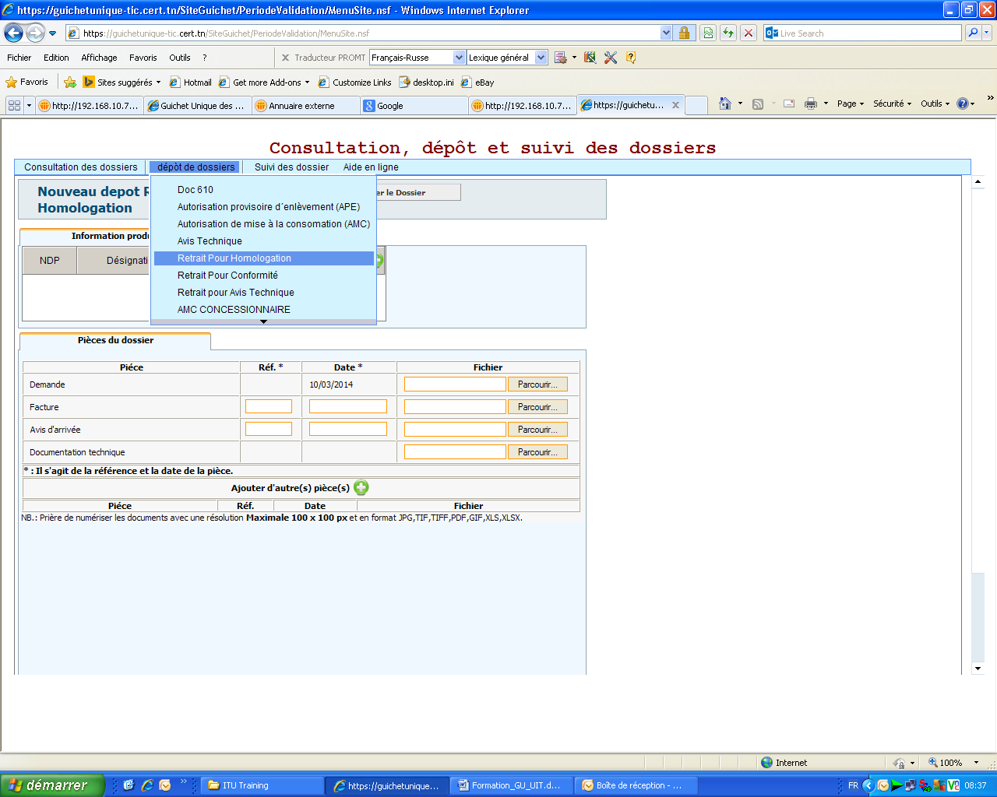
4- One-Stop Shop online services
Deposit of application
Presented by: Chammem Abdelkarim Decembre 2015

Slide 22
Plan
1
Introduction
2
Procedure
3
Business Application
4
One Stop Shop Online Services
5
Statistics
6
Conclusion
Presented by: Chammem Abdelkarim Decembre 2015

Slide 23
5- Statistics
Presented by: Chammem Abdelkarim Decembre 2015

Slide 24
5- Statistics
Presented by: Chammem Abdelkarim Decembre 2015

Slide 25
5- Statistics
Presented by: Chammem Abdelkarim Decembre 2015

Slide 26
5- Statistics
Presented by: Chammem Abdelkarim Decembre 2015

Slide 27
Plan
1
Introduction
2
Procedure
3
Business Application
4
One Stop Shop Online Services
5
Statistics
6
Conclusion
Presented by: Chammem Abdelkarim Decembre 2015

Slide 28
6- Conclusion
Following a well-written set of procedures helps employees to learn about and to do many or all aspects of their jobs independently,
They are also sets of instructions employees follow to ensure that they carry out specific tasks thoroughly and consistently
They are tailored for the organization and the job, not to a specific employee,
Presented by: Chammem Abdelkarim Decembre 2015

Slide 29
6- Conclusion
By following procedure, even the newest employee can learn quickly about how the organism operates and why,
Procedures should be reviewed and updated periodically to reflect changes.
Presented by: Chammem Abdelkarim Decembre 2015

Slide 30
Thank you for
your attention
Chammem.abdelkarim@cert.mincom.tn
Presented by: Chammem Abdelkarim Decembre 2015

