Slide 1

Conformity and Interoperability Training for ARB Region on Type Approval testing for Mobile Terminals, Homologation Procedures and Market Surveillance
Tunis-Tunisia, 20-24 April 2015
ITU C&I Programme: Pillars 3 and 4
Riccardo Passerini
Head Telecommunication Technologies and Network Development
ITU-BDT, Focal Point Q.4/2 riccardo.passerini@itu.int

Slide 2


C&I Programme
To tackle different obstacles to the achievement of conformity and interoperability, expressed by member states in ITU`s Decisions.
C&I Task Force
Regional Presence
Notes:
C&I Task Force evolving all Sectors
C&I Action Plan

Slide 3
Conformity Assessment benefits
Conformity assessment builds consumers’ trust and confidence in tested products and consequently strengthens business environment and, thanks to interoperability, the economy benefits from business stability, scalability and cost reduction of systems, equipment and tariffs.
While economically Conformance and Interoperability (C&I) increase market opportunities, encourage trade and technology transfer and contribute to the removal of technical barriers, they socially help spreading ICT services availability and affordability to all people at a good level of quality.
Notes:
PROBLEM STATEMENT
Conformity assessment builds consumers’ trust and confidence in tested products and consequently strengthens business environment and, thanks to interoperability, the economy benefits from business stability, scalability and cost reduction of systems, equipment and tariffs.
While economically Conformance and Interoperability (C&I) increase market opportunities, encourage trade and technology transfer and contribute to the removal of technical barriers, they socially help spreading ICT services availability and affordability to all people at a good level of quality.
To increase the benefits of C&I, many countries have adopted harmonized C&I regimes both at national and bi- or multi-lateral level. However, some developing countries, such as Southern African countries, have not yet done so because of a number of major challenges, such as the lack of appropriate/adequate regulatory frameworks, human capacity and infrastructure, to be in a position to test or to recognize tested ICT equipment (laboratories and related infrastructure).
World Telecommunication Standardization Assembly 2012 (WTSA-12), Dubai, Resolution 76.

Slide 4
ITU’s Decisions – C&I Action Plan
Resolution 177 ITU Plenipotentiary Conference
(PP-14)
Resolution 47 ITU World Telecommunication Development Conference (WTDC-10, rev. WTDC-14)
Resolution 76 ITU World Telecommunication Standardization Assembly (WTSA-08 rev. WTSA-12)
Resolution 62 Radiocommunication Assembly (RA-2012)
ITU Council Decisions (2009, 2010, 2011,2012, 2013, 2014)

Slide 5
“The ITU 4 Pillars”
C&I
1 Conformance Assessment
4 Testing Centers (Labs/MRAs)
2 Interoperability
3 Capacity Building
Notes:
Brief description and Action Plan Status

Slide 6
The ITU 4 “Pillars”
The Standardization Sector Side
Conformity Assessment
Interoperability Events
The Development Sector Side
Capacity building
Establishing C&I programmes in developing countries

Slide 7
The Telecommunication Development Bureau Side
Capacity building
Establishment of test centres and appropriate C&I Regimes including MRAs in developing countries.
ITU Forums with in-deep consideration for test centres and Capacity Building in the Regions
Held 2010 -2013:
Africa (Kenya 2010, Ghana 2011)
CIS (Moscow 2011)
Americas (Brasilia 2012)
Arab States (Tunis 2012) Forum and Training
Asia Pacific (Myanmar 2013)
Held 2014:
CIS (Moscow)

Slide 8
Capacity building and test centres
ITU is implementing proposals on human capacity building
ITU will assist developing countries in the establishment of test facilities and in cooperation with international institutions:
  UNIDO
  International Laboratory Accreditation Cooperation (ILAC)
  International Accreditation Forum (IAF),…)
  Labs and R&D institutions

Slide 9
Needs in Developing Countries for Test Labs and/or MRAs
Conformity Assessment Bodies to contribute to create an orderly telecom apparatus market place
Once reference standards and procedures are in place, test labs and/or MRAs can approve equipment for compliance
Sharing test labs resources and using same procedures amongst countries and regions may lowering overall costs while continuing addressing regional priorities
A robust framework (following international procedures – ISO/CASCO) needed for trust and confidence in test results and among test labs (MRAs)

Slide 10
Pillar 3
C&I
1 Conformance Assessment
4 Testing Centers (Labs/MRAs)
2 Interoperability
3 Capacity Building

Slide 11
Partnership and Collaboration
The ITU Secretariat signed MoUs with Testing centers in the Regions for promoting activities of the C&I Programme such as capacity building events and direct assistance:
AFR and ARB: CERT (Research and Studies Telecommunication Center, Tunisia)
AMS: CPqD (Brazil)
Europe: Sintesio (Slovenia) and Tilab (Italy)
CIS: ZNIIS (Russia)
ASP: agreement being finalized with MIIT (China)
International Accreditation Forum (IAF) and
International Laboratory Accreditation Cooperation (ILAC)
International Standardization Organization (ISO)
UNIDO

Slide 12
ITU Training activities on C&I
http://www.itu.int/en/ITU-D/Technology/Pages/CI_Events.aspx
ITU Academy – C&I training
CIS Countries NGN integration testing, Moscow (Russian Federation), 2010 and 2011
Africa and Arab Regions, Tunis 5-7 Nov 2012
ARB Region, Tunis 2-6 April 2013 (EMC Compatibility)
Africa Region, Tunis 28 October-1st November 2013 (EMC Compatibility)
Americas Region, Campinas, 24-28 June 2013 (EMC Compatibility)
ARB Region, Tunis 17-22 March 2014 (Mobile terminals)
Americas Region, Campinas (Brazil) 12-16 May 2014, (Mobile terminals)
Training Course on Conformance and Interoperability Testing for the Africa Region, 23-27 June 2014, Tunis (Tunisia)
CIS Region: ITU Virtual Laboratory for Remote Tests of Equipment, New Technologies and Services", 10-12 November 2014, Moscow (Russian Federation)

Slide 13
ITU Training activities on C&I for 2015
Training Course for the Arab Region on Type Approval Testing for Mobile Terminals, Homologation Procedures and Market Surveillance, 20-24 April 2015, Tunis (Tunisia)
Training Course for the Americas Region on Type Approval Testing for Mobile Terminals, NGN integration and interoperability testing, Homologation Procedures and Market Surveillance, 8-12 June 2015, Campinas (Brazil)
Training Course for the Africa Region on Type Approval Testing for Mobile Terminals, Homologation Procedures and Market Surveillance, 27-31 July 2015, Tunis (Tunisia)
Training Course for CIS Region, San Petersburg, July 2015 (t.b.c.)
Training Course for ASP Region, October 2015 (t.b.c.)

Slide 14
Training Goals
The ITU Training on C&I – is a capacity event in the framework of the Conformity and Interoperability Programme that has as objective:
  Improve knowledge of participants through the presentation of up-to-date information/technologies
  Contribute to increase awareness on the relevance of C&I testing
  Provide the necessary tools for participants to replicate knowledge in their country, taking into consideration national specificities
  Promote experience-sharing on Certification/Homologation process, Lab. Accreditation and testing among the participants from different countries in Conformance and Interoperability field
  Present a practical learning on standards, regulations, real Lab experience and accreditation procedures.

Slide 15
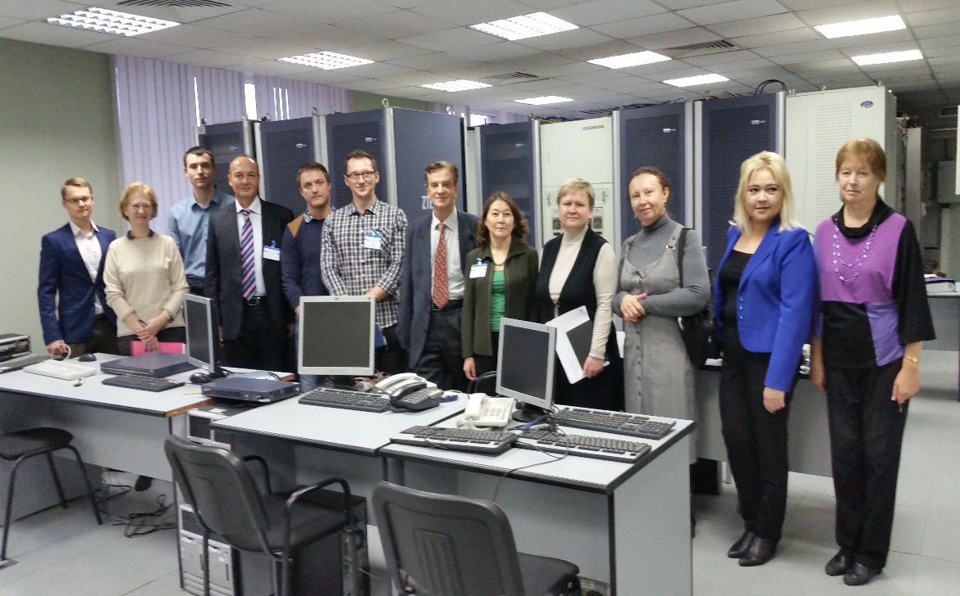
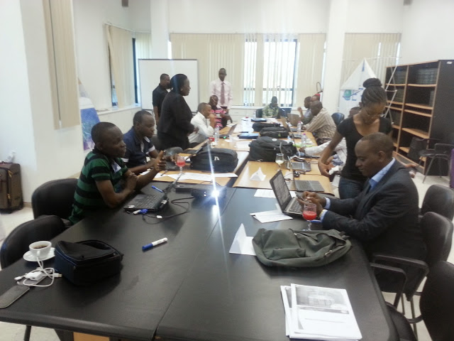
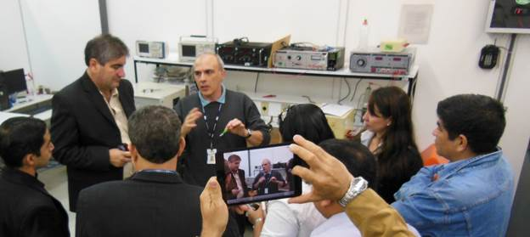
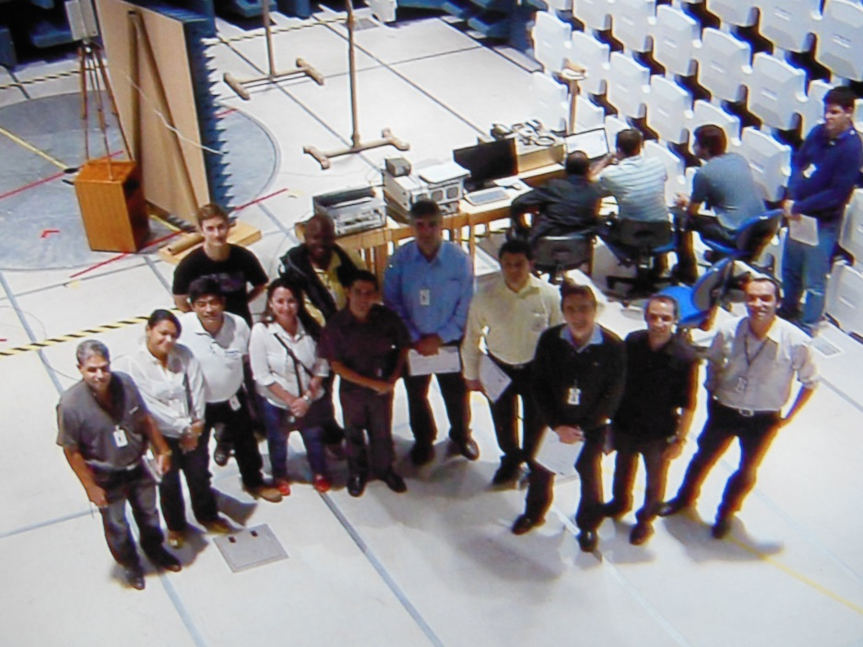
Training on C&I

Slide 16
Pillar 4
C&I
1 Conformance Assessment
4 Testing Centers (Labs/MRAs)
2 Interoperability
3 Capacity Building

Slide 17
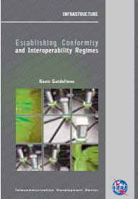
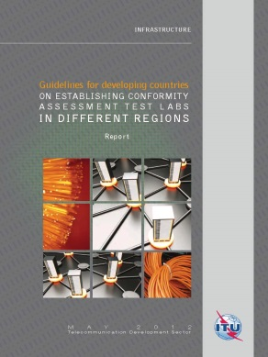
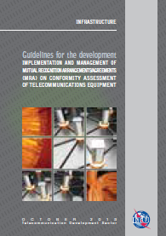
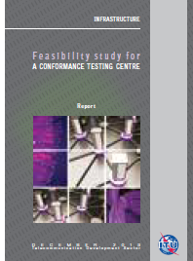
ITU C&I Guidelines
Establishing Conformity and Interoperability Regimes – Basic Guidelines (2014)
These Guidelines address challenges faced by developing countries as they plan and review their own C&I regimes. Aspects covered by this publication include, inter alia, conformity assessment procedures; legislation to promote an orderly equipment marketplace; surveillance; coordination across regulatory agencies; and relevant international standards.
Guidelines for developing
countries on Establishing Conformity assessment Test Labs in Different Regions (2012)
This set of guidelines is the first publication on C&I, its valuable content includes information concerning: The process required for building testing labs; A site analysis (e.g. existing testing labs, know-how);Collaboration mechanisms; Best practices; Reference standards and ITU Recommendations
Guidelines for the Development, Implementation and Management of Mutual Recognition Arrangements/Agreements on Conformity Assessment (2013)
These guidelines promote the understanding and establishment of Mutual Recognition Agreements (MRAs)
on conformity assessment that are intended to promote efficiency and resource sharing as well as to streamline the flow of products among participating Parties such as ITU Member States and private sector organizations, such as testing laboratories
Feasibility Study for the establishment of a Conformance Testing Centre (2013)
This feasibility study describes environments, procedures and methodologies to be adopted to establish, manage and maintain a testing center covering different kinds of conformance and interoperability testing areas

Slide 18
terms of reference available here
New ITU C&I Guidelines
Establishing Conformity and Interoperability Regimes – Complete Guidelines (2015)
These Guidelines compiled from a careful collection of international best practices,
address challenges faced by developing countries as they plan and review their own C&I regimes. Aspects covered by this publication include, inter alia, conformity assessment procedures; the right type of approval system, the legislation required to promote an orderly telecommunication service and marketplace; the calculation of fees, and the ideal enforcement and Surveillance; coordination across regulatory agencies; relevant international standards.

Slide 19
Direct Assistance on C&I
A number of countries have expressed strong interest and requested direct assistance (e.g. Sri-Lanka, Kiribati, Mongolia, Zambia, Cameroon, Cote d’Ivoire) in establishing C&I infrastructure and procedures
The Direct Assistance provided through the Regional Offices will provide support taken into consideration all C&I aspects, as:
  Regulatory framework
  Institutions roles and typical procedures
  Mutual Recognition Agreements
  Funding
  regional test centres and harmonized C&I programmes.
Notes:
Institutions: Accredita

Slide 20
Direct Assistance on C&I
A number of countries have expressed strong interest and requested direct assistance (e.g. Sri-Lanka, Kiribati and Mongolia) in establishing C&I infrastructure.
The Direct Assistance provided through the Regional Offices will provide support taken into consideration all C&I aspects, as:
  Policy and Regulatory framework
  Institutions roles and typical procedures
  Mutual Recognition Agreements - MRAs
  Funding
  regional test centres and harmonized C&I programmes.
  Roadmap and feasibility study for building labs

Slide 21
Direct Assistance on C&I
Mongolia
Cameroon
Zambia
Cote d’Ivoire
Ecuador

Slide 22
C&I Regional Assessment Studies
The C&I Assessment Studies looks for promoting the establishment of Harmonized C&I Programmes, when possible.
It will collaborate to improve regional integration and foster the availability of highly qualified institutions (as Laboratories, Certification and Accreditation Bodies)
In an overall analysis, the Assessment Studies contributes to:
Bridging the Standardization Gap,
reducing the Digital Divide, and
as is inherent to ICT technologies development, strengthens business environment for global players.

Slide 23
C&I Regional Assessement Studies
C&I infrastructure in regions/sub-regions/countries are being assessed
Analysis of the status in the regions are being conducted
Looking for promoting regional agreements about possible locations for resources (Labs), agreements and testing capabilities
Close collaboration with regional experts in addressing capacity building activities, accreditation and type approval testing.
Moving forward to establishing regional test centers and/or MRAs as appropriate

Slide 24
C&I Regional Assessment Studies
Roadmap
Conformity Assessment Bodies will contribute with an orderly telecom apparatus market place
Once standards and procedures are in place, test labs and/or MRAs can approve equipment for compliance
Sharing test labs resources and using same procedures amongst countries and regions, lowers overall costs while continues addressing regional priorities
Setup of a robust framework (base on international procedures – ITU, ISO, IAF, ILAC, etc.) needed for trust and confidence in test results and among test labs

Slide 25
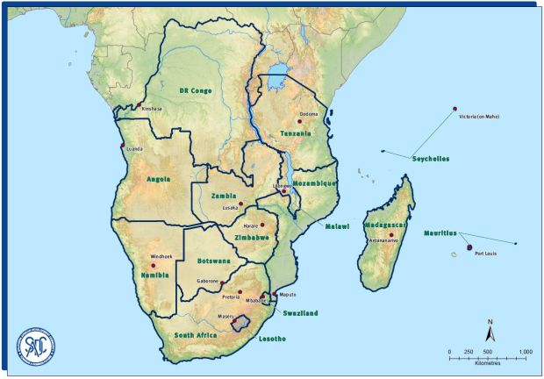
C&I Regional Assessment Studies
Calendar
Assessment Study for SADC Region completed 2014)
  The results of the Assessment Study have been presented during the Subregional Workshop for SADC (Southern African Development Community), 13-15 October 2014, Livingstone (Zambia)

Slide 26
C&I Assessment Study for SADC
Final Report
Survey Findings
Outcomes of the Workshop for SADC, Livingstone, Zambia, 13-15 October, 2014
  Recommendations: In Country C&I Test Lab
  Criteria for selecting countries for establishing regional test centres
  Proposed plan for a SADC framework MRA
  Media ​statement on the meeting of SADC Ministers Responsible for Communications, Postal and ICTs. Mangochi, Malawi,​ 21 November 2014​​

Slide 27

Assessment Study for Maghreb countries
Mauritania, Morocco, Algeria, Tunisia, Libya (completed 2014)
The results of the assessment study will be presented during the Subregional Workshop for Maghreb Countries, Tunis 9-11 December 2014
  Assessment Study for AMS (Caribbean) conducted in 2014, Assessment Studies for AMS (Central America) and AFR (EAC countries) are being conducted during 2015

Slide 28
C&I Assessment Study for Maghreb
Final Report
Survey Findings
Outcomes of the workshop for Maghreb, Tunis 9-11 December 2014
    Recommendations: In Country C&I Test Lab
    Criteria for selecting countries for establishing regional test centres
    Proposed plan for a Maghreb framework MRA

Slide 29
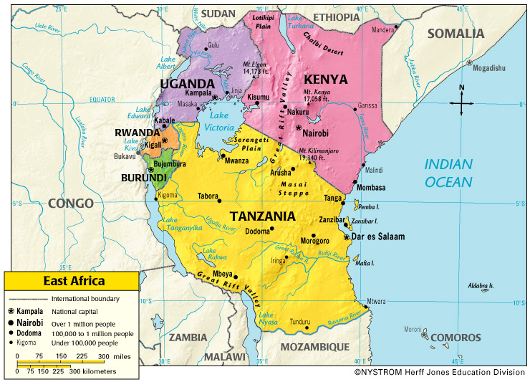
Assessment Studies for EAC countries:
The East African Community (EAC) is the regional intergovernmental organisation of the Republics of Burundi, Kenya, Rwanda, the United Republic of Tanzania, and the Republic of Uganda, with its headquarters in Arusha, Tanzania. (ongoing 2015)
The results of the assessment study will be presented during the Subregional Workshop for EAC countries, Nairobi October 2015 (t.b.c.)

Slide 31
WTDC-14 outcomes on C&I
The Dubai Declaration recognized that conformance and interoperability of telecommunication/ ICT equipment and systems can increase market opportunities and reliability and encourage global integration and trade.
Resolution 47 was amended, reaffirming the importance of collaboration and coordination between the three ITU Bureaux in implementing the ITU C&I programme.

Slide 32
WTDC-14 outcomes on C&I
Study Group Question 4/2, mandate:
“Studies of various issues related to conformance and interoperability are to be reported, and among others the description of the technical, legislative and regulatory framework that would be needed to implement appropriate C&I programmes by developing countries. Specifically, the following outputs are envisaged:
a) Harmonized Guidelines on technical, legal and regulatory aspects of C&I Regime;
b) Feasibility studies regarding establishment of laboratories in different C&I Domains;
c) Guidance on the framework and procedures to establish MRA;
d) C&I Regimes, case studies established at national, regional or global levels;
e) Development of a methodology for assessing the situation of C&I regimes in place in the regions (or sub regions);
f) Experience sharing and case studies reports on C&I programmes implementation.”

Slide 33
First Meeting Q.4/2 on C&I

Slide 34
Main Outputs of the first meeting Q.4/2
Working Plan:
1) List of Tasks to be completed
2) Results anticipated including titles of output documents and their target dates
3) Liaison required with other groups
4) Working Methods
Annex 1: Table of contents for final report on Question 4/2
Annex 2:C&I Vocabulary – Common ground
(next meeting, Geneva 27 April- 8 May 2015)

Slide 35
WTDC-14 outcomes on C&I
Outcomes of Objective 2, Output 2.2 of the Dubai Action Plan, focusing on the following issues:
a) Educating technicians, policy-makers and businesses on the importance of C&I procedures and testing, mobilizing the resources required to implement regional and national C&I programmes, in cooperation with other relevant regional and international organizations;
b) Providing assistance to developing countries in the establishment of national, regional or subregional C&I programmes, and conducting assessment studies for facilitating the establishment of common conformance and interoperability regimes at national, regional and subregional level;
c) Preparing guidelines on this process which outline the technical and human resources required and the international standards to be applied.

Slide 36
ITU Cooperation
Analysing the status of resources in the regions
Finding regional agreements about possible locations for resources/ MRAs and testing capabilities: establishing Forums of Experts at Subregional Level
Participation in Capacity Building activities, accreditation and certification
Participation in the creation of a common C&I regime: MRAs and regional test laboratories

Slide 37


www.itu.int
Thank You !
Notes:
37
Thank you.

Slide 38
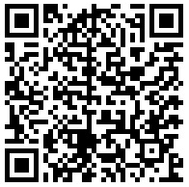
Thank you!!
C&I Portal
Riccardo Passerini
Head Telecommunication Technologies and Network Development
ITU-BDT, riccardo.passerini@itu.int

