Slide 1
Key activities and major ITU-T outcomes on C&I Pillar 1 and 2 of ITU C&I Programme

Slide 2
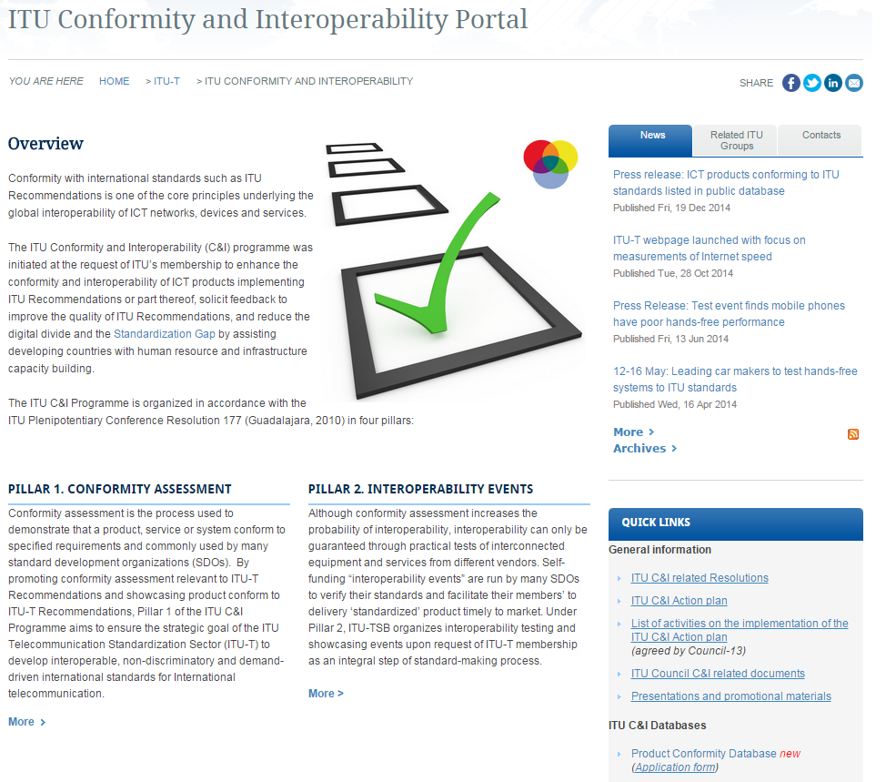
ITU-T C&I Portal
http://www.itu.int/en/ITU-T/C-I/Pages/default.aspx

Slide 3
Pillar 1
Conformity Assessment

Slide 4
Pillar 1 as defined in Resolution 177
(ITU PP-14)
“Instructs the Director of the TSB:
to continue to carry out pilot projects for conformity to ITU-T Recommendations to increase the probability of interoperability
to enhance and improve standards-setting processes in order to improve interoperability through conformity”
“Invited the Membership to populate the pilot conformity database with details of products tested to applicable ITU T recommendations”

Slide 5
Pillar 1 Key outcomes
First entries in the Product Conformity Database, (19 December 2014, http://itu.int/net/itu-t/cdb/ConformityDB.aspx)
Whitelist of mobile phones which meet the requirements of P.1100/P.1110
Pilot projects (http://itu.int/go/pilot-projects) of conformity assessment against ITU-T Recs
M.3170-series (SG2)
Mobile Number Portability (SG11)
SG11 work item Q.TL-rec-pro “Testing laboratories recognition procedure”
A living list of ITU-T Recommendations on key technologies suitable for C&I testing (http://itu.int/go/key-technologies)
A reference table of ITU-T Recs and corresponding test specification under C&I testing (http://itu.int/go/reference-table)

Slide 6
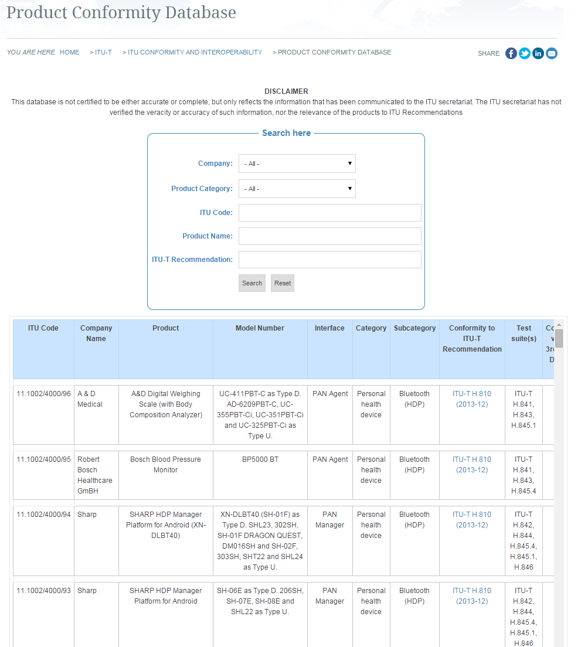
ITU conformity database http://itu.int/net/itu-t/cdb/ConformityDB.aspx

Slide 7
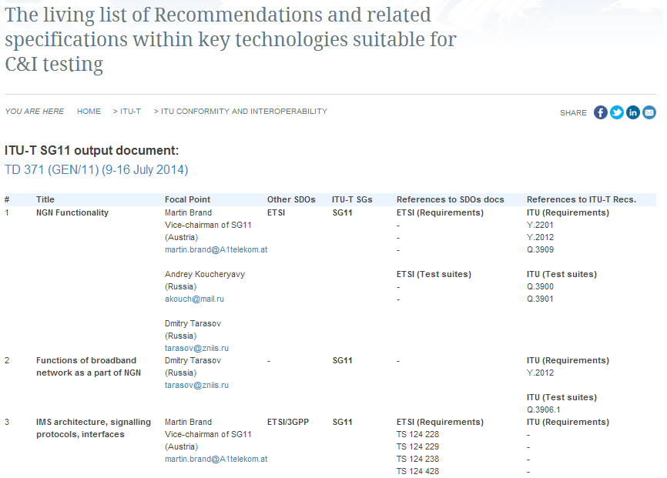
The list of key Technologies for C&I http://itu.int/go/key-technologies

Slide 8
Testing Laboratories recognition procedure work flow (under discussion)
In accordance with draft Recommendation ITU-T Q.TL_rec_pro “Testing Laboratories recognition procedure” (TD659-GEN/11, April 2015) there are two scenarios:
to join the existing conformity assessment programs, by providing ITU-T’s technical experts for making relevant TL’s assessment against ITU-T Recommendations;
based on experience gained from collaboration with existing schemes, ITU may in future consider the possibility of establishing a ITU-T TL self-recognition procedure, providing the assessment of ITU-T technical experts and assessment of the TL.

Slide 9
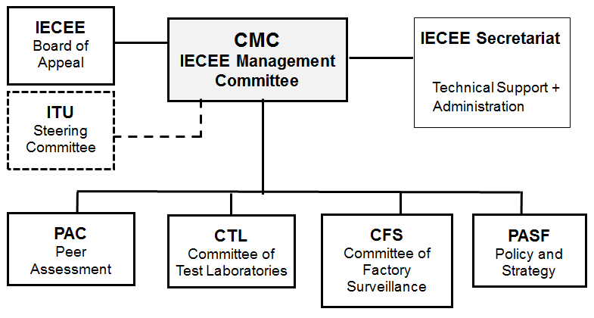
Possible ITU collaboration with IEC/IECEE
(PP-14, C63)
ITU partner with IEC to conduct a trial of voluntary 3rd party CA of suitable ITU-T Recommendations
A team of assessors selected by ITU-T and qualified by IECEE would recognize test labs which qualify for testing specific ITU-T Recommendations. A recognized test lab would then be able to issue certificates
An ‘ITU steering committee’ would be established within the IECEE organization structure

Slide 10
ITU-T SG11 activities on C&I
SIP-IMS conformity assessment. Work plan (C-218, SG11)
Requirements and test specifications of basic call and supplementary services which are provided on the IMS basis (around 20 new work items are going to start in April 2015)
Work item “Unified methodology of Internet speed quality measurement usable by end-users on the fixed and mobile networks” (ITU website)
New work item “Conformance test plan for Number Portability requirements defined by ITU-T Q.Suppl.4” (C-240, SG11)
Benchmarking of IMS platform. Work plan (C-220, SG11)

Slide 11
Objectives of SIP-IMS standardization plan
Collect all standards on SIP-IMS profile in ITU-T and amend it with missing standards (e.g. requirements, test specifications, use cases, etc.)
Establish the conformity assessment of SIP-IMS profile which may be used by all fixed telecom operators in the world for testing equipment based on SIP-IMS profile
Start the ITU pilot project for conformity assessment of the equipment which is based on SIP-IMS profile (Testing Laboratory and other interested parties are invited)
Create a list of TEs based on SIP-IMS profile which comply with ITU-T Recommendations (e.g. signalling protocol, voice QoS/QoE)
Note
Presentation of SIP-IMS standardization plan (TD219)
Work plan (TD218)

Slide 12
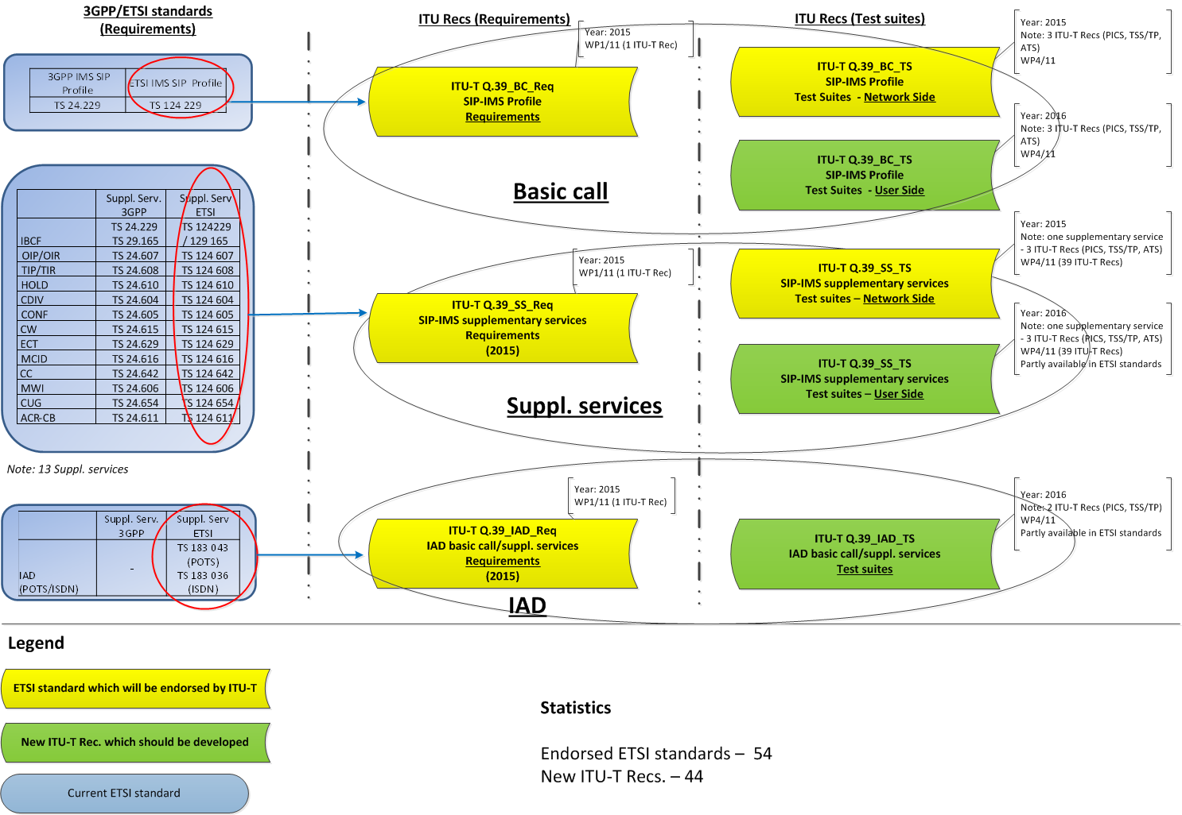
Work plan on SIP-IMS standardization

Slide 13
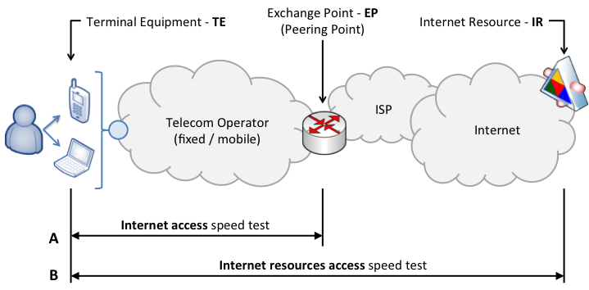
Measurements of Internet speed
(under ITU-T SG11 Q15/11 “Testing as a service TAAS”)
Two types of measurements:
Internet access speed
Internet resources access speed
Website
In progress:
Draft Recommendation ITU-T Q.Int_speed_test “Unified methodology of Internet speed quality measurement usable by end-users on the fixed and mobile networks”

Slide 14
ITU-T SGs activities on C&I
ITU-T SG12 assumes that ITU-T P.381 “Technical requirements and test methods for the universal wired headset or headphone interface of digital mobile terminals” may become a candidate for a pilot project (iLS to SG11 TD641)
ITU-T SG2 continue developing conformance testing specifications for network management interface (ITU-T M.3170) (oLS from SG2)
ITU-T SG12 revised ITU-T P.1100/P.1110
ITU-T SG15 developed Implementers' Guide for Recommendation ITU-T G.9801 (Conformance and interoperability tests for OMCI-EPON) (iLS to SG11 TD634)

Slide 15
ITU Activities to combat counterfeiting
ITU-T PP-14 New Resolution on Combating counterfeit telecommunication/ICT devices which refers to the Resolution 177 (PP-14) on Conformity and Interoperability
WTDC-14 Resolution 79 “The role of telecommunications/ICT in combating and dealing with counterfeit telecommunication/information and communication devices”
ITU held an event on combating counterfeit and substandard ICT devices (17-18 November 2014) Note: In its conclusion, ITU was invited to contribute by “using standards and C&I programs as a means to combat counterfeit and substandard ICT devices”
ITU-T SG11 approved a “Technical Report on Counterfeit ICT Equipment”. (Involvement of WTO, WCO, WIPO, MMF, GSMA etc.)
The Framework on combating counterfeit goods is under study in ITU-T SG11

Slide 16
JCA-CIT (Study period 2012-2016)
General statistic
5 meetings
Next meeting 27 April 2015
Key outcomes
Discussed key ITU-T activities on C&I (G.8265.1, SIP-IMS profile, Internet speed measurements etc.)
JCA-CIT decided to extend the list of ICT products to be tested on conformity (signalling protocols, interfaces, telecom services, benchmarking, QoS/QoE/NP) Report, 25 April 13
Assisted SG11 to maintain living lists on C&I (key technologies, reference table, pilot projects)

Slide 17
Pillar 2
Interoperability Events

Slide 18
Objectives of ITU Interop events
cross-connect various manufacturers
evaluate of interoperability of all participants on a peer basis
check end-to-end performance at common “interfaces”
to validate different implementations of standard, and feedback to standard-making

Slide 19
ITU Interop events
E-health testing and showcasing event (Geneva, ITU Headquarters, 10-12 February 2015)
2nd joint APT/ITU Conformance and Interoperability event (Bangkok, Thailand, 25-26 August 2014)
ITU test event on Performance assessment of vehicle-mounted mobile phones in conjunction with Hands-free Terminals according to Recommendations ITU-T P.1100 and ITU-T P.1110 (Geneva, ITU Headquarters, 12-16 May 2014)
Future events planned:
3rd APT/ITU Conformance and Interoperability event (Bangkok, Thailand, 7-8 Sep 2015)
2nd ITU-T testing event on performance assessment of vehicle-mounted mobile phones in conjunction with hands-free terminals according to Recommendations ITU-T P.1100 and ITU-T P.1110 (Geneva, ITU Headquarters, 8-10 September 2015)

Slide 20
ITU Test Event
Performance assessment of mobile phones in conjunction with vehicle's HFT in accordance with Recs. ITU-T P.1100/P.1110 www.itu.int/go/test-event
Background
Many mobile phones do not work properly with HFT’s system and thereby significantly degrading the speech quality of the complete system
Findings
an incorrect behavior of the mobile phone in the wireless connection to a vehicle’s HFT
an unacceptable quality of a voice-call inside the car and outside the car for the conversational partner
Only 30 % of phones passed the tests!
Key outcomes
New web portal describing the existing issues
Updated Recs. ITU-T P.1100/P.1110 with the new values of performance have been approved (December 14)
Automotive industry appealed to ITU to publish a “whitelist” of mobile phones which meet the requirements
Venue: ITU Headquarters
TL: HEAD Acoustics
Date: 12-16 May 2014
Participants: Mercedes-Benz,
Volvo, Bosch, Toyota, Renault
Number of tests: 40 (30 phones)
ITU press-release
Test report

Slide 21
Conclusions
The living list of ITU-T Recommendations which are suitable for C&I testing can be used by TLs for performing tests at the national/regional level
All interested parties are invited to participate in ITU-T SGs on developing ITU-T Recommendations for which the market requires C&I testing
Interoperability testing events become very popular and can help operators to fix the compatibility issues at the early stage (interoperability plays a significant role for user’s connection and interconnection among telecom operators)
Pilot project is one of the tools to verify technologies before implementing in the ICT market
Conformity assessment can play a role in the fight against counterfeit telecommunication/ICT devices

Slide 22
Denis Andreev
JCA-CIT Secretariat
ITU/TSB – C&I Programme coordinator
Fix. Tel: +41227305780
Mob.Tel: +41792494833
E-mail: denis.andreev@itu.int
TSB contacts
Conformance: conformity@itu.int
Interoperability: interop@itu.int
JCA-CIT tsbjcacit@itu.int

Slide 23
ADDITIONAL SLIDES

