Slide 1
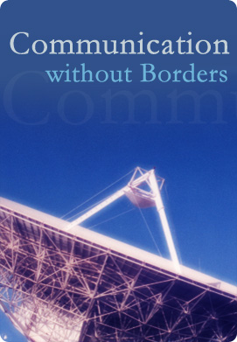
Why and How of an International Monitoring Station
ITU Workshop Limassol, Cyprus
14-16 April 2014
G. Baraglia

Slide 2
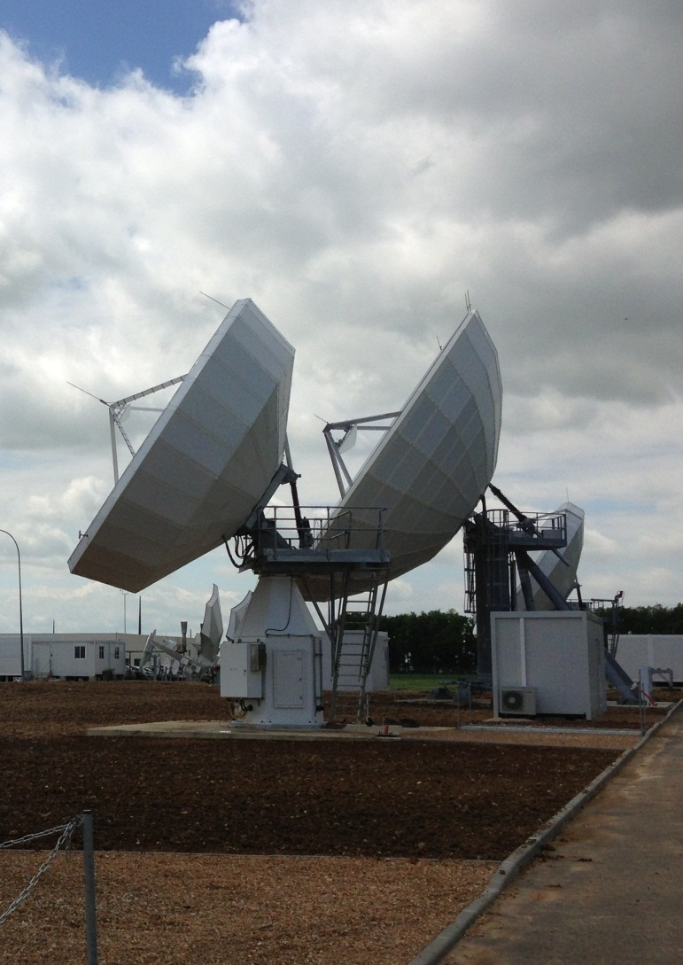
Presentation Agenda
Objectives – Scope - Mission
Project Financials
General Considerations
Project Feasibility
Antenna Choice
A Phased Approach
The ITU Vision
Project Timeline
Tender Procedure

Slide 3
Embrace the ITU Vision
“Spectrum management is the combination of administrative, scientific and technical procedures necessary to ensure the efficient operation of radio-communication equipment and services without causing interference.
“Administrations, which do not at present participate in the International Monitoring System, should be urged to make monitoring facilities available to that system, in accordance with Article 16 of the RR using the relevant information contained in the ITU-R Handbook on Spectrum Monitoring, latest revision.”
ITU Handbook on 2Spectrum Monitoring (paragraph 1.1.1)
ITU-R 23-1 Resolution
Notes:
The procurement of a Radio Space Monitoring System such as the one that will be defined by this project will provide a complete visibility over the satellite spectrum received in the Sultanate of Oman satisfying the Authority’s Missions.

Slide 4
Objectives
What the Authority could achieve with monitoring
Follow, among others, ITU Recommendation ITU-R SM.1054.
Support the National Satellite Industry, for both the governmental and commercial sectors.
Strengthen the perception of equality and control of the Authority current approach to Spectrum Management.
Support the Authority through the required license fees collection and deter operators from illegally exploiting the Space Radio Spectrum.
Verify the correct application of the Technical and Administrative Procedures in the Spectrum Management domain.
Provide the appropriate hardware and software capabilities to maintain the current Regulatory Regime.
Notes:
The procurement of a Radio Space Monitoring System such as the one that will be defined by this project will provide a complete visibility over the satellite spectrum received in the Sultanate of Oman satisfying the Authority’s Missions.

Slide 5
Objectives
What the Authority will miss without monitoring
No capacity to maintain the control over the current Regulatory Regime.
Unable to follow ITU Recommendations.
Unable to support the governmental and commercial sectors for the National Satellite Industry.
No control of the Radio Space Spectrum.
No control over Licensing fee verification.
No capacity to verify the correct application of the Technical and Administrative Procedures in the Spectrum Management domain.
No capacity to detect and identify unauthorised radio space transmissions.
Notes:
The procurement of a Radio Space Monitoring System such as the one that will be defined by this project will provide a complete visibility over the satellite spectrum received in the Sultanate of Oman satisfying the Authority’s Missions.

Slide 6
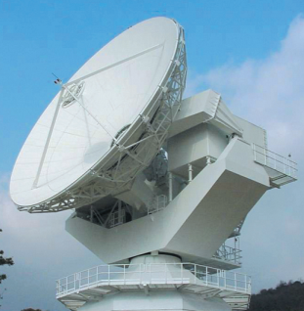
Scope
Manage frequency and band allocation at national and international level to improve the efficient use of the satellite radio spectrum.
Verify and record the assignment of satellite radio frequency and services, associated to on-site inspections to ensure correct measurements of space spectrum usage .
Spectrum monitoring of space spectrum usage to avoid service degradation and reduce harmful interferences.
Determine the technical and operational procedures necessary to maintain a complex network of signals and services.

Slide 7
Mission
Regulate and Maintain Satellite Telecommunication Services in National Territories.
Promote the importance of Telecommunication among Service Providers and beneficiaries.
Guarantee users to have equal access rights and high quality Telecommunications Services.
Police the licensing procedure of authorised operators and bandwidth usage.
Support and manage the increasing demands on Services and Frequency Bandwidth
Notes:
The procurement of a Radio Space Monitoring System such as the one that will be defined by this project will provide a complete visibility over the satellite spectrum received in the Sultanate of Oman satisfying the Authority’s Missions.

Slide 8
Feasibility Study
Orbital Arc and its Visibility
Protection from EMI
Civil Engineering Work
Accessibility
Human Resources
Space Radio Services to be Monitored
Frequency Bands to be Monitored
Serious considerations should be given to the possibility of having a transportable/mobile receive station that can be deployed in specific regions of the national territories.
This could be useful to perform on-site measurements, detection of illegal uplink transmissions or to support investigations from neighboring countries.
A flying case based mobile station will be easily deployed on a truck or trailer for land use or on a ship or platform for maritime use.

Slide 9
Financial and Economical Impact
Financing the project may require a considerable effort, a single supplier with the expertise to integrate equipment from different manufacturers should be preferred to subcontracting out the various parts of the system.
Effective surveillance system will allow the Authority to detect unregistered terminals and so to enforce registration and licensing regulations, offsetting the cost against the extra revenue it could generate.
Ref ITU Report ITU-R SM.2182
Ref. ITU Recommendation ITU-R SM.1139

Slide 10
Financial and Economical Impact
Financial benefits will be gained in the eventuality that the Authority’s nation engages in a program to launch a national communication spacecraft. The system will provide all necessary technology and support during the different phases of the space program.
The system can find considerable justification in the current ITU requirements for international spectrum monitoring and policing, with the opportunity to interact with existing International Monitoring Stations to provide the international community with the necessary support.
Ref ITU Report ITU-R SM.2182
Ref. ITU Recommendation ITU-R SM.1139

Slide 11
General Costs Consideration
Little Impact/Variation on monitoring system Cost
Carrier Monitoring
Carrier Geolocation
Monitoring and Control
Operations Control Centre
Options for Carrier Monitoring and Carrier Geolocation have a minor impacts on the monitoring system overall cost, between 60% and 90% of the cost is due to antennas and RF in general.
Major Impact/Variation on monitoring system Cost
Type of Radio Services to be Monitored
Range of Frequency Bands to be Monitored
Number of Antennas
Size of the Antennas
Civil Works for the Monitoring Site and for the Operation Centre will have similar costs as the Carrier Monitoring and Carrier Geolocation systems together.
Notes:
Minor Variables will remain mostly unchanged even if the scope of the monitoring system changes
Major Variables have great impact on the project finances
There are no Technical Limitations to Space Monitoring

Slide 12
Project Timeline
7 – Equipment Delivery
8 – System Installation
Site Acceptance Test (S.A.T.)
System Operation
System Maintenance
System Administration
11 - Commissioning
System Warranty
Remote Support
6 – Civil Works
10 - Training
1 - Scope and Mission Definition
2 - Tender Release
3 - System Design
Critical Design Review
Sites Survey
Visit and Live Demo
4 - Project Selection
5 - Project Kick Off Meeting
Delivery Timeline
S.A.T. Procedure Definition
Interface with Existing Database
Notes:
The procurement of a Radio Space Monitoring System such as the one that will be defined by this project will provide a complete visibility over the satellite spectrum received in the Sultanate of Oman satisfying the Authority’s Missions.

Slide 13
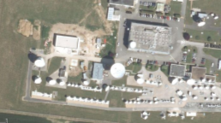
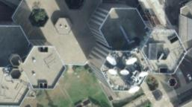
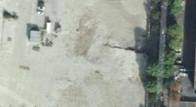
Land Acquisition
Identifying the site for the Radio Space monitoring installation is principal.
At least 2 different sites should be considered
Site Survey to determine
Eventual terrestrial RFI
Visibility of the GSO arc
Commercial Teleport
Authority’s Premises
Green Field
Notes:
The procurement of a Radio Space Monitoring System such as the one that will be defined by this project will provide a complete visibility over the satellite spectrum received in the Sultanate of Oman satisfying the Authority’s Missions.

Slide 14
A Phased Approach
PHASE 1
C, Ku-Band Monitoring and Geolocation
PHASE 2
PHASE 3
All the remaining Radio Space Services
Non-GSO MSS
GSO for BSS, FSS and C-Band MSS only
L, S-Band Monitoring
L, S-Band Geolocation
Optional X-Band
Ka Band Monitoring only
Optional Geolocation
Ka Band Geolocation
From 0.137 to 31.8 GHz Monitoring
A phased procurement and introduction of the monitoring system will provide some advantages:
Modular Approach
System Expansion planned
Core System
Budget over many years
Control over expenditures
Time to adapt to new tools
Phase 1 alone will possibly cover 95% of the entire capacity to be monitored for 60% of the total budget invested.

Slide 15
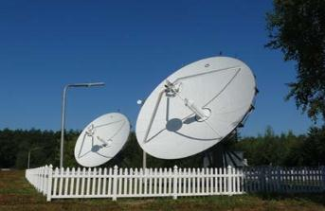
Phase 1
PHASE 1
C, Ku-Band Monitoring and Geolocation
Optional X-Band
Ka Band Monitoring only
2 x 7.2m C and Ku antennas
1 x 4.8m Ka antenna
Steerable, Turning Head with Tracking
Steerable, Turning Head with Tracking
ADVANTAGE
Multiband antennas are often cheaper than procuring separate ones with the same frequency range and require less maintenance.
DISADVANTAGE
Different Bands monitoring cannot be performed on two separate satellites.
NOTE
A second Ka Band antenna for Geolocation can be added in Phase 2.
Kiev, Ukraine

Slide 16
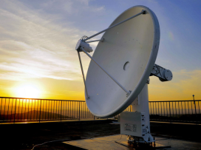
Phase 2
PHASE 2
L, S-Band Monitoring
Ka Band Geolocation
1 x 2.4m L and S antenna
1 x 4.8m Ka antenna
Full Motion with Monopulse Tracking
Steerable, Turning Head with Tracking
ADVANTAGE
Ka Band Geolocation can be procured when more satellites are using this particular Band
DISADVANTAGE
2.4m for non-GSO MSS might be limited when pointing close to the horizon
NOTE
A second L and S-Band antenna for Geolocation on non-GSO MSS Services can be added in Phase 3.
CSIR, South Africa

Slide 17
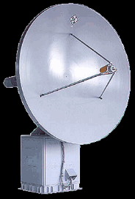
Phase 3
PHASE 3
L, S-Band Geolocation
All Space Radio Services
1 x 2.4m L and S antenna
1 x 3.0m antenna
Full Motion with Monopulse Tracking
Full Motion with Tracking
ADVANTAGE
Complete the Radio Space Monitoring frequency and service coverage of the monitoring system.
DISADVANTAGE
Relevant investments for extremely limited capacity exploited.
NOTE
The antenna in the figure does not cover entirely the ITU assigned Frequency Bands, a combination of antennas will be required.
R&S

Slide 18
RFI and Tender Methodology
RFI - Request For Information
No Detailed System Definition Required
Allows Vendors to Propose Solutions
Allows the Authority to Explore the Market
Provides a Rough Order of Magnitude (ROM)
Allows Authority to Meet Vendors prior Tender
Allows Authority to Eventually Shortlist Vendors
RFI is often used when the precise Scope of the Tender is not clear, or when the Authority wants to explore the industrial and technological possibilities. The RFI provides an idea of the budget required.
Tender
Requires Detailed System Definition Required
Authority May Have Limited Choice
No Contacts with Vendors prior Tender
Allows Authority to Eventually Shortlist Vendors
On relevant system, like the case of this monitoring architecture, an RFI can precede the Tender procedure allowing the Tenderer to reach a broader industry base.

Slide 19
General Considerations
Commercial Approach with 3 Phase Scope Vs. Scientific Approach with Full Scope
Reference Emitter to improve Geolocation Capacities and Accuracy.
Mobile Unit to detect Illegal Transmitters
The purpose is to support the Spectrum Management process in general and to solve harmful interference issues.
The Spectrum Monitoring mission has little in common with Radio Surveillance or Lawful Interception.
Notes:
The procurement of a Radio Space Monitoring System such as the one that will be defined by this project will provide a complete visibility over the satellite spectrum received in the Sultanate of Oman satisfying the Authority’s Missions.

Slide 20
SAT Corporation (SAT) has prepared this document for use by its personnel, licensees, and potential licensees. SAT reserves the right to change any products described in this document as well as information included herein without prior notice.
The information contained herein is presented for educational purposes only and the right to copy and use this document is limited to that necessary to fulfill this function. The recipient agrees that they will not, nor will they cause others to, copy or reproduce this information, either in whole or in part, or manufacture, produce, sell or lease any product copied from or essentially based upon the information contained herein without prior written approval of SAT.
Registered trademarks of SAT Corporation include, but are not limited to, Monics, SAT-DSA, satID and SigMon.
Copyright© 2014 SAT Corporation. All rights reserved.
Contact
Guido Baraglia gbaraglia@sat.com

