Slide 1
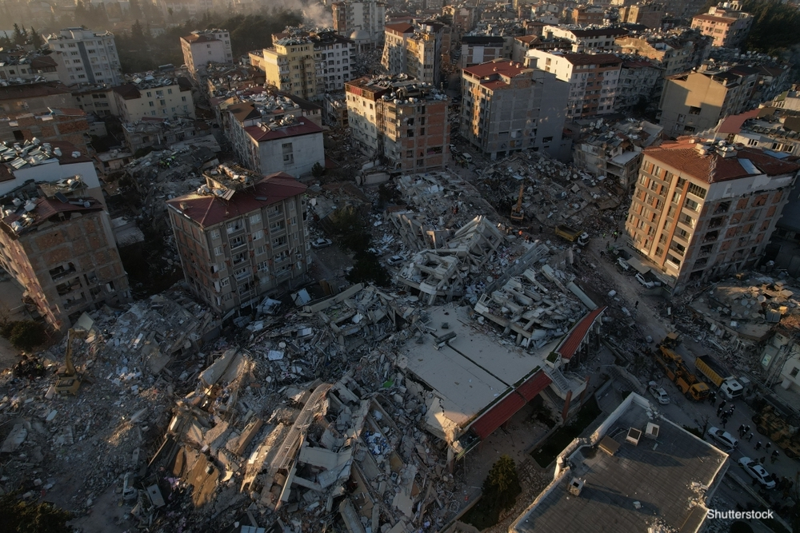
TÜRKİYE / SYRIA EARTHQUAKES
6 February 2023
04:17

Slide 2
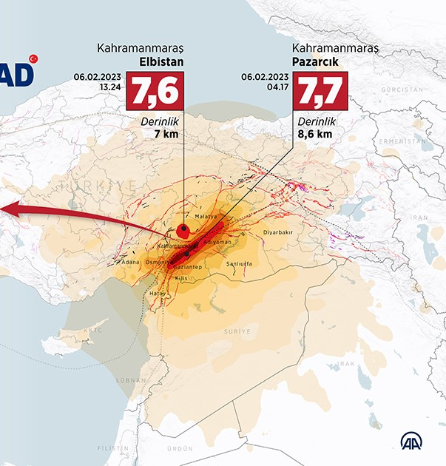
46 104 people passed away
100 000 (apr.) people injured
230 000 (apr.) buildings heavily damaged
80 000 (apr.) resqued under rubble

Slide 3
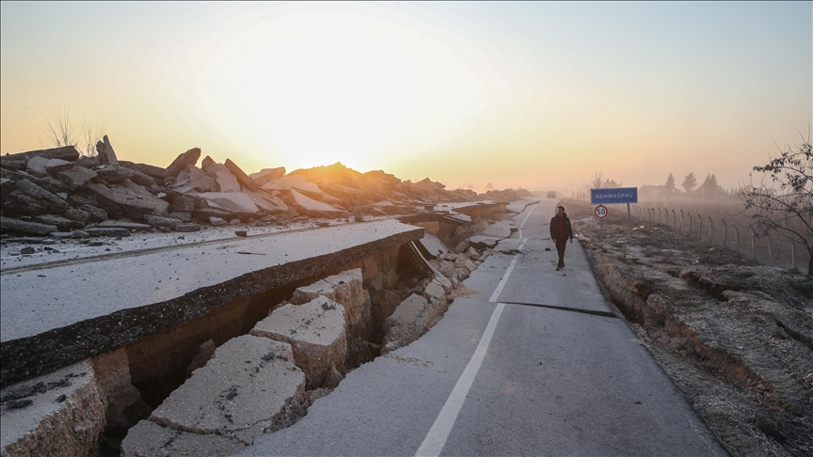
11 cities affected
13,5 million people affected
3 million 320 thousand people moved

Slide 4
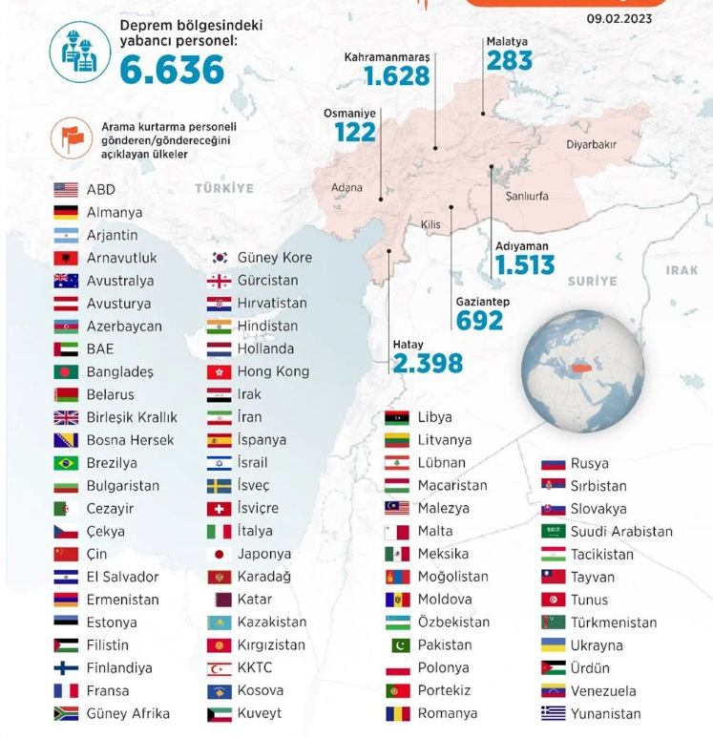
90 COUNTRIES HELPED TÜRKİYE
MANY THANKS
ALL OF THEM

Slide 5
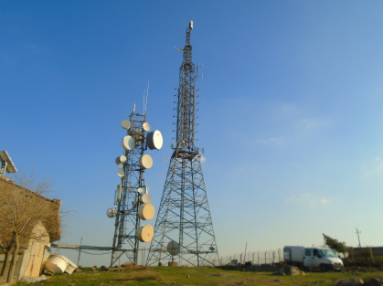
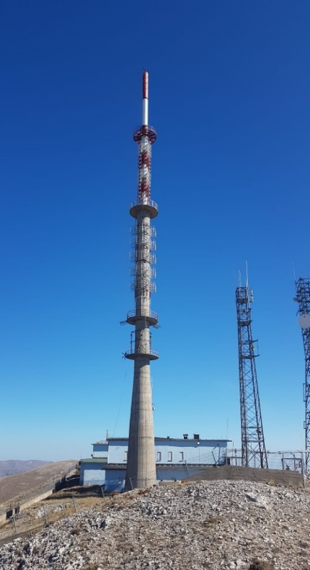
2 Local Office
Diyarbakır
Mersin
2 Transmitters Servis Office
Malatya
Gaziantep
90 Rd/TV Terrestrail Transmitter Stations
250 TRT employee (apr.)

Slide 6
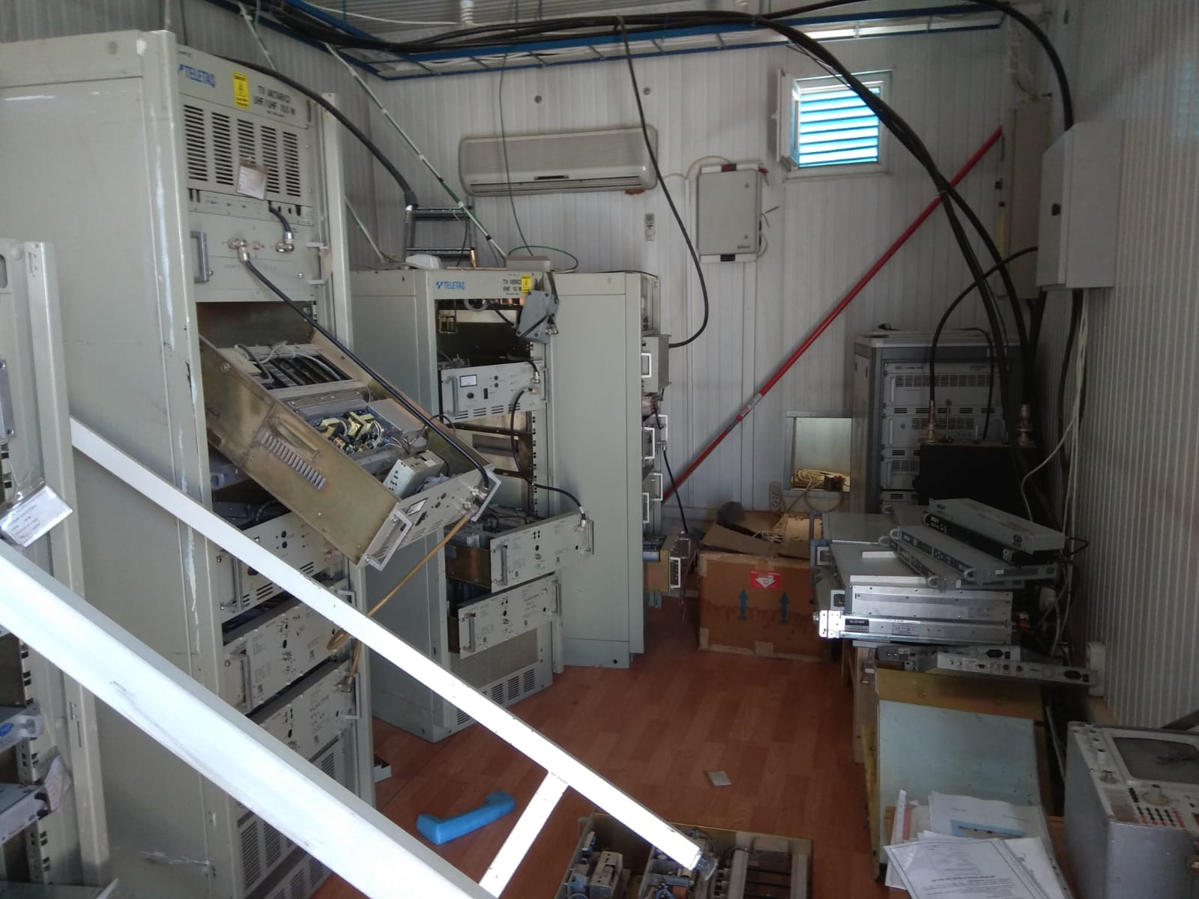
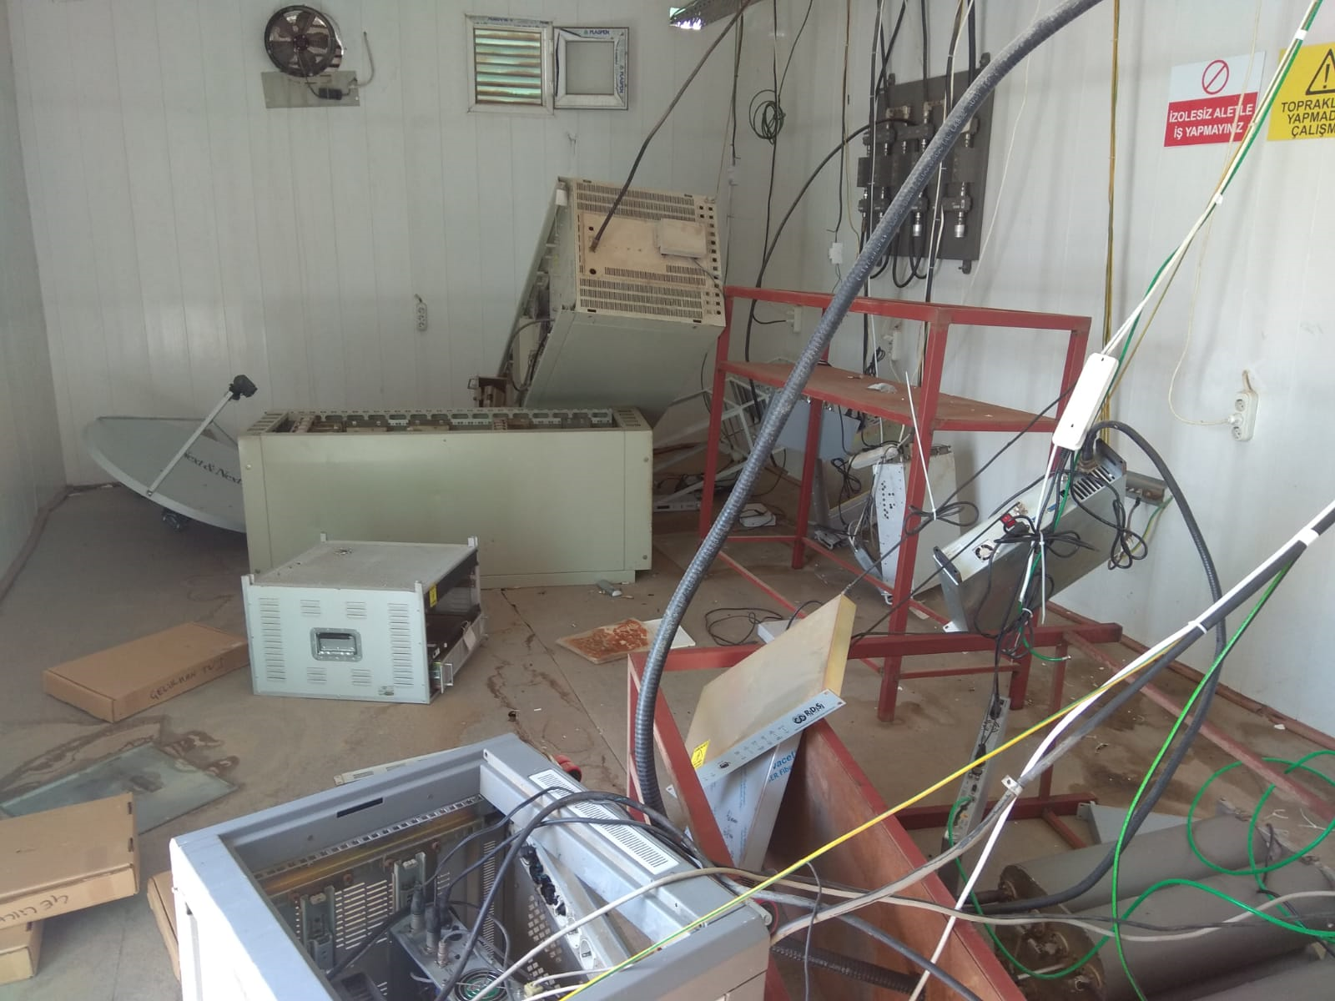
1 station totally collapsed.
4 station heavily damaged
28 station moderately damaged.
57 station no damaged.

Slide 7
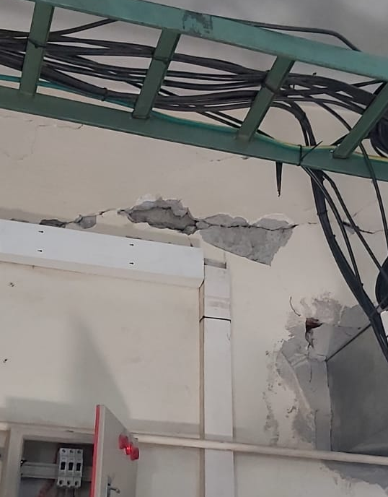
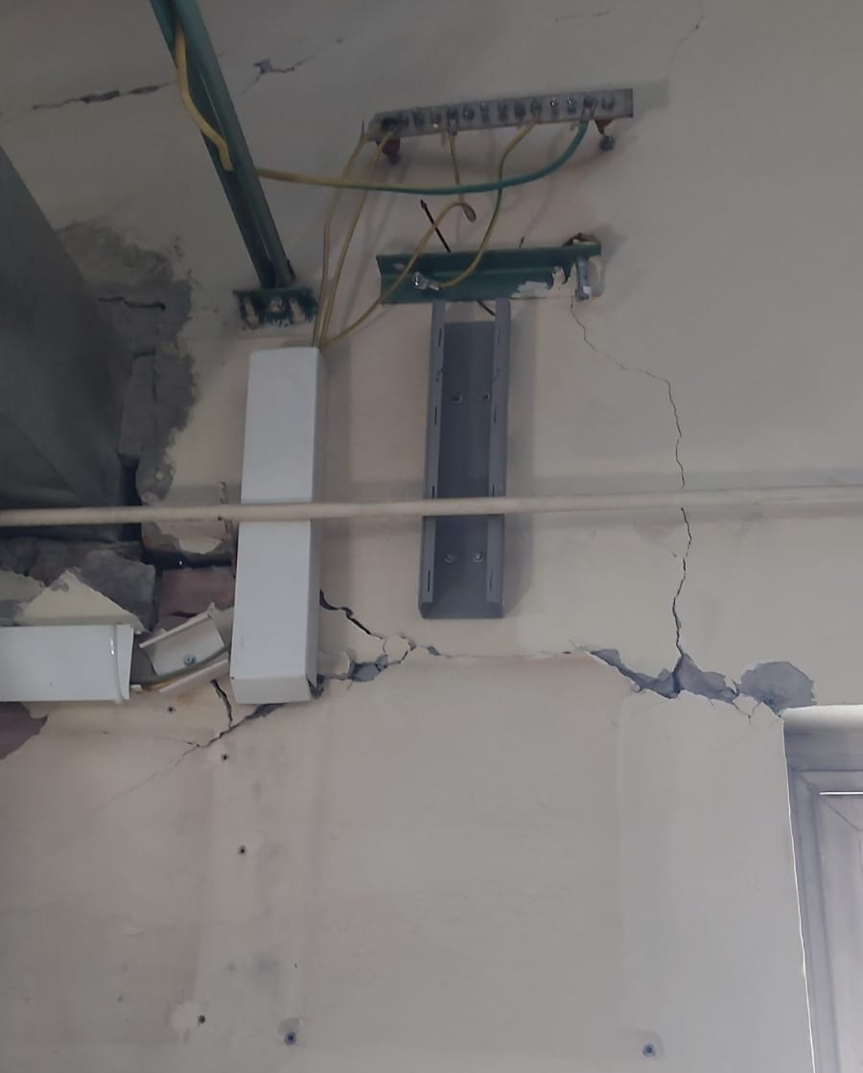
Continued FM Broadcast from undamaged and generatorized stations
Satellite broadcasting no problem
Contact Elektricity Network Operators.
Oil for generators.

Slide 8
Radio Channels
Radio 1
TRT FM
Radio 3
Radyo Nağme
Radyo Türkü
Radyo Kürdi
Radyo Haber
Radio 1
Started in 30 minutes

Slide 9
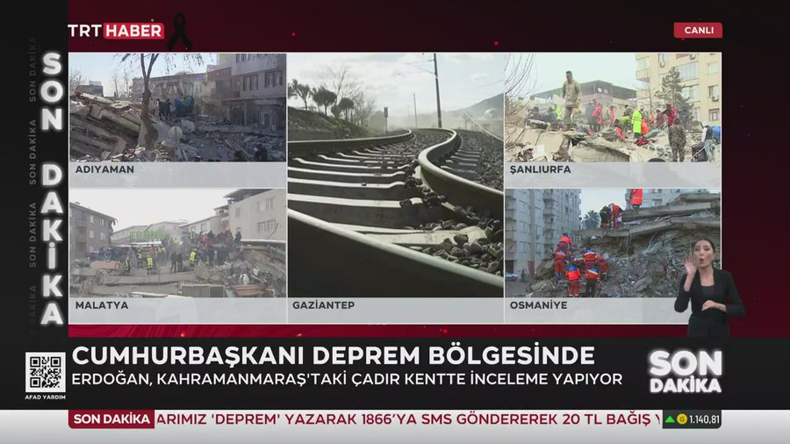
TV Channels
TRT 1
TRT HABER (News)
TRT SPOR
TRT 3
TRT Müzik
TRT Çocuk (For kids) --- Excepted
TRT HABER (News)
(in 30 minutes)

Slide 10
We Used
Satellite-uplink
GSM Network (4.5G) - IP video stream equipment
IP Audio Codec for Radio

Slide 11
Thank you

