Slide 1
Overview of the DSO and Digital Dividend implementation in the GE06 countries
Multilateral Frequency Coordination Meeting of Caspian and Central Asia administrations on the UHF band
30 – 31 March, 2017
Nikolai Vassiliev
Chief, BR Terrestrial Services Department
International Telecommunication Union

Slide 2
GE06 Digital Switchover
Status of Digital Switchover in the GE06 planning area:
COMPLETED : 46
ON-GOING: 56
NOT STARTED: 10
Source: ITU DSO database at http://www.itu.int/en/ITU-D/Spectrum-Broadcasting/Pages/DSO/dashboard.aspx
Transition to digital television liberates a portion of spectrum, Digital Dividend (DD), which may be used for new TV services or other applications, e.g. mobile service

Slide 3
Digital Dividend
WRC-07 allocated 790 – 862 MHz to mobile service in R1 (DD1)
WRC-12 allocated 694 – 790 to mobile service in R1 (DD2)
RR give flexibility: allocations to broadcasting and mobile services
Choice of the service is a national decision. But international aspects are critical, taking into account:
Difficulties in sharing between broadcasting and mobile in border areas
Advantages of global harmonization of IMT bands below 1 GHz
Coordinated implementation of DD is very important -> a number of R1 countries created groups dealing with re-arrangement of the 700 MHz and 800 MHz bands and implementation of DD
E.g. WEDDIF – West European Digital Dividend Implementation Forum

Slide 4
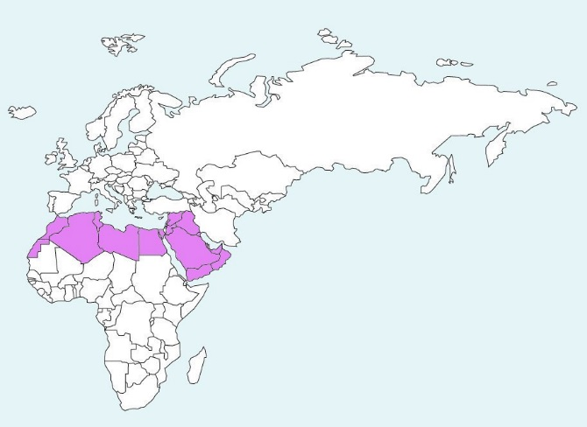
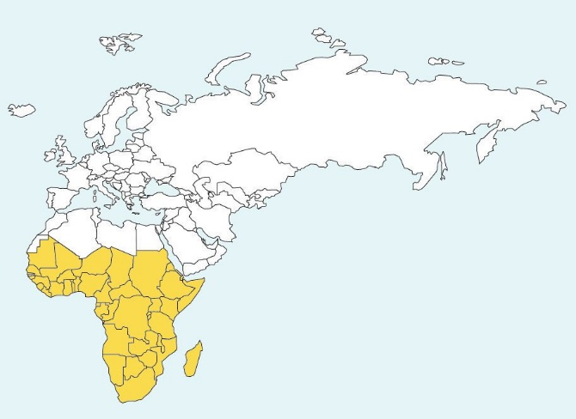
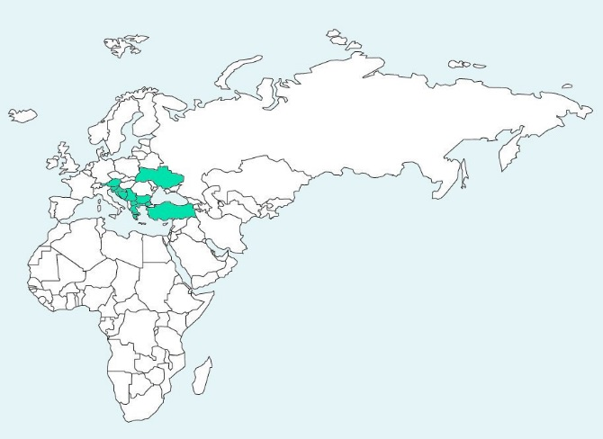
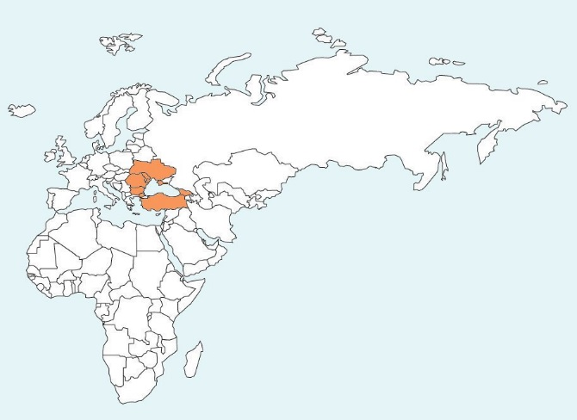
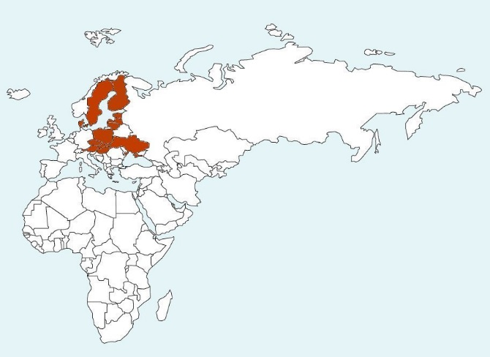
Region 1 coordination meetings and groups
WEDDIF: 8 countries, created in 2010
NEDDIF: ≈ 12 countries, created in 2010
SEDDIF: ≈ 11 countries, created in 2014
BSDDIF (Black Sea): 4 countries so far,
created 2016
Sub-Sahara Africa coordination meetings:
47 countries, 2011 - 2014
ASMG coordination meetings:
28 countries, 2014 - 2015
Meeting of Black and Caspian sea countries: 7 countries, 2013

Slide 5
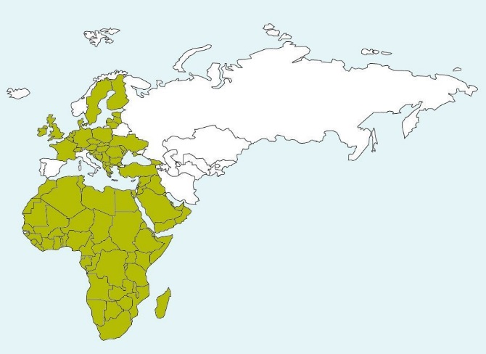
Region 1 UHF activities
More than 100 countries of the GE06 Area participate in UHF coordination

Slide 6
Objectives of coordination groups
To build informal consensus on UHF band utilization, aimed at concluding formal agreements
To search additional TV channels below 694 MHz and to facilitate their coordination, in the event 700/800 MHz allocated to IMT
To facilitate modification of the GE06 Plan through the Article 4 procedure by submitting coordinated requirements

Slide 7
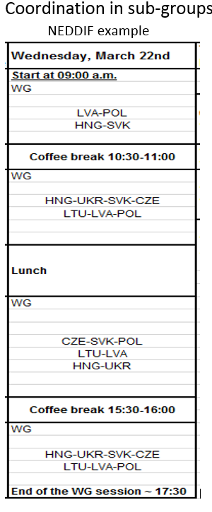
Working methods
Meetings 2 – 4 times per year, 3 – 5 days
Review of activities and resolving problems
Submission of requirements and compatibility analysis
Bi- and multilateral coordination, refining technical parameters
Bi-lateral coordination between the meetings by correspondence

Slide 8
Technical aspects
Agreed number of layers (multiplexers)
The same minimum number of MUX for each administration (4 in the Sub-Sahara Africa and Arab groups); or
Chosen by each country (CEPT). When different, balanced by quality of layers, e.g. if less MUXs -> more protection, higher emissions (WEDDIF)
Assignments vs allotments
Planning for both, with preference for assignment planning
Allotments are simplified compared with GE06, describing “service area”
Coordination of assignments within allotments, SFNs
Coordination criteria (Field strength, C/I, coordination margin)
Relaxed compared with GE06 (e.g., due to reduced % of locations)
The same criteria for Group (e.g. coord. margin = 4 dB) or agreed bilaterally
Freezing GE06 until coordination is completed

Slide 9
Lessons learned
Exchange of files and creating database is critically important
Files contain channels in 470 – 694 MHz, and in 700/800 MHz
Channels in use, licensed channels and future requirements
Database of agreed channels to fix the situation, kept by a focal point
Roadmap is useful
Defines steps, deadlines for completion of activities
Liaison with other groups is necessary, due to the domino effect of planning
Mapping channels (placing on maps) is illustrative

Slide 10
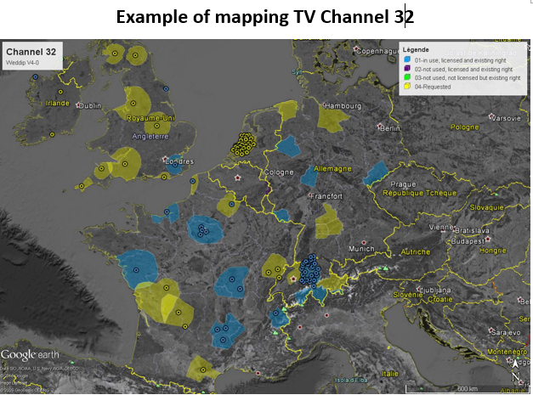
Channel mapping

Slide 11
Incompatibility table Example HRV
 | AUT |  |  |  |  |  |  |  |  |  |  |  |  |  |  |  | BIH
 |  | BN | BS | KO | KW | NON | NOO | NOS | NOW | OON | OOS | S++ | STM | STO | STW | TO |  | BJE | KOZ | LEO | MAJ | PLJ | TRO | TUS | VEL | VLA
HRV-D01 |  |  |  |  |  |  |  |  |  |  |  |  |  |  |  |  |  |  |  |  |  | 26
HRV-D02 |  |  |  |  |  |  |  |  |  |  |  |  |  | 23, 26, 30, 39 |  |  |  |  |  |  |  | 26
HRV-D02-east |  |  |  |  |  |  |  |  |  |  |  |  |  |  |  |  |  |  |  |  |  | 38
HRV-D02-west
HRV-D03 |  |  |  | 28 |  |  |  |  |  |  |  |  |  |  |  |  |  |  |  |  |  |  |  |  |  | 34
HRV-D04 |  |  |  | 28 | 48 |  |  |  |  |  |  |  |  |  |  |  |  |  | *41
HRV-D05 |  |  |  | 28, 39, 46 |  |  |  |  |  |  |  |  |  |  |  |  |  |  |  |  |  |  |  |  |  | 34
HRV-D06 |  |  |  | 30, 46 | 30, 31 |  |  |  |  |  |  |  |  |  |  |  |  |  |  |  |  |  |  |  |  | 34 | 31
HRV-D07 |  |  |  |  |  |  |  |  |  |  |  |  |  |  |  |  |  |  |  |  |  |  |  |  |  | 31
HRV-D08 |  |  |  |  |  |  |  |  |  |  |  |  |  |  |  |  |  |  |  |  |  |  |  |  |  | 34 | 33
HRV-D09 |  |  |  |  |  |  |  |  |  |  |  |  |  |  |  |  |  |  |  |  |  |  |  | 28 |  | 34
 |  |  | incompatible |  |  |  |  |  |  |  |  |  |  |  |  |  | * | not compatibile with our local coverage which is in operation (L-ZA - Sveta Nedelja)
 |  |  | partly incompatible

Slide 12
UHF assigned channels-GE06 Plan

Slide 13
Region 1 UHF activities
More than 100 countries of the GE06 Area participate in UHF coordination.
Can some color be added to the white space ?

Slide 14
Thank you for your attention!

