Slide 1
CCITT/ITU-T 60 Anniversary

Slide 2
Anniversary Talks on Digital Financial Services (DFS)
Stephen Ibaraki Moderator sibaraki@acm.org
CCITT/ITU-T 60 Anniversary

Slide 3
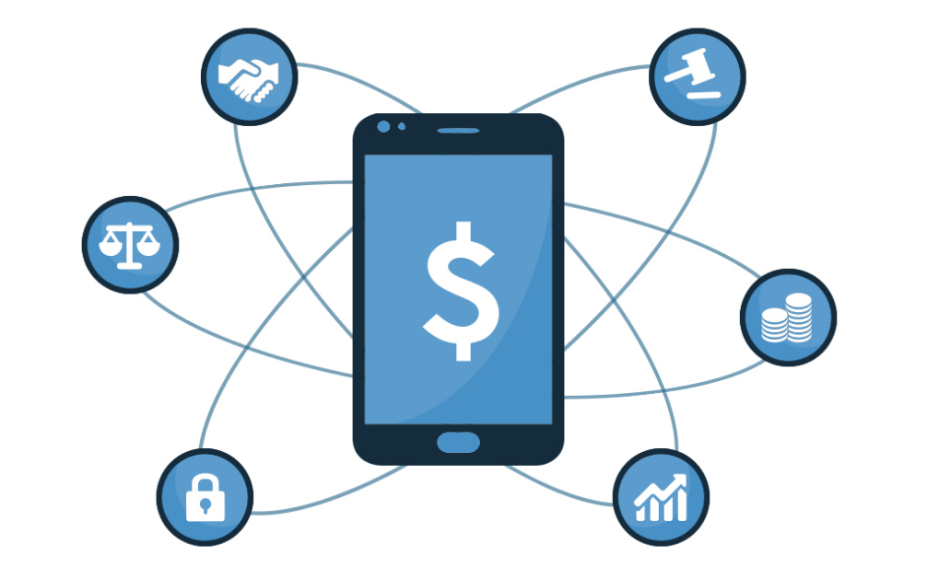
DFS Numbers
2 billion unbanked
1.6 billion mobile
G20 pillars
DFS
Financial inclusion
Accelerated economic opportunity
Innovation
Notes:
SRC: News

Slide 4
DFS Challenges
Activation
Distribution
activating new accounts
reliable cash-in/cash-out points
Keeping money digital
Products beyond payments
business proposition to accept digital payments
disproportionately high costs to manage their daily expenses.
Notes:
SRC: CARIBOU DIGITAL (BILL AND MELINDA GATES FOUNDATION

Slide 5
DFS Challenges
Financial education and digital influence: hard to justify a switch
Fraud and risk: substantively contributes to the cost of services
Shared infrastructure: proprietary technology and processes drive up the cost of DFS
Notes:
SRC: CARIBOU DIGITAL (BILL AND MELINDA GATES FOUNDATION

Slide 6
ITU DFS
World Bank: 2020, 1 B
Telecom regulators
Payment organizations
Central banks
ITU Focus Group DFS 2014
Standard bodies
Mobile operators
Notes:
SRC: ITU

Slide 7
ITU DFS
Challenges:
Scaling
Interoperability
Policy and regulatory
Standardization
Collaboration telecom and FS
Consumer trust and protection
Quality of service
Notes:
SRC: ITU

Slide 8
ITU DFS
New models
Digital identity, authentication, KYC
Aadhaar
Social media
1 Billion
$400 million saved
420 million 8 billion P2P
DFS policy and regulation?
Notes:
SRC: ITU

Slide 9
DFS Future
What is the future of the workforce?
How will financial inclusion be enabled?
What is the future of FinTech?
What will be the impact of AI and machine learning?
How do we address cybersecurity?
Where will we fully integrate big data, analytics and the IoT?
What about block chain?
How is biometrics evolving?
Notes:
SRC: FINANCIAL SERVICES ROUNDTABLE FINTECH IDEAS FESTIVAL

Slide 10
Setting the context
There are many questions to ponder with DFS.
Join the discussion to share your questions with the panelists on how you would like to see the international community approaching the biggest questions surrounding Digital Financial Services.

