Slide 1
COUNTERFEIT MOBILE PHONES; THE SITUATION IN GHANA
ITU Workshop on “Combating Counterfeit & Substandard ICT Devices” Geneva, 17-18 Nov. 2014
Isaac Boateng
National Communications Authority, Ghana
VC, ITU-T SG11 & Rapporteur Q8/11

Slide 2
Outline
Introduction
Impact of Counterfeit Devices
How the Regulator is Addressing this
Challenges
Recommendations

Slide 3
Introduction
Mobile phone is the most popular ICT device in use in Ghana; not only used to make/receive voice calls but for other services;
chatting,
browsing,
video calling
money transfer etc.
However, increased demand for mobile phones has resulted in the rise in counterfeit handsets, batteries and accessories.

Slide 4
With features and appearance similar to the original, counterfeit phones have become even more attractive with functionalities like;
multiple SIM
television tuners.
Motivation in owning is the fact that they are affordable and can easily be bought on the streets.
It provides employment opportunities

Slide 5
However people are ignorant of the effects of these counterfeit phones:
Health and Safety
Environment
Quality of service
Interference and harm to public networks
Tax evasion
The only interest is to communicate with friends and relatives regardless of device used.
IMEIXS estimates that about 60% handsets in the market have no IMEI or replicated IMEI) .
Source: http://www.imeixs.com

Slide 6
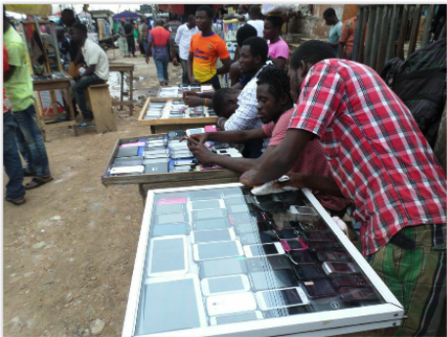
Mobile Phone Street hawkers

Slide 7
Phone repairs on the Street

Slide 8
Impact on our Health and Environment
Most counterfeit mobile phones are shipped to African countries
They pose E-waste, disposal & health problems
They are easily damaged but some are repaired and find their way back into the market
But they don’t meet the specifications of manufacturers
Some are also recycled in the informal sector without recourse to any impact assessment

Slide 9
E-waste are disposed at free range

Slide 10
Indigenous yet harmful way of recycling

Slide 11
Some Documentaries on Ghana’s E-waste
BBC Documentary on Ghana’s E-waste
The Blacksmith Institute and CUNY School of Public Health – March 2010

Slide 12
Other Impacts of Counterfeiting
Cyber-security related threats;
Facilitate drug trade, terrorism, and other local and international criminal activities
Jeopardize consumer privacy;
Impair safety of digital transactions;
Damage the trademarks of genuine manufacturers
Evade applicable taxes and duties
Affect government tax coffers.

Slide 13
How the Regulator is Addressing Counterfeit?
NCA has licensed a VAS provider (IMEIXS) which has a system capable of;
block counterfeit and stolen phones.
We also use our Type Approval Process to combat counterfeit;
Type Approval is proof by a manufacturer or its Authorised agent of a product that specific essential minimum technical and regulatory requirements related to the product have been fulfilled

Slide 14
Technical requirements
The minimum essential technical requirements:
International, Regional and National Standards
Environmental, Health and Safety Standards
Proof of Genuineness
Electromagnetic Radiation and Emissions
Radio Frequency requirements
Network Compatibility/Interoperability

Slide 15
Regulatory requirements
Manufacturers or their Authorized Agents require Type Approval Certificate to manufacture, assemble or sell any Electronic Communication Equipment (ECE) in Ghana.
Dealers are also required to deal in only type approved and genuine ECE.
Approved Equipment models come with NCA Type Approval Certificate (TAC)
Importers must inform the NCA of any ICT equipment importation into the country for checks, TAC and final clearance
Two levels of clearance
Customs Clearance
Regulatory Clearance

Slide 16
Regulatory requirements
TAC must always be visible and displayed to the public
All communications equipment coming into the country must be inspected and passed by NCA
Destination Inspectors go to the point of entries for inspection
Market Surveillance will be an integral part of the process in future.
Establishment of National ICT anti-counterfeit Task Force in collaboration with the security agencies and the Ghana Standard Authority

Slide 17
TAC Unique Identifier
Type Approved Equipment models are now given unique identity marks on the Certificate
ECE CC TAT IY SN
“NCA APPROVED: XXX - XX- XX- XXX”
ECE CC : ECE COLOUR CODE
TAT : TYPE APPROVAL TYPE (modular or host)
IY : ISSUE YEAR
SN : SEQUENCE NUMBER

Slide 18
Why the TAC Unique Identity?
To show that the Certificate is for specific equipment model/category/type
ECE meets essential requirements of the Authority
To provide public confidence
Manufacturer’s/Dealer’s own declaration that ECE is genuine
Manufacture/Dealer bears responsibility for any breach under which TAC was issued.
If equipment is found to be Fake/Counterfeit
If certain key functions (both software and hardware) of the ECE is altered

Slide 19
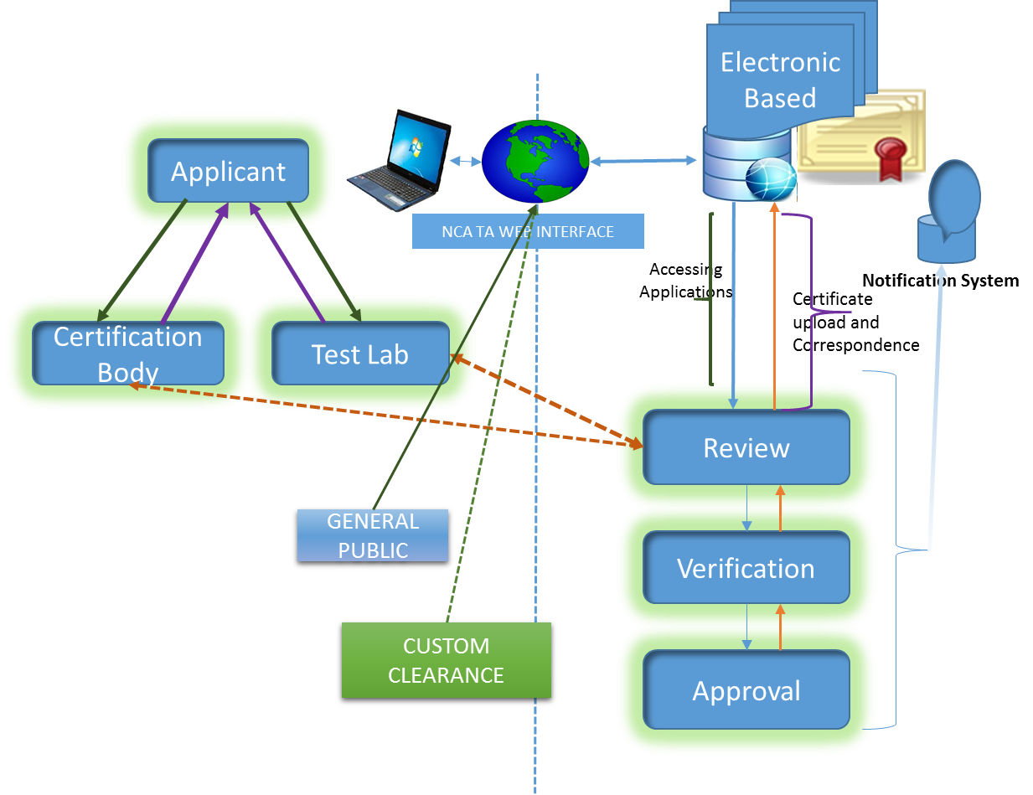
Type Approval Process Goes Electronic

Slide 20
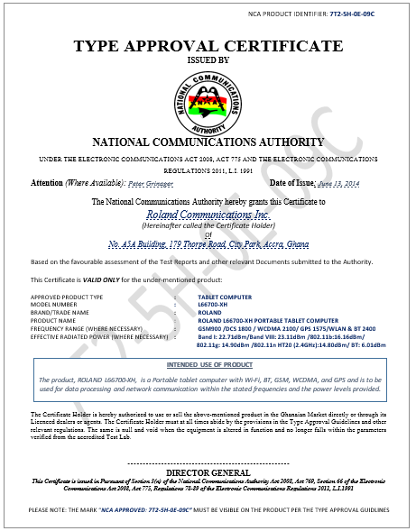
Sample Of TAC

Slide 21
Challenges
Our TAC is based on manufacturer’s own test results, SDoC or from recognized/accredited 3rd party testing labs
Independent verification and market surveillance are required to provide assurance that the products category/model sold in the market have met the requirements of the Authority and may not be counterfeit.
Lack of testing labs or access to databases for verification, market surveillance & enforcement make it a challenge.
Porous ports of entry and un-approved routes
Counterfeiters have taken advantage
Less consumer education on effect of buying counterfeit ICT devices
Issue of affordability for quality devices; mostly the reason for buying counterfeits
Fact that counterfeiters contribute to the high mobile phone penetration and universal service/access, particularly in developing countries.

Slide 22
Some recommendations
We need a testing laboratory in Ghana for the West African Sub-region
We welcome PPP initiatives
Market opportunities for ICT testing in the Sub-region
There should be global & coordinated efforts in combating ICT Counterfeiting
ITU must spearhead; SG11 has started work this area
Regulatory Authorities, Operators, Law Enforcement Agencies, Customs should be allowed free access to existing databases to combat counterfeiting
It will help the global fight against ICT counterfeiting.

Slide 23
NCA web sources related to Type Approval
portal.nca.org.gh
www.nca.org.gh
Type Approval Guidelines
Contacts
typeapproval@nca.org.gh
isaac.boateng@nca.org.gh

Slide 24
THANK YOU

