Slide 1
OECD Research on Counterfeiting and Piracy; Economic and Policy Issues
Combating Counterfeit and Substandard ICT Devices
(Geneva, Switzerland, 17-18 November 2014)
Piotr Stryszowski Economist, OECD
Piotr.Stryszowski@oecd.org

Slide 2
(PARIS, CDG AIRPORT)

Slide 3
OECD studies on counterfeiting an piracy
The initial project
Counterfeit and pirated products (2008)
Digital piracy (2009)
2009 Update of Phase 1 figure
The upcoming project (2015-16)
Scoping phase

Slide 4
OECD studies on counterfeiting an piracy
GOALS:
To assess the magnitude of the problem
To study the effects of counterfeiting and piracy
To determine the relevant policy conclusions

Slide 5
Measurement
Measurement needs rigorous methodologies (what and how)
Magnitude – issue of measurement unit (volume, value, number of seizures)
Effects – on employment, profits, growth, etc.
Data is hard to find
activities are illicit and clandestine
numerous industries affected
existing data is sparse, incomplete and inconsistent
Measurement of counterfeiting and piracy has been a data driven exercise (not methodology based)

Slide 6
Measurement
What do we measure: Tangible products that infringe trademarks, copyrights, patents or design rights
Data comes from: Surveys undertaken (customs authorities with the assistance of the World Customs Organisation, WCO)
Tailored Methodology developed to assess the magnitude of the problem in international trade, principally using statistics on customs seizures
Global scale
All industries (HS categories)

Slide 7
Counterfeiting and piracy
Illicit Trade
Domestically produced and consumed counterfeit products
Other illicit trade
(e.g. drugs)
Trade in fakes

Slide 8
Magnitude of the problem
“T.R.I.C.”
indices
Absolute
figure
Customs data
(WCO, One-off)
Trade data
(UN comtrade)
Time indices
Step 1
Step 2
Step 3

Slide 9
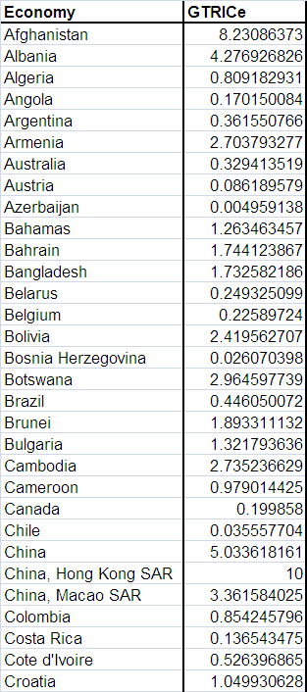
Magnitude of the problem (index)
GTRIC-e (economies)
Exporting economies
Relative index:
10 – highest likelihood
0 – smallest likelihood
12.6% likelihood compared to the “top exporter”

Slide 10
Magnitude of the problem (index)
GTRIC-p (products)
HS product categories
Relative index:
10 – highest likelihood
0 – smallest likelihood
Code 95 Toys, games & sports equipment; parts & accessories

Slide 11
Magnitude of the problem (absolute number)
Up to US$ 250 billion of international trade could have been in counterfeit or pirated products in 2007
The figure does not include
domestically produced and consumed products
non-tangible pirated digital products
If added, the figure could be several hundred billion dollars higher
Earlier figure of 5-7% of world trade lacks rigorous foundation and could not be confirmed or disproved

Slide 12
Magnitude of the problem (time index)
Trade in counterfeit and pirated goods grew steadily over the period 2000 – 2007
?

Slide 13
The upcoming project (2015-2016)
Expert meeting (28.05.2014)
Starting point: GTRIC
Magnitude (new customs data)
Economic and policy effects
Regional case studies
Industry case studies

Slide 14
For the attention of policymakers
Horizontal problem (finance; internal affairs; police; customs; health; labour …)
There must be a clear C&P policy, supported by enforceable (and effectively enforced) legal and regulatory framework
Improve co-ordination amongst domestic agencies
Enhance co-operation with industry

Slide 15
For the attention of policymakers
International problem (active role of criminal networks)
International co-operation (source countries, transit points)
Awareness!
Education of consumers/users is critical (not only end products, also B2B)
Increase training/awareness amongst government officials
Enforcement!!!!

Slide 16
(PARIS, CDG AIRPORT)

Slide 17
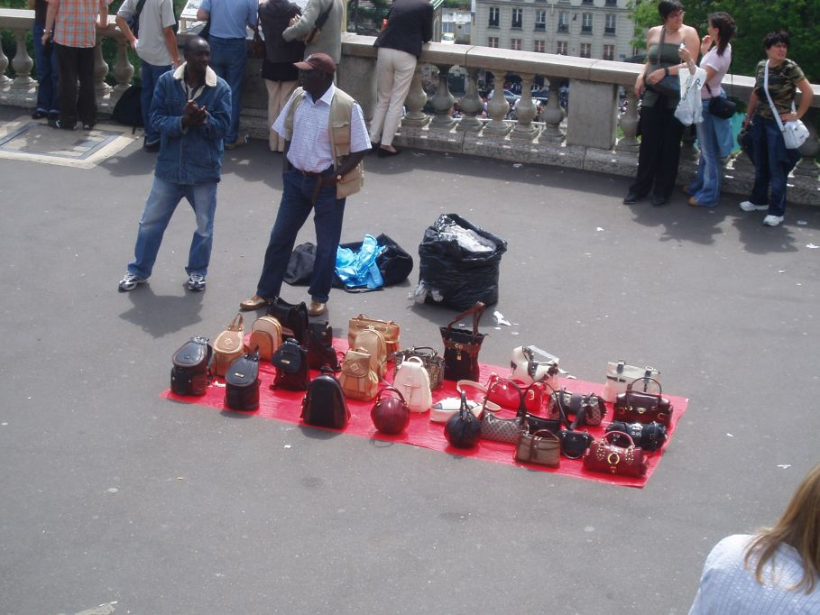
(PARIS, MONTMARTRE)

Slide 18
for further information
Piotr Stryszowski
OECD
2, rue André-Pascal
75775 Paris CEDEX 16
France
Email: Piotr.Stryszowski@oecd.org
Phone: (+33) 1 4524 9130
Fax: (+33) 1 4430 6257

