Slide 1
ITU Workshop on "Future Trust and Knowledge Infrastructure", Phase 1
Geneva, Switzerland, 24 April 2015
Data Format of Cyber Physical Systems
for Future Knowledge Society
Jun Kyun Choi,
Professor, KAIST & jkchoi59@kaist.ac.kr

Slide 2

Contents
`
1
Vision of Future Knowledge Society
`
2
Reviews of Existing Data Formats
`
3
Requirements of New Data Formats
`
4
Appendix

Slide 3
Vision of Future Knowledge Society
(Data Aspects)

Slide 4
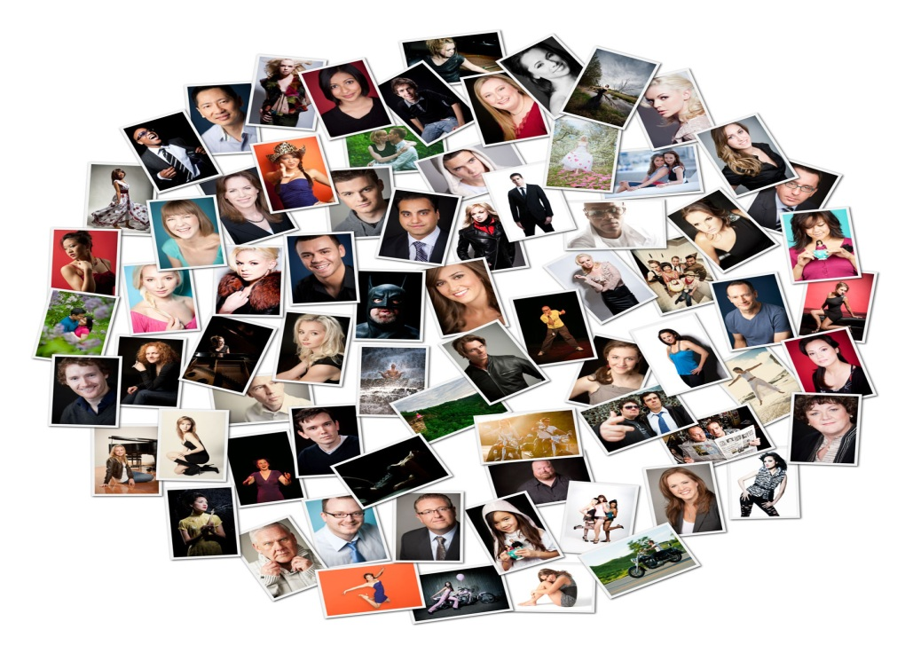
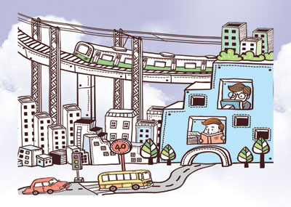
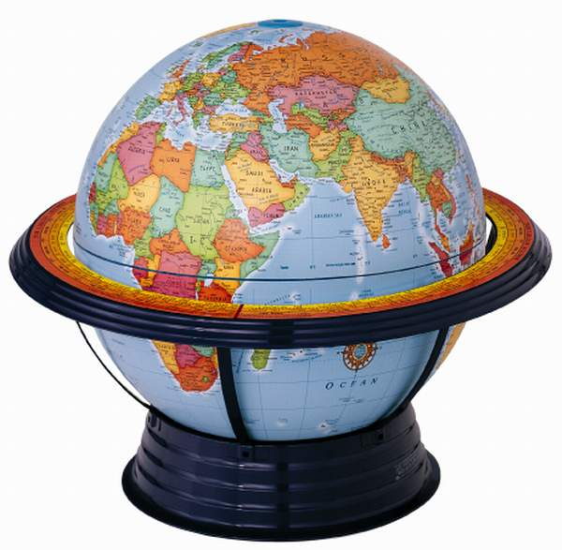
Social Overhead Capital for ICT Infra
Human
Relationship
Physical World
Social
Infrastructure

Slide 5
Conceptual Vision for ICT Convergence Infra
Cyber World | Knowledge World | 精神 | 理想 | 空 | 涅槃(Nirvana) | Enablers or Agents
 |  |  |  |  |  | Messiah, Messenger, Foreteller, Novelist, 先知者, 先覺者 Engineers/Scientists for ICT Convergence
Physical world | Data World | 物質 | 現實 | 色 | 俗世

Slide 6
Definition of “Creative Economy”
New Paradigm of Existing Business and Economy
Knowledge Economy from manufacture
New Values from existing Business
New Communication Platform between human-human and human-machine
Evolve creative & intelligent economy from old traditional industries
Find new values from different types of human intelligences → ‘New Arts, New Concept, and New Industry”
Social platform for Emotional intelligence and empathy/sympathy as well as delivery of information data

Slide 7

Why we need “Creative Economy” ?
Last Mile of Manufacturing Industry
Limits of growth of existing industries relying on physical resources and productivity
Crisis of Capitalism relying on math production/consumption as well as aging society
New Eco-platform toward Knowledge Society
Eco-platform of Information and Knowledge sharing, not data platform itself
  What is the value of intelligence and knowledge ?
Eco-environments to share old knowledge (history, book, etc.), current knowledge (human opinion, and idea, etc.) and future knowledge (new material, medical treatment, etc.)
Ohm’s Law of Knowledge Society
Knowledge Power (P) = Flows (I) x Difference (V)
        = (Flows of Knowledge)² (I²) x Knowledge Sharing Platform (R)
        = (Difference of Knowledge)² (V²) / Knowledge Sharing Platform (R)

Slide 8
Strategies of “Creative Economy”
Productivity of New Values
Human Networking and Human Platform : Evolution of existing SNS
Communication platform between human and machine : human friendly eco-system
Sharing platform of information and resources: Evolution of existing Cloud platform
New knowledge creating tool: Evolution of authoring tool with camera and office packages
New Values with Social Ecology Aspects
Cultivate Social Energy and Social consensus among human minds
New window of human happiness not relying on money and physical resources
New Value on Technology Aspects
New communication technology of 5G and M2M/IoT
Energy efficient products and solutions (Electric Car, Energy Storage System, etc.)
ICT Convergence with Energy, Transport, Education, Health, Public Safety, etc.

Slide 9
Types of Human Intelligences
Classifications
Value of Knowledge
Logical/Mathematical Intelligence
  Science, Mathematics, Engineer
Interpersonal Intelligence
  Politician, teacher, leadership, etc.
Body-Kinesthetic Intelligence
  Athlete, Dance, Player, etc.
Musical Intelligence
  Musician, Artist, etc.
Intrapersonal Intelligence
  Pastor, Monk, Priest, etc.
Linguistic Intelligence
  Writer, Reporter, Journalist, etc.
Spatial Intelligence
  Architect, Pilot, etc.
Convergence among Heterogeneous Intelligences
  Health+Music: Emotional Therapy
  Energy+Sport: Bicycle Generator
  Game+Education: Edutainment, Simulator
Multi-dimensional Creation Platform
  Sharing of unstructured tacit knowledge
  Accumulation platform of know-how’s
Sharing Knowledge and Experiences
  Autonomous accumulation and sharing platform of knowledge and intelligences
  Sharing experiences by using 5D UI/UX tools
Application Platforms
  Platform for new material and new technologies
  Synergy effect between digitized information silo and human experiences
Virtual Spaces for Collective Intelligences
  Collaboration among peoples
  Virtual spaces for workshop and conferences

Slide 10
Key Issues for Future Society
“Hyper connected society” for Co-existence, Consensus, and Sharing
  Technology Breakthrough by using Smartphone and IoT/M2M technologies
  Information Resonance of Smart Internet and Social Networking Services
  New Opportunities of Explosion of Digital information and Big Data Analytics
“Mobile Native” for global digital nomads
  Global citizenship/community and Digital Native/Immigrants/Nomad
  Smart Senior of aging society
  Cultural convergence by utilizing ICT
  Accumulation of people knowledge : New Democracy/Assembly and Virtual Space for new Agora
“Free Economy” on collaborative consumption
  Sharing culture and economy by utilizing social network services
  Privacy Collapse and New opportunity of statistics information from group/community interests
“The Third Industrial Revolution” for sharing information (Jeremy Rifkin)
  Energy Internet and Industrial Internet, Great Escape from telecommunication and broadcast
  Global Integration of on-line/off-line Markets and E-commerce
  Global re-organization of Job/Labor Markets and Human Resources

Slide 11
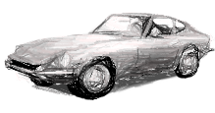
Future Trends on ICT Industry
Environments
Ageing
Knowledge Media
Prediction
- Green Energy
- Energy Saving Network
- Bio Energy
- Health 2.0
- RFID Care
- Education 3.0
- Knowledge Media
- Information Predication and Prediction
NIT accelerate technology development of all the industrial areas
ICT Convergence Infra
Health
Military
Ship
Construction
Automobile
(note)
ICT : Information and Communication Technology
NIT : Networking and Information Technology

Slide 12
Trends on Future ICT Services
Emerge new knowledge media industry
Education, Energy, Health, Transportation etc.
N
E
W
Discovering
New Technology
3rd class of
IT Industry
Social Media with information processing
IPTV, Web 2.0/3.0, Web/App Store, etc.
Knowledge Convergence
Value-added Services
of ICT Infra
App. &
Web Services
Traditional Communication
& Broadcast Services
2nd class of
IT Industry
5G, UHD TV etc.
Saturate the existing broadcast and Telecommunication Services
Data Service
1st class of
IT Industry
Current
Year 2020

Slide 13


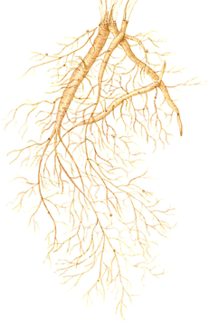

Conceptual Vision for IT Convergence Infrastructure
Current
3 Years
10 years
Stage
1st Stage
IT Convergence
2nd stage
Creative Convergence
3rd Stage
Creative Eco-Convergence
Industry
IT
Human & Health care
Autono System
Intelligent Car, Robot
Vehicle
Energy
Construction
uEco-City
U-Eco building & city
Robot
Health
Machine
Military
Nano devices, computers & Robotics
Ship
Textile
Air
Huge complex system design & computing
Self-organized
Services
Cyber reality & Future human Interface
Knowledge Media
Lifelong education
Security & socio-cognitivism
Governance
Personal & social security
Key Technology
Intelligent Disaster Prevention Technology
User-centric personal health care technology
Creative
Technology
Self-assured/Self-organizing IT Vehicle Technology
Collective and Collaborative computing Technology
Future
Network and Computing Infrastructure
Future City and Environment Technology
Intelligent Service Robot Technology
Personal Assistance and Self-learning Technology
Media security and Knowledge Science Technology
Virtual reality technology
Self-organizing Energy Eco-system Technology
IT
Infra
(Intelligence)
All Computerized Things
(Resonance)
All Conscious Things
(Conformity)
All Connected Things

Slide 14
Reviews of Existing Data Formats

Slide 15
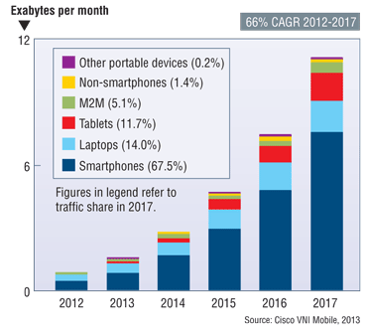
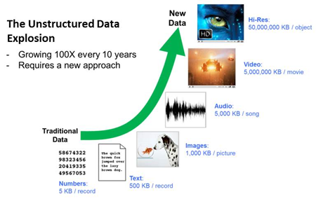
Data Volumes
(refer) 2013 Visual Networking Index, Cisco
(refer) http://www.datanami.com/

Slide 16
Data Types depending on Applications
Telecommunication and Broadcast Applications
  AV/Multimedia stream, metadata, etc.
Internet and Web Applications(including semantic contexts)
  File, image, documents, etc.
  Virtual/Object Data (URN/URL/URI)
Location related Applications
  GPS code, CPS (physical 3D space)
  Transport and Logistics Industry (Geolocation Map)
Identification related Applications
  Sensor/RFID code, product code, bar code, etc.
  Trade, Copyright, and Ownership (Shipping code, Product value chain, security key, etc.)
Data Intensive or Contents related Applications
  Healthcare and Medical application

Slide 17
Data Models of Resource Description Framework (RDF)
Entity–Attribute–Value model
  Making statements about resources
    (Examples) XML DTD (Document Type Definition), tag, name, address, etc.
Data Serialization Model
  File, memory buffer, packets of communication protocol, time-varying data (A/V), etc.
  Text-based/binary-based, structured/unstructured, hierarchical/non-hierarchical, scalar/vector/graph, class/object, etc.
    (Examples) Binary/Integer/Real/Exponent/Character/String/Boolean/Time, Vector/Matrix/Array, 2D/3D Graphics, Recursive, Audio/Video Stream, etc.
Metadata/Schema/Markup Model (for Semantic web)
  Specify the processing to be performed or the related actions (i.e., activate, trigger, invoke, etc.)
  Create the values of the data
    (Examples) ontology for IoT/CPS, OWL, etc.

Slide 18
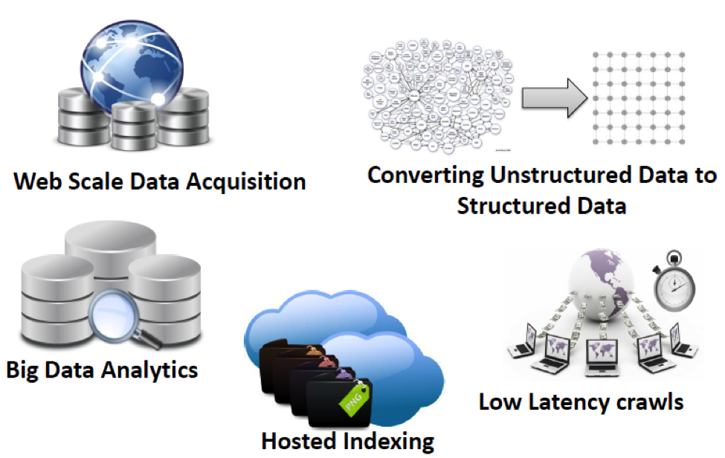
Data as a Service
(refer) http://promptcloud.com

Slide 19
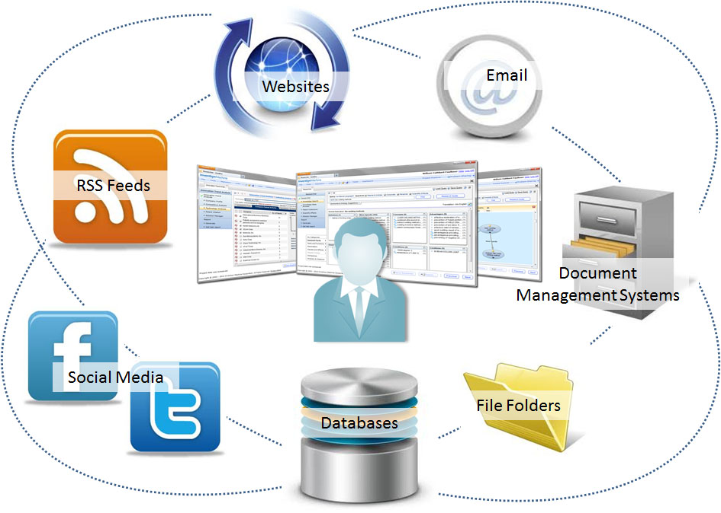
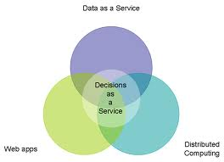
Data Warehouse
(refer) http://inventionmachine.com/

Slide 20
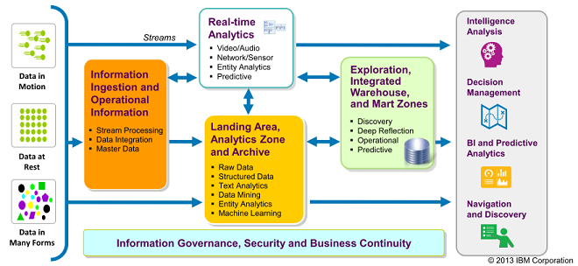
Big Data and Analytics Process
(refer) http://jtonedm.com/2013/06/05/big-data-and-analytics-fueling-competitive-advantage/

Slide 21
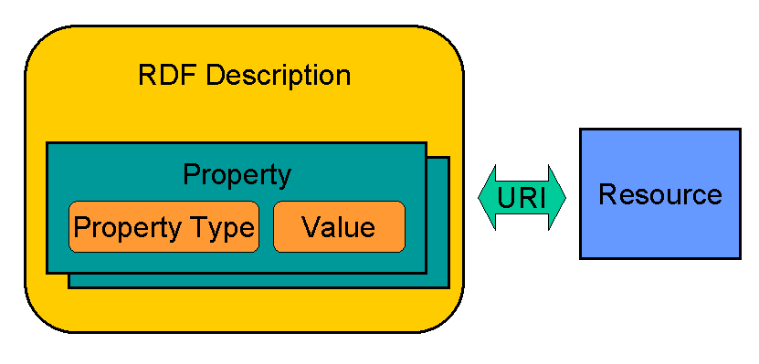
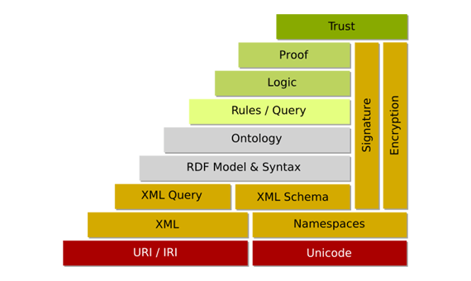
Resource Description Framework (RDF)

Slide 22
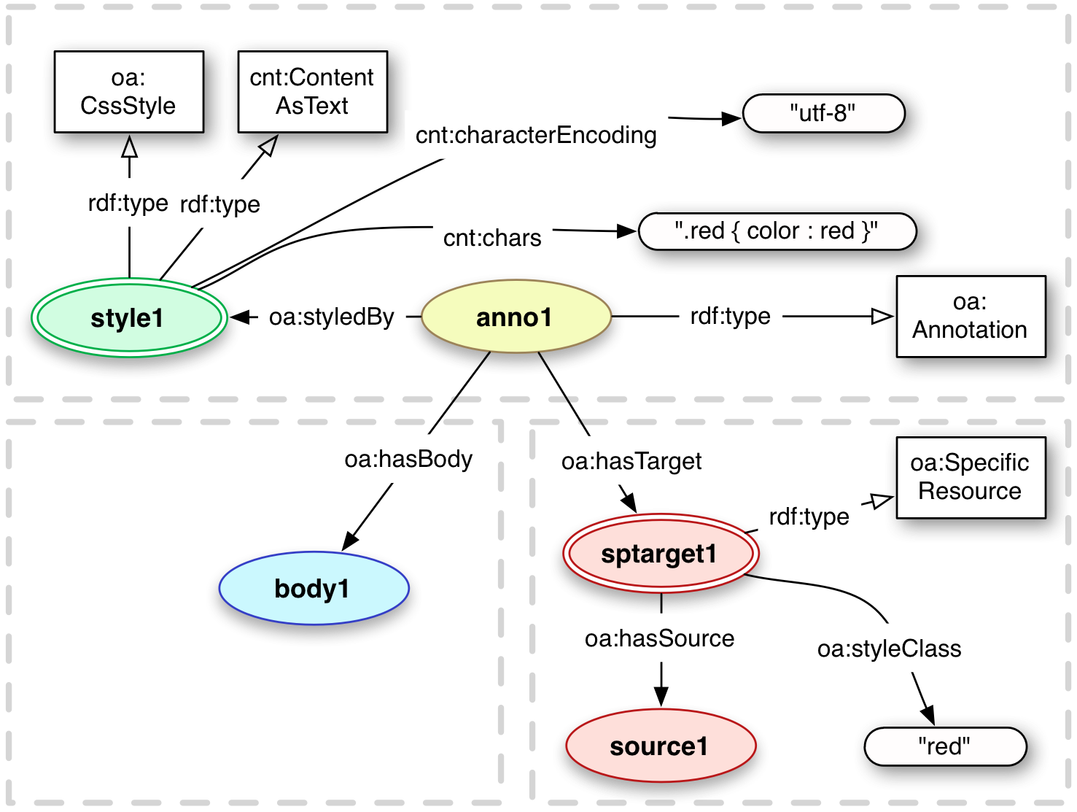
Open Annotation Data Model : Publishing (W3C)
(refer) http://www.openannotation.org/spec/core/publishing.html

Slide 23
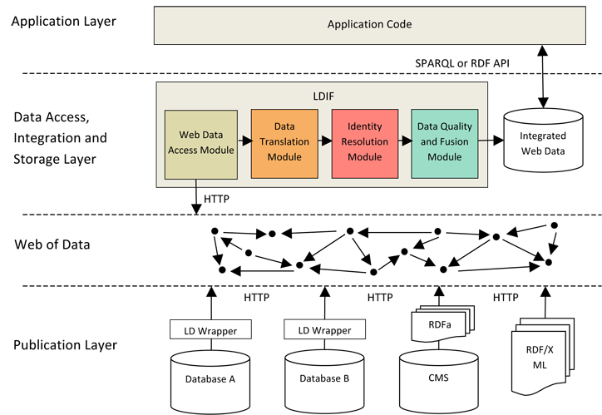
Integration Architecture of Linked Data
(refer)
http://ldif.wbsg.de/

Slide 24
Requirements of New Data Formats

Slide 25
Requirements for New Data Formats
(Basic) Recognize by human organ and their supporting utilities
  Simple audio/sound, and visual image
  Language including translation tools
(Extended) Accumulation, Filtering, and Processing
  Linked chains among related data or sensing data from IoT equipment
  Accumulation by collective intelligence and crowdsourcing
  Filtering based on experience, preference, and accumulated know-hows
  Creation of new information and knowledge (like big data processing)
(Applications) IoT, Media, Energy Avatar, Traffic Guider
  Context-aware information based on IoT sensors and AV devices
  Navigation assistant (or Guider) for road and traffic conditions
  Energy Avatar for analysis and prediction of energy consumption

Slide 26
Creating New Data World
Need new data types for knowledge society
  (Mapping) Data types connecting physical world to cyber world
    Identification/classification, Location, Status, Role/Function, etc.
    (Example) GPS, address, serial no. etc.
  (Vitalization) Data types for human understanding, meaning, interpretation, and translation, perception, recognition based on accumulated knowledge, reasoning, learning, action, behaviors, and experience
    (Example) Pythagorean Theorem, know-how of medical treatments, etc.
  (Visualization) Data types for communication, sharing, seeing, rendering, hearing, and writing, etc.
    (Example) icon, logo, graphic image, character sets,
Vitalization
of accumulated knowledge, action, and experience
Visualization of word, image, icon, and gesture
Mapping between Physical world and Cyber world

Slide 27
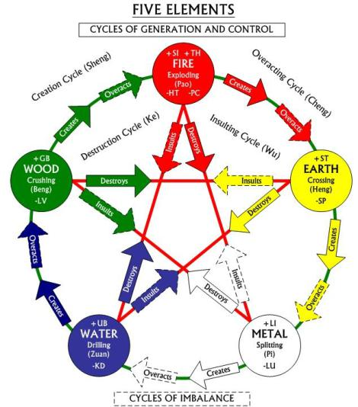
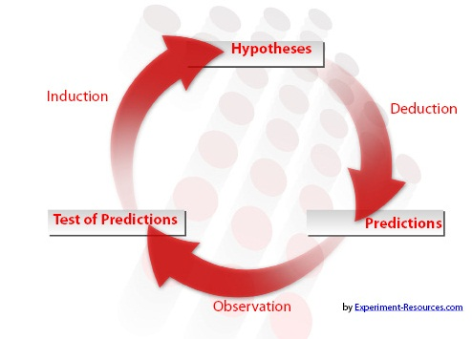
Mechanism of Data Self-Accumulation
Recipe for Information Acquisition from Data
  Recursive and Re-incarnation process of data accumulation
  Self-proliferation Cycle of Knowledge
Knowledge Accumulation Process
(ref) https://explorable.com/aims-of-research
(ref) http://www.cfagbata.com

Slide 28
Linked Chain between Data and Information
New values of Linked Open Data (LoD)
  New Values when Data are linked
    H + H + O → Water [H₂O]
    Dynamic Hyperlink among similar and/or heterogeneous data
  Environments/Conditions that Data is meaningful
    vegetable + salt + pepper + pot [Environment] → Kimchi
    “On the Origin of Species” → survival plan of live data
    CCTV camera + location + status → meaningful context information

Slide 29
Technical Issues for New Data Format
Requirements of Future Data Formats
  Minimize processing power during Creation, delivery, and display
  Minimize metadata, attributes and description information in nature
  How to insert information or knowledge at the linked chains
Name of Data
Other Data
Contents of Data
Description of Link
(e.g., location, attribute)
Description of Data
(e.g., metadata)

Slide 30
Technical Issues of Data Format
HTML5-based ?
  XML/RDF, HTTP, COAP/RESTful, etc.
Data and Metadata Together
  Media object and media resource model
  Media Ontology, Media Annotation
  File Format, Micro-format, ATOM/RSS
  Device Data Format for Mashup
Data format for Web-based open API
  Open, Auto-configurable, and future flexible
  But, Securable and manageable is in question ?

Slide 31
Meanings of Data, Information, and Knowledge - 1
(Value) “Data is King” or “Data is new Oil”
  New Value when data is processed and accumulated
    Added new value when combined with other data and different environments
    Different meaning and understanding when the environments is changed
  Various form of data when it is created, shared, processed, and utilized
    Depending on applications (energy, transport, health, education, safety, etc.)
    Supported by metadata and descriptor
    Depending on activated conditions and environments
      Vitalized with the related information and filtering conditions
    May have self-proliferation phenomenon of biological cell at future
  But, Data is very “Dangerous” like Nuclear Power
    Imagine radioactive contaminated water

Slide 32
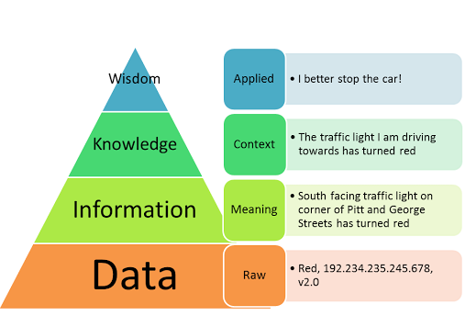
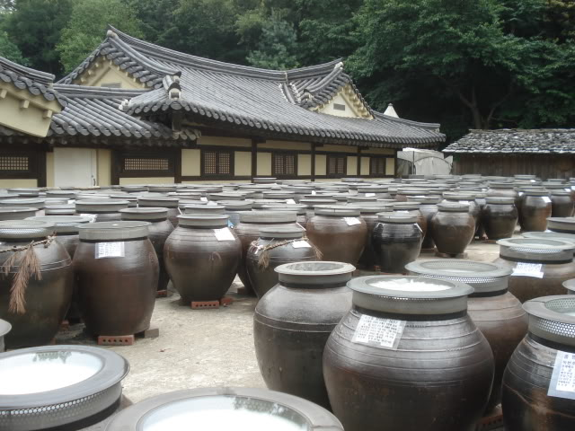
Meanings of Data, Information, and Knowledge - 2
(DIKW) Value chains among Data, Information, and Knowledge
  Linked Structure among data, information, and knowledge
  How to make a process of data to get useful information
    No meaning like “01100101100110…”
  Tier x data extracted from intelligent filtering process
    Based on previous or background information, and statistics, etc.
  Decision making by aggregating the related data
    Depending on know-how, experience, and context-awareness
(Environments) What environment for data is valuable
  At right time, right place, and right condition
  Location-, time-, and context-awareness: 5W1H rule!

Slide 33
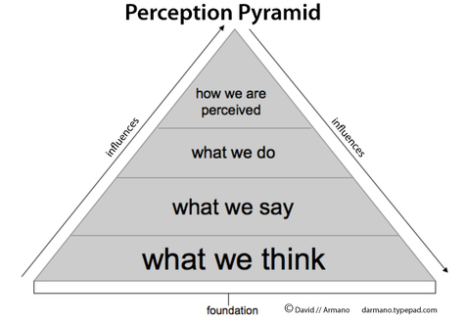
Data Sciences for Knowledge Society - 1
(Human Perception) How to make a process from data acquisition to get knowledge?
  What percentage of data is perceived by human?
    Could not catch critical situations from all the CCTV cameras during 24 hours/day
  What amounts of information are extracted from same image and sound?
    Depending on his/her experiences and intelligence level! (e.g., X-ray image, accent, intonation, smell, etc.)
  If new tools create, share, and utilize open data from IoT devices
    Identify location and time
    Recognize contexts from image and situation!
(ref) http://darmano.typepad.com/

Slide 34
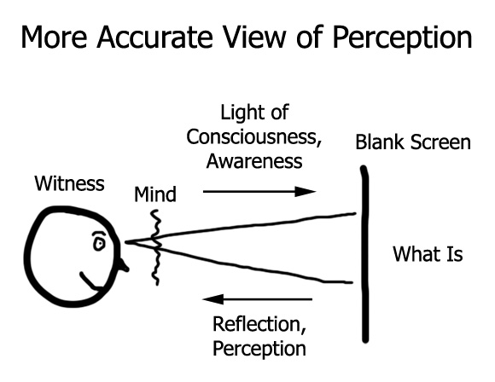
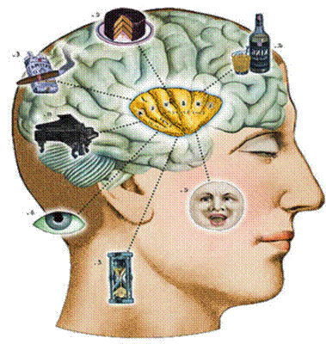
Processing for Human Perception and Cognition
Perception
  True or False
  Belief, Value
  Benefits, Consequence
Cognition
  Attention, memory, judgment, evaluation, reasoning, computation, problem solving, decision making
(ref) http://www.mcgill.ca/cogsci/

Slide 35
Data Sciences for Knowledge Society - 2
(Type/Format) Cyber physical space for Energy, Transport, Health, Environment, Surveillance, etc.
  Various Standards for 3D physical space!
    3D scalable geo-graphic, MPEG, OGC, Web3D, OpenGL, etc.
  Resolution and Accuracy of cyber physical 3D information
    Depending on applications, data volume, and processing time, etc.
  Data Type and Format for IoT/WoT/WoO applications
    Image and sound data may be combined with data format for energy, transportation, health, surveillance/monitoring, etc.
    3D game, 3D image for navigation, 3D simulation for war and building construction, etc. → data format may be different!

Slide 36
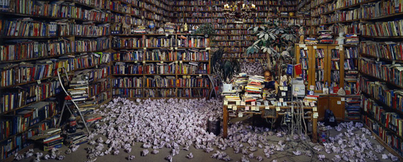
Data Sciences for Knowledge Society - 3
(Accumulation) High-level Education/Learning/Experience for Cognition Process of Knowledge
  How to accumulate human knowledge collectively!
    Collectively intelligence by mechanisms of perception – see, hearing, touch, smell, taste, and attention
    New platform for knowledge sharing and accumulation!
  Sharing tacit knowledge and real/virtual experience!
    Experiences of driving, cooking, and gaming by simulation at virtual space

Slide 37
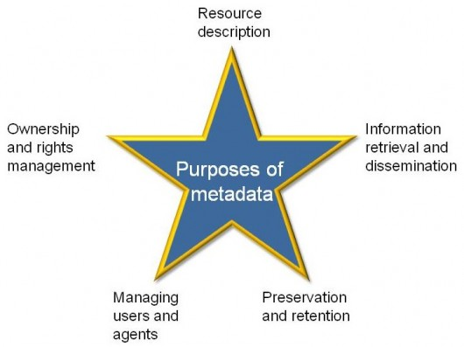
Open Data Platform - 1
(Metadata) Data could not stand alone without metadata or descriptors
  Re-define Data and Metadata → Metadata is not only descriptive information of data
    used for handling, sharing, and processing data
  New data format including metadata is needed
    Active Hyperlink or Active Data (with corresponding software) → like computer virus
    New Metadata is different from existing metadata in MPEG standards
    Recursive data format according to levels of human perception and intelligence
(ref) http://aspiresquared.co.uk/

Slide 38
Open Data Platform - 2
(Platform) new model for data processing including database
  “Data + Processing + Storage” in harmony → web-based platform?
  New version of web platform → HTML5-based I/O tags for IoT/WoT world?
    How to contain location, status, behaviors information that is not descriptive from existing web standards (such as text script/binary-based web)
    Recursive data format to support complex and iterative algorithm or logics
    New Markup language to adopt new UI/UX tools (e.g., 2D/3D drawing, gesture, expression, etc.)
  Data format for IoT/WoT application !
    May enhance the existing HTML5 standards to cover physical world
  How to build Cyber Physical System for future flexibility?
    3D virtual space, location, depth/granularity/tier/level, attribute, etc.

Slide 39
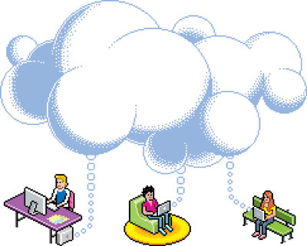
Open Data Platform - 3
(Next Generation Web) good for future open data world ?
  Common platform for data creation, delivery, share, and consumption
  Keep Simple User Interface and software/application interface
    Utilize existing wireline/wireless network, computing/software, and database
  Support data format and processing platform for energy, transport, medical/health, education, environment industries
(Cloud) sharing data by using cloud platform
  Performance, security, availability of cloud platform is suitable for future demand
  Open ecosystem for data sharing and software re-use!
  Compatibility of existing web standards and data formats

Slide 40

Notes:
This is the end of my presentation.
All of you have been a very patient audience (laughter).
Hopefully, my presentation helped you better understand the strength of Korea’s ICT sector, its potential and vision.
I just want to tell you that your partnership and business would be invaluable in making Korea’s potential and vision into reality.
Thank you so much for your time and attention.

Slide 41
<Appendix>
Existing Data Types and Formats

Slide 42
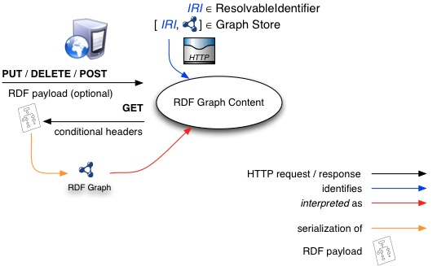
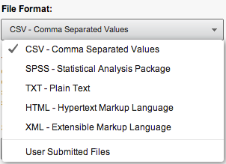
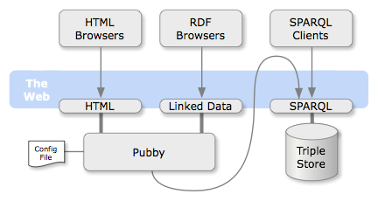
Graphic Data Format of RDF (W3C)
(refer) http://www.w3.org/
(refer) http://wifo5-03.informatik.uni-mannheim.de/

Slide 43
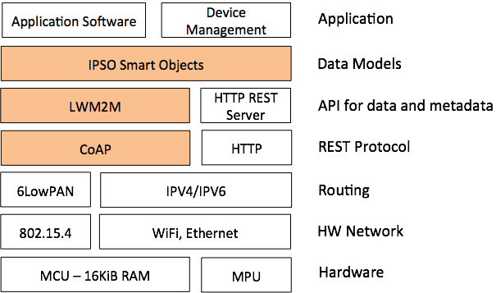
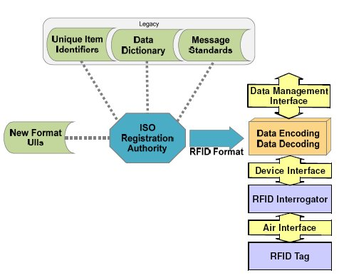
Data Standards – IoT and RFID
(refer) http://iot-datamodels.blogspot.kr/
(refer) http://grifs-project.eu/

Slide 44
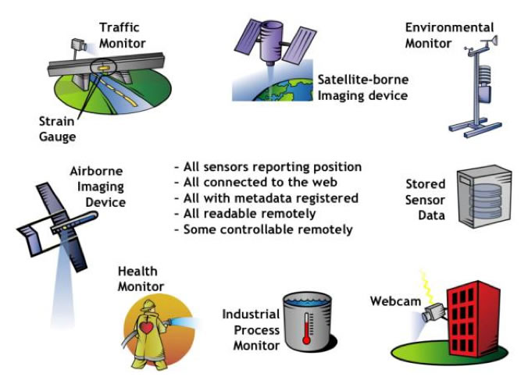
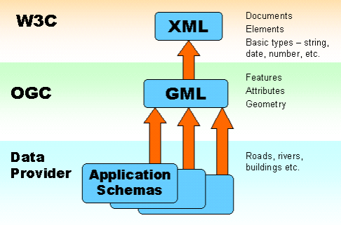
Geospatial Data Format (OGC)
(ref) http://www.opengeospatial.org/

Slide 45
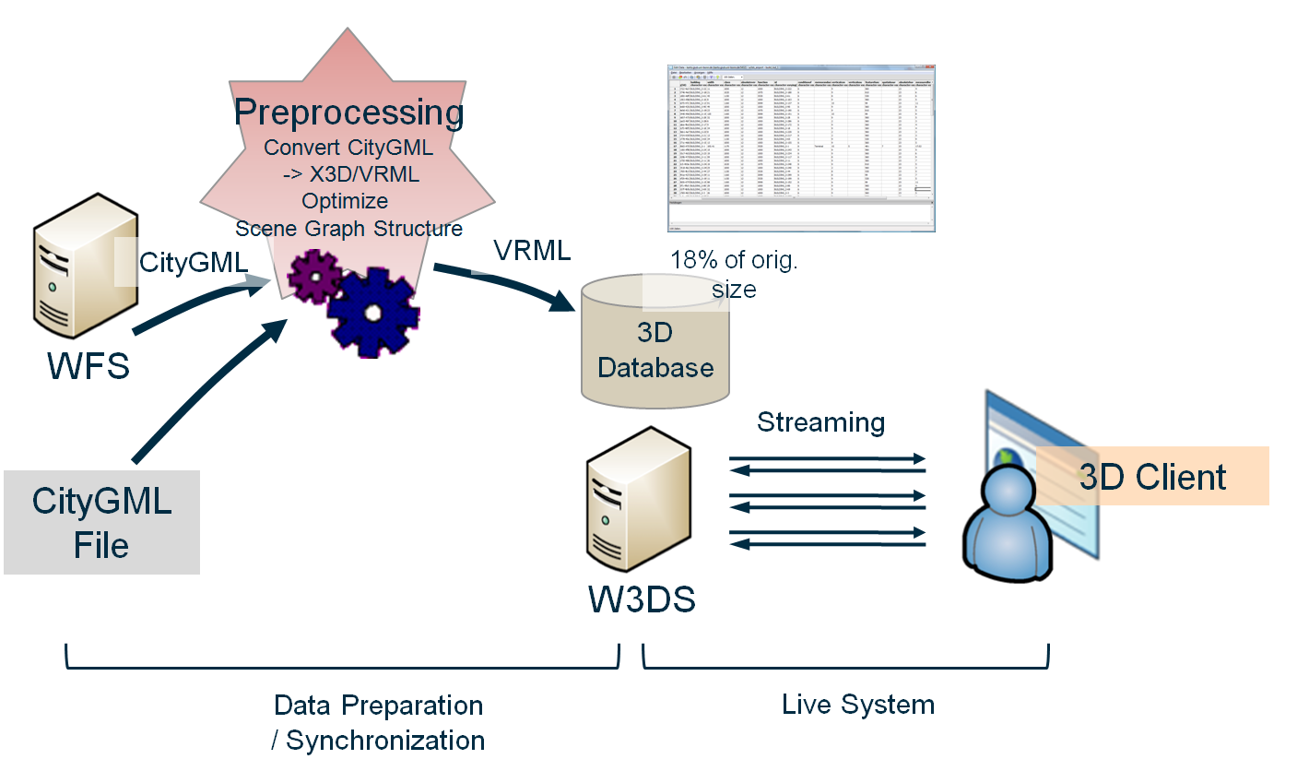
Data Format of OGC Web Services
(ref) www.geog.uni-heidelberg.de

Slide 46
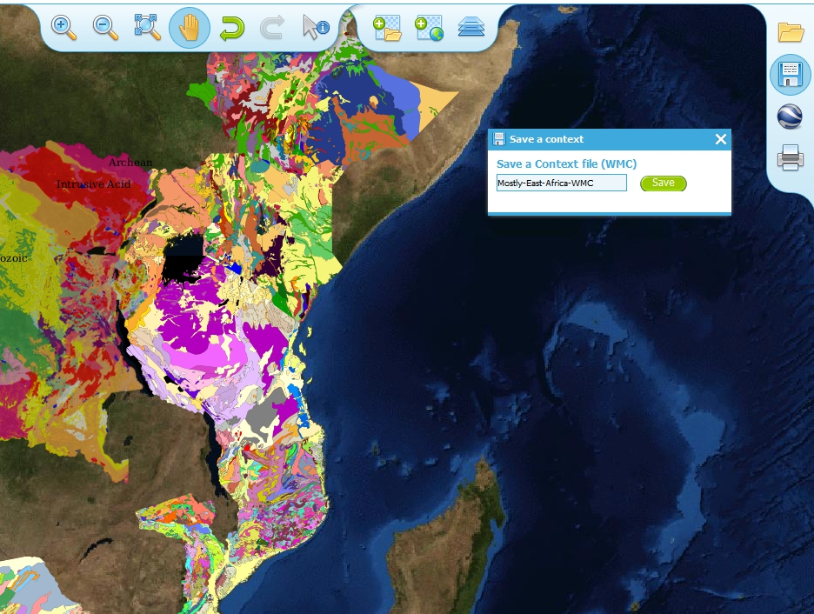
OGC: Web Map Contexts (Example)
(ref)
http://www.onegeology.org/

Slide 47
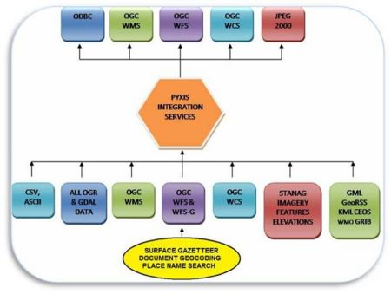
Supported Data Formats of OGC
Raster/Elevation Data Source
Long Format Name | Extension
Arc/Info ASCII Grid | AAIGrid
Arc/Info Binary Grid | .adf
Compressed Arc Digitized Raster Graphic CADRG | .tl2
Hierarchical Data Format Release 4 | .HDF4
Hierarchical Data Format Release 5 | .HDF5
GEODAS Grid Data Format - "GRD98" | .g98
Erdas Imagine | .img
JPEG JFIF | .jpg/.jpeg
Multi-resolution Seamless Image Database | .sid
Network Common Data Form NetCDF | .cdf
Oracle Spatial GeoRaster | Oracle
TIFF / GeoTIFF | .tif/.tiff
OGC Web Coverage Service | WCS
OGC Web Map Service | WMS
USGS ASCII DEM | .dem
USGS SDTS DEM | *CATD.DDF
WMO Gridded Binary Image GRIB | .grb
Vector/Feature Data Sources
Long Format Name | Extension
ESRI Shape | .shp
GML | .gml
KML | .kml
Mapinfo File | .tab
Vector Map (Vector Smart Map) | .toc (VMAP)
Microsoft Excel Spreadsheet | .xlsx/.xls

Slide 48
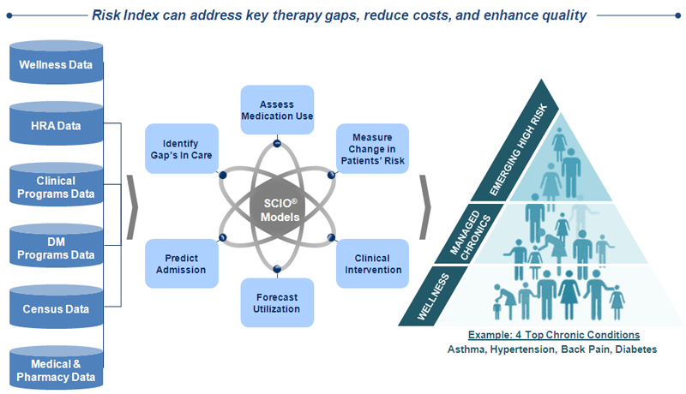
Health Science Data Sources
(ref) https://www.sciohealthanalytics.com

Slide 49
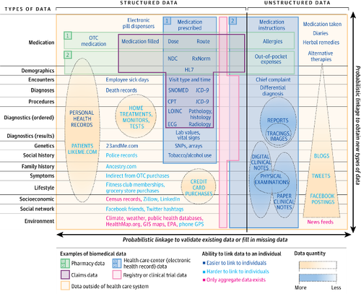
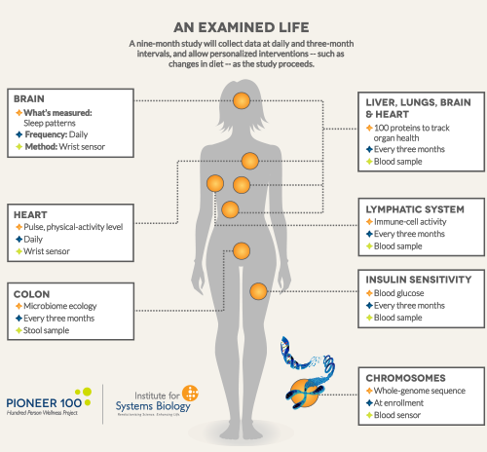
Data Types of Healthcare
(ref) http://isbmolecularme.com/
(ref) http://histalk2.com/

Slide 50
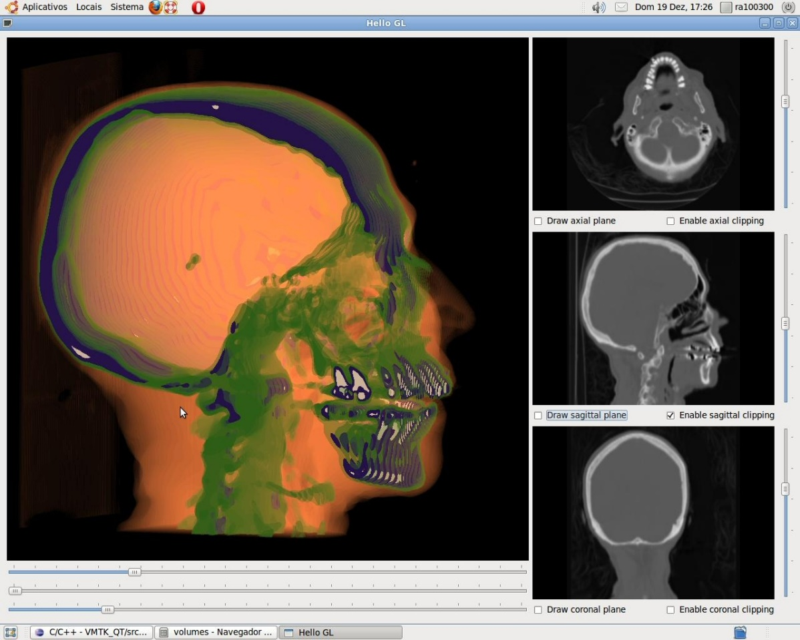
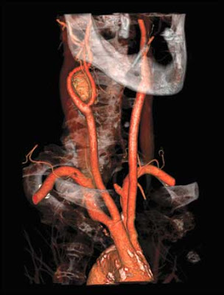
Medical Data Visualization
(ref) http://healthinformatics.wikispaces.com/
(ref) http://www.dca.fee.unicamp.br/

Slide 51
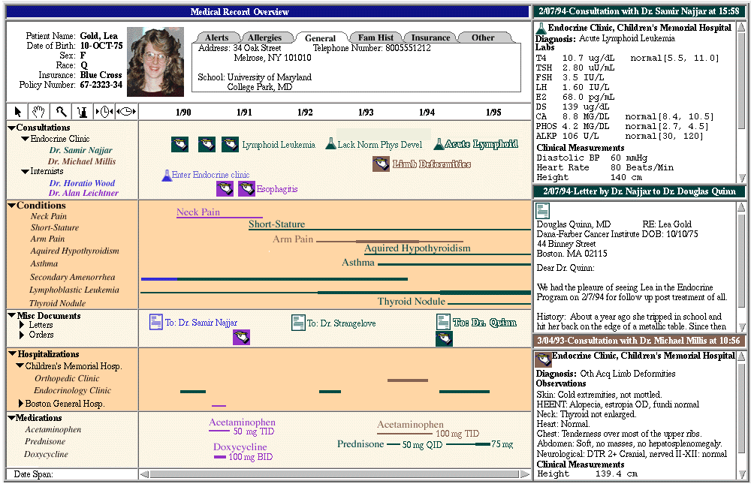
Personal Medical Data Record (Example)
(ref) http://hcil2.cs.umd.edu/

Slide 52
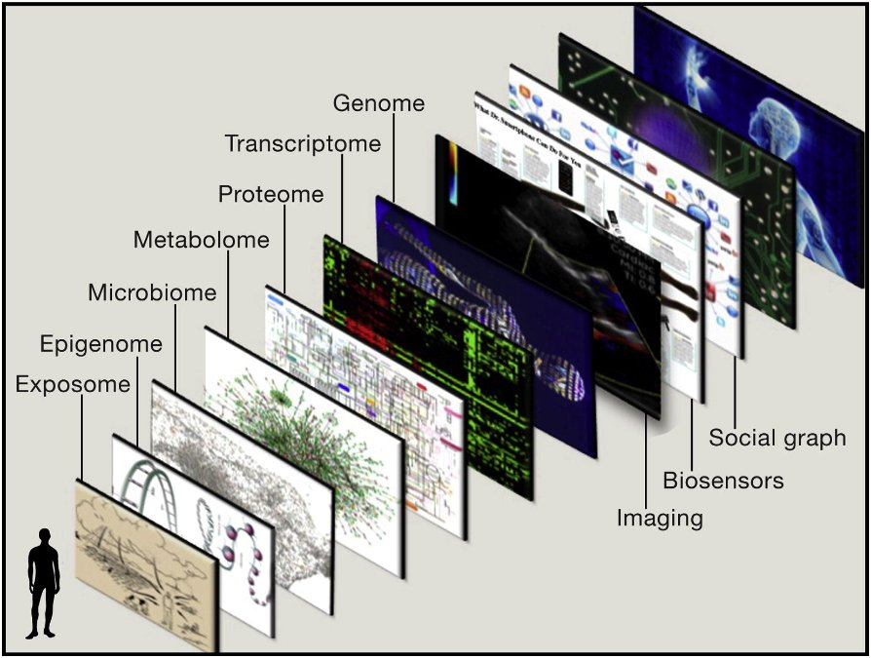
Medical Geographic Information Systems
(ref) https://www.linkedin.com/pulse/20141106010537-10405966-how-individualized-medical-geographic-information-systems-and-big-data-will-transform-healthcare

