Slide 1

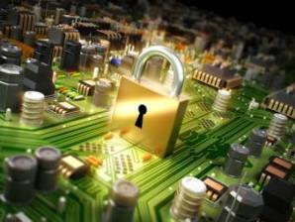


Ilias Chantzos
Senior Director, Government Affairs - EMEA
Symantec

Slide 2
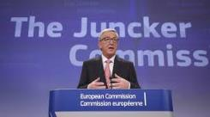
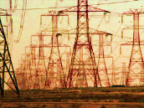
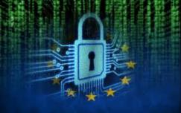

Big themes in the European policy agenda
Cyber-Security
Critical Information Infrastructure Protection
Privacy and Data Protection
Internet of Things (IoT)
Big Data
All data-driven, therefore any good policy approach will look at how to protect data

Slide 3
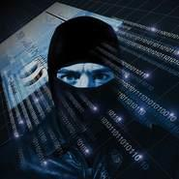
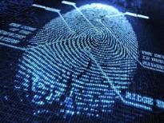

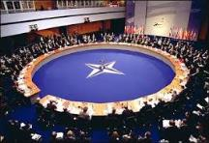
Cyber-security a main public policy theme
Greater awareness of risks and vulnerabilities
In 2013 the number of targeted cyber attacks increased by 91% YoY
Over the years, high-profile attacks have demonstrated how increasingly sophisticated attackers become
Cyber-attacks are perceived as a tier-1 threat by the EU and NATO
The EU is harmonising legislation on Critical Infrastructure Protection & Data Protection

Slide 4



Critical Information Infrastructure Protection
Catapulted to the forefront
  Several incidents of various nature
  Widespread concern
  Edge of cyber-warfare, state-sponsored actions
2010
Stuxnet
2011
Duqu
2012
Gauss
2012
Flame
2014
Dragonfly
2014
Regin

Slide 5



Network & Information Security Directive
Increasing resilience
Obligation for EU Member States to:
Establish national cybersecurity strategies
Build incident response capabilities, create and Equip national CERTS
Appoint an authority with responsibility for cybersecurity
Share information with each other.
Obligations for industry and operators:
In key sectors, develop a risk management approach
Obligation for industry to notify cybersecurity breaches and share information with governments.

Slide 6




General Data Protection Regulation
  Directly applicable to all countries
  Following up from 95/46/EC
  Applicable to all industry of a certain size and possibly by Country discretion, to public sector
  Regulates how personal data are collected, processed, retained and transferred

Slide 7









The information lifecycle and good data governance
Principles of data collection
Fairly and lawfully
Receiving individual consent
Relevance
Proportionality
Types of data
Purpose limitation
Specific data
For specific purpose
Any changes need to be notified
Any processing
Collect
Process
Information
lifecycle
Provide access
Right to rectify data
Data destruction policy
Data transfers
Applicable rules
Retain
Duration
Types of data
Secure
Technical measures
Organizational measures
Data loss
Retain &
Secure
Manage
Notes:
Slette og bare hurtigt sige at man baserer sig på ideen om Lifecycle and Good Data Governance

Slide 8




Awareness of data vulnerability
In a digital economy data is the “new currency”
Information protection generates value, enables growth
Individual/Industry/Government/National security: all interlinked.
Focus shifts:
Systems/HW/Devices ➔ information/identity/ interactions
Passive defense ➔ Active intelligence
Not vaccine, but DNA analysis
Recognizing an attack, correlate data ➔ learn from previous attacks
  Cooperate to understand cyber-threats: PPP - MoUs

Slide 9

Where is the public sector going?
Rethink national security and national defense strategy
Know what information and infrastructure assets to be protected
Understand the value of information
CyberSecurity is no longer just about firewalls and AntiVirus
Cooperation structures between government & NII owners/operators
Direct impact on the lives of citizens
Direct impact on the operations of government
Info-sharing
Threat mitigation
Incident response
Accidental loss and Open
Source Intelligence
Resilience and continuity of operations
Educate the users
Intelligence driven
Dynamic and mobile
Process and people driven

Slide 10

Securing smart sustainable city systems
Highly complex ICT systems
Highly interconnected components (IoT)
High volume of data
High vulnerability

Slide 11








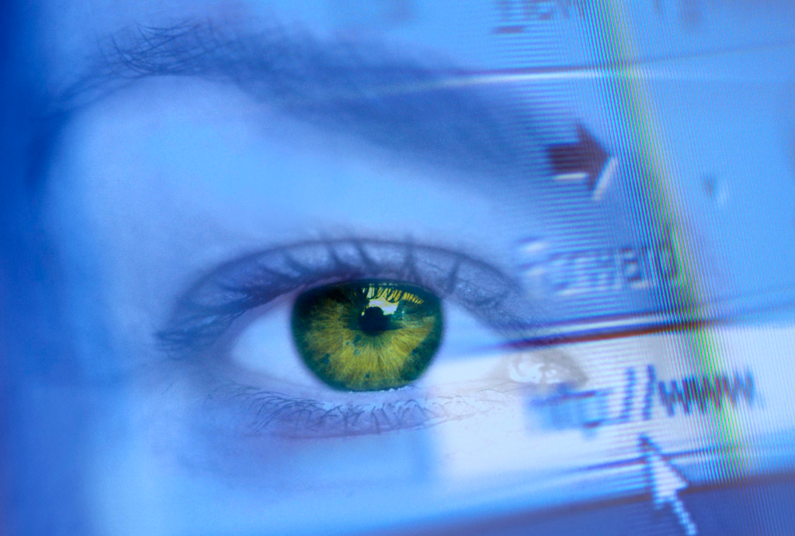





Securing the smart sustainable city
Smart grids
Cyber-security
Intelligent transportation
Resilience
Connected healthcare
Privacy
Public safety & security
Compliance
Wireless & hotspots
Data integrity
11

Slide 12
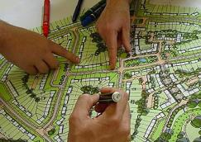


Ensuring safety of critical infrastructure and continuity of critical services through cyber-resilience
City governance to ensure that ICT strategies are strongly interwoven into the fabric of the wider city evolution strategy
Technology to enable policy
City CIOs increasingly part of strategic policy discussions
Systems/IoT, need to be standardised, interoperable and open, but also secure
Cyber-security and resilience to be embedded from inception
Cyber-security + backup and recovery systems for mission-critical administration data (& Big Data)
Legislation increasingly prescriptive, nationally and EU
Notes:
Cyber-security Strategy & Directive
of the European Union, published in February 2013, seeks to ensure that critical infrastructure is adequately protected from any
kind of cyber attack and that information is protected according to compliance standards
“Achieving cyber resilience”

Slide 13

Conclusions
Smart city deployments imply vulnerability
Complex, heterogeneous ICT implementations
Diverse stakeholders
Hyper-connectivity, IoT, Big Data, Cloud Computing
Data is the digital currency - Data governance is the new focus
Intelligence + Processes + People + Tools
Cyber-attacks and data breaches are dangerous and costly
Human lives - Data - Financial - Reputation - Credibility
Cyber-threats are here to stay
→
Conceive the resilient smart city with Cyber-Security and Resilience in mind

Slide 14


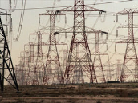
EU Definition of Critical Infrastructure
Energy installations and networks
Communications and information technology, Cloud
Finance (banking, securities and investment)
Healthcare
Food production and distribution
Water (dams, storage, treatment and networks)
Transport (airports, ports, intermodal facilities, railway and mass transit networks and traffic control systems)
Logistics
Production, storage and transport of dangerous goods (e.g. chemical, biological, radiological and nuclear materials)
Government (e.g. critical services, facilities, information networks, assets and key national sites and monuments).
Media

Slide 15
Ilias Chantzos
Senior Director, Government Affairs - EMEA
Symantec
Ilias_Chantzos@Symantec.com

