Slide 1
Bristol is Open
Future Cities Bristol City Council
Joe.dignan@bristol.gov.uk
Joe.dignan@kintechi.com

Slide 2
Why cities are important
“Barcelona has been around for 2000 years,
I am not sure how much longer Spain will be”
Manel Sanroma- CIO Barcelona

Slide 3

What is Driving the IT Agenda
Cloud
IoT
BYOX
Economy

Slide 4

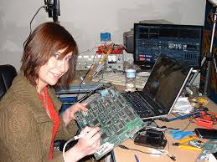
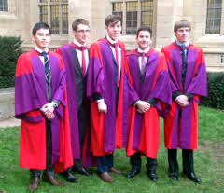
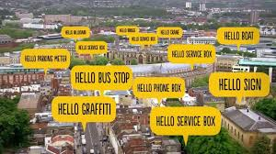
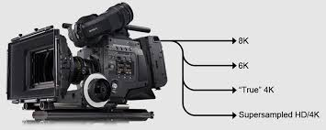

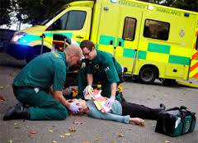
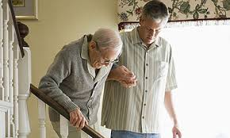

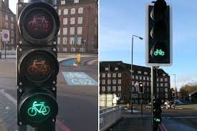
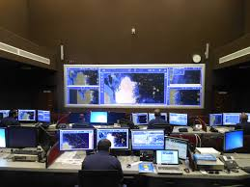

Why? Use cases
businesses
& academia
___________
Culture &
creative
content
___________
People, community,
service delivery
___________
Better
city
management
Ggj

Slide 5
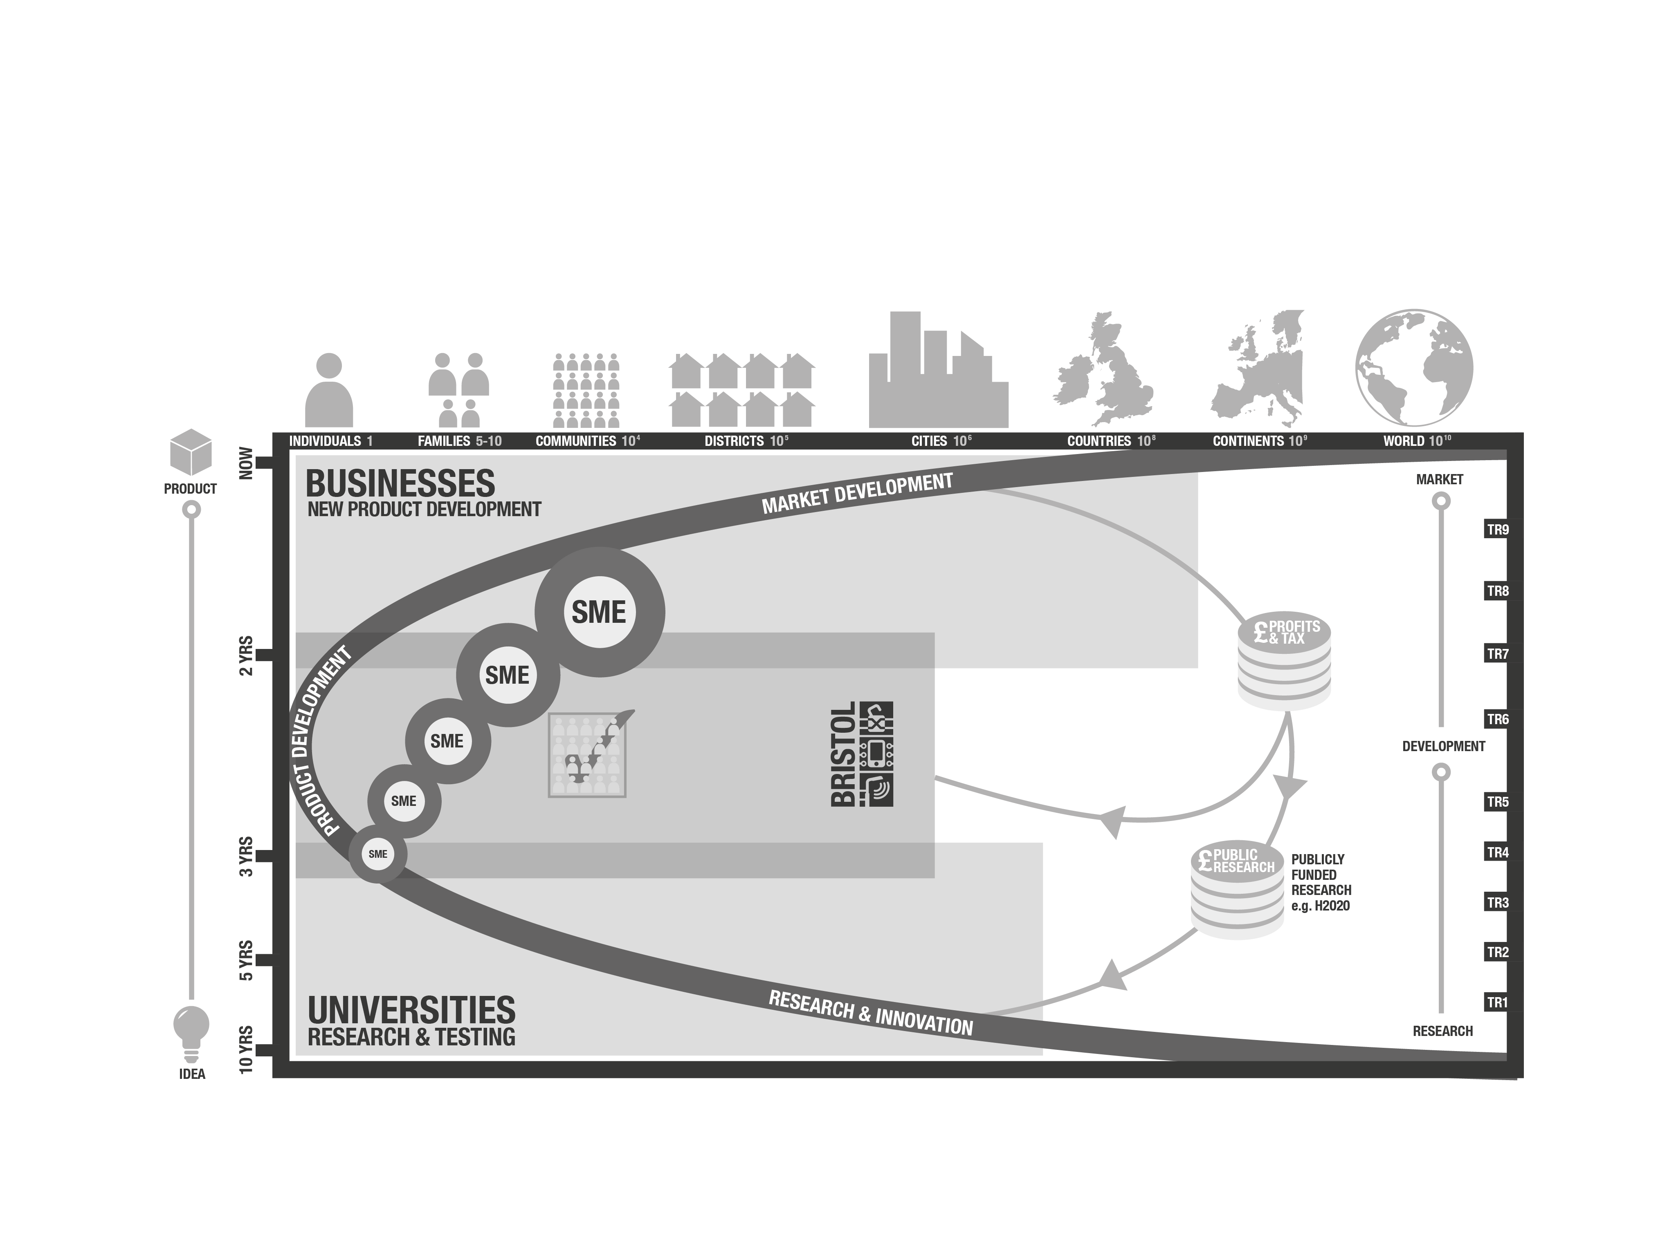
Our philosophy of innovation, co-creation, enabled by a JV

Slide 6
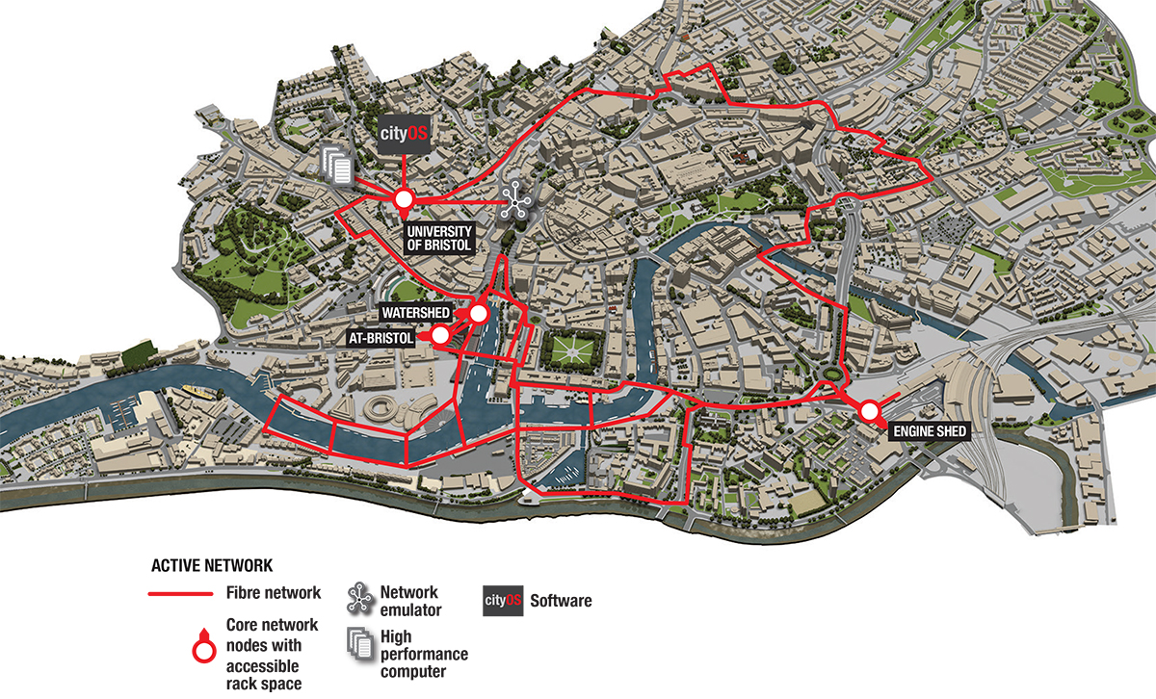
A city-region SDN test-bed

Slide 7
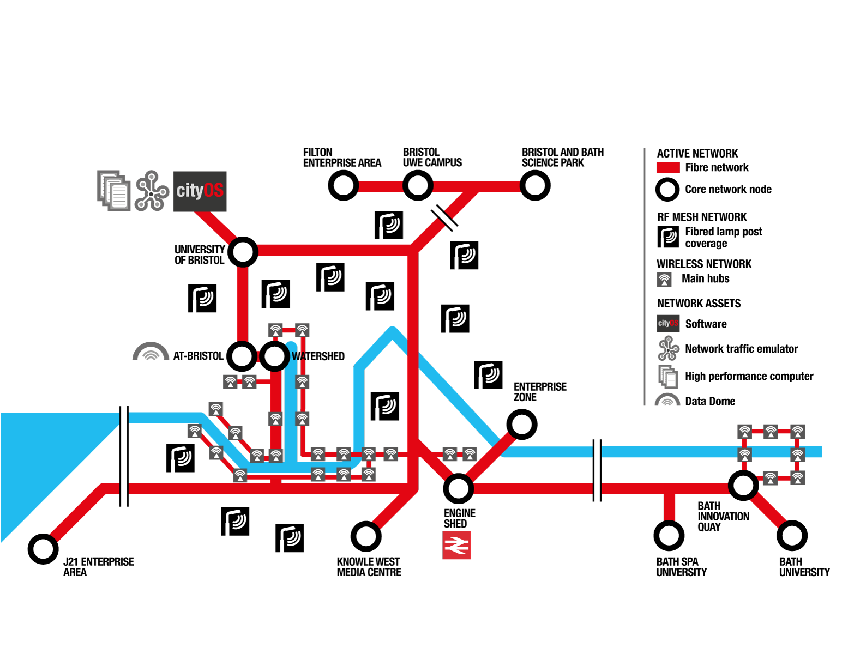
Phase II, wider City-Region, live in stages 2015-17
Work in progress

Slide 8
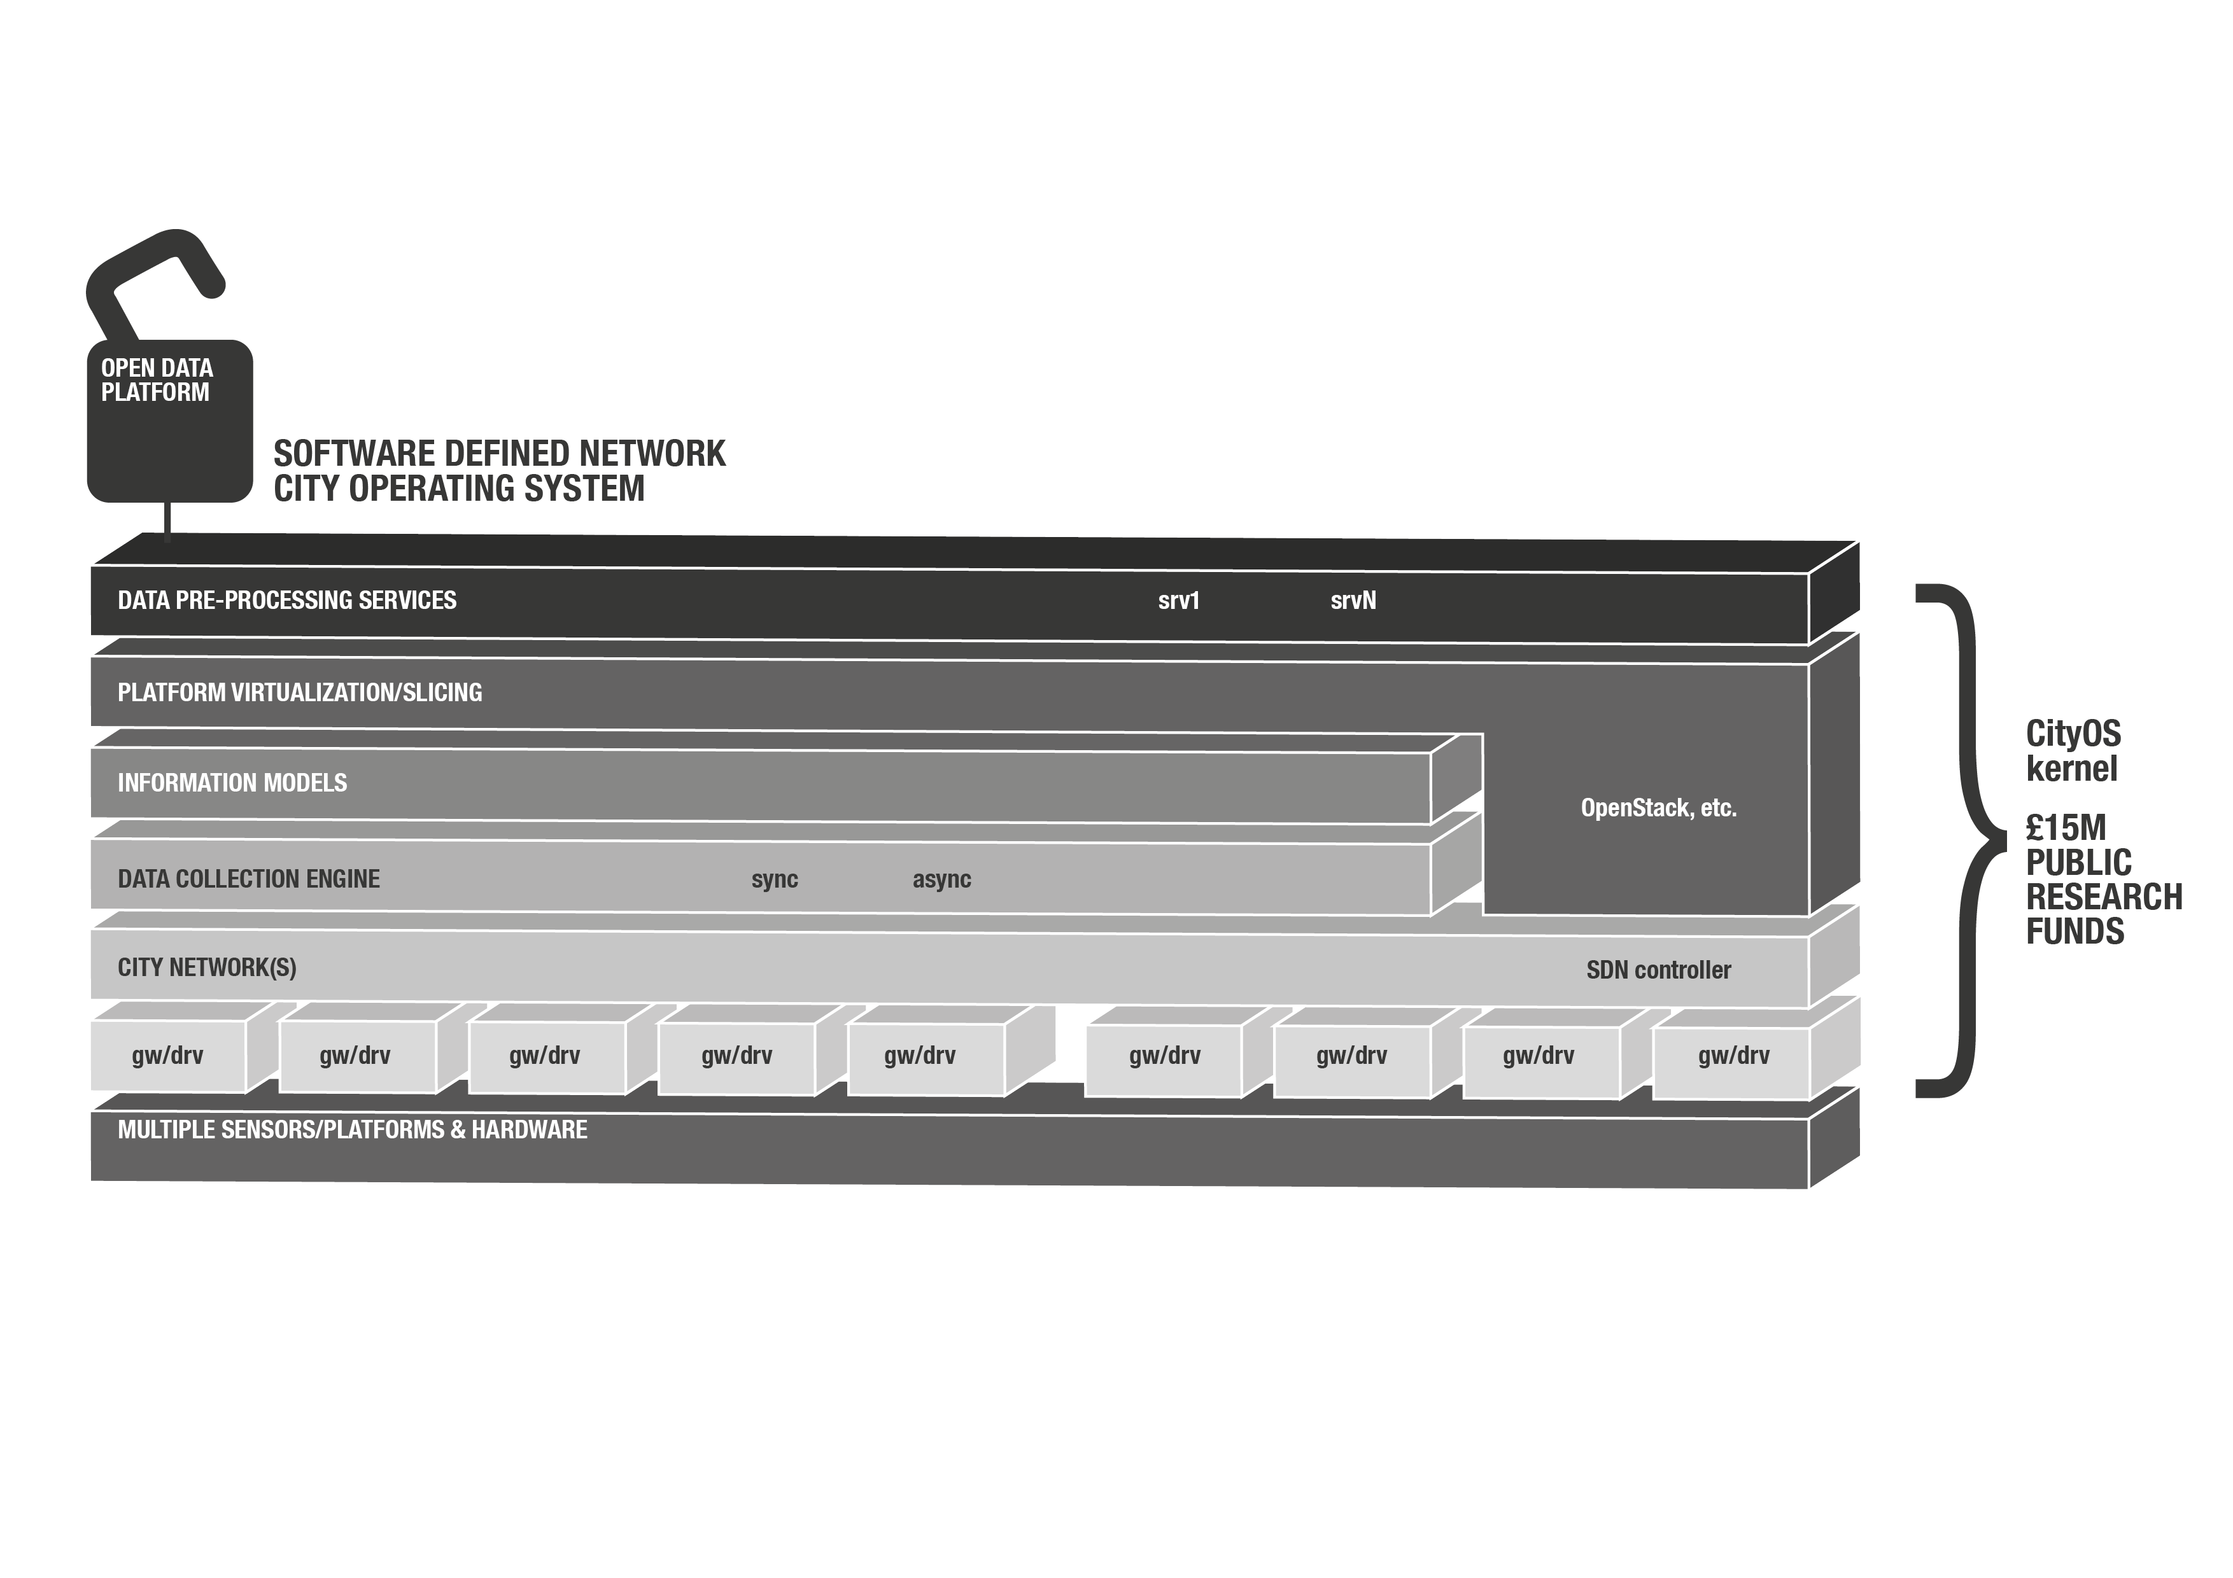
A CityOS: built from a Software Defined Network

Slide 9
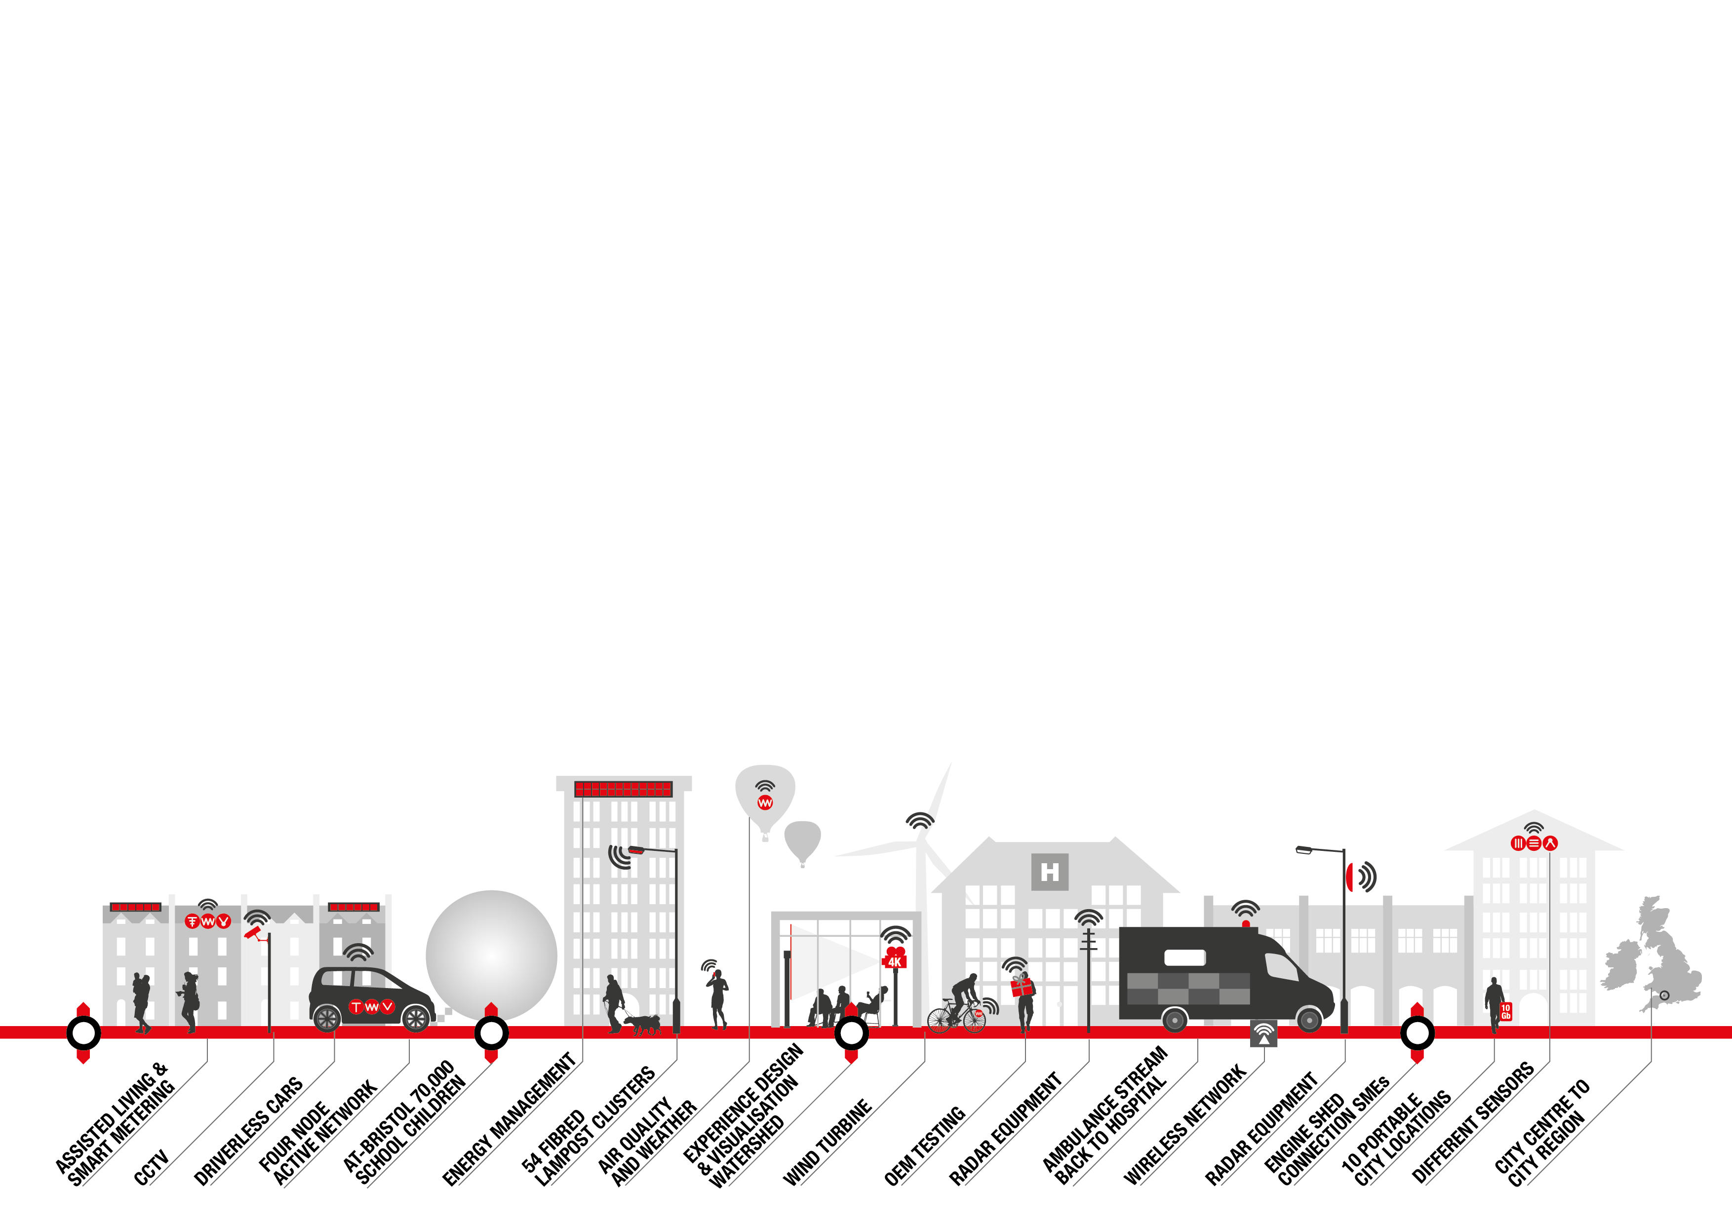
‘I see Bristol as a laboratory for change’
Mayor George Ferguson
BIG DATA GENERATION

Slide 10
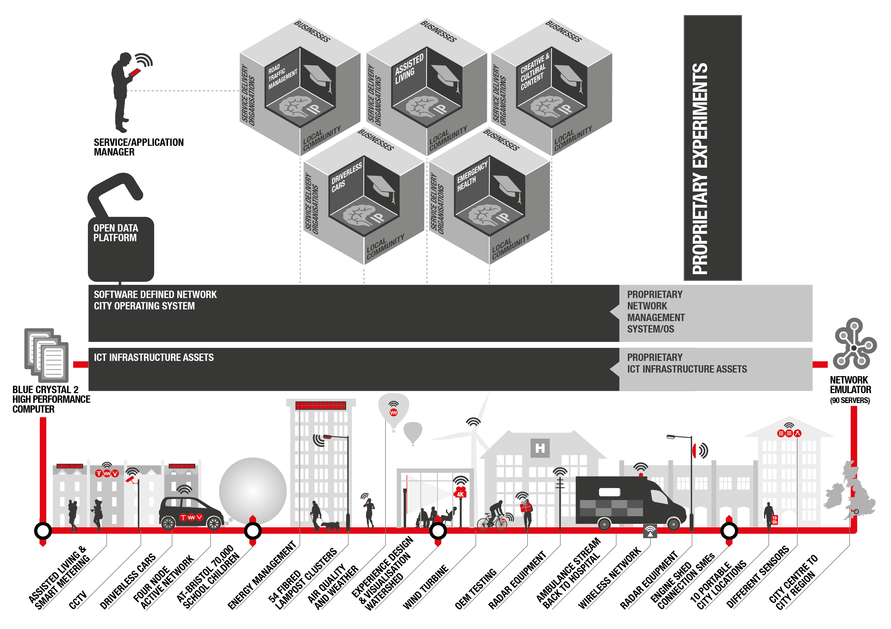

Slide 11
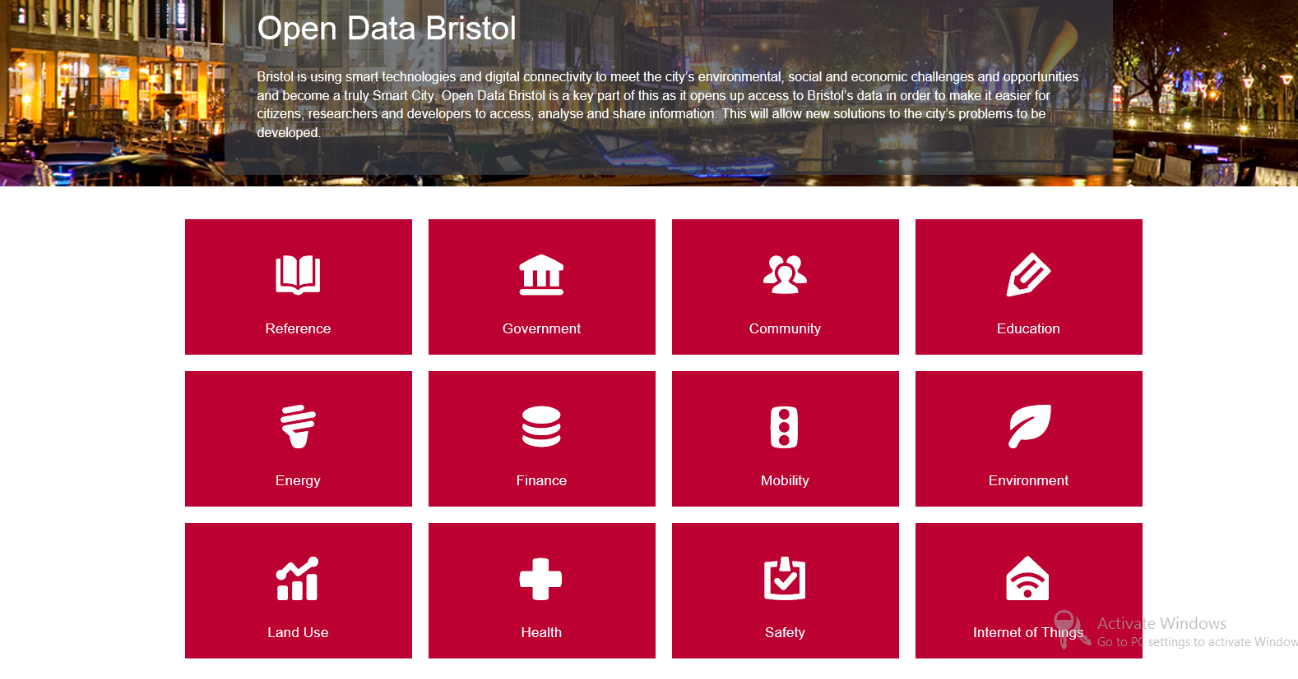
Bristol Open Data Platform

Slide 12
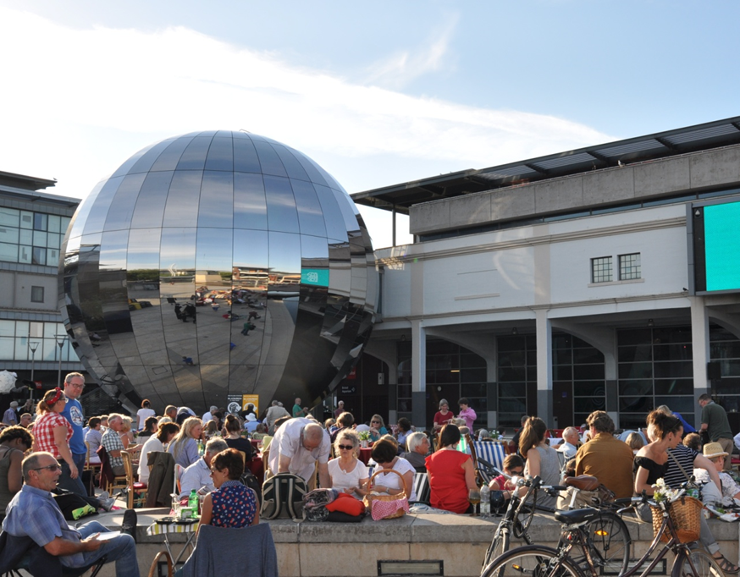
Digital Dome

