Slide 1

Developing a European Data Ecosystem and a Common Vision for Interoperability of Energy Systems in Smart Cities
Christian Mastrodonato
Ready4SmartCities Coordinator

Slide 2

Creating an Innovation Environment
MORE THAN 100 PROJECTS SO FAR SUPPORTED BY THE EC AND INDUSTRY
ICT integration for effective energy management and decision making from buildings to neighborhoods and cities
ICT
NMP
Fostering the development of new technologies and their integration in buildings and districts
Large scale demonstration of most promising solutions and their contribution to future smart cities
ENERGY
ENVIRONMENT
Notes:
2

Slide 3






Strategies from Buildings to Cities
Smart Buildings
Smart Districts
Smart Cities

Slide 4
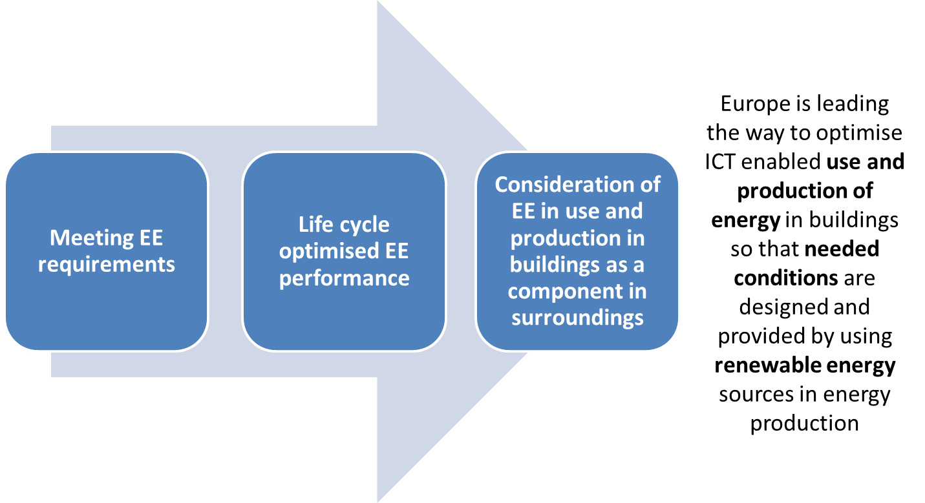
Towards Connected Buildings

Slide 5
ICT Covers Infrastructures Lifecycle
A p p l i c a t i o n a r e a s
Integrated processes, new business models & services
Integration of buildings systems
Design
Structure & envelope
Energy equipment
+ systems
Construction process
Performance monitoring + management
End of life
Integration with mobility, infrastructures, smart cities & citizens
Integration by means of ICT
Integration with grids & local/district energy systems
ICT infrastructures
Knowledge sharing, awareness, education & training

Slide 6
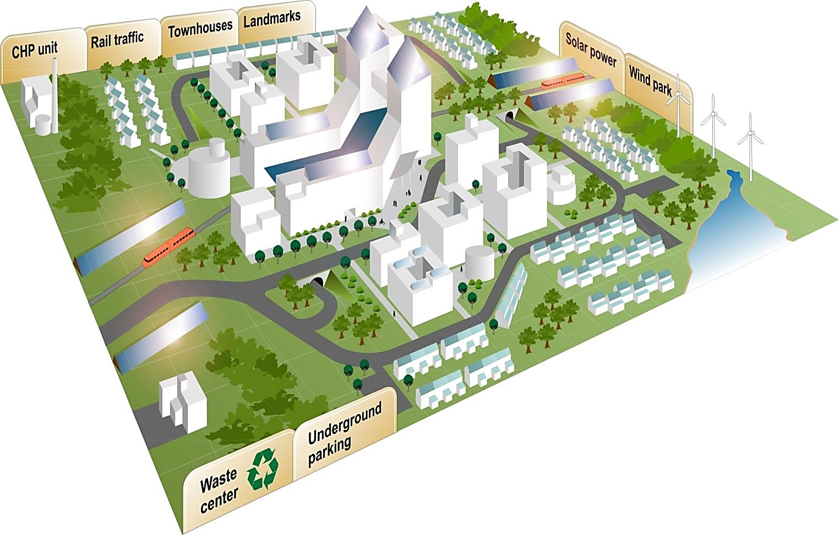






EE neighbourhood elements
Energy distribution
©
People involvement
Energy production and storage
Buildings, infrastructure & open spaces
Transport
system

Slide 7
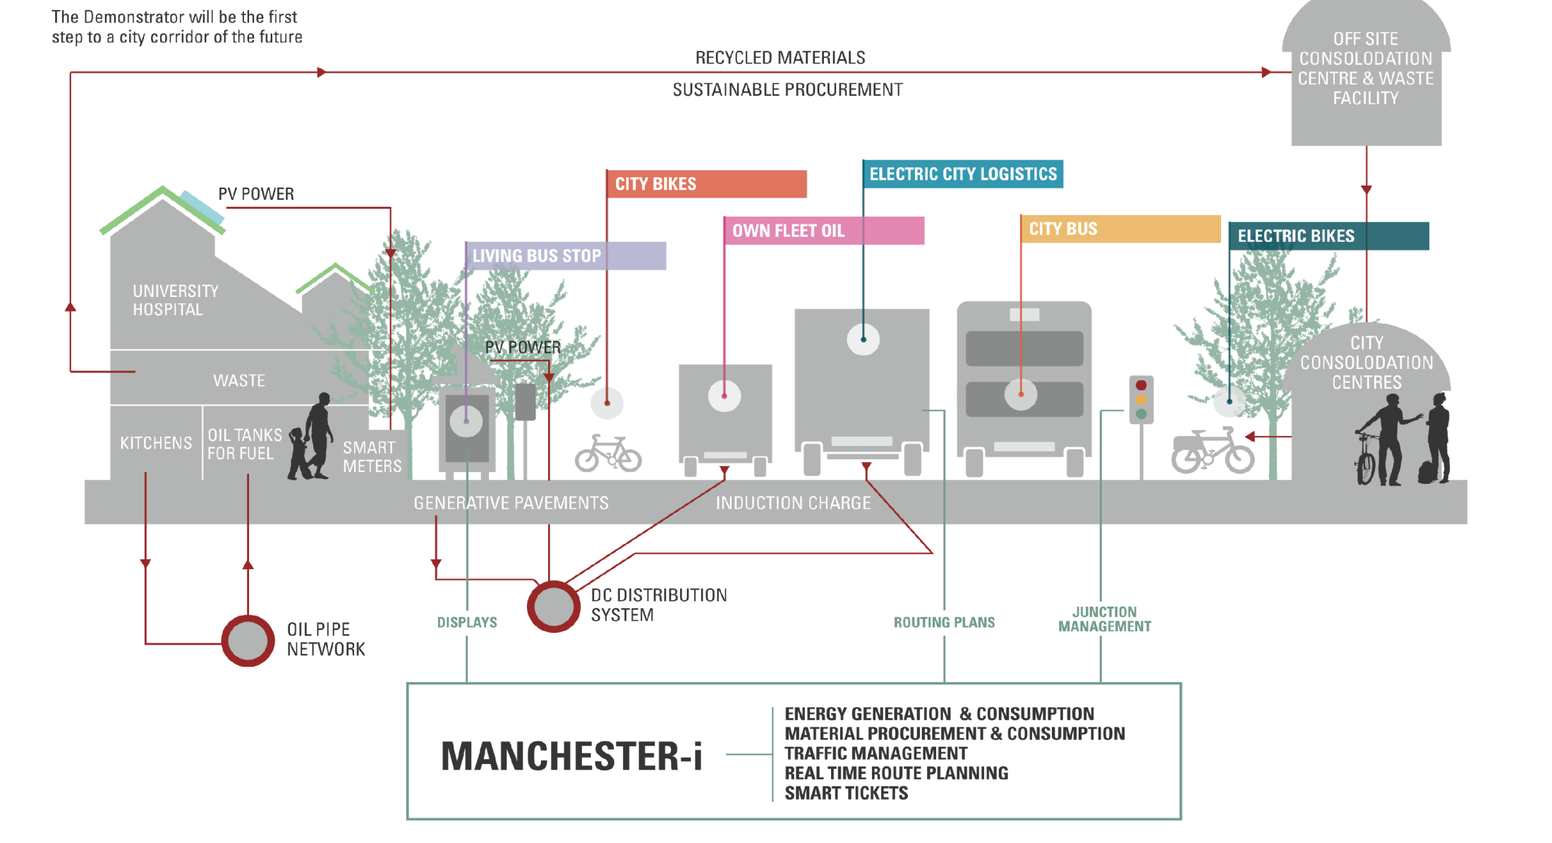
Smart Cities as Intersection of Energy, Transport, Waste and ICT

Slide 8
Key ICT needs: Implementation recommendations
Integrated EE neighbourhood planning process and tools
Supporting well informed EE living decisions for people
ICT for knowledge sharing in EE neighbourhoods
Training & education of experts
Tools for holistic energy management in neighbourhoods
Neighbourhood energy management systems integrated with buildings, smart grids and neighbourhood systems
Energy data for neighbourhoods
Holistic planning and operation of energy efficient neighbourhoods

Slide 9
Ready4SmartCities Main Goals
READY4SmartCities project contributes in creating a common approach on Smart Cities.
In co-operation with all relevant stakeholders (engineering specialists, ICT and RES
providers, energy companies) the main goals are:
To deliver a new data ecosystem that will accommodate cross-domain data and will allow the exploitation of such data at global scale
To identify a set of ontologies relevant to Smart Cities and the different requirements and guidelines on how to use data described according to those ontologies
To identify an holistic and shared vision, allowing feasible step-by-step action plans for relevant stakeholder groups to develop and use ICT-based solutions for energy system in urban and rural communities towards future Smart Cities

Slide 10
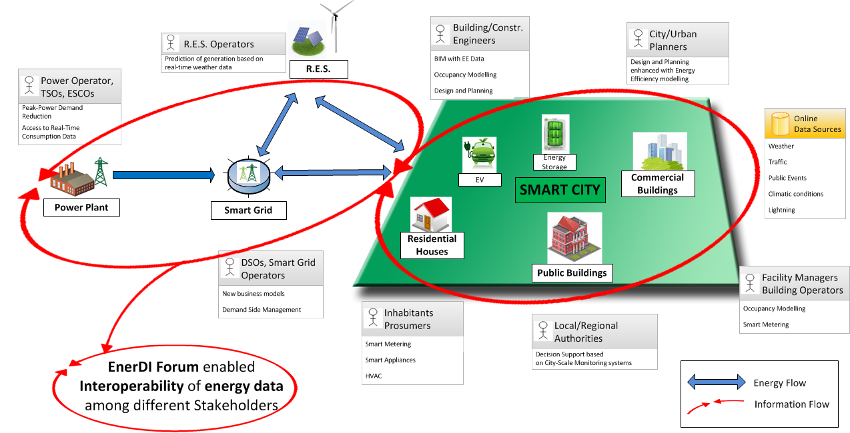
Stakeholders Involvement
READY4SmartCities

Slide 11
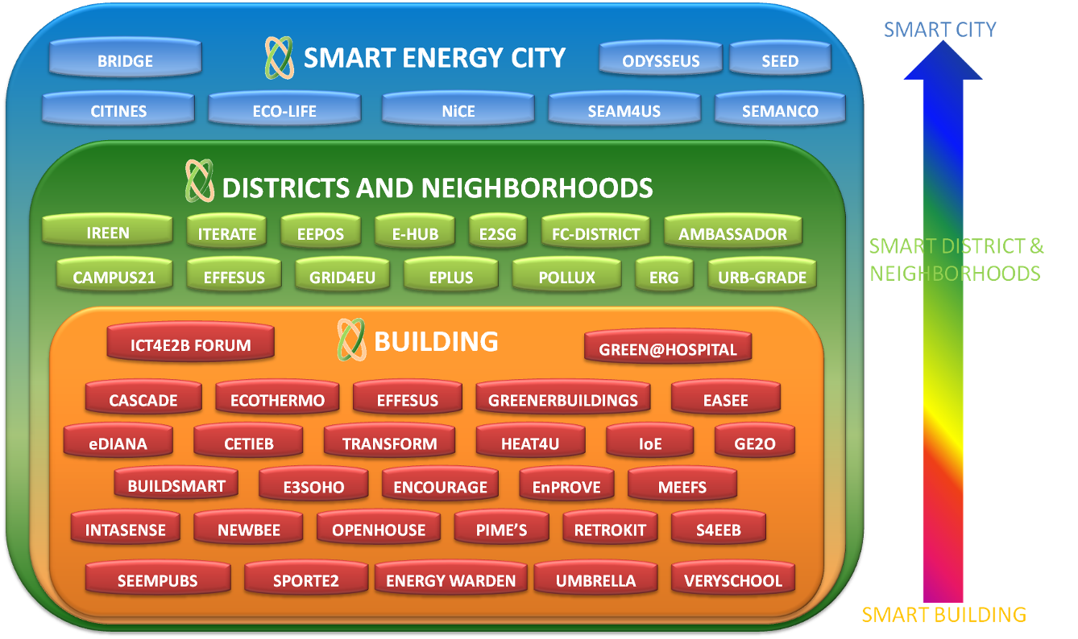
European Front-end Activities Coordination

Slide 12



New Data Ecosystem
Energy-related Models
Models
Ontologies
Standards
READY4SMartCities
EMS
Ontology repository
Energy Management Systems
EEM&V
Requirements & guidelines
z
Success stories
Energy dataset registry
Measurement & Validation data
Energy datasets

Slide 13

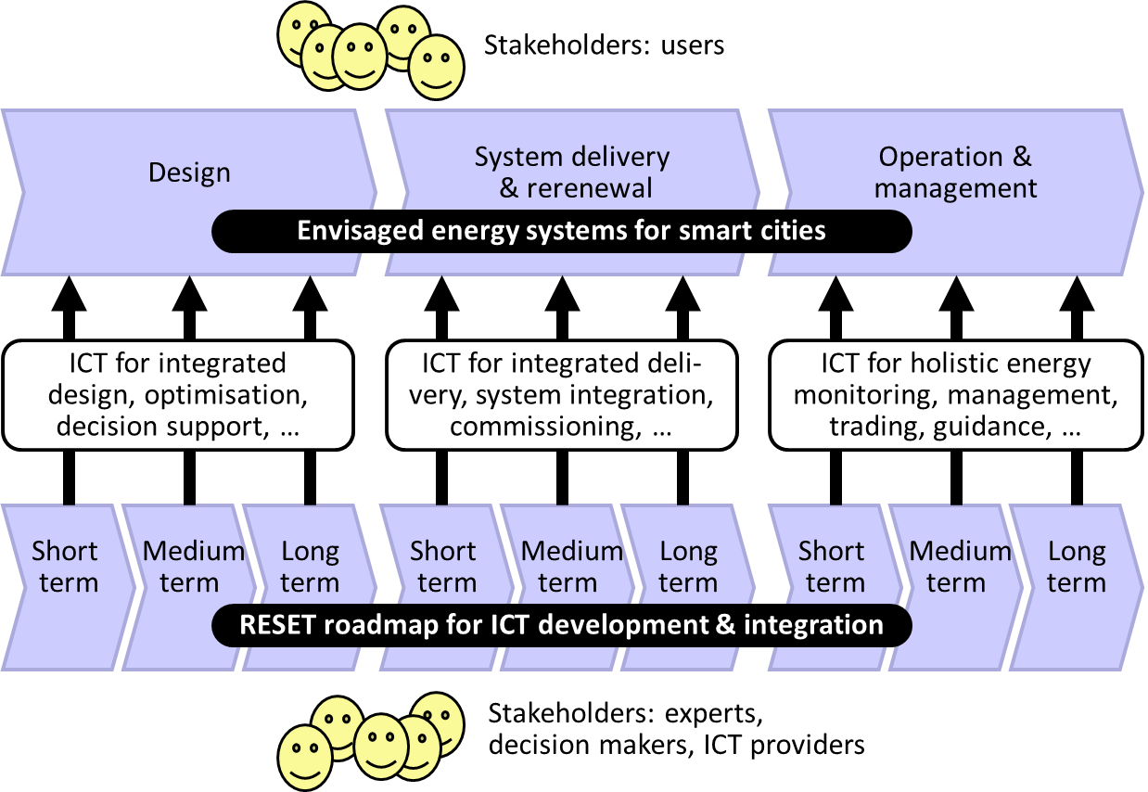
Holistic and Shared Vision

Slide 14
Collecting EE Data Resources
The aim is to identify the knowledge and data resources to support Energy
Management System interoperability including:
Ontologies and vocabularies
Relevant datasets
Ontology alignments and data links
Covered data are:
Energy use and production
Energy behavior of:
- construction elements (building envelope)
- equipment (devices, sensors, automation systems)
- users (human behavior, occupancy analysis)

Slide 15

Process, data, terms - ontologies
Smart Cities need to communicate with open protocols:
  Data defined in standards
  Terms defined in dictionaries
  Based on use cases (processes)
Terms
Process
Data
ISO 12006-3 (IFD)
ISO 29481 (IDM)
ISO16739 (IFC)

Slide 16
Knowledge Sharing Repositories
Ontology/Dataset Catalogue http://smartcity.linkeddata.es/index.html
Smart Cities https://webgate.ec.europa.eu/fpfis/wikis/display/eeCities/Home
Validation and ee Measurement Methodologies https://webgate.ec.europa.eu/fpfis/wikis/display/ValMet/Home
eeSemantics https://webgate.ec.europa.eu/fpfis/wikis/display/eeSemantics/Home

Slide 17
FOR ANY INFORMATION PLEASE FOLLOW US:
Project Website - http://www.ready4smartcities.eu/
Ontology/Dataset Catalogue - http://smartcity.linkeddata.es/index.html
LinkedIn - ICT for Energy Efficient Communities
Twitter - @LD4ee
Thank you for the attention!

