Slide 1
ITU Regional Standardization Forum For Africa Dakar, Senegal, 24-25 March 2015
QUALITY OF SERVICE IN KENYA
DERICK SIMIYU KHAMALI,
MANAGER TELECOM COMPLIANCE
COMMUNICATIONS AUTHORITY OF KENYA
khamali@ca.go.ke

Slide 2
QoS legal Framework
The Kenya Constitution -Bill of Rights
The Communications Act KICA
QoS Regulations passed in 2010
License Requirement under ULF
The Annual Publication of QoS
Penalties and Litigations.

Slide 3
Role of the ICT Sector Regulator - CA
The ICT Regulator in Kenya is called the Communications Authority of Kenya – CA formerly known as the CCK.
CA is a converged regulator with a ULF framework of licensing. Technology Neutral.
Assigns and manages Communication resources (Freq/Nos)
Sets / Adopts standards and ensures compliance to them.
Promote and safeguard the consumer interests.
Performs monitoring of performance by the operators.
Publishes the industry performance in the media annually.
Enforces compliance to set standards and service delivery.

Slide 4
Roles of CA
Establish Quality of Service Framework.
QoS assurance through periodic monitoring and evaluation.
Adopt internationally inter-operative standards
Establish equipment type approval regulations
Carry out and certify Type approval of equipment.
Manage scarce resource
Establish and maintain a mutually conducive environment for operators, the public and authorities
Promote consumer awareness through kikao kikuu -public dialogues and stakeholder workshops.

Slide 5
The Network Service providers
Kenya has several Network Facility Providers / Operators categorized as NFP (T1 or T2).
Only NFP T1 operate the mobile networks.
The other NFPs have installations linking Operators and their customers across the country.
The NFP/ASP licenses is strict on Quality of service delivered to customers.
The country has three (3) mobile networks with the following customer base;
Safaricom – 22 million,
Airtel Networks / Yu mobiles – 7.5 million and
Telkom Kenya/Orange – 3.5 million.

Slide 6
Roles of service providers
Operators to provide services that meet the minimum requirements of QoS standard.
Establish Monitoring system, customer support centers and proactively address consumer complaints.
Ensure resilience and redundancy of network infrastructure
Ensure use of type approved/Accepted equipment
Ensure optimum usage of authorized scare resource frequency and numbering through use of efficient technologies
Establish open standard interoperable points of interconnect and share resources where technically feasible.
Ensure integrity of network systems and protect consumer’s privacy or confidentiality of information.

Slide 7
Role of Consumers
Buy Type approved/accepted terminals
Ensure proper use of services
Ensure to Use services of licensed operators only.
Demand and Pay for services used
Use the right channels for Complains
May resort to CA for arbitration on failure to reach resolution with operator

Slide 8
QoS Monitoring system
The system is an MTP4 symphony – TEMS Discovery model for both indoor and outdoor performance monitoring;
Data collected in all parts but more concentration in major towns, highways and installations.
The set up ensures the slave is maintained in a stable condition and the master assess the field.
The MO and MT calls are assessed at the master.
The EMC must however ensure connectivity of the units to synchronize time and call set ups.

Slide 9
Verification of Compliance Statistics
The operators periodically submit statistics on the network performance and customer support.
This is verified during monitoring; the statistics include network coverage , outage, Consumer Complaint reports and network performance statistics.
Only customer centric statistics are monitored in the drive/walk tests.

Slide 10
Parameters Monitored – Voice
Rx Lev: the level of signal accessed by the terminal– (-dBm)
Set Up Time: the amount of time taken to establish a call
Call Drop Rate: Percentage number of calls that are dropped after connection to the system or Network during the call duration - (<2%)
Call Block Rate: Percentage number of calls that are blocked after call set up attempt - (<5%)
Speech Quality (MOS): the perceived opinion from a scale of 1 to 5 above the (>95%)

Slide 11
Parameters Monitored – Voice
Call completion Rate: the number of calls that are successfully terminated by the user since set up – (>99% )
Call Set Up Success Rate: the percentage of the calls that are successfully set up in from all the call attempts - >95% .
Handover Rate: The ability to sustain a call in option until completion in %.
REGULATION OF DATA PARAMETERS UNDER DEVELOPMENT

Slide 12
Evaluation and Enforcement
At the end of the monitoring period, the major cause and areas of failure are identified and communicated to the operators.
A timeframe is given for resolution & remedy.
A repeat assessment is done to verify operators compliance
The comparative performance of the operators are published in public media.
The penalties are levied where there is noted repeated failure to achieve minimum targets.

Slide 13
QoS Eco system
CA-QoS REGULATIONS
SERVICE PROVIDER QOS OFFERED
NETWORK PERFORMANCE QOS
CONSUMER PERCEPTION QOE
QoS REQUIREMENTS

Slide 14
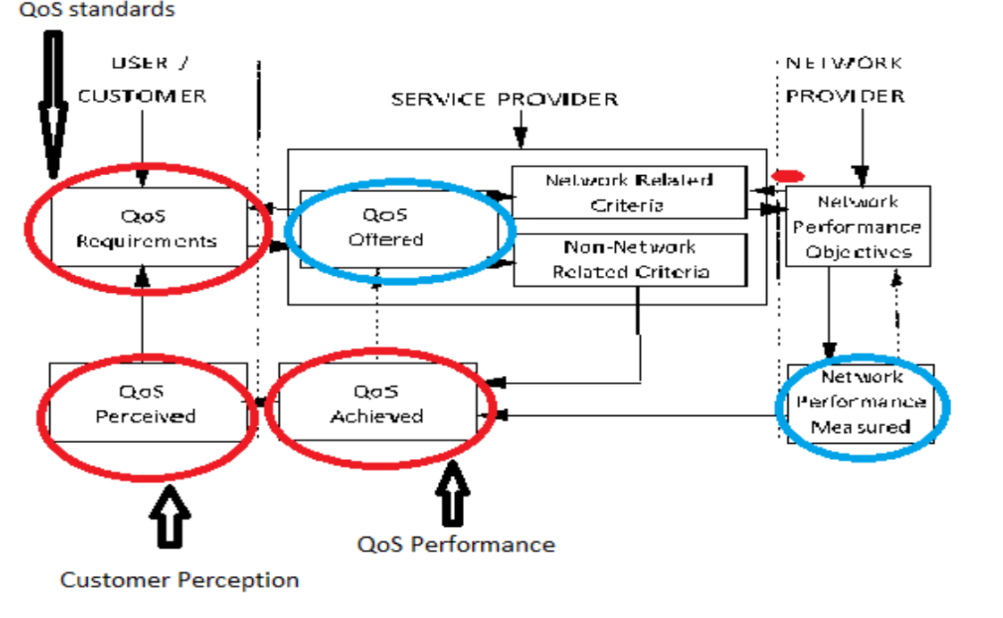
Inter relations of different views of QoS

Slide 15
Relationship between QoS and NP
QoS criteria
Non network related
Network related
QoS criteria also called QOE
QoS criteria
Mapping
Network performance
Target - range
parameters
or limit
Parameter 1
xxxx
Parameter 2
yyyy
Parameter N
zzzz

Slide 16
Mapping QoS to Network Performance
The user's QoS requirements is the starting point. This is mapped to QoS offered parameters by the service provider.
These are mapped to network and non-network related performance parameters.
The network related parameters are mapped into NP parameters and target values are assigned.
A set of monitoring systems keeps track of the desired performance.
The achieved end-to-end QoS performance is derived from the measurements and combined with the non network related QoS.
QoS performance is compared with the users/customer's QoS perceived and Corrective action is taken to address the difference.

Slide 17
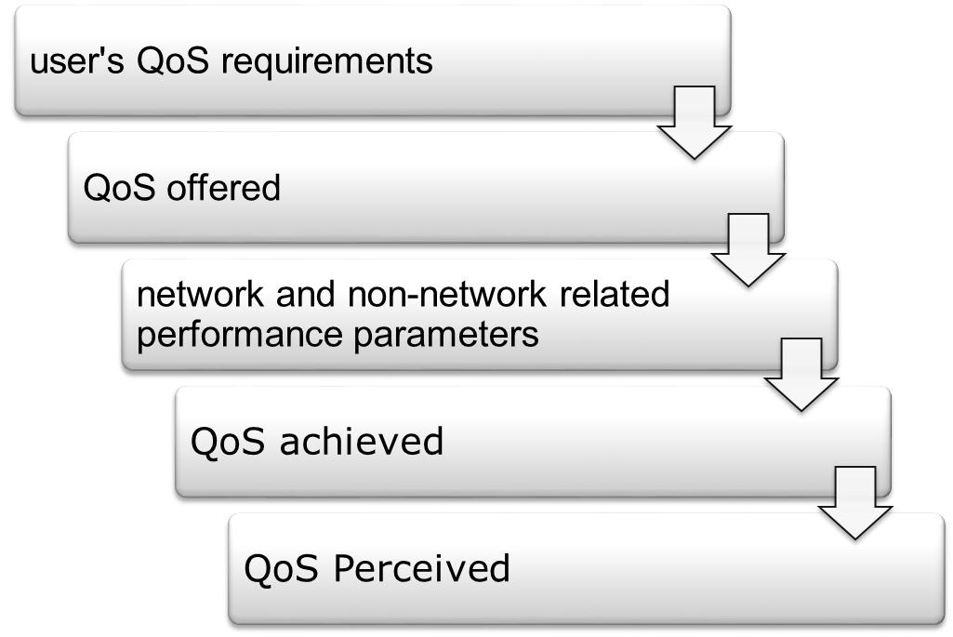
Mapping QoS to Network performance
The achieved QoS is the end-to-end QoS performance is derived from measurements.
users/customer's QoS perceived is obtained from customer surveys, consultative workshops and could be indicated by number of complaints.
Corrective action is taken to resolve difference between QoS Perceived and QoS achieved.

Slide 18
Relationship btn QoS and NP
An example of mapping of QoS into NP is shown below:
- QoS requirement for telephony: not more than x % of connections made to experience difficulty on the clarity of conversation;
- the NP requirements are the parameters identified as contributing to call clarity:
transmission loss, noise (impulsive and non impulsive), echo, delay, crosstalk, voice clipping, (and possibly others);
end-to-end target values for each parameter may be specified. The sum effect should result in not more than x % of calls experiencing difficulty in call clarity.

Slide 19
Challenges
Bridging the QoS and QOE expectations and targets. Establishing the causes of network failure and to determining the remedial action
Keeping pace with the changing technology.
Addressing thefts, vandalism, unstable power and delays in issuing way leaves.
Cost of service delivery and monitoring performance may be quite high.
Assessing and reporting performance for the mobile virtual network operators – MVNOs.

Slide 20
Conclusion
There is a clearly defined legal and regulatory mechanism in Kenya.
Kenya has installed a technical mechanisms for monitoring and enforcement of QoS to ensure consumer protection.
Monitoring is designed to benchmark respective operator performance against set target and identify major cause and areas of failure for remedial action.
As live transforms to a mobile telephony society, there is need to guarantee simultaneous monitoring of end to end performance for all the population at county level.
There is therefore need for a methodology of relating QoS and QOE performance targets to satisfy customers.
The Way forward is to outsource and supervise the network monitoring by other contractors countrywide.

Slide 21
RECOMENDATION
Prequalify and engage the external contractors for simultaneous tests
Contractors to be assigned cluster of counties for monitoring performance
An aggregator to be engaged to handle data processing and reporting.

Slide 22
Conclusion on QOS
Quality is key for success of all ICT Dependent services.
All stakeholders must take responsibility.

Slide 23
Communications Authority of Kenya. Waiyaki Way, Westlands Nairobi.
P,O Box 14448 Nairobi 00800
Tel: 0204242000/418
Email: khamali@ca.go.ke
Website: www.ca.go.ke

Slide 24
THANK YOU

