Slide 1
ITU Regional Standardization Forum For Africa
Dakar, Senegal, 24-25 March 2015
Perceptual Evaluation of
OTT Video Streaming Services
Joachim Pomy, Consultant
Michael Keyhl, CEO
OPTICOM GmbH Germany
consultant@joachimpomy.de

Slide 2


Who We Are
Founded 1995 in Erlangen, Germany
Spin-Off from the Fraunhofer-Institute IIS (Home of MP3)
„Originators“ of Perceptual Audio Quality Measurement (1988)
Co-Authors of Six Major International Standards
Leading Source of Voice and Video Quality Test Products and
OEM Technology for Mobile and IP-based Network Testing
> 100 Licensed OEM Customers
> 40.000 Licensed PESQ Products

Slide 3

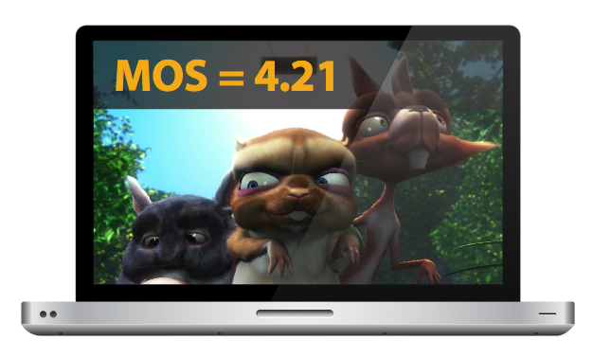


How Do You Measure Video Quality?
How Do You Measure Video Quality..
...to benchmark Multi-Screen QoE of ABR VoD OTT Services as perceived
by subscribers?

Slide 4




How Do You Measure Video Quality..
...to benchmark Multi-Screen QoE of ABR VoD OTT Services as perceived
by subscribers?
Conclusion 1:
Clear Need for a New Streaming Video Quality Measurement Technique
Conclusion 2:
Newly Interpret Video Quality in the Context of Multi-Screen Use Scenarios

Slide 5
Overview
ABR and Existing Video Metrics and Standards
Stakeholders in the OTT QoE Rivalry
Defining an >OTT Quality Model<
Designing a Video Quality Measure for OTT
Introduction to PEVQ-S
Conclusions

Slide 6
Overview
ABR and Existing Video Metrics and Standards
Stakeholders in the OTT QoE Rivalry
Defining an >OTT Quality Model<
Designing a Video Quality Measure for OTT
Introduction to PEVQ-S
Conclusions

Slide 7
Testing Typologies
Full Reference (FR)
No-Reference (NR)
Principle: Differential Analysis comparing Degraded with the Original Source Video
Access to Reference/Studio Source
Pixel-based, Frame-by-Frame Comparison
e.g. OPTICOM‘s PEVQ/ITU-T J.247
+ Highest Accuracy and Repeatability
+ Standardized
‒ Processing Intensive
Principle: Single-ended Analysis,
NO Information on the Original Source Video
Pixel-based, or
NR/IP Transport Stream Analysis, only, no Payload decoding
Various Proprietary Metrics
‒ Low Accuracy „Estimates“ only
‒ Failed in Standardization
+ Lightweight, easy to apply

Slide 8
Video Quality Standards developed by VQEG and ITU based on BT.500/P.910
SD TV
ITU-T J.144 (03/2001-03/2004) <FR>
"Objective Perceptual Video Quality Measurement Techniques for
Digital Cable Television in the Presence of a Full Reference"
VQEG
MM
ITU-T J.246 (08/2008) <RR>
"Perceptual Visual Quality Measurement Techniques for Multimedia Services over
Digital Cable Television Networks in the Presence of a Reduced Bandwidth Reference"
VQEG
HD
ITU-T J.341 (01/2011) <FR>
"Objective Perceptual Video Quality Measurement of HDTV for
Digital Cable Television in the Presence of a Full Reference"
VQEG
Hybrid
ITU-T J.247 (08/2008) <FR>
"Objective Perceptual Multimedia Video Quality Measurement in the Presence of a Full Reference"
Ongoing Project <FR, RR, NR>
Models have been submitted in 2012 and testing is underway. Report expected 2014..
ITU-T J.342 (04/2011) <RR>
"Objective Video Quality Measurement of HDTV for
Digital Cable Television in the Presence of a Reduced Reference Signal"

Slide 9
ABR Video Streaming Techniques
Adaptive Video Streaming Techniques
RTP based
HTTP
based
Adobe
HTTP-based Dynamic Streaming
Adobe RTMP-based Dynamic Streaming (Flash)
Microsoft
Smooth Streaming (Silverlight)
Apple
HTTP Live Streaming
(HLS)
MPEG DASH
Dynamic Adaptive Streaming over HTTP
Windows, Mac,
Connected TVs
Windows, Mac, Windows Phone, Connected TVs
iDevices, Android
Windows, Mac, Linux, Solaris, not on iDevices (Flash)
Windows, Mac, Linux, Solaris, not on iDevices (Flash)
(based on Jan Ozer: ‘Video Compression for Flash, Apple Devices and HTML5‘ [2011])

Slide 10
Example: YouTube Upload
Reference/Source
Upload: V_Res 1920x1080, V_Fps 24, V_BitRate 8Mbit/s
PD or ABR Protocols
Protocol | V_Codec | V_BitRate | V_Res | V_Fps | A_Codec | A_Bitrate | Format | PEVQ-S
PD | MPEG4 | 60kbit/s | 176x144 | 12 | AAC | 24kbit/s | 3GP | -
PD | MPEG4 | 200kbit/s | 320x180 | 24 | AAC | 32kbit/s | 3GP | -
PD | FLV | 300kbit/s | 426x240 | 24 | MP3 | 64kbit/s | FLV | ✓
PD | - | - | - | - | OGG | 96kbit/s | WEBM | -
PD | VP8 | 600kbit/s | 640x360 | 24 | OGG | 110kbit/s | WEBM | ✓
PD | H.264 | 500kbit/s | 640x360 | 24 | AAC | 96kbit/s | MP4 | ✓
PD | H.264 | 2Mbit/s | 1280x720 | 24 | AAC | 192kbit/s | MP4 | ✓
ABR | - | - | - | - | AAC | 128kbit/s | MP4 | -
ABR | H.264 | 100kbit/s | 256x144 | 15 | - | - | MP4 | -
ABR | H.264 | 250kbit/s | 426x240 | 24 | - | - | MP4 | ✓
ABR | H.264 | 400kbit/s | 640x360 | 24 | - | - | MP4 | ✓
ABR | H.264 | 800kbit/s | 854x480 | 24 | - | - | MP4 | ✓
ABR | H.264 | 1.6Mbit/s | 1280x720 | 24 | - | - | MP4 | ✓
ABR | H.264 | 3Mbit/s | 1920x1080 | 24 | - | - | MP4 | ✓
Various Codecs at Various Bitrates
Compare Various Frame Sizes
Compare Different Fps
Handle Common Bitstream Formats

Slide 11
Only
PEVQ was validated for QCIF, CIF, VGA, SD, and HD based on BT.500/P.910
SD TV
ITU-T J.144 (03/2001-03/2004) <FR>
"Objective Perceptual Video Quality Measurement Techniques for
Digital Cable Television in the Presence of a Full Reference"
VQEG
MM
ITU-T J.246 (08/2008) <RR>
"Perceptual Visual Quality Measurement Techniques for Multimedia Services over
Digital Cable Television Networks in the Presence of a Reduced Bandwidth Reference"
VQEG
HD
ITU-T J.341 (01/2011) <FR>
"Objective Perceptual Video Quality Measurement of HDTV for
Digital Cable Television in the Presence of a Full Reference"
VQEG
Hybrid
ITU-T J.247 (08/2008) <FR>
"Objective Perceptual Multimedia Video Quality Measurement in the Presence of a Full Reference"
Ongoing Project <FR, RR, NR>
Models have been submitted in 2012 and testing is underway. Report expected 2014..
ITU-T J.342 (04/2011) <RR>
"Objective Video Quality Measurement of HDTV for
Digital Cable Television in the Presence of a Reduced Reference Signal"
PEVQ ☑
PEVQ ☑
PEVQ ☑

Slide 12
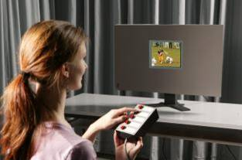
Validation by Subjective Testing
ITU-R BT.500: Originally
CRT TV-Quality Testing (SD)
ITU-T P.910:
Multimedia (QCIF, CIF, VGA)
and IPTV (HD 720/1080)
Mostly ACR Tests
Test Sequences 8 – 15 sec
5-Point Opinion Scale
Averaging over a Large Enough Test Population  MOS
Conclusion 4:
Need for New Subjective Testing - Snapshots of 10 s Video are Inadequate to Assess Re-Buffering and Long-term Behavior of Streaming Video

Slide 13
Overview
Existing Video Metrics and Standards
Stakeholders in the OTT QoE Rivalry
Defining an >OTT Quality Model<
Designing a Video Quality Measure for OTT
Introduction to PEVQ-S
Conclusions

Slide 14








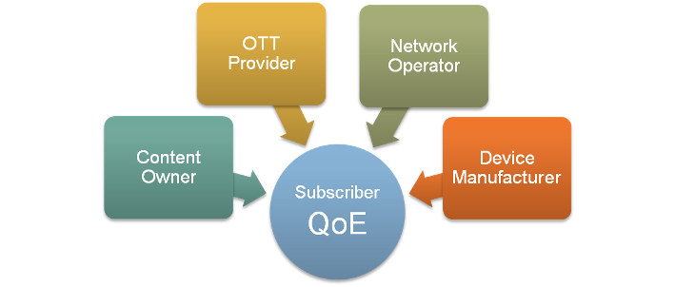







Stakeholders involved in a QoE Rivalry

Slide 15
Overview
Existing Video Metrics and Standards
Stakeholders in the OTT QoE Rivalry
Defining an >OTT Quality Model<
Designing a Video Quality Measure for OTT
Introduction to PEVQ-S
Conclusions

Slide 16
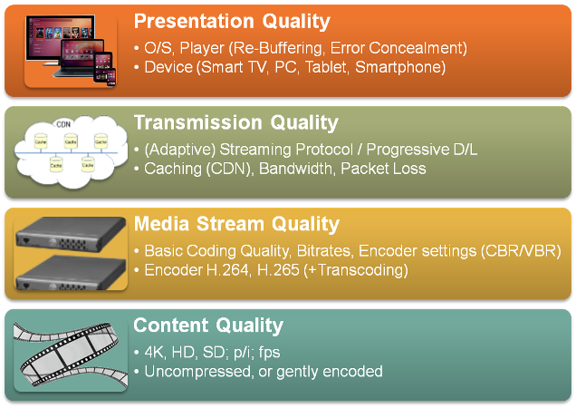
Defining a
4-layered
OTT Quality Model

Slide 17
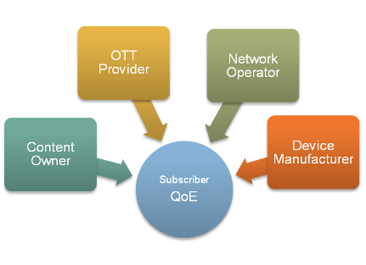
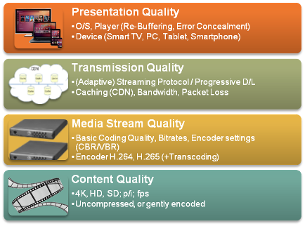
Stakeholders‘ Different Quality Views
Stakeholders for OTT QoE…
…and related Quality Layers

Slide 18
Overview
Existing Video Metrics and Standards
Stakeholders in the OTT QoE Rivalry
Defining an >OTT Quality Model<
Designing a Video Quality Measure for OTT
Introduction to PEVQ-S
Conclusions

Slide 19




OTT VQM Requirements
VQM Should be related to the Content Quality as a Reference
Accurately score encoding and transcoding Artifacts
= Media Stream Quality
Measure and compare the Picture Quality for different Frame Sizes and Frame Rates
= Media Stream/Transmission Quality
Continuously track the different Bit Rates and evaluate how ‚smooth‘ the Player is able to interact with the Server in a Congested Network = Transmission Quality
Take into account Player and Device Characteristics as well as Viewing Environment = Presentation Quality

Slide 20
Overview
Existing Video Metrics and Standards
Stakeholders in the OTT QoE Rivalry
Defining an >OTT Quality Model<
Designing a Video Quality Measure for OTT
Introduction to PEVQ-S
Conclusions

Slide 21
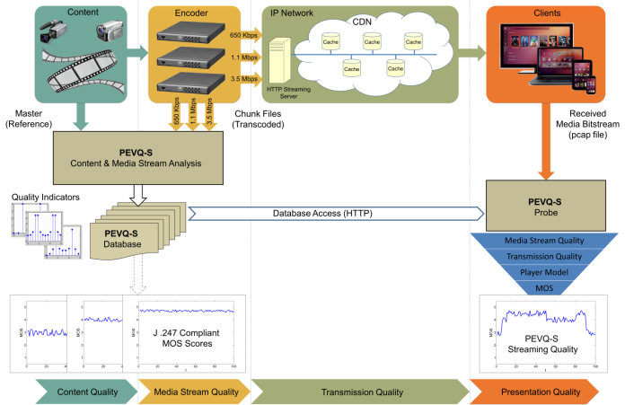

Slide 22
Overview
Existing Video Metrics and Standards
Stakeholders in the OTT QoE Rivalry
Defining an >OTT Quality Model<
Designing a Video Quality Measure for OTT
Introduction to PEVQ-S
Conclusions

Slide 23
Conclusions (1/2)
Clear Need for a Streaming Video Quality Measurement Technique which accurately evaluates Subscriber QoE
We must reformulate QoE Concepts and newly interpret Video Quality in the Context of Multi-Screen Use Scenarios
Currently, no Standardized Subjective and Objective VQM Standard exists for ABR Video Streaming
PEVQ-S is proposed to leapfrog this Shortcoming, based on advancing existing Standards, while maintaining maximum Backward-Compatibility and Validated Accuracy
PEVQ-S is suited to evaluate all 4 OTT Quality Layers:
Content, Media Stream, Transmission and Presentation Quality

Slide 24
Conclusions (2/2)
PEVQ-S allows for Analysis of Common ABR Protocols and Formats, Various Codecs at Various Bitrates
PEVQ-S can analyze Video at Different Frame Sizes and Fps
An Advanced Hybrid Architecture: (a) the PEVQ-S Media Stream Quality Database and (b) the PEVQ-S Client Probe combines the high Accuracy of a FR Measure with a Light-weight Realtime Client Implementation, even on Android Smartphones
Measures Current Video Quality (CVQ) MOS and Headroom for Optimization for the Best Video Quality Available (BVQA) MOS
PEVQ-S is made available as an OEM-Technology to leading OTT, Middleware and T&M Vendors and soon to be found in Products

Slide 25
Any questions ?
Contact:
Consultant@joachimpomy.de

