Slide 1
ITU Regional Standardization Forum For Africa
Dakar, Senegal, 24-25 March 2015
HIGHLIGHTS OF THE WORK OF QUESTIONS 13, 14 AND 15 OF ITU-T SG5
Peter Ulanga,
Rapporteur Q13/5
Associate Rapporteur Q14/5 and Q15/5

Slide 2

Working Party 3 (WP3/5)
ICT and climate change
Work areas:
Q13/5 - Environmental impact reduction including
e-waste
Q14/5 - Setting up a low cost sustainable telecommunication infrastructure for rural communications in developing countries
Q15/5 - ICTs and adaptation to the effects of climate change
Q16/5 - Leveraging and enhancing the ICT Environmental sustainability
Q17/5 - Energy efficiency for the ICT sector and harmonization of environmental standards
Q18/5 - Methodologies for the assessment of environmental impact of ICT
Q19/5 - Power feeding systems

Slide 3
Highlights
Q13/5 – Environmental Impact Reduction Including e-waste
Q14/5 – Setting up a low-cost sustainable telecommunication infrastructure for rural communications in developing countries
Q15/5 - ICTs and adaptation to the effects of climate change

Slide 4

ITU-T Study Group 5
Question 13 - Environmental impact reduction including e-waste
Working Party 3 – ICTs and Climate Change
Study Group 5 – Environment and Climate Change

Slide 5
Question 13/5: Environmental impact reduction including e-waste
Main study area:
Avoid hazardous materials through standards
Minimize the environmental and health impact of ICT products, equipment and facilities
Promote proper and environmentally responsible recycling
Foster responsible and proper final disposal of e-waste

Slide 6

Question 13/5: Environmental impact reduction including e-waste
Main tasks:
Raise awareness
Assist countries to develop policies on e-waste management
Develop international standards on life-cycle management of ICT equipment
Carry out research and development
Help companies becoming more sustainable and socially responsible

Slide 7
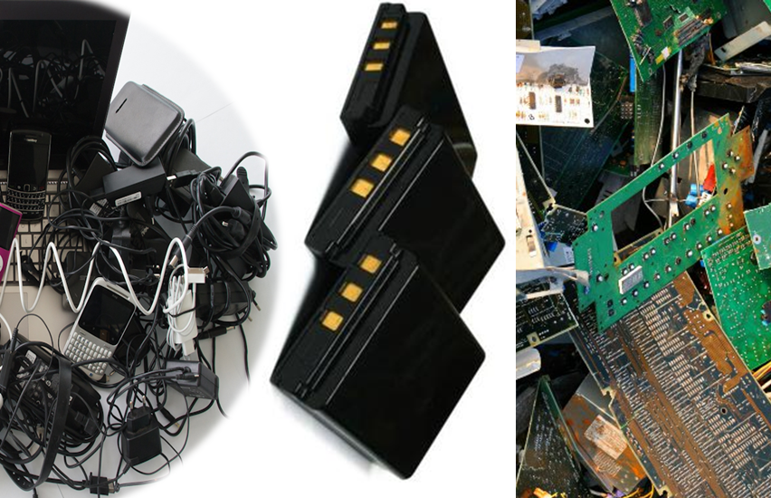
Highlights on deliverables:
ITU-T Recommendations
E-waste management
Batteries
Power supply series
Notes:
This slide summarizes the main green ICT standards that have been developed by Question 13/5 in the area of e-waste.
I will provide more detailed information on every single achievement in the next slides.
Recommendation ITU-T L.1000: Universal power adapter and charger solution for mobile terminals and other hand-held ICT devices.
Recommendation ITU-T L.1001: External universal power adapter solutions for stationary information and communication technology devices.
Recommendation ITU-T L.1002​: External universal power adapter solutions for portable information and communication technology devices. ​
Recommendation ITU-T ​L.1005​: Test suites for assessment of the universal charger solution.
​
Recommendation ITU-T L.1010​: Green batteries solution for mobile phones and other hand-held information and communication technology devices.
Recommendation ITU-T L.1100: A method to provide recycling information of rare metals in ICT products.
Recommendation ITU-T L.1101: ​Measurement methods to characterize rare metals in information and communication technology goods.

Slide 8
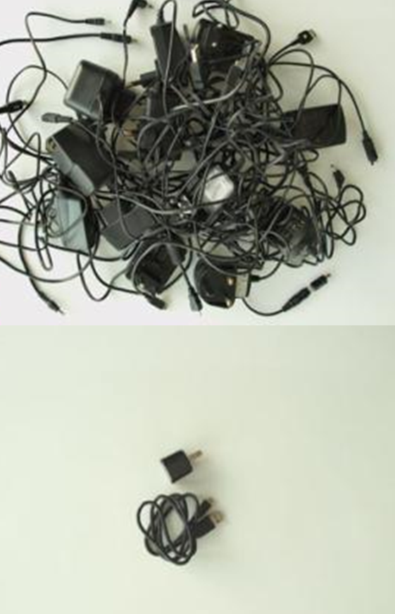
Power supply series
Recommendation ITU-T L.1000: Universal power adapter and charger solution for mobile terminals and other hand-held ICT devices:
  Saves 82,000 tons of e-waste per year
  Saves at least 13.6 million tonnes of CO2 emissions annually
Recommendation ITU-T L.1001: External universal power adapter solutions for stationary information and communication technology devices:
  Saves 300,000 tons of e-waste per year
  Reduces the energy consumption and greenhouse gas (GHG) emissions of external power supplies by between 25% and 50%
Notes:
Recommendation ITU-T L.1000 provides high level requirements for a universal power adapter and charger solution that will reduce the number of power adapters and chargers produced and recycled by widening their application to more devices and increasing their lifetime. The solution also aims to reduce energy consumption. The longer life cycle and possibility of avoiding device duplication reduces the demand on raw materials and waste. The universal power adapter and charger solution is designed to serve the vast majority of mobile terminals and other ICT devices. [Approved 2011-06-13]
- “Universal power adapter and charger solution for mobile terminals and other ICT hand held devices” (Recommendation ITU-T L.1000)
- Saves 82,000 tons of e-waste per year
- Saves at least 13.6 million tonnes of CO2 emissions annually
Recommendation ITU-T L.1001 provides requirements for a universal power adapter solution (UPA) for stationary ICT devices that will reduce the number of produced power adapters by widening their application to more devices, enabling their reuse and increasing their lifetime. The solution also aims to reduce energy consumption. The longer life cycle and possibility of avoiding device duplication reduces the demand on raw materials and production of huge e-waste amount. The universal power adapter solution for ICT equipment for stationary use is designed to serve the vast majority of ICT devices. [Approved 2012-11-29]
- NEW - “External universal power adapter solutions for ICT equipment for stationary use” (Recommendation ITU-T L.1001)
- Saves 300,000 tonnes of e-waste annually
- Reduces the energy consumption and greenhouse gas (GHG) emissions of external power supplies by between 25% and 50%

Slide 9

Power supply series
DRAFT Recommendation ITU-T L.1002​: External universal power adapter solutions for portable information and communication technology devices:
  Reduces e-waste, optimizing the use of scarce and raw materials and allowing for reuse
  Recommends design for MTBF 50.000 hours of active use
  Increases usability
Recommendation ITU-T ​L.1005​: Test suites for assessment of the universal charger solution:
  Describes specific test suites to assess energy efficiency, interworking, safety and electromagnetic compatibility of the universal charger solution and charger

Slide 10
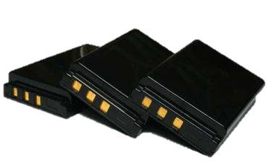
Batteries
Recommendation ITU-T L.1010​: Green batteries solution for mobile phones and other hand-held information and communication technology devices. ​
  Extends the lifetime of handsets
  Reduces global resources consumption
  Eliminates toxic materials
Notes:
Recommendation ITU-T L.1010 (Green battery solutions for mobile phones and other hand-held information and communication technology devices) defines a minimum set of parameters necessary to identify green battery solutions that should be considered by developers/manufacturers to reduce the future environmental impact of battery use. The provision of so-called green batteries is to extend the lifetime of handsets, reduces global resources consumption and eliminates toxic materials. [Approved 2014-02-13]

Slide 11
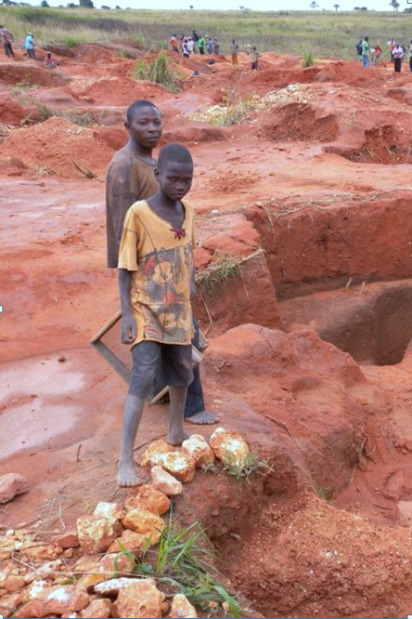
E-waste management
Necessity of rare-metal recycling:
A mobile phone contains no less than 20 rare metals
A ton of gold ore yields just 5 g of gold, whereas a ton of used mobile phones yields a staggering 400 g.
Recommendation ITU-T L.1100: A method to provide recycling information of rare metals in ICT products.
Notes:
A mobile phone contains no less than 20 rare metals and the need to recycle these metals is clear – a ton of gold ore yields just 5 g of gold, whereas a ton of used mobile phones yields 400 g. Recommendation ITU-T L.1100 (Procedure for recycling rare metals in information and communication technology goods) outlines the necessity for rare metal recycling and the procedures to be employed when recycling. The recommendation details considerations in all phases of the recycling process and provides guidelines as to how organizations may fairly and transparently report on rare metal recycling. [Approved 2012-02-22]

Slide 12
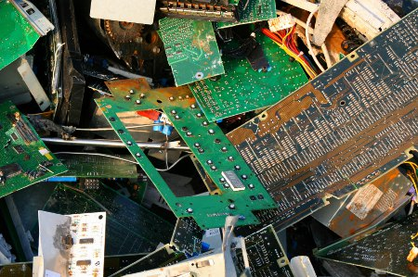
E-waste management
Necessity of a common and accurate measurement method:
For successful recycling, producers are required to provide detailed information on rare metals to recyclers.
A common measurement method can facilitate recycling information exchanges between producers and recyclers.
Recommendation ITU-T L.1101: ​Measurement methods to characterize rare metals in information and communication technology goods:
  XRF (X-ray fluorescence)
  ICP-MS (inductively coupled plasma mass spectrometry)
Notes:
For successful recycling of rare metals, producers are required to provide detailed information on rare metals to recyclers. A common measurement method can facilitate recycling information exchanges between producers and recyclers. Recommendation ITU-T L.1101 (Measurement methods to characterize rare metals in information and communication technology goods) presents measurement methods to characterize rare metals in ICT goods by using XRF (X-ray fluorescence) and ICP-MS (inductively coupled plasma mass spectrometry) measurement methods. [Approved 2014-03-22]

Slide 13

Supplement 5 to ITU-T L-series Recommendations
Agreed: December 2014
Title: Life-cycle management of ICT goods
Scope:
It provides information for the practical implementation of the life-cycle approach in companies, facilities and plants as well as distributors, including chapters on best practices with a specific focus on material usage and selection.
Notes:
Supplement 5 to ITU-T L-series Recommendations (Life-cycle management of ICT goods) has been developed to provide information for the practical implementation of the life-cycle approach in companies, facilities and plants as well as distributors, including chapters on best practices with a specific focus on material usage and selection. [Agreed 2014-12-19]

Slide 14
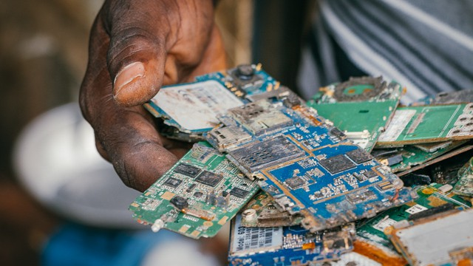
Supplement 4 to ITU-T L-series Recommendations
Agreed: December 2014
Title: Guidelines for developing a sustainable e-waste management system
Scope:
  It provides a set of guidelines that countries could refer to when designing their e-waste management system;
  It provides guidance on policy/legal framework, collection mechanisms, financial mechanisms and engagement with all relevant stakeholders.
Photo: Fairphone, CC BY-NC-SA 2.0 (cropped)
Notes:
Supplement 4 to ITU-T L-series Recommendations (Guidelines for developing a sustainable e-waste management system) provides a set of guidelines that countries could refer to when designing or adjusting their e-waste management system. It provides guidance on policy/legal framework, collection mechanisms, financial mechanisms and engagement with all relevant stakeholders. [Agreed 2014-12-19]

Slide 15
New work items
Supplement on Collection of sustainable models for e-waste management by private corporations;
Supplement on Assessment of quantity of
E-waste in developing countries;
Supplement Circular Economy;
Supplement on Implementation guidance for ICT SME supply chains due diligence on conflict minerals.
Notes:
Here is a list of new work items that Q13/5 decided to create at the last SG5 meeting that took place in December 2014 in India (Kochi).

Slide 16
What do we see in the future of 13/5?
Q13/5 will be focusing on new study areas around issues of e-waste management …

Slide 17
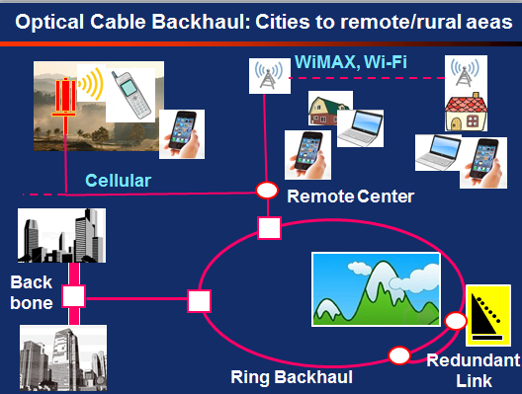
ITU-T Study Group 5
Question 14 - Setting up a low-cost sustainable telecommunication infrastructure for rural communications in developing countries
Working Party 3 – ICTs and Climate Change
Study Group 5 – Environment and Climate Change

Slide 18
Question 14/5: Setting up a low-cost sustainable telecommunication infrastructure for rural communications in developing countries
Main study area:
low cost transmission technologies
Studies around the areas of energy efficiencies
Sustainable and environmental friendly infrastructure
Easy to install infrastructure requiring low maintenance skills

Slide 19
Main tasks
1) Low-cost trunk transmission lines to rural stations with sufficient bandwidth;
2) Wireless and wired networks connecting rural stations and end-users;
3) Low energy consumption cost effective infrastructure; ( could they Work off-grid)
4) Solution should be easy to deploy and setup;
5) Solution should be robust and have low maintenance requirements;
6) The system should be environmentally friendly throughout its lifecycle.

Slide 20
How is it envisaged to solve the problems?
3) Low energy consumption cost effective infrastructure; ( could they Work off-grid)
5) Solution should be robust and have low maintenance requirements;
High Opex
Low ARPU
Sparse population

Slide 21
Approved Work Items
Work Item | Subject/Title
Infrastructure best practices | Adequate power, building/shelter, accessibility, skilled manpower to operate
System requirements | Deployment architecture, power consumption, power source, packaging, operation & maintenance, etc.
Technical requirements best practices | Identify, assess and consolidate the challenges faced by developing countries in setting up a low cost sustainable telecommunication infrastructure in rural areas of developing nations.
Mobile network technologies best practices | Type of transmission media, i.e. fiber optics, satellite technology, over-the-air antenna, etc.

Slide 22
Approved Work Items
Automated remote weather sensing equipment best practices | Remote weather stations to provide short-term extreme weather event information and long term trends such as drought and monsoon
Sustainable power for systems in remote rural areas best practice | Possible technological/engineering solutions for sustainable power requirements
Work Item | Subject/Title

Slide 23
Q14/5 framework recommendation
Framework Recommendation
  Recommendation to provide a framework of general requirements for low cost sustainable infrastructure for developing countries

Slide 24
Structure of the Deliverables of Q14/5
Framework Recommendation
Supplement A
Supplement B
Supplement C
Supplement D

Slide 25
Supplements to Framework Recommendation
Supplement A – Using Capacity Transfer Repeater to set up a low cost sustainable telecommunications infrastructure for rural communications in developing countries
Supplement B – Using Microwave Links to set up a low cost sustainable telecommunications infrastructure for rural communications in developing countries

Slide 26
Supplements to the Framework Recommendation
Supplement C – Using Fiber Optic Cable to set up a low cost sustainable telecommunications infrastructure for rural communications in developing countries
Supplement D – Using Hybrid Satellites to set up a low cost sustainable telecommunications infrastructure for rural communications in developing countries

Slide 27
Looking forward ;)
Contributions from Africa are required to ensure relevant deliverables of the work of Q14/5
We need more contributions on areas of systems requirement to cover different aspects of low-cost technologies requirements in rural areas

Slide 28

ITU-T Study Group 5
Question 15 - ICTs and adaptation to the effects of climate change
Working Party 3 – ICTs and Climate Change
Study Group 5 – Environment and Climate Change

Slide 29
Question 15/5
ICTs and adaptation to the effects of climate change
Main study area:
Studying how ICTs can be effective in enabling countries to better adapt to climate change;
Studying how the telecommunications infrastructure and associated ICT can be resilient to the effects of climate change;
Producing Recommendations;
Collecting, sharing and disseminating information and best practices.
Notes:
Q15 is tasked to look at issues related to the establishment of a robust telecommunications infrastructure for extreme climate conditions,
Helping countries adapt to the negative effects of climate change using ICT and Establishing links at regional and national levels

Slide 30

Question 15/5
ICTs and adaptation to the effects of climate change
Main Tasks:
Establishing requirements via questionnaires and analysis;
Seeking cooperation with various expert groups and Task forces;
Encouraging the sharing of use cases in ICT and climate change;
Encouraging ICT industry involvement in climate change adaptation.
Notes:
Q15 is tasked to look at issues related to the establishment of a robust telecommunications infrastructure for extreme climate conditions,
Helping countries adapt to the negative effects of climate change using ICT and Establishing links at regional and national levels

Slide 31

Deliverables under study
Draft Recommendation ITU-T L.Cities_Adaptation - how ICTs can help cities to adapt to the effects of climate change
Draft Recommendation ITU-T L.Infrastructure_Adaptation - best practices for the adaptation of the ICT infrastructure to the impacts of climate change
Draft Supplement to ITU-T L.1500 series on effects and possible impact of climate change
Contributions are
needed!
Notes:
Some of the deliverables that are being developed include:
L.Cities Adaptation
Recommendation L.Adaptation_Cities on how ICTs can help cities to adapt to the effects of climate change. It will also provide a framework and a checklist to assist municipal authorities in the implementation of ICT-based solutions in cities' climate change adaptation strategies.
L.Infrastructure Adaptation
Recommendations to establish best practices for the adaptation of the ICT infrastructure to the impacts of climate change
Adapting the ICT sector and infrastructure to the impacts of climate change
Supplement to L.1500 series Recommendations
Supplement to ITU-T L.1500 series Recommendations on effects and possible impact of climate change

Slide 32
Highlights on deliverables
New Recommendation ITU-T L.1500 - Framework for information and communication technologies (ICTs) and adaptation to the effects of climate change (Approved)
  Recommendation ITU-T L.1501 - on how countries can utilize ICTs to adapt to the effects of climate change
  Recommendation ITU-T L.Infrastructure_Adaptation - on adapting the ICT infrastructure to the effects of climate change (under development)
  Recommendation ITU-T L.Cities_Adaptation - on how ICTs can help cities to adapt to the effects of climate change (under development)
Notes:
Recommendation ITU-T L.1500 describes a framework for information and communication technologies (ICTs) and adaptation to the effects of climate change. This framework identifies and defines the basis for development of the following Recommendations:
Recommendation ITU-T L.1501 on how countries can utilize ICTs to adapt to the effects of climate change. It will also provide a framework and a checklist for countries to integrate ICTs into their national strategies for adaptation to climate change. Examples of checklists, use- cases, best practices, guidelines, consideration points, etc will be added when appropriate.
Recommendation ITU-T L.Infrastructure_Adaptation on adapting the ICT infrastructure to the effects of climate change. It will provide a set of guidelines, requirements and best practices to be referred to during operation, maintenance, upgrade and improvement of existing ICT infrastructure and when planning, designing and constructing ICT projects, goods, networks and services to adapt to the effects of climate change. Examples of checklists, use- cases, best practices, guidelines, consideration points, etc will be added when appropriate.
Recommendation ITU-T L. Cities_Adaptation on how ICTs can help cities to adapt to the effects of climate change. It will also provide a framework and a checklist to assist municipal authorities in the implementation of ICT-based solutions in cities’ climate change adaptation strategies. Examples of checklists, use- cases, best practices, guidelines, consideration points, etc will be added when appropriate.

Slide 33
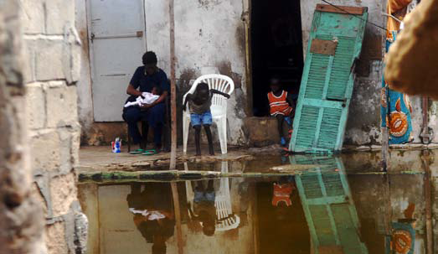
Highlights on deliverables
Recommendation ITU-T L.1501
Best practices on how countries can utilize ICTs to adapt to the effects of climate change
The role of ICTs in adaptation to climate change
ICT can provide the basic access to information, capital and resources which can improve economic development and reduce vulnerabilities
ICTs can be used for each of the following steps
  Observation (combining existing data in new ways)
  Analysis and planning
  Implementation and management
  Capacity building
  Networking
  Monitoring and evaluation
Notes:
ITU-T L.1501 - Best practices on how countries can utilize ICTs to adapt to the effects of climate change
This Recommendation provides guidance on how ICTs can help countries to adapt to the effect of climate change. It also provides a framework and a checklist for countries to integrate ICTs in their national climate change adaptation strategies. This recommendation is part of L.1500 series recommendations on Adaptation to the effects of Climate Change. It is designed to assist countries in integrating ICTs into their national climate change adaptation strategies.
This Recommendation describes the complexity of climate change and explains why countries need to adapt. It also describes the role of ICTs in helping countries respond to the effects of climate change by looking at how various sectors use ICTs; including the ICT sector. It is designed to be a guide for policy and regulation makers in developing policies and regulations regarding adaptation of nations or countries, management, and policies and regulations to climate changes and provides a ‘multi-level framework for ICTs integration in climate change adaption’ to assist countries in integrating ICTs in their national climate change adaptation strategies.
ICTs can be used for each of the following steps:
Observation (combining existing data in new ways): Climate variations occurring in a specific region can be determined in this step. This can be carried out through data collection tools (remote sensing techniques, sensor-based networks etc). The data can be stored in digital repositories and shared among the stakeholders committed to develop the appropriate adaptation strategy.
Analysis and Planning: The stored data can then be analyzed by scientists and policy makers to plan and design adaptation strategies. This analysis of climate change scenarios can be conducted using software based modeling systems (Decision Support Systems and Geographic Information Systems). The results of analysis derived from these modeling systems can then be used to facilitate the development of adaptation plans on a sectoral basis.
Implementation and Management: “The nature of adaptation interventions varies depending on a wide range of elements, such as the set of stakeholders, the sector and the scale of application. As a result, ICT support the implementation and management of adaptation strategies with a wide variety of tools: among the others, forecasting tools, early warning system and resource management systems play a prominent role in this phase” [b-CPD].
Capacity building: Raising awareness of the negative effects of climate change with the help of ICT.
Networking: ICT can be used for knowledge sharing to ensure that all the stakeholders are aware of the effects of climate change as well as the possible measure to build up resilience to climate change at the different levels [b-CPD]. “Social media tools can also support public awareness and education campaigns, as well as foster participative processes. ICT applications such as participatory videos, photo-diaries or the use of mobile phones for collective mapping/monitoring exercises, could be used to foster greater involvement of low-income urban dwellers in climate change and risk-reduction initiatives, involving them in decisions such as the best location for drinking water supplies in case of sudden salinization, or failures in drainage systems due to floods” [b-CDI, 2011].
Monitoring and Evaluation: “The final stage of every adaptation process is its monitoring and assessment: the performance of the initiative must be constantly verified in order to reach the goal defined during the planning phase” [b-CPD].

Slide 34
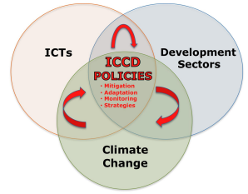
Highlights on deliverables
Recommendation ITU-T L.1501
Best practices on how countries can utilize ICTs to adapt to the effects of climate change
Framework for ICTs and climate change adaptation
ITU-T L.1501 provides the multi-level framework for ICTs integration in Climate Change adaptation for countries to integrate ICTs into their national climate change adaptation strategies
Three main components of the framework:
  Content: policy development
  Structure: institutional arrangements
  Design and implementation
  of coherent Process

Slide 35

Highlights on deliverables
Recommendation ITU-T L.1501
Best practices on how countries can utilize ICTs to adapt to the effects of climate change
Checklist of Indicators
To assist countries ensure that they meet the necessary requirements for the adoption and the implementation of the framework for ICTs and climate change adaptation
To assist countries ensure that they keep a record of the possible trends linked to climate change

Slide 36
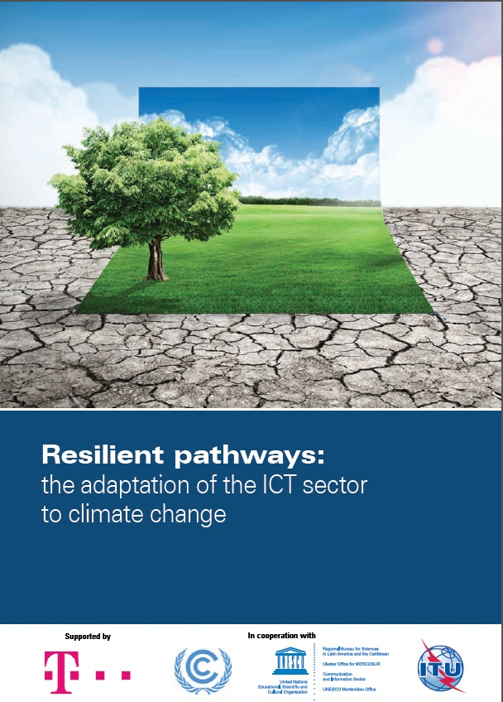
Resilient Pathways:
The Adaptation of the ICT Sector to Climate Change
Authors: Ospina, A.V., Faulkner, D., Dickerson, K., Bueti, C.
Objective of the report:
To explore the impacts of climate change on the ICT sector and the potential for adaptation, while emphasizing the need for resilient pathways of action, enabling environments and new standards.
Notes:
The main objective of this report is to explore the impacts of climate change on the ICT sector and the potential for adaptation, while emphasizing the need for resilient pathways of action, enabling environments and new standards to foster the sector’s approach to adaptation.

Slide 37
Resilient Pathways:
The Adaptation of the ICT Sector to Climate Change
Resilience: A relevant concept
Ability of the ICT sector to withstand, recover, adapt, and potentially transform in the face of climate change impacts.
Ospina and Heeks (2010)
An innovative approach:
A changing climate will lead to a changing business environment.
Recognizing the problem, identifying the risks, and responding with adaptation measures can help businesses minimize their risks and build resilience [to projected and unanticipated change].
Partnership for Resilience and Environmental Preparedness (PREP)

Slide 38
Resilient Pathways:
The Adaptation of the ICT Sector to Climate Change
Resilient Pathways Framework
CLIMATE CHANGE
Extreme events
(short term)
+
Chronic trends
(long term)
ICT Sector
Adaptation
Resilience Attributes:
Robustness, self-organization, learning, scale, rapidity, redundancy, flexibility and diversity
IMPACTS
Levels:
International
National
Sectoral
Local
ADAPTIVE ACTIONS
Notes:
-ICT Sector Responses to Climatic Impacts: Focus on Short AND Long term climatic impacts
-It acknowledges the need to coordinate adaptive actions in the ICT sector at the international, the national, sectoral and local levels
-It recognises the need to strengthen a series of resilience attributes in the sector:
Robustness
Self-Organization
Learning
Redundancy
Flexibility
Diversity
Scale

Slide 39
Resilient Pathways:
The Adaptation of the ICT Sector to Climate Change
Conclusions:
Adaptive practices: part of the “new normal” for business operations
Adaptive approaches: assessment of the potential risks and vulnerabilities, direct and indirect impacts of climate change, as well as mechanisms to tackle new business opportunities and new standards.
Adoption of resilient pathways: by going beyond generic contingency and risk management measures.
Integrating the attributes of resilience can help strengthen the sector’s approach to climate change adaptation by improving its ability to cope, adjust and potentially transform, and by enabling sector-wide strategies in the face of short-term shocks and long-term trends.
Notes:
ICT Sector Responses to Climatic Impacts.
Key ICT Sector Attributes:
Robustness
Self-Organization
Learning
Redundancy
Flexibility
Diversity
Scale

Slide 40
CONCLUSION OF THE HIGHLIGHTS
THE THREE QUESTIONS HAVE A LOT OF RELEVANCE TO THE NEEDS OF THE DEVELOPING COUNTRIES
COUNTRIES ARE REALLY ENCOURAGED TO PARTICIPATE IN THE WORK OF STUDY GROUP 5 AND ESPECIALLY IN THE WORK OF QUESTION 13, 14, 15

Slide 41
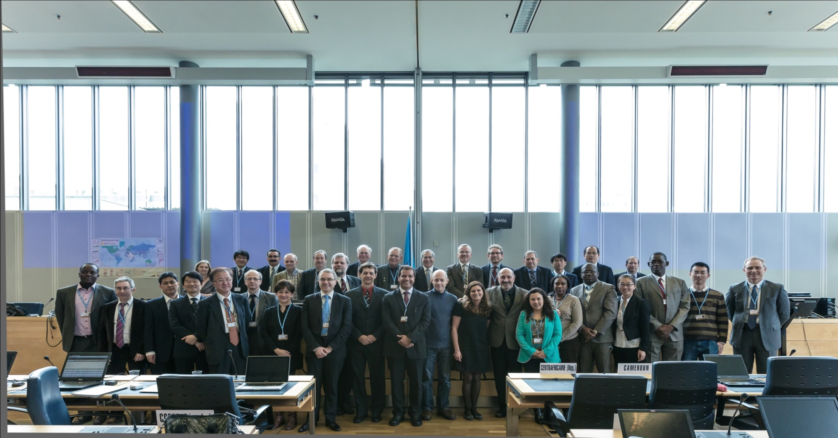
Additional information
ITU-T/SG5 “Environment & Climate Change”
Contact: ulanga@ucaf.go.tz
itu.int/go/ITU-T/climate
THANK YOU! tsbsg5@itu.int

