Slide 1
ITU Regional Standardization Forum For Africa Dakar, Senegal, 24-25 March 2015
The Securing of Networks
(Plan of Continuity of service)
Bocar KELLY,
Leader of Department Architecture and Planning Networks, SONATEL bocar.kelly@orange-sonatel.com

Slide 2
Context
The securing of networks is part of our Plan of Continuity of activities that takes into account all the aspects below
Crisis Management (CM)
Outside scope
Process allowing to cope with disaster of extreme gravity
Business Impact Analysis (BIA) Outside scope
Identify the critical functions for the business and assess the impact of their Losses
Disaster Recovery Plan (DRP)
Process of resumption after disaster to a level of agreed services of functions Critics
Work area Recovery (WR)
Outside scope
Process of the restoration of a working environment after disaster for critical functions
Securing networks: one of the stages of the DRP

Slide 3
What Approach ?
Functional Analysis
Definition of stakes
Statements of existing and planned security
Risk Analysis
Roadmap for setting conformity
Identification of evaluation criteria of impacts
Inventory of fixtures
Plans of action
Identification of gaps

Slide 4
Approach : Functional Analysis
Identify the level of service required for each element of the Network (duration of unavailability, duration of loss of information, potential risk, etc. )
Classification of nodes of the network in relation with the level of service (C2, C3, C4, etc. )
Level of Availability | Year | Month | Week | Category
2 nine - 99% | 3.65 days | 7.20 hours | 1.68 hours | C2
3 nine -99.9 per cent | 8.76 days | 43.2 mn | 10.1 mn | C3
4 nine - 99.99 % | 52.56 mn | 4.32 mn | 1.01 mn | C4
5 nine - 99.999 % | 5.26 mn | 25.9 s | 6.05 s | C5
6 nine - 99.9999 % | 31.5 s | 2.59 s | 0.605 s | C6

Slide 5
Approach : Functional Analysis
Example of classification for some elements of the Sonatel network
 | Category | Level of Availability | Disaster Recovery
MSC/PTS/HLR | C5 | 5 nine - 99.999 % | OUI
IN (Réseau Intelligent) | C5 | 5 nine - 99.999 % | OUI
Réseau de Transmission | C5 | 5 nine - 99.999 % | OUI *
SMSC | C5 | 5 nine - 99.999 % | OUI
Réseau IP | C5 | 5 nine - 99.999 % | OUI*
OTA/DMC (Configuration des appareils) | C4 | 4 nine - 99.99 % | OUI
CRBT (ring back tone) | C4 | 4 nine - 99.99 % | OUI
* : Transmission network/IP in loops

Slide 6
Approach : Inventory of fixtures
Statements of existing or planned securities:
Network Segmentation:
Access Network
Collection, Transmission and IP
Heart of Ntwork CS&PS
Platforms of Service
NRJ and Environment
Analysis of the Level of the Securing of Equipment :
internal redundancy of cards (2N, N+1, etc. )
Geographical Redundancy
Double Power Supply
Etc.

Slide 7
Approach : Analysis of Risks
Technical study of scenarios of likely disaster for each element of the network
Identify for each risky node , one or several potential risks
For each risk, identify the probability of occurrence
Finally, define the level of gravity in relation with impacts (financial, operational, mark, etc. )
Classification of the various nodes of the network (C5, C4, C3, etc. )

Slide 8
Approach : Plan of Development
Define the scenarios of evolution:
Propose an architecture adapted to each type of service
Define the roadmap of implementation

Slide 9
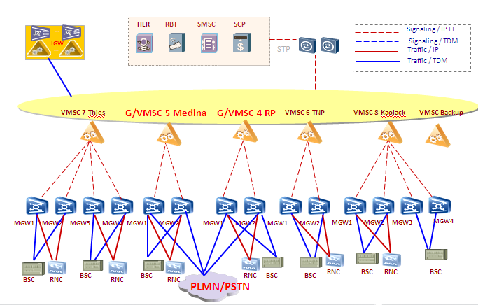
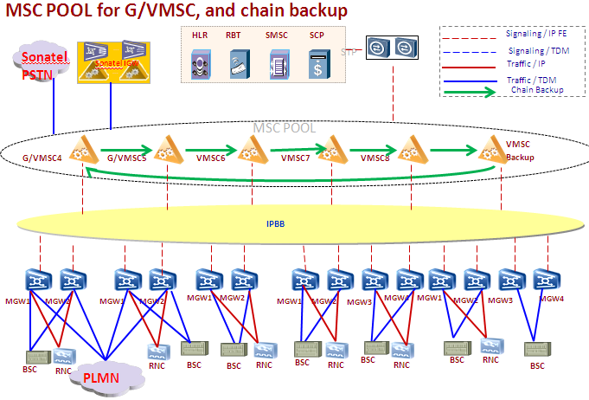
Use case: Securing the Heart of CS Network
Migration of an initial architecture in silo (absence of geographical redundancy for the MSCS) toward an architecture in a pool with a backup of mutual MSCS.

Slide 10
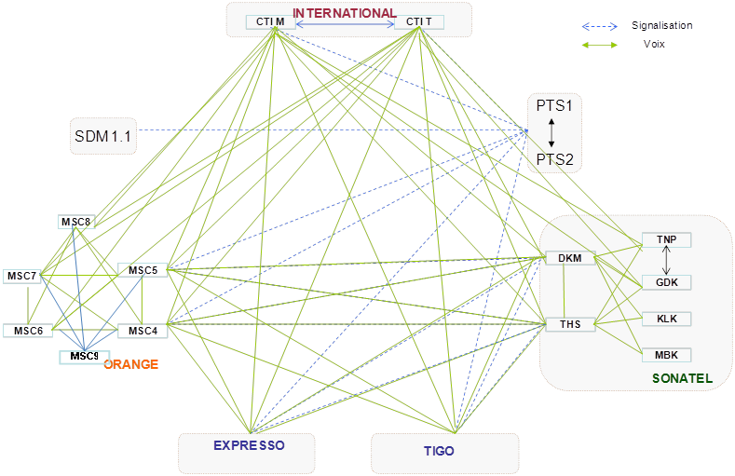
Architecture of the Switching Network of Sonatel
Establishment of a geographical redundancy for all critical nodes of the network with securing interconnecting links.

Slide 11
THANK YOU

