Slide 1
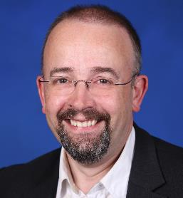
Y.3520 Cloud computing framework for end-to-end resource management
ITU Workshop on “Cloud Computing Standards – Today and the Future”
(Geneva, Switzerland 14 November 2014)
Mark Jeffrey,
Rapporteur Q19/13,
Microsoft Corporation
Mark.Jeffrey@Microsoft.com

Slide 2
Comprehensive View of Management

Slide 3
Single Cloud Management

Slide 4
Software enabled services
The objective of the software enabled services (SES) management concept enables both
traditional service providers and
Internet content and media service providers
to leverage the opportunities and service marketplace that are presented by the convergence of networking and IT.

Slide 5
Software enabled services
Specifically, the SES management solutions provide a means to allow consistent end-to-end management and metering of services exposed by and across different service providers' domains and technologies.

Slide 6
Multi-cloud Management

Slide 7
Architectural Vision

Slide 8
Conclusions and Recommendations
ITU is working with TMF and others
Cloud Management is somewhat different to traditional telecom management
Software Enabled Services (SES) are a key concept
Management is inherently multi-cloud management
Service Management Interfaces
Y.3520 explains all this

