Slide 1
Return to the Past
Workshop on Voice and Video Services Interoperability Over Fixed-Mobile Hybrid Environments, Including IMT-Advanced (LTE) 1 December 2015
Chaesub Lee
Director, ITU Telecommunication Standardization Bureau

Slide 2
Welcome to Geneva

Slide 3
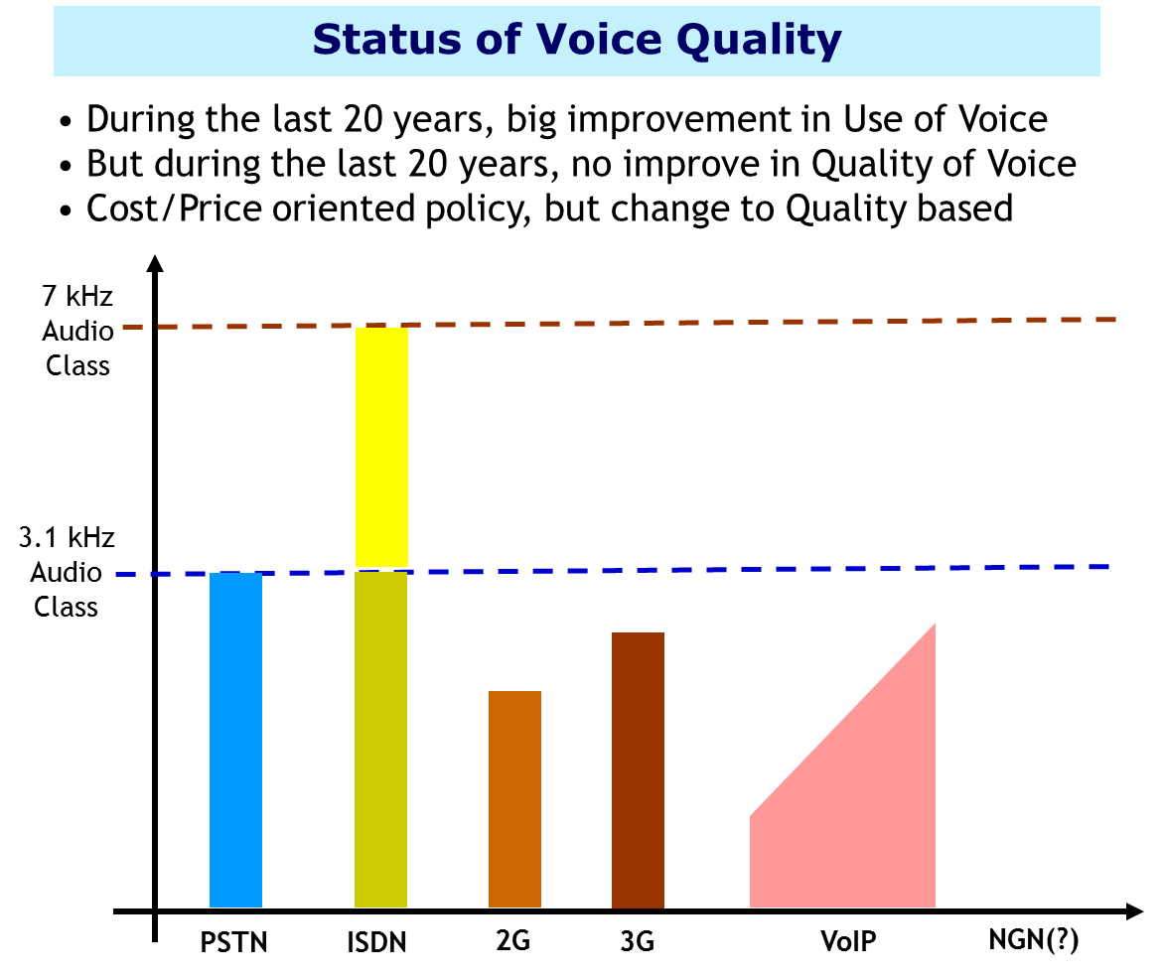
Legacy quality to Modern quality
ITU Workshop “Future of Voice“, Geneva, 15-16 January 2006
Today(?)

Slide 4
Words used for vision but forgotten (?)
3.1 kHz Audio → Digitalized Speech and Audio
7 kHz Audio → Hi-Fi Audio
Defined at 1988
Under the environment of B–Ch (64 kbps) and T1 (1.5 M)/E1 (2 M)
We are living in Broadband Connected World.
We are enjoying Multimedia Information, even networked game…
10 Mb/s
64 kb/s

