Slide 1
ITU Workshop on “Voice and Video over LTE” Geneva, Switzerland, 1 December 2015
NNI standards for IMS inter-connection including mobile and fixed IMS network in Japan
Kenjiro Arai NTT (arai.kenjiro@lab.ntt.co.jp)

Slide 2
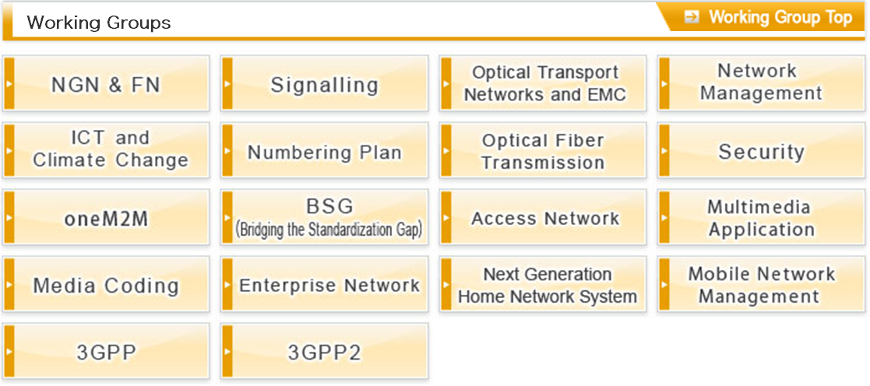
National standards for IMS interconnection
Recently, national standards for IMS interconnection have been published in TTC.
The standards mainly specify the detailed signalling requirements over the NNI.
NNI (SIP/SDP) specification between different operator's IMS networks
- Developed in collaboration with Signalling and 3GPP WGs.
Carrier ENUM/DNS specification for SIP routing over the NNI.
- Developed in collaboration with Signalling and Numbering Plan WGs.
Related WGs

Slide 3
NNI (SIP/SDP) specification

Slide 4
NNI (SIP/SDP) specification - General
Through a lot of discussions, we reached an agreement to adopt 3GPP TS 29.165 as a basis of the protocol specification for the future interconnection between IMS networks of the domestic operators.
The fist version of specification has been published as a TTC standard (JJ-90.30) in May 2015. (The latest version is 2.0)
TS 29.165 Figure 5.1.1

Slide 5
NNI (SIP/SDP) specification - Scope
3GPP TS 29.165 specifies the SIP/SDP signalling (3GPP usage of SIP and SDP protocols) requirements on both roaming and non-roaming NNI.
On the other side, our specification is focused only on a non-roaming NNI, between IMS home networks, including both mobile and fixed IMS.
Target of standardization in JJ-90.30
TS 29.165 Figure 4.2

Slide 6
NNI (SIP/SDP) specification - Objectives
The goal of NNI specifications (JJ-90.30) are:
A) to clarify the signalling requirement on the basis of the domestic circumstances, B) to help the operators to reach agreements on their interconnection by selecting the option items listed in 3GPP TS 29.165 Annex C in advance, C) to help the implementations, configurations, and operations of the operator's REAL networks by providing the supplementary information.
TTC JJ-90.30
refers to
This standards conforms to 3GPP TS 29.165 and shall not specify anything deviated from 3GPP TS 29.165.
Japanese specific signalling requirements regarding numbering plan, unallocated number talkie.
A
The selections of the option items listed in 3GPP TS 29.165 Annex C are specified in a normative annex.
B
The supplementary information regarding network operation / maintenance, the callflows / the message coding examples are described in informative annex.
C

Slide 7
Carrer ENUM/DNS specification

Slide 8
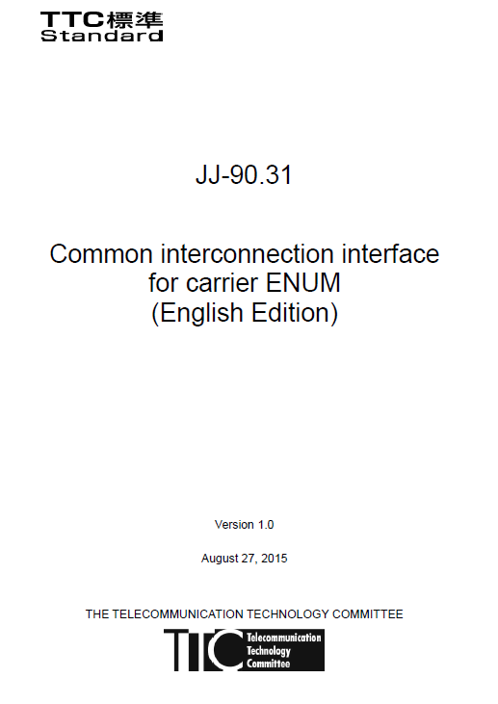
Carrier ENUM/DNS specification - General
Based on demand from operators on the standardization of number portability, we have developed the ENUM/DNS spec. for implementation/deployment.
The first version of specification has been published as a TTC standard (JJ-90.31) in August 2015.
High-level architecture
TTC JJ-90.31
Global industry
ITU-T E.164 Sup.2
refers to
is aligned with
endorsement
GSMA IR.67
JT-E164 Sup.2
refers to
is aligned with
ENUM Protocols
Call Control procedures
IETF RFC 6116
3GPP TS 24.229

Slide 9
Carrier ENUM/DNS specification - Contents
Main contents of ENUM/DNS related specifications are:
Specifying the detail of query/answer message (e.g. TLD of query, NAPTR RR) over the carrier ENUM interface, using the corresponding RFCs, and
Specifying the usage of the carrier ENUM interface in the IMS network.
Target of standardization in JJ-90.31
Mobile Network
Fixed Network
Carrier ENUM (Tier 2)
Carrier ENUM (Tier 2)
2. ENUM query/answer
IMS
(Originating Side)
IMS
(Terminating Side)
1. Initial INVITE
3. Initial INVITE
4. Initial INVITE
Usage of the carrier ENUM/DNS interface by IMS network. - This is specified in JJ-90.30(SIP/SDP

Slide 10
Future works in TTC
In TTC, we are planning to address the following works for the future commercial IMS interconnection.
Study on the alignment with GSMA NNI (SIP/SDP) Profile.
This is the one of the most important works in SIP SUB-WG, to avoid the duplex development of the IMS equipment.
TTC is trying to finalize this work by the end of this year.
Signalling / IMS services specific to the mobile operators
Now JJ-90.30 (SIP NNI) does not specify adequate requirements specific to the mobile operator.
At first, it is necessary to identify what are the signalling requirements / IMS services specific to the mobile operators.
Other enhancement and maintenance (if any)

Slide 11
Thank you very much!

