Slide 1
ITU Workshop on “Voice and Video over LTE”
Geneva, Switzerland, 1 December 2015
Considerations for end to end video quality QoE assessment as a means of verifying interoperability
Paul Coverdale
Consultant, Huawei Technologies Co. Ltd.
coverdale@sympatico.ca

Slide 2
Outline
Background
Methodologies for assessing video QoE
Key requirements for an objective video QoE assessment tool
Current ITU-T Standards
Summary

Slide 3
Background
Today LTE is deployed by 360 operators in 124 countries. Out of them, 80 operators are investing in Voice over LTE (VoLTE) and 14 have already launched VoLTE services.
But VoLTE also allows for video over LTE (ViLTE) with managed quality of service, since the network is managed by the operator allowing them to prioritize real-time communication over data and reserve resources for specific services.
But how to ensure interoperability of ViLTE among different service providers?

Slide 4
Interoperability as perceived by the end-user
Important to consider interoperability from the viewpoint of the end-user
  They are the one who pays the bill
The need to reliably establish and close a video session is clearly important, but so also is the video quality (QoE) during the session

Slide 5
Methodologies for assessing video QoE
In principle, assessment of Quality of Experience (QoE) for video (as for audio) must be performed using subjective tests, with metrics such as the mean opinion score (MOS)
However, it is also possible to estimate QoE based on objective measurements and associated quality estimation models
Subjective testing needs more resources and effort, because it requires human subjects, and is not so convenient in a live-service setting
Objective measurement and QoE calculation is generally much faster and more convenient, but the accuracy of the final evaluation depends on the accuracy of these models, and an understanding of the important human factors

Slide 6



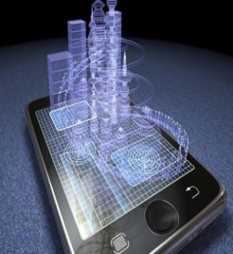

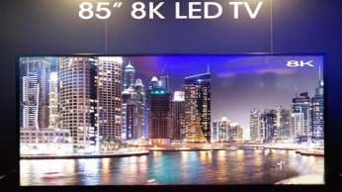

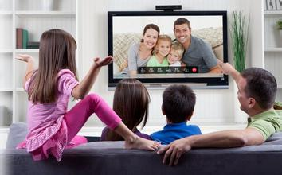
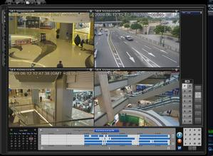
Evolution of Video Quality Experience: Different Screens, Services, and Networks
Live
VoD
1970s–1980s
1990s-2010s
2020s
TV call
Black&white→Colorful
Analog→Digital
VCR → 8K
Plane → Stereoscopic
Static 3D→Dynamic 3D (holographic)
surveillance
Multi-Screen Experience to Eye’s Extreme
Interactive and immersed experience
Meeting basic requirements
(Scope of the current experience standards)

Slide 7












Requirements for objective video QoE assessment
Research method
Subscriber survey
Determine top factors and their weights.
Human factor engineering experiments
Measure subjective perception.
ITU-T Recommendations
Determine the calculation method and formulae
Quantified collection
1
2
Experience modeling
Measurement indicators
Performance Metrics
Experience assessment
3
4
Network requirements
Network architecture
Network assessment
Application scenario
  BTV
  VoD
  Video communication
  Security surveillance
Planning guidance
  Phone
  Pad
  TV
  Camera
  Fixed network
  Mobile network
Continuous evolution

Slide 8

Subscriber Survey, Highlighting Top 3 Factors That Affect User Experience
Subscriber survey
Determine top factors and their weights.
Top 3 factors that affect user experience: video source quality, video loading speed, and video view experience
Weight importance
Note: A larger weight value indicates greater importance.
Interaction
Performance
Contents
Focus group interview
Questionnaire
Video quality = Content quality (ultra HD, HD, and SD)
Initial loading = Content loading duration (initial channel zapping or VOD loading response time)
View experience = Broadcasted video quality (frame freezing or blocking)
3000+ survey samples
Source: Huawei, UCD center, 2015

Slide 9
Video QoE Modelling
Experience
factors
Top Three Factors for Video Experience
Video source
Playback process
Viewing process
Video quality
Interactive experience
View experience
Experience
targets
0 distortion
0 waiting
0 damage
High definition
Initial Loading time
0 Blocking
High Frame rate
Color Gamut
Zapping time
0 Stalling

Slide 10
Video QoE Assessment Panorama
Video MOS modeling factors
  Video quality
  Interactive experience
Viewing experience
sQuality*
sInteraction
sView
Video MOS = f (sQuality, sInteraction, sView)
* s=score
Application scenario
  Video communication
  Security surveillance
  BTV
  VoD
  Phone
  Pad
  TV
  Camera
  Fixed network
  Mobile network
Objective multi-screen, multi-network, and multi-service(BTV,VOD Video communication Video surveillance etc) video experience standard
Notes:
IV : changes in GREEN

Slide 11
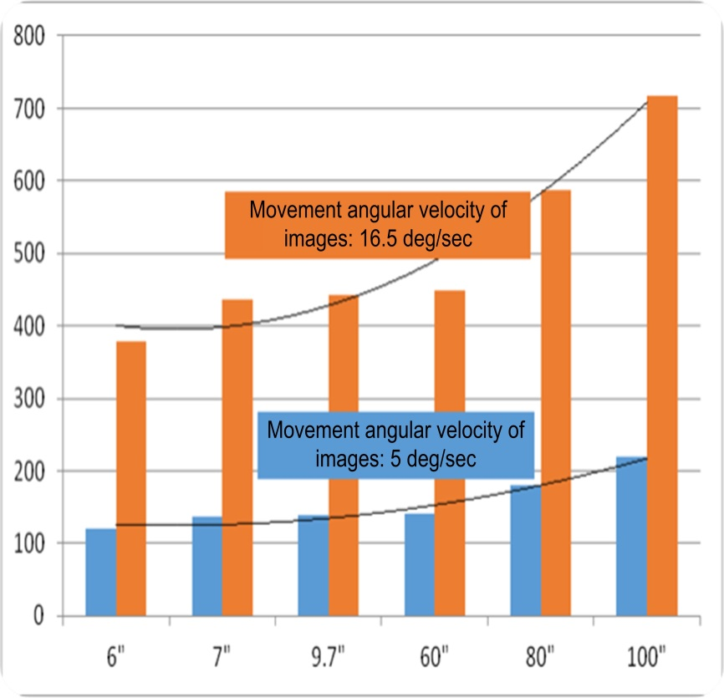









Video Quality Factors: Definition, Motion, and Fidelity
Video quality
Interaction experience
Viewing experience
The definition depends on viewing angle and resolution.
The frame rate affects video motion.
High fidelity means true colors, delicate pictures, and complete details.
100"
True
colors
Rec. BT.709
8 bits
Rec. BT.2020 10 bits
Rec. BT.2020
12 bits
(Sports)
Delicate
pictures
60"
6"
9.7"
42"
（Drama）
8 bits
10 bits
12 bits
Complete details
Typical viewing distance of a mobile phone with a 6" screen:
Typical viewing distance of an iPad with a 9.7" screen:
Typical viewing distance of a TV screen:
Maximum frame rates for screen sizes
SDR
8 bits
HDR
10 bits
HDR
12 bits
2.5 m
30 cm
41 cm

Slide 12
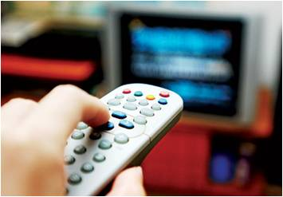


Interactive Response Factors: Video Loading and Switching Duration
Video quality
Interaction experience
Viewing experience
Interactive Operations and Acceptable User Experience
1s channel switching
2s video loading
0.5s fast forwarding/rewinding
Ultimate Experience Objective: 0 Wait Time
100 ms = immediate response
Notes:
IV : changes in GREEN

Slide 13


Viewing Experience Factors: Erratic Display/Video Freeze
Video quality
Interaction experience
Viewing experience
Current criteria (VOD freeze):
  VOD freeze duration on mobile phone/pad screens
  <= 10%
  VOD freeze duration on TV screens <= 1%
Current criteria (erratic display during live broadcast):
  Resolution higher than 720p: 1 erratic display/4 hours;
  Resolution lower than 720p: 1 erratic display/2 hours;
Ultimate experience: 0 erratic display/video freeze
  Same requirement for TV, mobile phone, and pad screens
Source: DSL Forum TR-126
Ultimate user experience: 0 occurrence of video freeze and erratic display
Notes:
IV: changes in GREEN

Slide 14
Anticipated Video Service Experience Evolution
The video industry technical can help the 3 top factors reach the following requirements.
  TV: 1080p @ 60 fps, 8 bit, ITU-R Rec. BT.709
  Mobile phone: 720p @ 30 fps, 8 bit, ITU-R Rec. BT.709
  TV: 4k @ 120 fps, HDR, 12 bit, ITU-R Rec. BT.2020
  Mobile phone: 2k @ 120 fps, HDR, 12 bit, ITU-R Rec. BT.2020
  TV: 8k @ 240 fps, HDR, 12 bit, ITU-R Rec. 2020
  Mobile phone: 4k @ 120 fps, HDR, 12 bit, ITU-R Rec. BT.2020
  Video quality
  TV:
    channel switching time < 500 ms
    Initial VOD wait time: < 1s
  Mobile phone:
    Initial VOD wait time: < 1s
  TV:
    channel switching time < 100 ms
    Initial VOD wait time: < 100 ms
  Mobile phone:
    initial VOD wait time < 100 ms
  TV:
    channel switching time < 1s
    Initial VOD wait time: < 2s
  Mobile phone:
    initial VOD wait time < 3s
  Interaction experience
  Number of erratic displays during a live video stream<= 2
  VOD freeze duration on mobile phone/pad screens <= 10% (within the 1-minute statistical period)
  VOD freeze duration on TV screens <= 1% (within the 45-minute statistical period)
  Number of erratic displays during live broadcast <= 1
  VOD freeze duration on mobile phone/pad screens <= 5% (within the 1-minute statistical period)
  VOD freeze duration on TV screens <= 0.1% (within the 45-minute statistical period)
  Number of erratic displays during live broadcast <= 0
  VOD freeze duration on mobile phone/pad screens <= 0% (within the 1-minute statistical period)
  VOD freeze duration on TV screens <= 0% (within the 45-minute statistical period)
Viewing experience
Now
2018
2020+
Notes:
The research about the experience of video communication is in progress

Slide 15
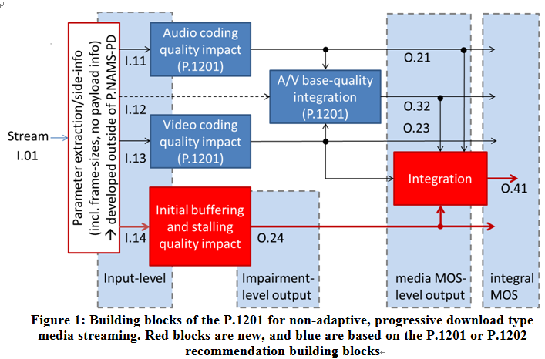
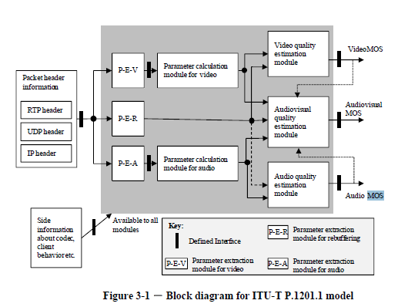
Current ITU-T Video QoE Models
IPTV/Mobile TV Services
HTTP Progressive Download
(Rec. P.1201/P.1202)
(Rec. P.1201 Appendix III)
Measures the quality degradation
    due to compression
    due to packet-loss
    due to rebuffering
Provides packet-level (P.1201)/bit stream-level (P.1202) assessment algorithm
Formulated by adding the initial buffering time and video freeze impact to the P.1201 standard
Without consideration of user interactions
user interactions (such as pausing, seeking, user initiated quality change, user initiated play or user initiated end) are NOT considered at all
Notes:
Difference between the P.1201 and P.1202 standards
Complementary to the ITU-T P.1202 models, there are two further models described in ITU-T P.1201.1 and ITU-T P.1201.2. The respective entry-document for these models is ITU-T P.1201. It describes packet header only-based video, audio and audiovisual quality models. The main differences with ITU-T P.1202 can be summarized as follows:
The ITU-T P.1201 models provide audio, video and audiovisual quality estimates, while the ITU-T P.1202 only models provides video quality estimates
The ITU-T P.1201 models use packet header information, while the ITU-T P.1202 models exploit further bitstream information, such as coding-related information. As a consequence, the ITU-T P.1202-models can be more accurate in their quality predictions. In turn, they require non-encrypted streams, to enable the access to payload information. Since the ITU-T P.1202 models are more complex, they also require more computational power to estimate the video quality

Slide 16
Summary
Successful interoperability of ViLTE depends on ensuring end-user satisfaction with the resulting video quality (high QoE)
Standardized objective models for predicting video QoE are becoming available in ITU-T, and will play an important rule in ensuring ViLTE interoperability
Will complement audio QoE assessment models for ensuring VoLTE interoperability

