Slide 1



WeGO for
Smart Sustainable Cities
6th ITU Green Standards Week - Montevideo
September 5th 2016
Presenter: David Hahm
WeGO Program Director
Notes:
© Copyright Showeet.com

Slide 2




WeGO (World e-Governments Organization of Cities and Local Governments)
International organization of cities around the globe that pursues sustainable urban development based on ICT
Established in 2010 by 50 founding member cities
Currently has 101+ members around the world
President City: Seoul (Korea)
Secretariat located in Seoul with two Regional Offices in China and Russia
Website: www.we-gov.org
Mission: Promotion of smart and sustainable cities for the enhanced well-being of urban citizens

Slide 3
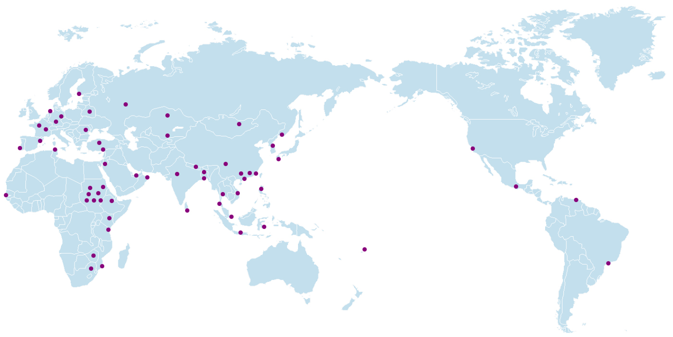
WeGO’s Global Network of Cities
101+ members
Ulyanovsk, European Regional Office, Russia
Helsinki
Moscow
Rotterdam
Minsk
Ulyanovsk
Berlin
Astana
Frankfurt
Bucharest
Ulaanbaatar
President City Seoul, Korea
Paris
Baku
Tashkent
Vladivostok
Barcelona
Ankara
Seoul
San Francisco
Pittsburgh
Lisbon
Tunis
Antakya
Chengdu
Hebron
Kathmandu
Zhejiang
Saga
Chengdu, Asian Regional Office, China
Abu Dhabi
Muscat
Agra
Dhaka N.
Ningbo
North Kordofan
Khartoum
Dhaka S.
Hong Kong
Mexico City
Dakar
Shaikan
Addis Ababa
Bangkok
Manila
Caracas
Hasahisa
Sennar
Galle
Seberang Perai
Nairobi
Bandung
Baubau
Dar es Salaam
Jakarta
Harare
Suva
Maputo
Asuncion
Sao Paulo
Port Alegre

Slide 4


Overview of WeGO Activities
Digital Capacity Building
e-Government Training Programs
e-Government Tools
IT Consultation & Pilot Projects
Feasibility Study (FS) and Pilot Project Programs
Knowledge Sharing & Networking
Smart City Conferences
Promotional Opportunities
WeGO Regular Meetings
Global Recognition
WeGO Awards - International e-Government Competition

Slide 5

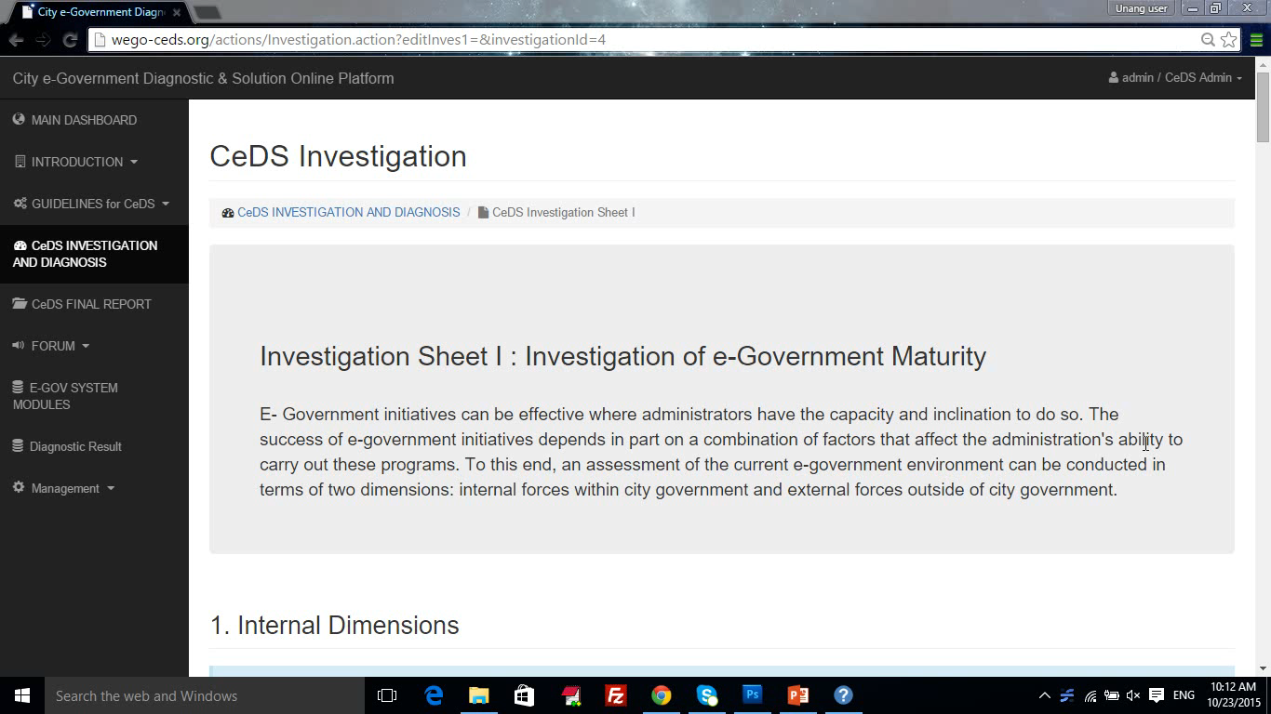
Digital Capacity Building
ICT Tools
City e-Government Diagnostic and Solution (CeDS) Online Platform
WeGO eGovFrame and Technical Training and Service Program
A technical training and service program on the WeGO eGovFrame, an open source software framework
An online toolkit that allows WeGO members to conveniently self-assess their e-Government maturity level
WeGO-TM Forum Smart City Maturity & Benchmark Model
An end-to end self-assessment tool for cities to evaluate their smart city maturity and benchmark against other cities

Slide 6

IT Consultation & Feasibility Project
Providing technical assistance based on a focus area decided by WeGO Members
Post-F/S Project implementation through partnership with Korea EXIM Bank to acquire funding
Dar es Salaam:
e-Office
2010
Seberang Perai
Smart Street & Traffic Light System
2015
2013
2012
2016
Ulaaanbaatar: Underground facility Management
Buenos Aires
Smart Card
Dar es Salaam
e-office
Maputo:
Claims and Solid Waste Management
Addis Ababa
e-office
Seoul
Overseas expansion strategy
Hanoi:
Citizen Participation System
San Fernando, La Union
Open Government Management System

Slide 7

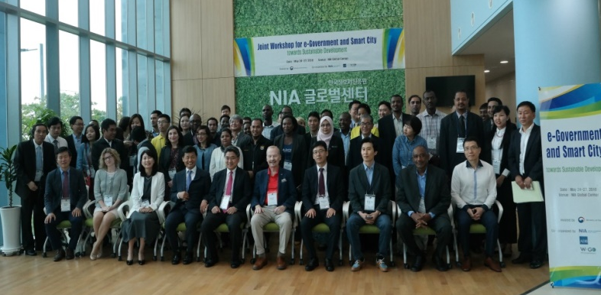
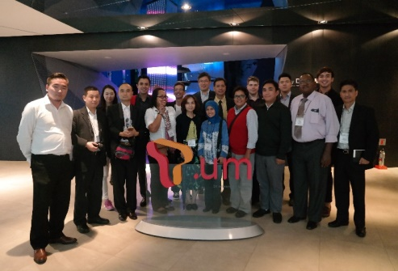
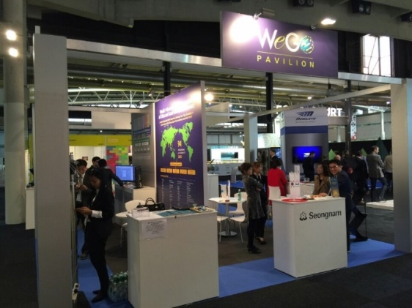
Knowledge Sharing & Networking
Smart City Conferences & Events
Joint Workshop for e-Government and
Smart City with ADB & NIA Global Academy
(23-27 May, Jeju Island, Korea)
Joint workshop focusing on smart city and e-Government for local and national government officials to explore development opportunities
1
2
Seoul Program with
Seoul Human Resource Development Center (SHRDC)
(May 22-29, Seoul, Korea)
Discussing emerging e-Government trends and Seoul’s best IT policies
3
Smart City Expo World Congress (SCEWC)
(November 15-17, Barcelona, Spain)
Promoting WeGO and members at the premier global summit for smart cities
A 60-120 m² exclusively tailored WeGO Pavilion with excellent visibility
Speakership opportunities at the World Congress

Slide 8



Knowledge Sharing & Networking
Smart City Conferences & Events
International Forum on Urban Policy for Sustainable Development Goals
(June 8-10 in Seoul, Korea)
In partnership with Seoul Metropolitan Government (SMG)
Organized a session on ICT-enabled smart sustainable city
4
5
2nd Asia-Pacific Regional Forum on Smart Sustainable Cities and e-Government (August 30 to September 1st in Phuket, Thailand)
In partnership with International Telecommunication Union (ITU)
Habitat III Side Event on Data Revolution
(October 17-20 in Quito, Ecuador)
In partnership with United Cities and Local Governments Asia-Pacific (UCLG ASPAC)
6

Slide 9



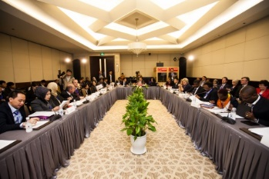

Knowledge Sharing & Networking
WeGO Executive Committee Meeting 2016 (EXCOM)
  October 12-14 in Beyoglu, Turkey
  An annual meeting of WeGO’s elected executive committee members on key WeGO agendas and emerging trends
WeGO General Assembly 2017
  June 20-23 in Ulyanovsk, Russia
  Meeting of the members to discuss key agendas and to vote

Slide 10

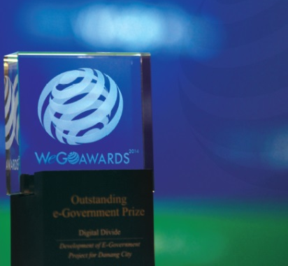
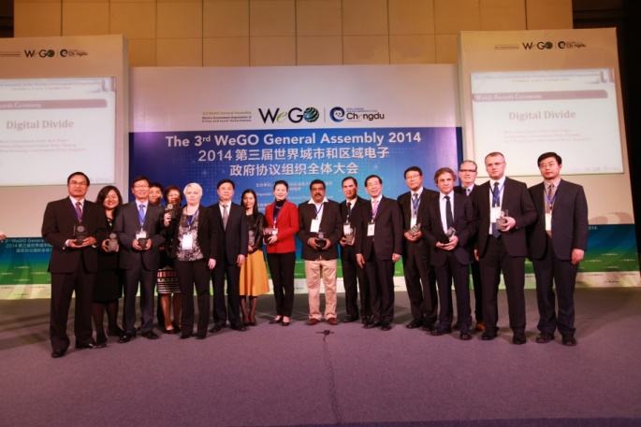
Global Recognition
WeGO Awards
Open City
Urban Management
Digital Divide
Efficiency
A triennial competition of WeGO designed to recognize and promote outstanding practices of e-Government of cities and local governments
Services

Slide 11

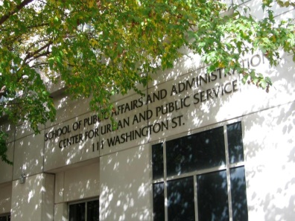

Seoul: A Brief Background
2013 ~ 2014
2011 ~ 2012
#1 for 6 consecutive times
2009
2007
E-Governance Institute at Rutgers University (2013 ~ 2014)
Rank | 1 | 2 | 3 | 4 | 5 | 6 | 7 | 8 | 9 | 10
City | Seoul | New York | Hong Kong | Singapore | Yerevan | Bratislava | Toronto | Shanghai | Dubai | Prague
Country | Korea | USA | Hong Kong | Singapore | Armenia | Slovakia | Canada | China | UAE | Czech
Score | 85.80 | 66.15 | 60.32 | 59.82 | 59.61 | 58.31 | 58.05 | 56.02 | 55.89 | 54.88
2005
2003
Holzer, M., Zheng, Y., Manoharan, A. & Shark, A. (2014). Digital Governance in Municipalities Worldwide, Sixth Global E-Governance Survey: A Longitudinal Assessment of Municipal Websites Throughout the World. National Center for Public Performance, Rutgers University.

Slide 12






Seoul’s Big Data Solution: Late-Night Bus(Owl-Bus)
Why Late-Night Bus?
“Buses don’t run by the time I get off work. I don’t have a car.
I hope there will be buses available late at night!”
@gu***
Response from the City
Let's set-up late-night
bus routes
Problems
  Limited Resources
  Traffic Analysis
No public transportation from 01:00 AM ~ 05:00 AM
Subway
Bus
Taxi

Slide 13
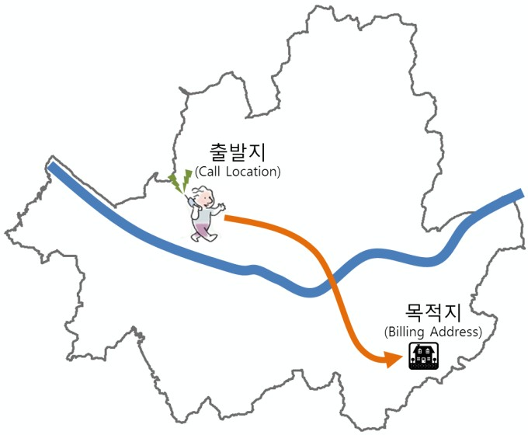
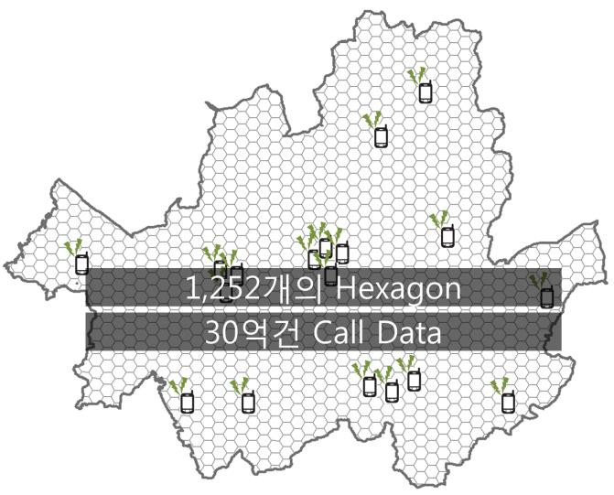
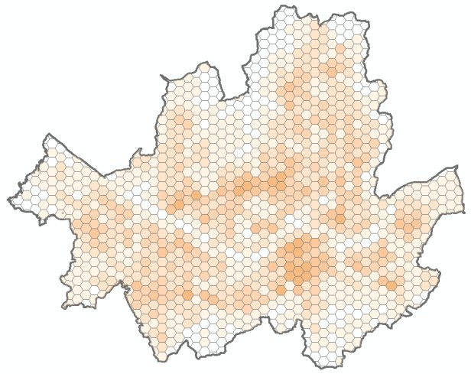
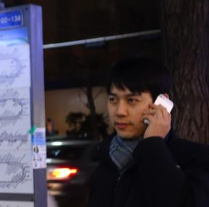
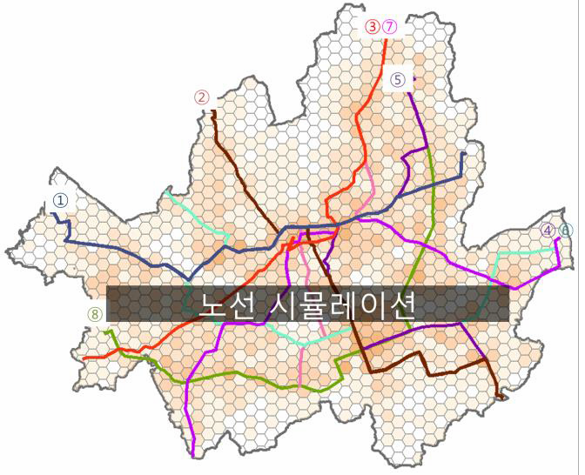
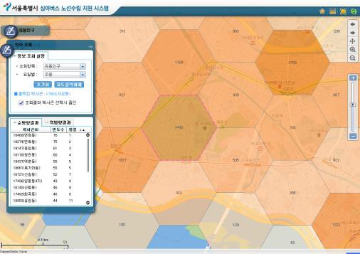
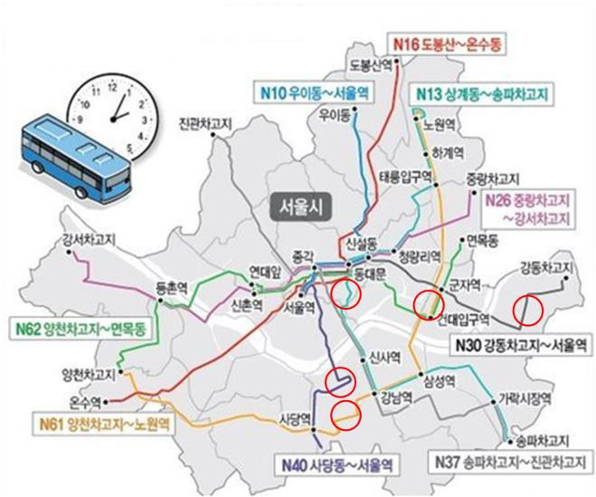
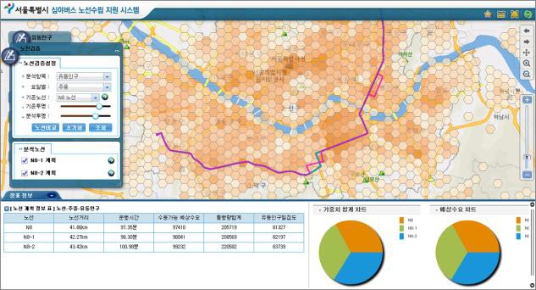
Seoul’s Big Data Solution
Big Data Problem Definition
Modeling
Analysis
3 billion mobile call data
Night Bus Routes
Routes Optimization
Finalized Routes

Slide 14
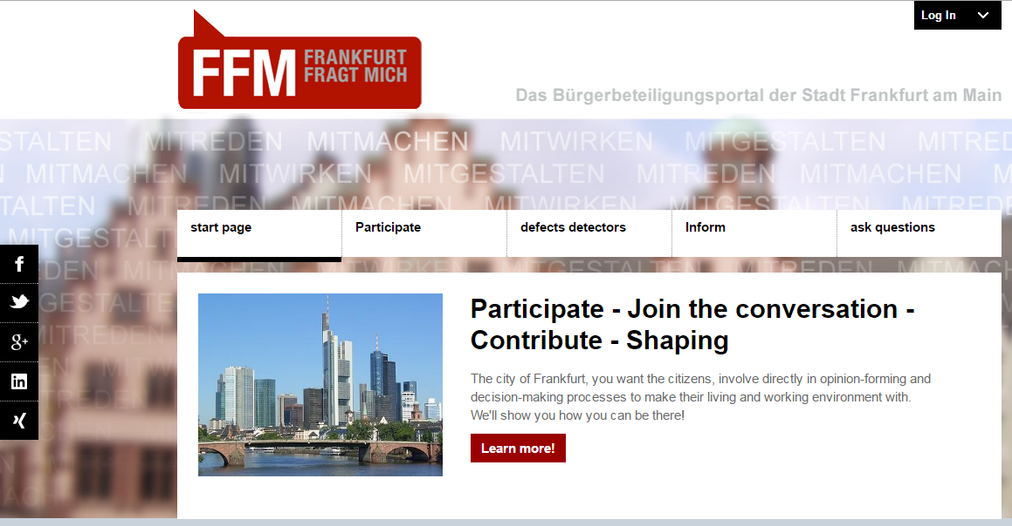
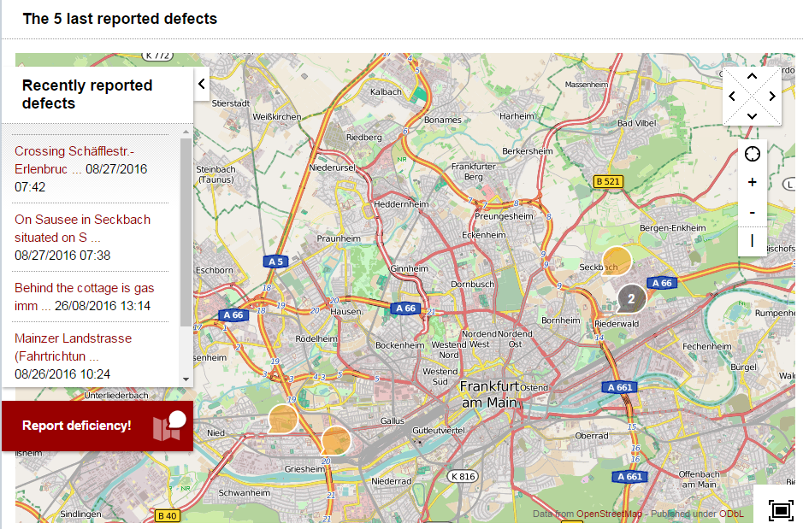
“Frankfurt Asks Me”
The participation portal “Frankfurt Asks Me” is the central point of contact for all online participation for the citizens of the City of Frankfurt
The objective of the project is to use modern communication channels to open up new opportunities for the participation of citizens
The requests of citizens received by phone and email are collected centrally and transferred to public authorities
The technical platform has been designed to be multi-client capable open system, such as a set of “building blocks for participation”.
Can be used in other cities and other public institutions across the Federal Republic of Germany.

Slide 15
Thank You
Notes:
© Copyright Showeet.com

