Slide 1
6th Green Standards Week, Montevideo-Uruguay
The Challenges and Opportunities of eMaterials Lifecycle Management in LATAM
Consuelo Velarde
September 5th 2016

Slide 2
Agenda
Goals of eMaterials Lifecycle Management
The Opportunity
The Challenges
A Success Story: Mobile Carrier Buy-Back Program
About Belmont Trading Company

Slide 3
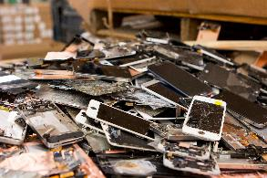
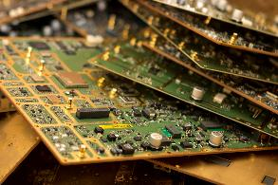
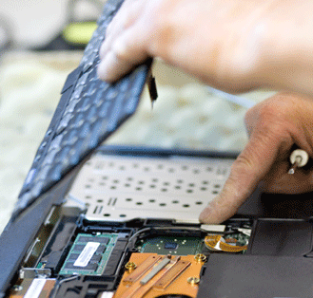
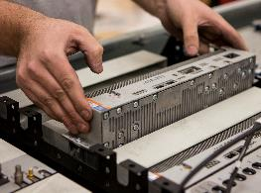
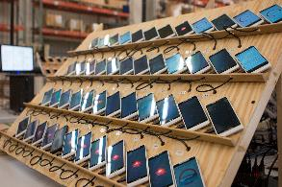
eMaterial vs eWaste
eWaste
Generally implies material that is: Beyond Economic Repair (BER) or End Of Life (EOL) Destined for lower-value recycling/metals recovery
eMaterial
Any electronic product that is transitioning from one use to the next, such as: New in box equipment that an OEM never sold as new Resalable used equipment even if it requires repair or refurbishment to make it suitable for resale Material generally referred to as eWaste: BER or EOL material that cannot be used again due to obsolescence or damage.
In this presentation we use the most applicable term given the context of the topic we are discussing.

Slide 4
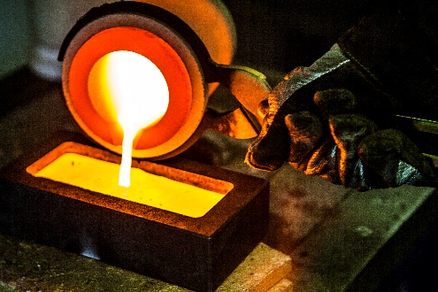
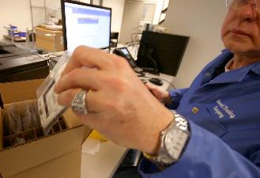
eMaterial Value Recovery Drivers
Scrapping & Recycling
Component Harvest & Resale
Remarketing Whole Units
Maximizing Economic Value
Pursuing Sustainability Goals
Complying With Regulations
Lower Value Recovery
Higher Value Recovery
Striving for higher value recovery options helps us achieve economic, sustainability, and regulatory goals
Protecting Private Data

Slide 5
Even if we can only recycle a phone for its metal, we get significant environmental and economic value
Total value per 100 cell phones: $192.51
Source: Shegerian, John, Triple Pundit, August 21, 2015

Slide 6
LATAM countries’ per-capita eWaste generation is relatively low by world standards…
Source: http://i.unu.edu/media/ias.unu.edu-en/news/7916/Global-E-waste-Monitor-2014-small.pdf

Slide 7
…With some countries offering significant eWaste processing opportunities
Source: http://i.unu.edu/media/ias.unu.edu-en/news/7916/Global-E-waste-Monitor-2014-small.pdf

Slide 8
Challenges: Communication, Logistics, Standards Adoption
Communication
Educating consumers: Hazards of eWaste in landfills Economic value of eMaterials Availability of recycling/reuse options Cost of educational campaigns; who pays?
Logistics
Movement of scrap material Movement of resale material Import and export Establishing resale channels (B2B and B2C)
Standards Adoption
Common definitions of: Hazardous waste Scrap eWaste Etc NGO standards: R2 eStewards

Slide 9
Turning Challenges into Opportunities: Summary
Challenge
Regulatory Environment
Processing, Remarketing, Recycling Capacity
Educating Consumers
Logistics
Standards Adoption
Recommendation
We need a clear, consistent definition and application of rules in the regulations
We encourage the eMaterials processors to fare-trade economy in order to expand local capacity in countries in Latin America
Promote and communicate initiatives of recycling on a regular basis
In order to minimize the logistics cost we need to generate volumes to consolidate materials. How are we going to do that?
Work toward adoption of standards on the management of eMaterials to promote responsible recycling programs

Slide 10
About Belmont Trading Company

Slide 11
Belmont’s global processing and remarketing capacity and capabilities are extensive
With headquarters just outside of Chicago, IL and 10 facilities on 4 continents around the globe, Belmont Trading Company is a global leader in providing asset management and value recovery services for used electronic equipment
Global Processing Capacity
Mobile Devices | Network Telecom | Computing Equipment
1,000,000+ Units/Mo | 14,000+ Plug-in Units/Mo | 200,000+ Units/Mo
200+ Metric Tons/Mo | 400+ Metric Tons/Mo | 350+ Metric Tons/Mo
Asset Management
Value Recovery

Slide 12
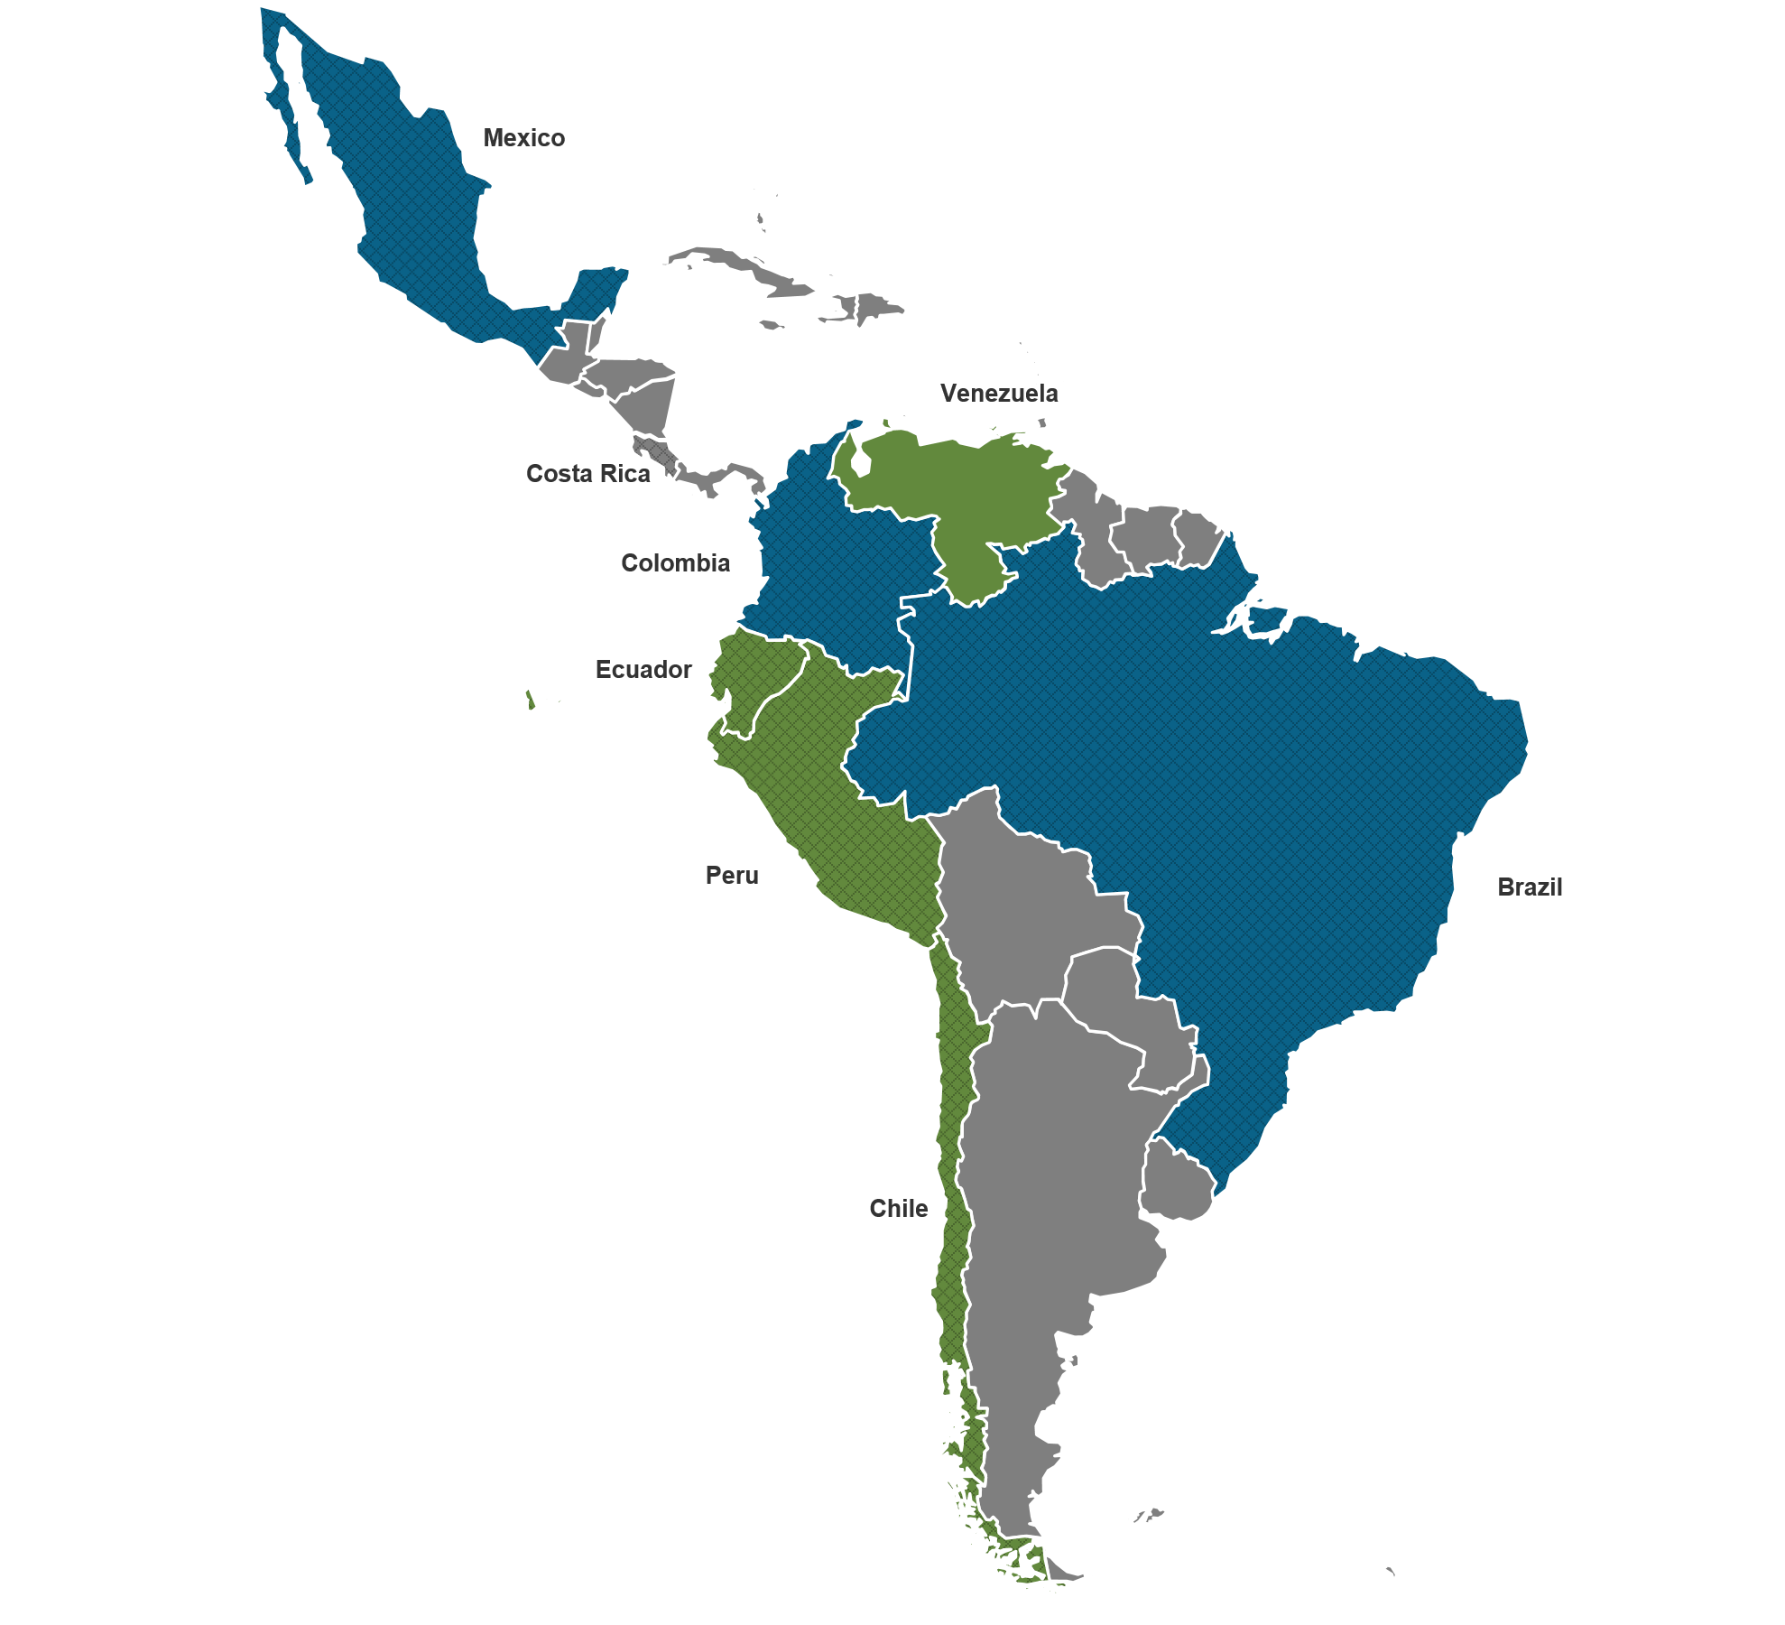
Belmont’s network in LATAM allows us to cover more than 80% of the eMaterials market
Belmont Facilities
Mexico
Colombia
Brazil
Belmont Partner Network
Chile
Ecuador
Peru
Venezuela

Slide 13
Case Study: Latin American Mobile Device Trade-In Program
Client
Leading LATAM mobile network operator Diversified service portfolio includes mobile phones, cable TV, broadband, mobile payments Operates online eCommerce site and a network of retail stores
Client Situation
Sought partner to run online and in-store mobile device trade-in program and provide: Maximum recovery value by selling phones in optimal markets (domestic or international) Maximum velocity of cash conversion Minimum environmental impact Compliance with strict Colombian regulations
Integrated Solution
Belmont partnered with client and in-store processor to develop end-to-end trade-in program Belmont manages all out-of-store logistics, leveraging Colombia facility for device collection & processing, Dubai and Hong Kong facilities for international remarketing, U.S. facility for recycling devices that can’t be remarketed
Business Value Delivered
Turn-key solution for mobile carrier Client’s end customers who trade in consume significantly more services and data than non-participating customers

Slide 14
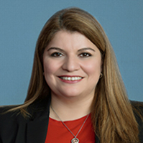
Thank You!
Consuelo Velarde de Tremmel
Business Development Manager of Latin America
consuelov@belmont-trading.com
Belmont Trading Co., Inc.
ISO 9001, ISO 14001, OHSAS 18001, Responsible Recycling© (R2)
900 Corporate Grove Drive, Buffalo Grove, Illinois 60089 USA
www.belmont-trading.com
http://www.belmont-trading.com/mx.aspx
http://www.belmont-trading.com/co.aspx
http://www.belmont-trading.com/br.aspx
@BelmontTrading
@BelmontEspanol
@BelmontColombia
https://www.linkedin.com/company/belmont-trading
https://www.youtube.com/user/BelmontTrading

