Slide 1
Turning Concepts into Action: 5G Preparation and the Carrier Eco-System
May 11, 2016
Antonio Amendola
Executive Director International External Affairs
AT&T
antonio.amendola@intl.att.com
@antonioamendola

Slide 2
Agenda
Looking Back at 2015
State of 5G
AT&T Trial Update
© 2016 AT&T Intellectual Property. All rights reserved. AT&T, Globe logo, Mobilizing Your World and other marks are trademarks and service marks of AT&T Intellectual Property and/or AT&T affiliated companies. All other marks contained herein are the property of their respective owners. The information contained herein is not an offer, commitment, representation or warranty by AT&T and is subject to change.

Slide 3
A Look Back
What do we know now?
Estimated Standards Timeline
Use Case Opportunities
3GPP Phase 1: 2018
3GPP Phase 2: end of 2019
Expected widespread industry deployments: Phase 2 and beyond
Enhanced mobile broadband
Throughput of 5 Gbps +
Massive IoT
Connection Density
Long battery life
High reliability / low latency
Industrial control
Remote manipulation

Slide 4
5G Estimated Timeline
2016 | 2017 | 2018 | 2019 | 2020 | 2021 | 2022
Standards
Phase 1: eMBB
Phase 2
Commercial mobile network launch
S. Korea Winter Olympics
Pre-standard
Enhanced mobile
Full standard

Slide 5
Path to 5G
Pre-Deployment
5G Industry Expectations
LTE-Advanced Evolution (R13&14)
FD-MIMO
Improved densification management
Dual connectivity
Improved latency
Higher order modulation
Virtualization
Narrowband LTE
Designed for low-power devices, with 10-year battery life
Standards this summer; deployment late 2017 / early 2018
So much more than speed
Multi-gigabit speeds and high capacity
Connectionless Massive IoT
Ultra-Low Latency and high reliability
Sub 6 GHz for wide area coverage with improved spectral efficiency
Flexible, lean carrier design
Multi-RAT network using sub 6 GHz, mmWave and unlicensed bands in concert
Massive MIMO
Densification with self-backhaul
SDN/NFV based architecture

Slide 6
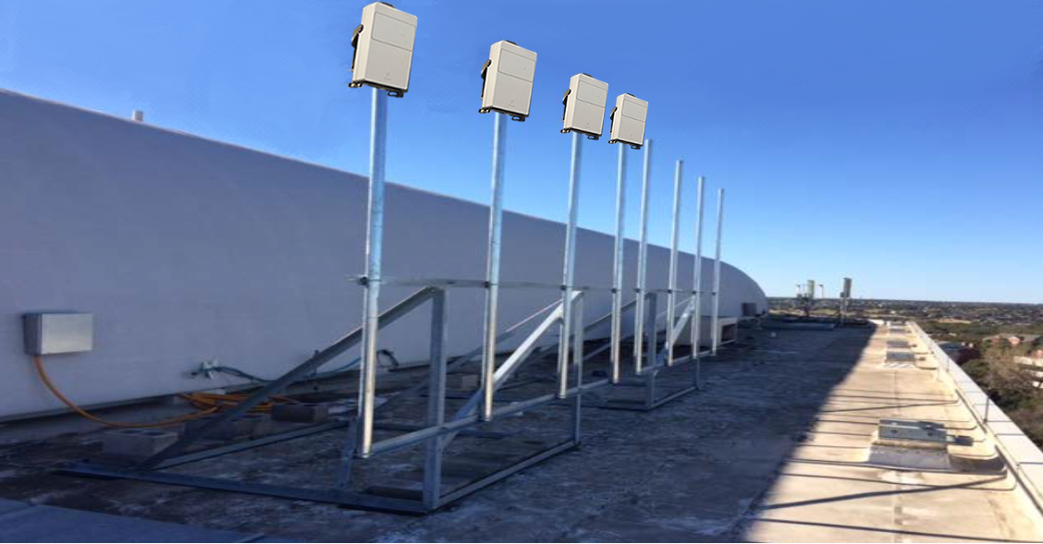
AT&T’s 5G Trials
Extension of current Lab testing
2Q16 kick-off – Austin, TX
Fixed broadband solution – between 15-28 GHz
Outdoor tests this summer
Wireless connectivity to fixed locations by EOY
Mobility testing
cmWave and mmWave spectrum
Enhanced mobile broadband –
Multi-Gbps + and low latency
Coverage/channel characteristics at new frequencies
© 2016 AT&T Intellectual Property. All rights reserved. AT&T, Globe logo, Mobilizing Your World and other marks are trademarks and service marks of AT&T Intellectual Property and/or AT&T affiliated companies. All other marks contained herein are the property of their respective owners. The information contained herein is not an offer, commitment, representation or warranty by AT&T and is subject to change.

Slide 7
Next Steps
Trials and Testing
Standardization
Key Architecture Components:
NFV / SDN
Big Data / Analytics
Architecture Considerations:
X-RAN
Transport
Core Network Development
© 2016 AT&T Intellectual Property. All rights reserved. AT&T, Globe logo, Mobilizing Your World and other marks are trademarks and service marks of AT&T Intellectual Property and/or AT&T affiliated companies. All other marks contained herein are the property of their respective owners. The information contained herein is not an offer, commitment, representation or warranty by AT&T and is subject to change.

