Slide 1
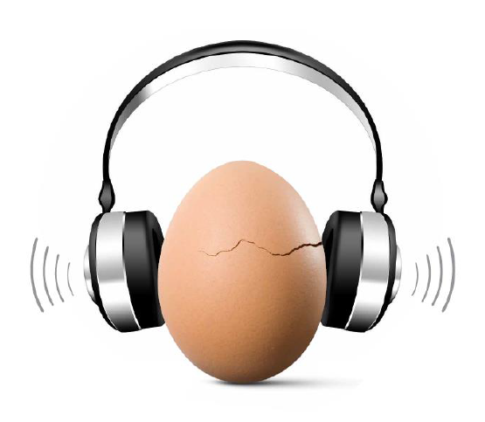
Make Listening SafeTM Initiative
World Health Organization and
International Telecommunications Union
Brian Fligor, ScD, PASC brian.fligor@gmail.com
Shelly Chadha, MD, MPH chadhas@who.int
Notes:
Script: Introduce the contributors to the presentation (name and affiliation)

Slide 2
WHO-ITU Stakeholders' Consultation for Safe Listening Devices
Held on 1 October 2015
Participants:
  Academia
  Industry
  Standardization agencies (IEC, CENELEC)
  Professional organizations
  NGOs
  Governments

Slide 3
Outcomes
Established the need of standards for safe listening devices
Shared views and experiences
Explored emerging technologies for safe listening.
Gained an understanding of the importance of behaviour modification as part of the initiative

Slide 4
WHO-ITU Expert Consultation for Safe Listening Devices
Held on 2 October 2015
Participants:
  Invited experts
  Standardization agencies (IEC, CENELEC)
  Audio Engineering Society
  WHO, ITU

Slide 5
Outcomes
Agreed on the overall leadership of WHO and ITU in the process.
Gained an understanding of the standardization process, including the need for coordination with other standardization agencies.
Identified key areas of focus regarding standards for safe listening devices.
Established the need to focus on behaviour modification, in parallel with development of technical standards.

Slide 6
Considerations for ITU Standards
WHO working group on Safe Listening Devices’ standards
Role of WHO and this working group is to ensure that the standards developed are in line with WHO’s vision and objectives (users can enjoy listening while keeping hearing safe). The working group is a group of experts who will advise and guide WHO on what are the most appropriate measures for safe listening and to review the technical information available.
Members: Shelly Chadha, Brian Fligor, Christian Giguère, Christian Huggonet, Chuck Kardous, Michael Santucci, Warwick Williams

Slide 7
Considerations for ITU Standards
WHO working group on Safe Listening Devices’ standards
Need to involve all stakeholders in this effort (standardization organizations, professionals and industry)
Standards under development require discussion on methods which maintain the quality of music and provide the user with information and option to exercise control.
Standards should focus on:
  Dosimetry: integration of sound level over time
  Volume limitation: only under specific need
  Health communication messaging on user interface, packaging, manual
  Parental notification and/or controls

Slide 8
Dosimetry: Not just the level, it’s the “level over time”
Sound-induced auditory injury follows dose-effect relationship
Sound “overdose” results in metabolic overload, leading to apoptosis of structures in cochlea and primary auditory nerve fibers
Well established damage risk criteria in workplace noise exposure studies
  85 dBA for 8-hour daily exposure, 40-hr weekly exposure over working lifetime (8% at risk for “Material Hearing Impairment”)
  90 dBA for 8-hour daily exposure, 40-hr weekly exposure over working lifetime (25% at risk for “Material Hearing Impairment”)
  Single-number level limiting ignores well-established science

Slide 9
Level alone matters when risk for acoustic trauma*
* defined as a single exposure resulting in immediate injury to auditory system
Generally, threshold level for acoustic trauma accepted as 140 dB SPL (peak)
Literature suggests in highly susceptible individuals, this threshold might be as low as 132 dB SPL (peak) (Price, 1981)

Slide 10
Considerations for ITU Standards
WHO working group on Safe Listening Devices’ standards
There may be a need to provide stricter norms for children, as compared to adults
  Child specific directions/controls could be included (Damage Risk Criteria based on 40-year exposure).
Assumes 40-years of exposure (“working lifetime”) – long enough?
What is an acceptable degree of hearing loss/hearing loss risk?
Tinnitus? Hyperacusis? Diplacusis?

Slide 11
Considerations for ITU Standards
WHO working group on Safe Listening Devices’ standards
WHO is initiating a review of current norms and limits and as a first step will explore whether these are suitable or need revision, based on existing research. Based on the outcomes of this, a plan will be developed to establish the most appropriate criteria.
Standards under development currently will be based on current knowledge. These will have the possibility of revision should the risk criteria change in future.

Slide 12

Considerations for ITU Standards
WHO working group on Safe Listening Devices’ standards
Other than the music player itself need to focus on the ear/headphones and introduce ambient sound exclusion (e.g., passive sound isolation, active noise reduction) for consideration as part of the standards.
No Sound Isolation
Passive Sound Isolation
CLL 72dBA
CLL 72dBA, café
CLL 72dBA, café (74 dBA)
CLL 72dBA, airplane
CLL 72dBA, airplane (82 dBA)
CLL 72dBA, lawnmower
CLL 72dBA, lawnmower (90 dBA)
CLL 87 dBA, café (+13dB SNR)
CLL 92 dBA, airplane (+10dB SNR)
One can extrapolate the risk for hearing loss
CLL 97 dBA, lawnmower (+7dB SNR)

Slide 13
Summary: a “wishlist” for a PLD
Partnership between manufacturers, health promoters, and end users
PLD provides tools for users to inform them of listening behaviour and potential risk over time
  Focus on dosimetry
  Level limiting against acoustic trauma, preserves music fidelity
Ambient noise control (active noise reduction, passive sound isolation, or both)
User interface that provides accessible interpretation to users and/or parents
Controls for parents, options for users

Slide 14
All of the following are supporting materials: these slides are for explanatory purposes only

Slide 15
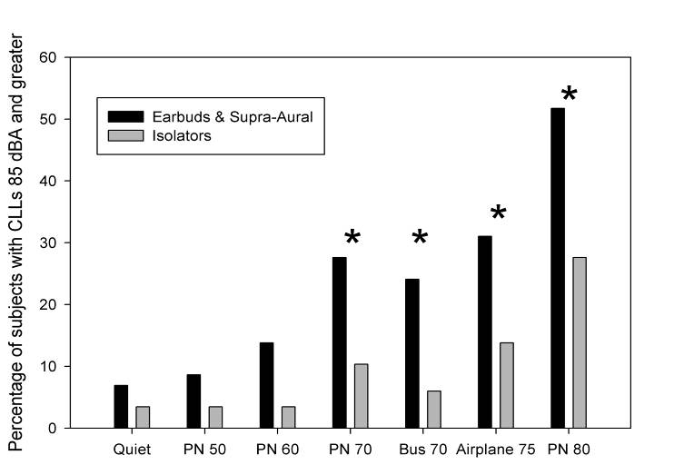
Headphone type and Chosen Listening Level
Portnuff, Fligor & Arehart (2011)
Notes:
15
15

Slide 16
Influence of Ambient Noise on Listening Level
Free-field Equivalent CLL in dBA
Estimated Ambient Noise Level in the Ear Canal in dBA
Fligor and Ives: NIHL Prevention in Children, Oct 2006, Cincinnati, OH, USA

Slide 17
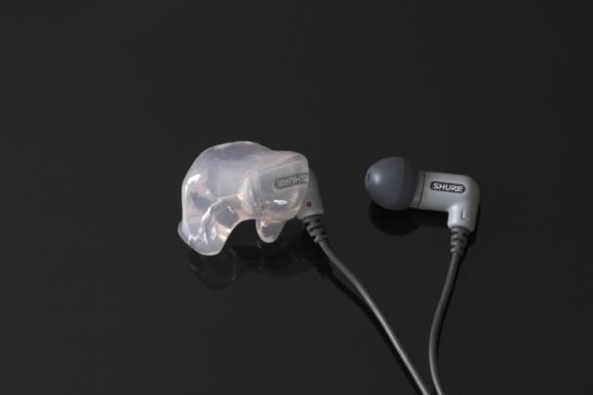
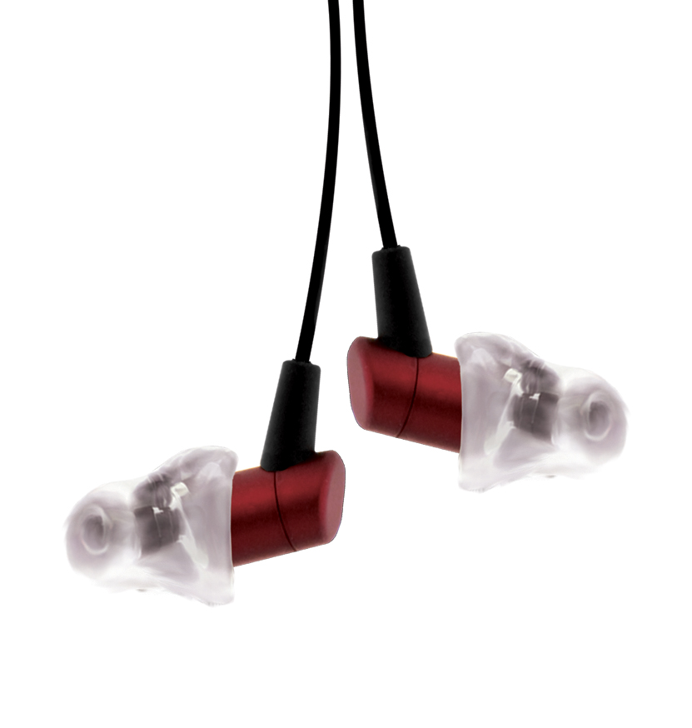
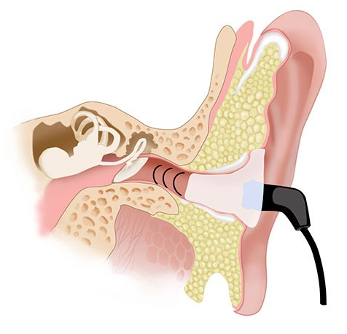
Acceptable HLPP strategy with PLD?
Passive sound isolation: custom vs. non-custom
Images used with copyright holders’ permission
Notes:
17

Slide 18
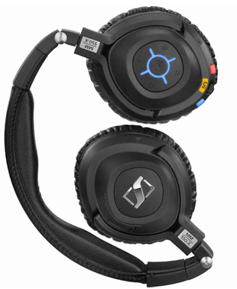
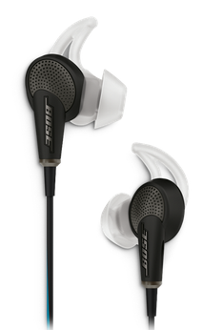
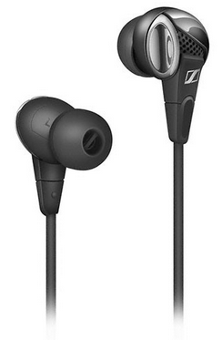
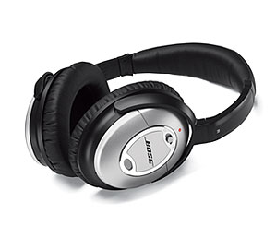
Acceptable HLPP strategy with PLD?
Active Noise Reduction and/or Passive Isolation
Notes:
18

Slide 19
Influence of ambient noise on chosen listening level
Earphones providing no sound isolation vs. earphones that provide active noise reduction to block ambient noise
No Sound Isolation
Active Noise Reduction
CLL 72dBA
CLL 72dBA, café (74 dBA)
CLL 72dBA, café
CLL 72dBA, airplane (82 dBA)
CLL 72dBA, airplane
CLL 72dBA, lawnmower (90 dBA)
CLL 72dBA, lawnmower
CLL 87 dBA, café (+13dB SNR)
CLL 92 dBA, airplane (+10dB SNR)
One can extrapolate the risk for hearing loss
CLL 99 dBA, lawnmower (+7dB SNR)
Notes:
19

