Slide 1

Rethinking Spam
ITU Workshop on
“Countering and Combating Spam”
The Evolution of A Threat Vector
Myla V. Pilao
Director of Core Technology Marketing
Trend Micro, Inc.

Slide 2
Spam at a glance

Slide 3
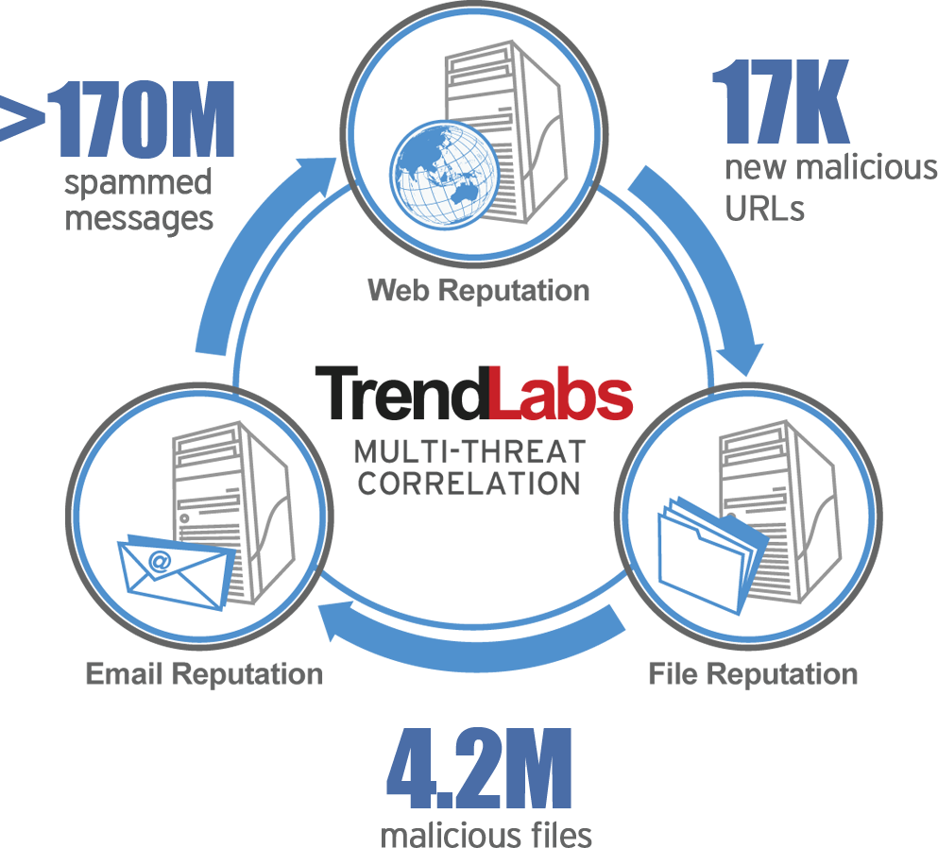
On a typical day, Trend Micro identifies…

Slide 4
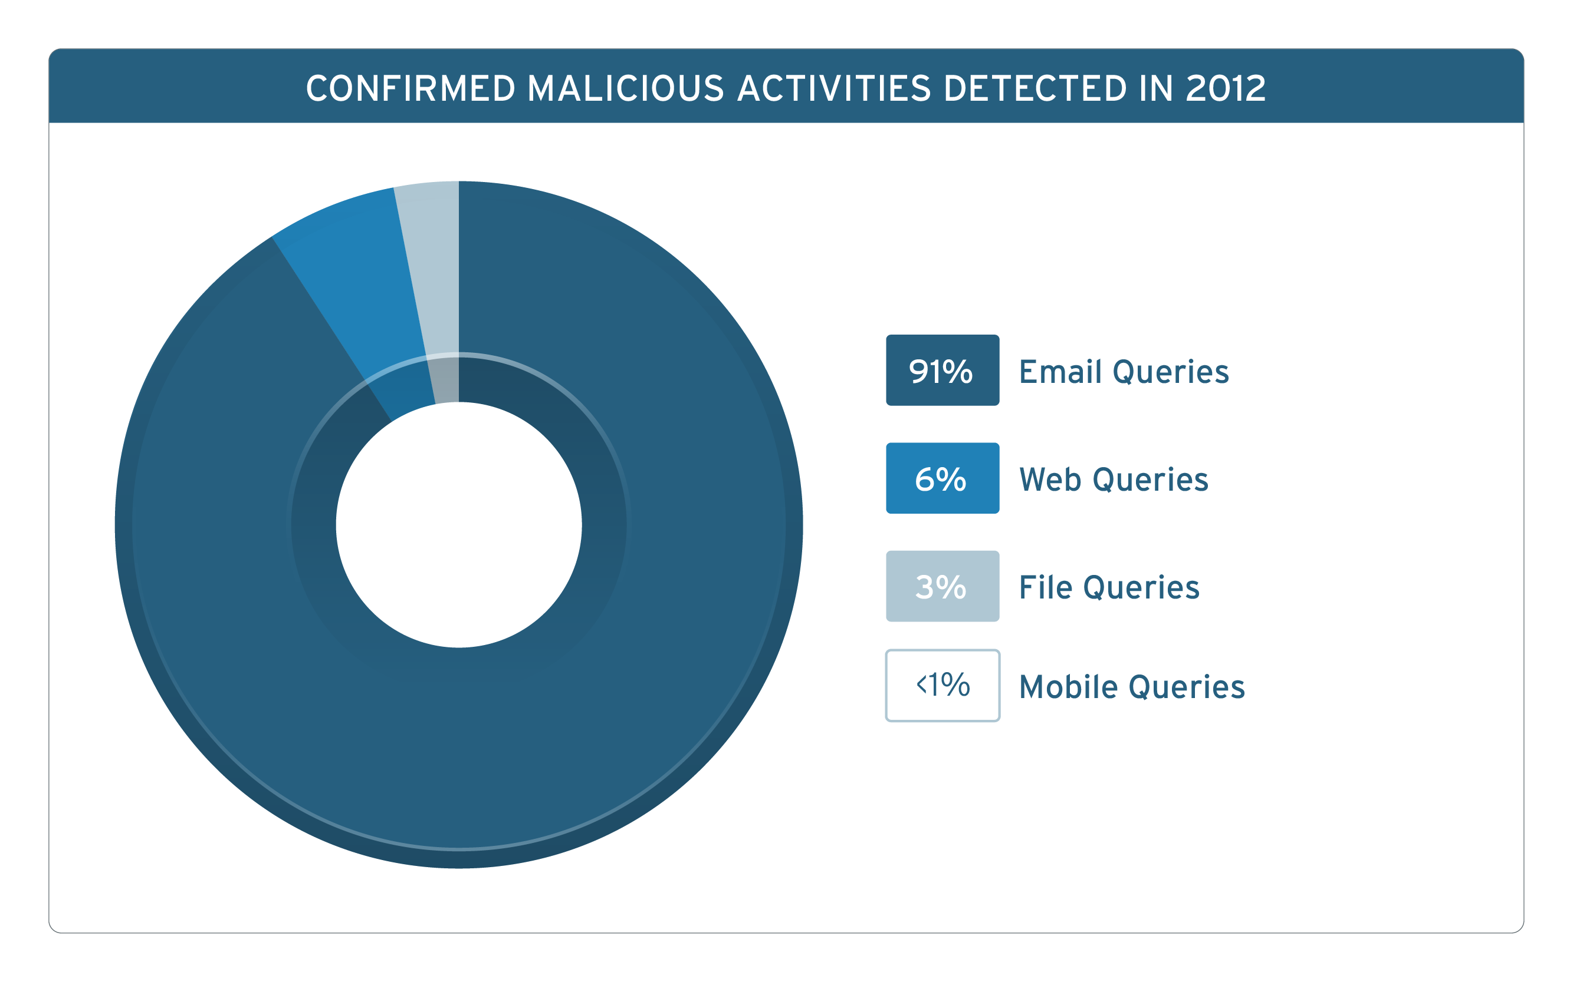
Email -Bulk of malicious activities

Slide 5
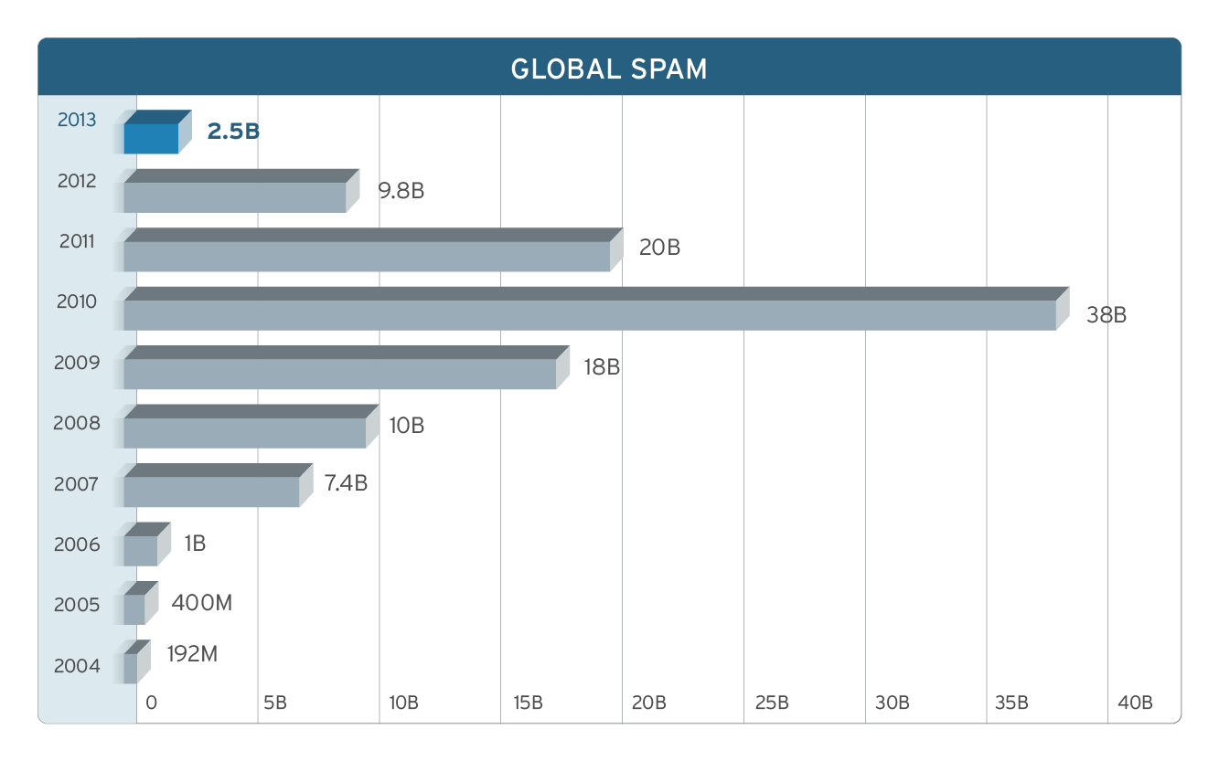
Massive Impact of Botnet Takedown
Notes:
The Rustock botnet was taken down by Microsoft on March 16, 2011.
Other botnet takedowns follow suit, which led to the decline of spam after 2010.
Cybercriminals changed tactics and moved to other forms spam (social media spam for example).
Despite the decline, spam is still the biggest chunk of all the threats that we detect every day.

Slide 6
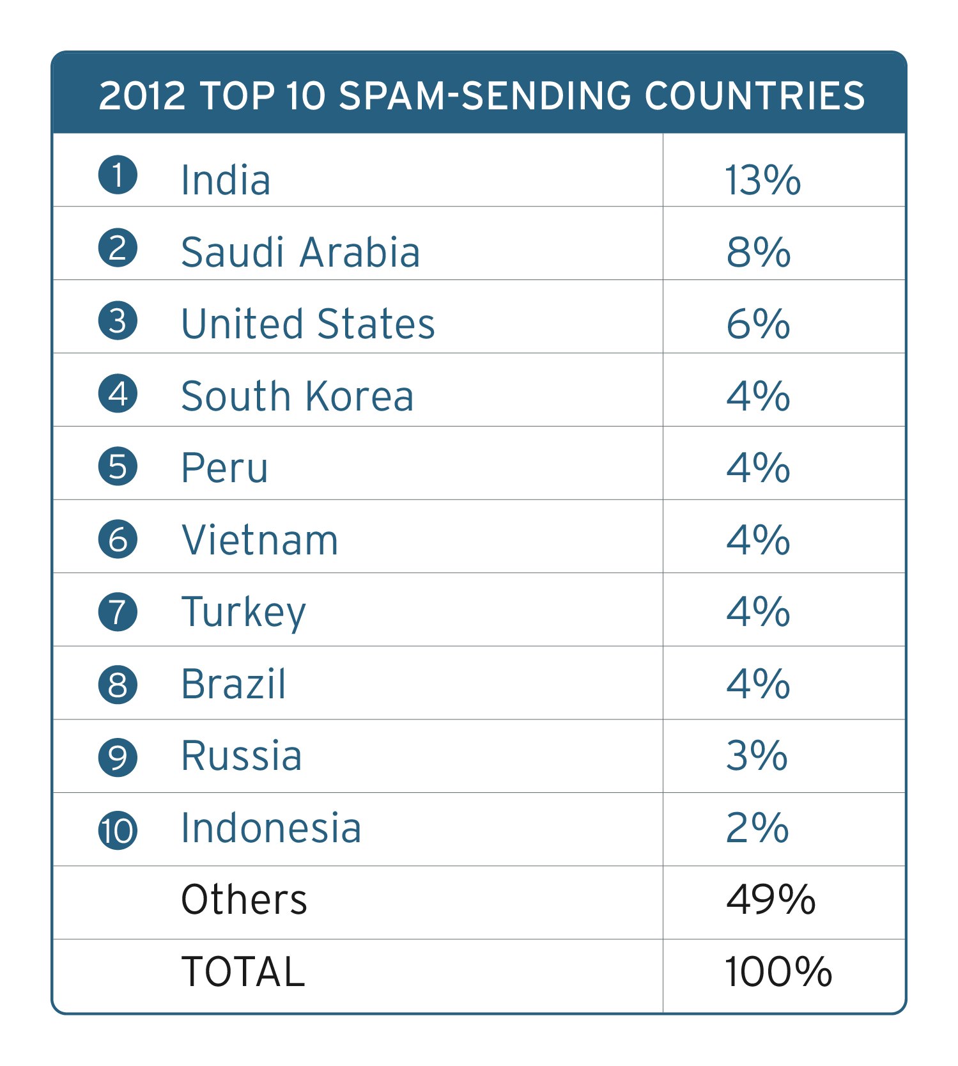
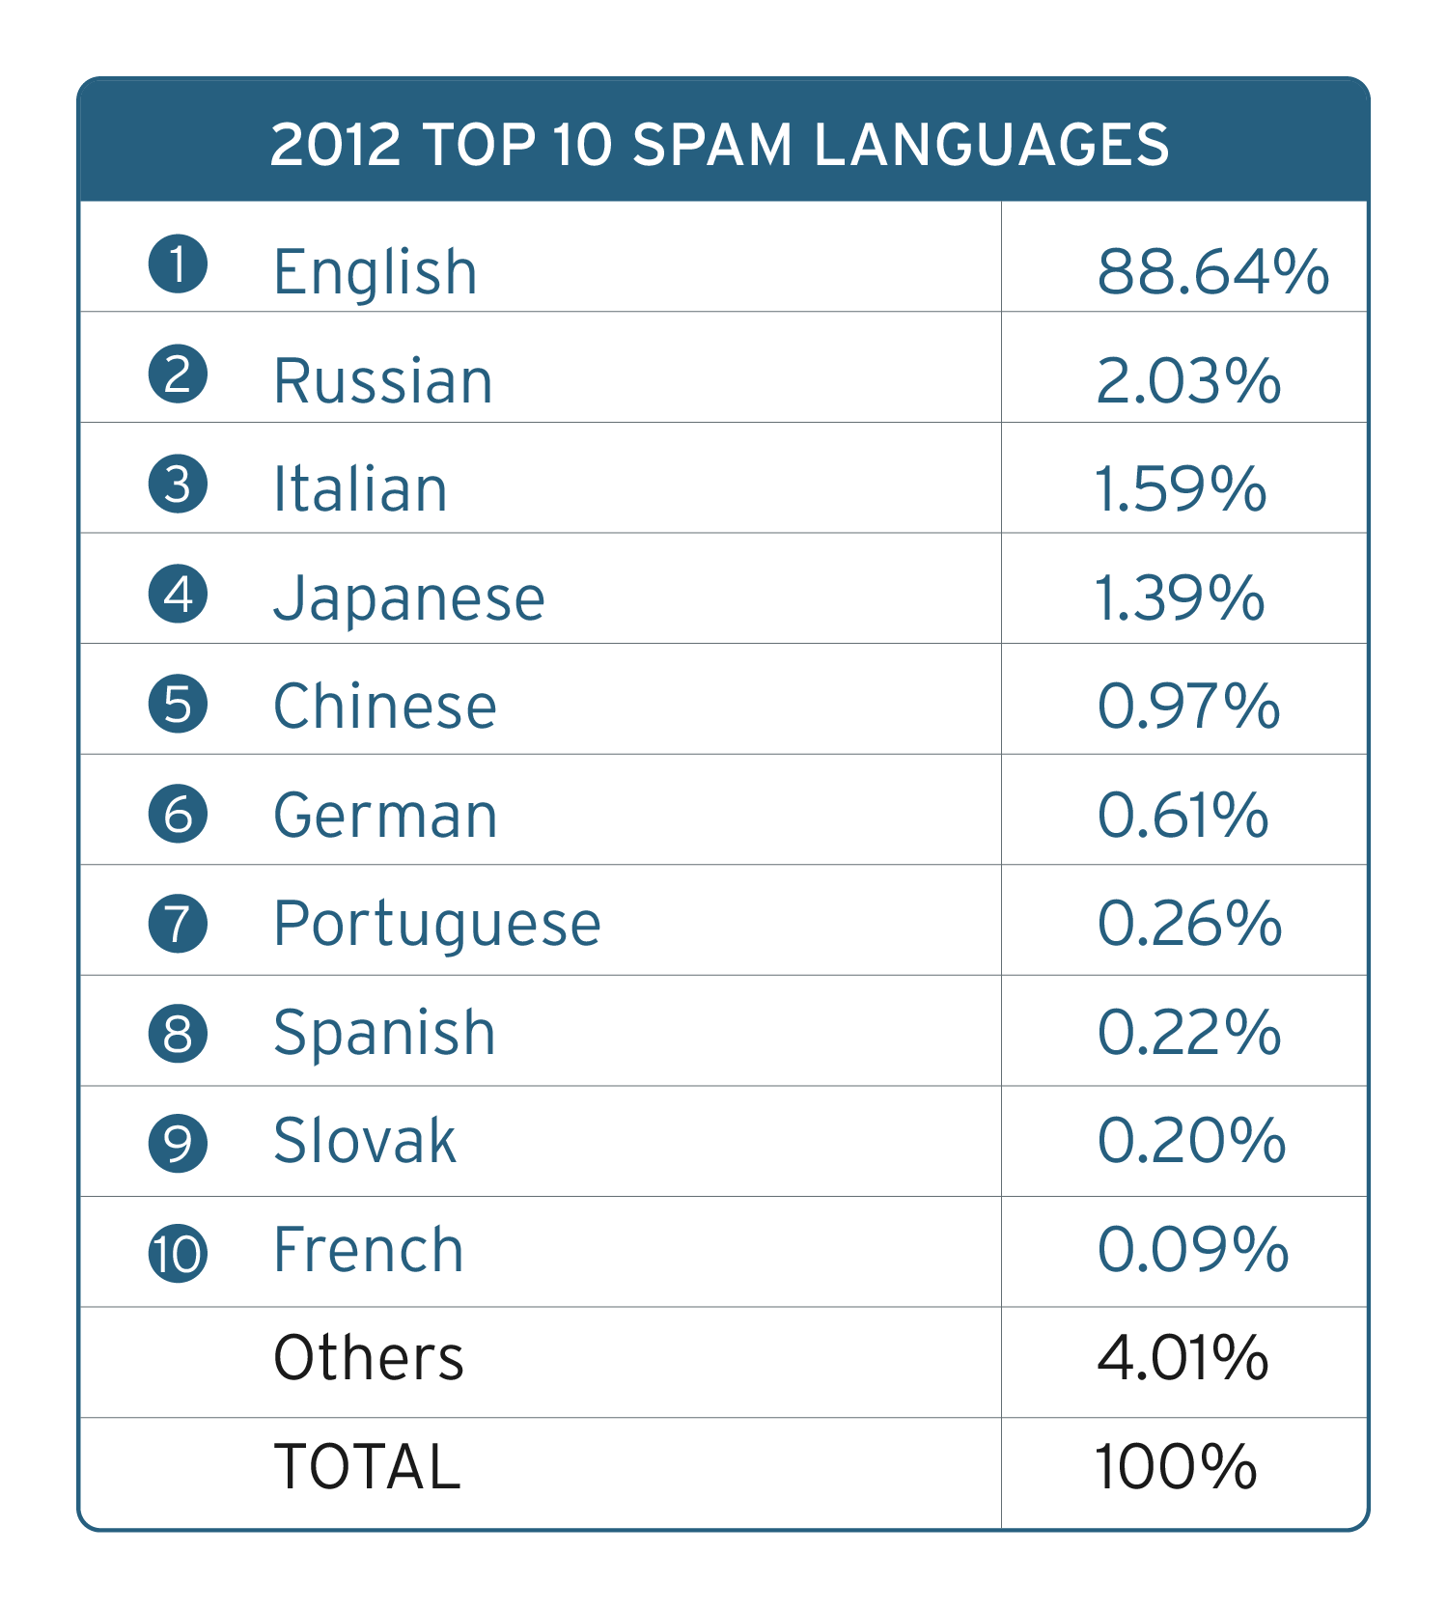
Spam is global
Notes:
After the takedowns in 2011, cybercriminals decided to focus on countries, other than the US.
Cybercriminals may have selected these countries because of technological advancement (South Korea).
One note of interest is the presence of three of the 4 BRIC countries. These countries are often described as having newly advanced economic developments. These developments could also mean technological advancements within the countries, like increase in Internet usage and users, smart devices adoption, etc. But since BRIC countries are still in the development stages, their tech landscapes may be exploited by cybercriminals.

Slide 7
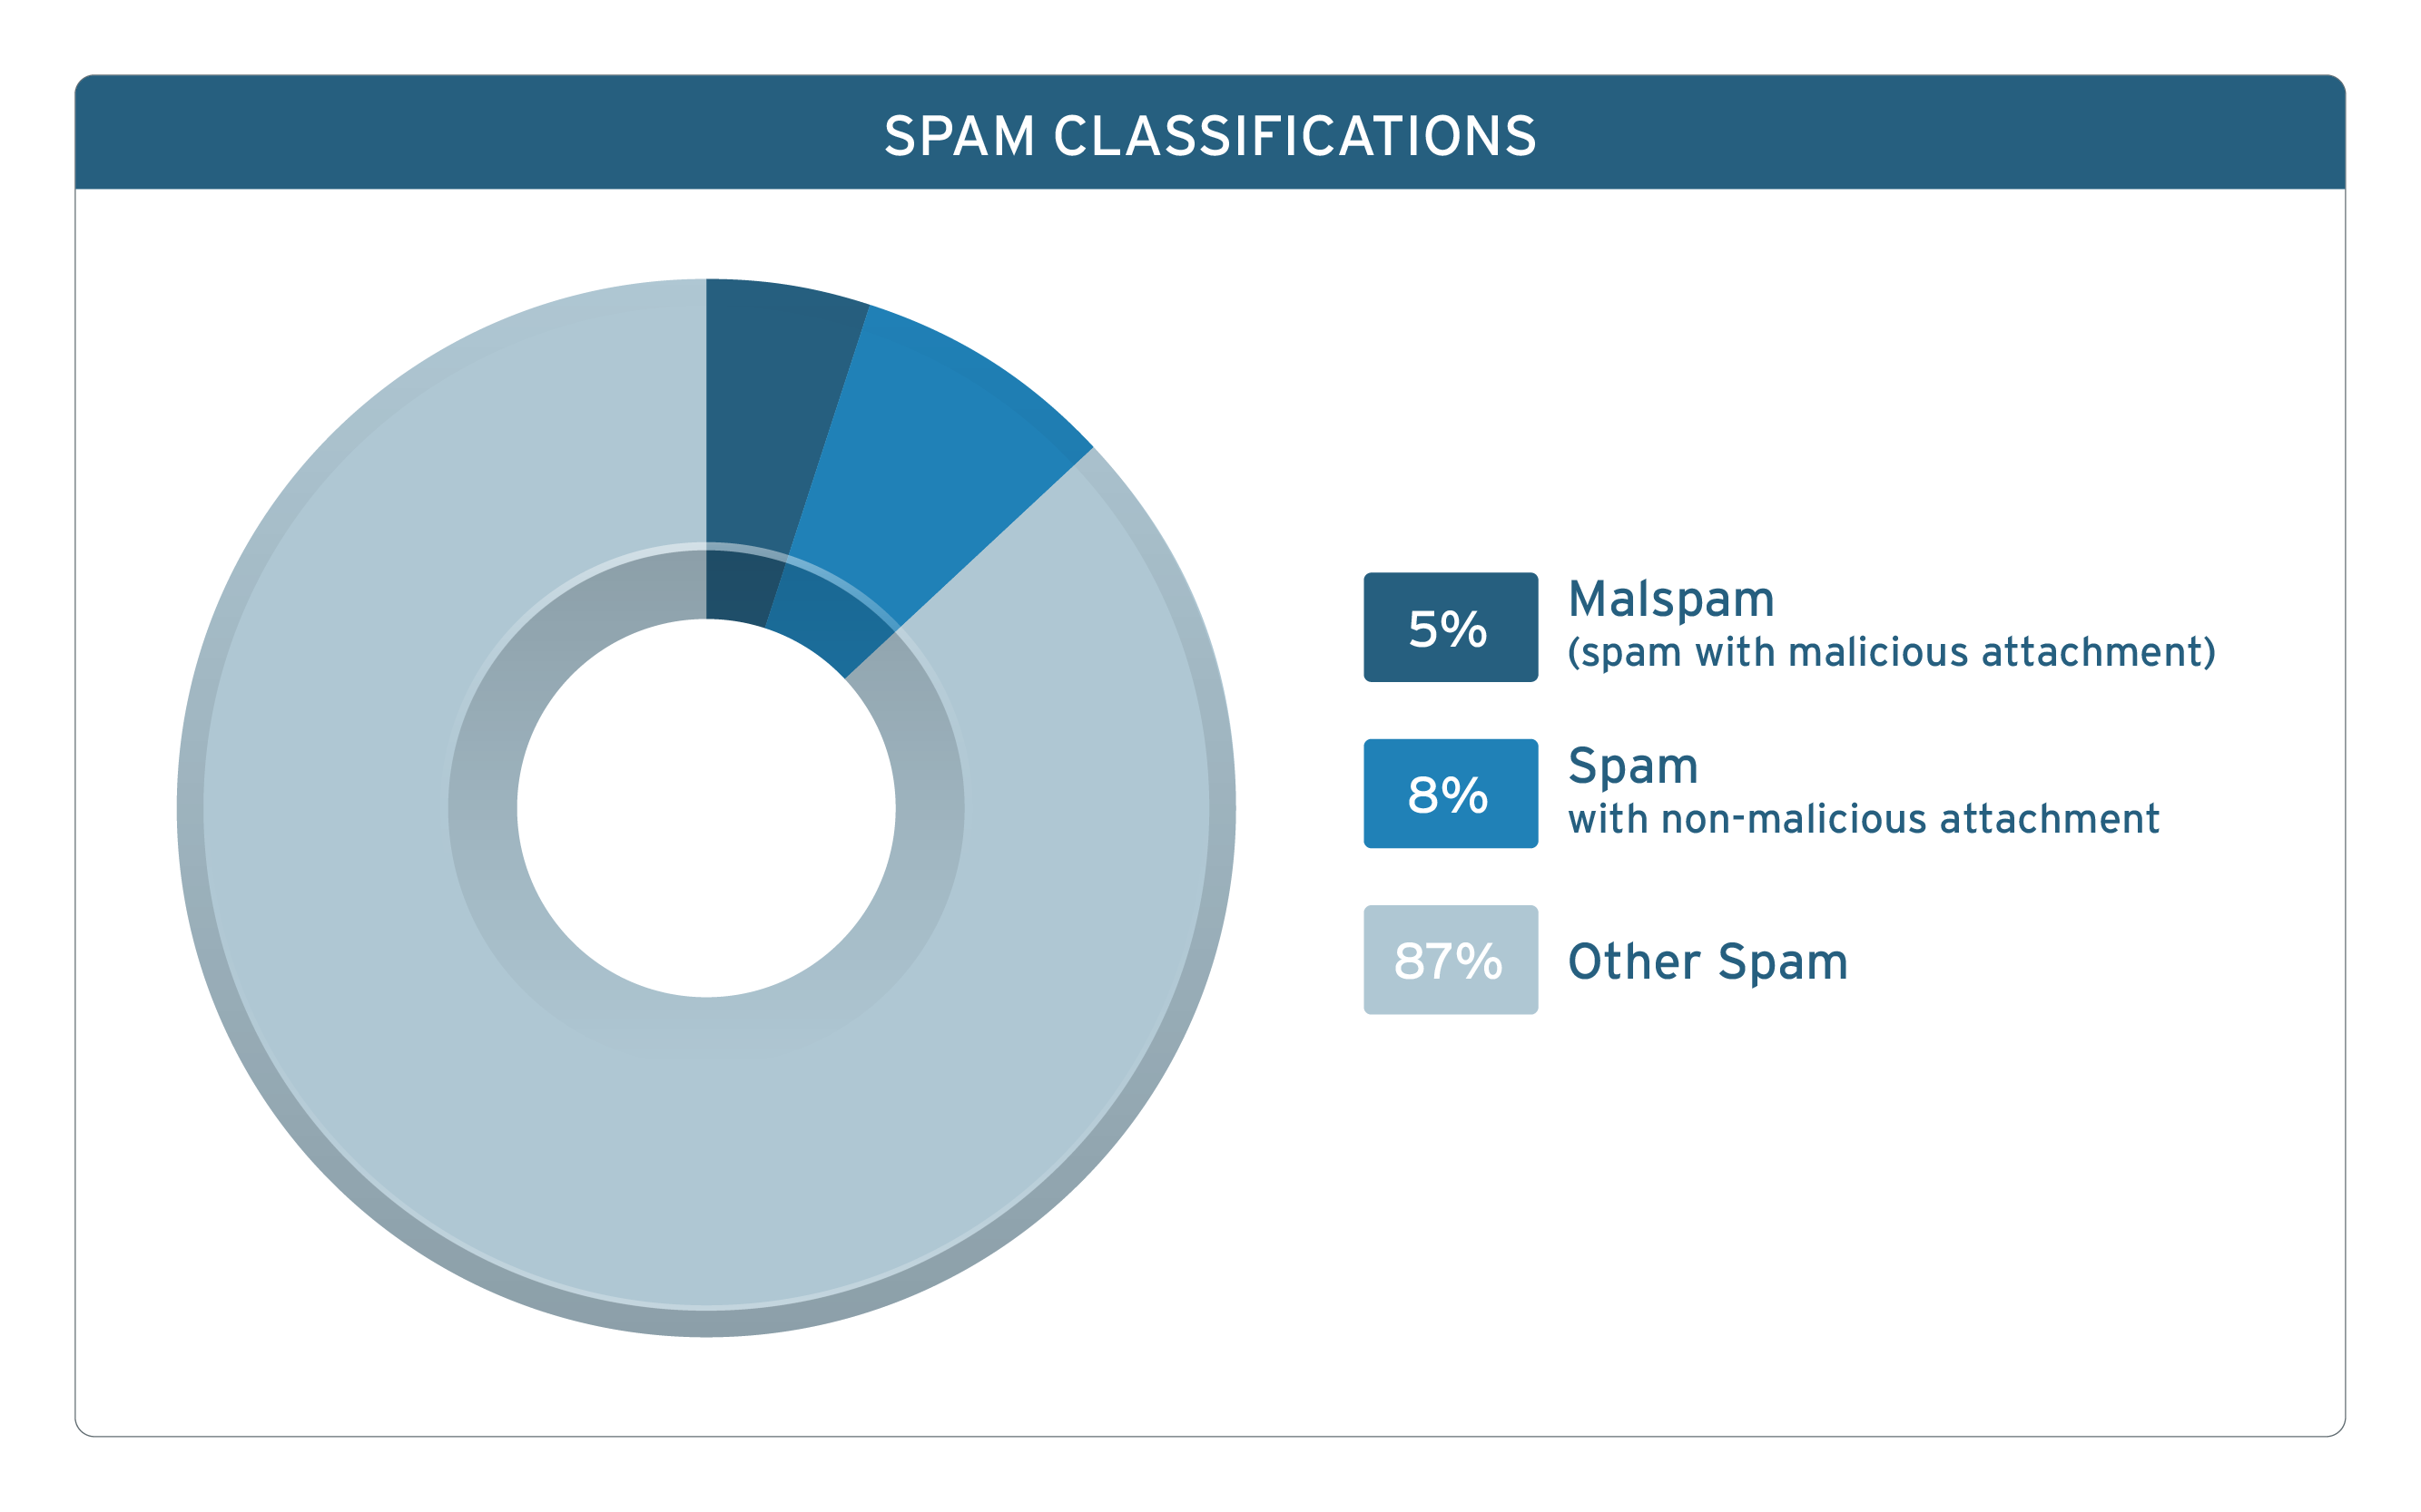
Traditional Method dominates the market

Slide 8
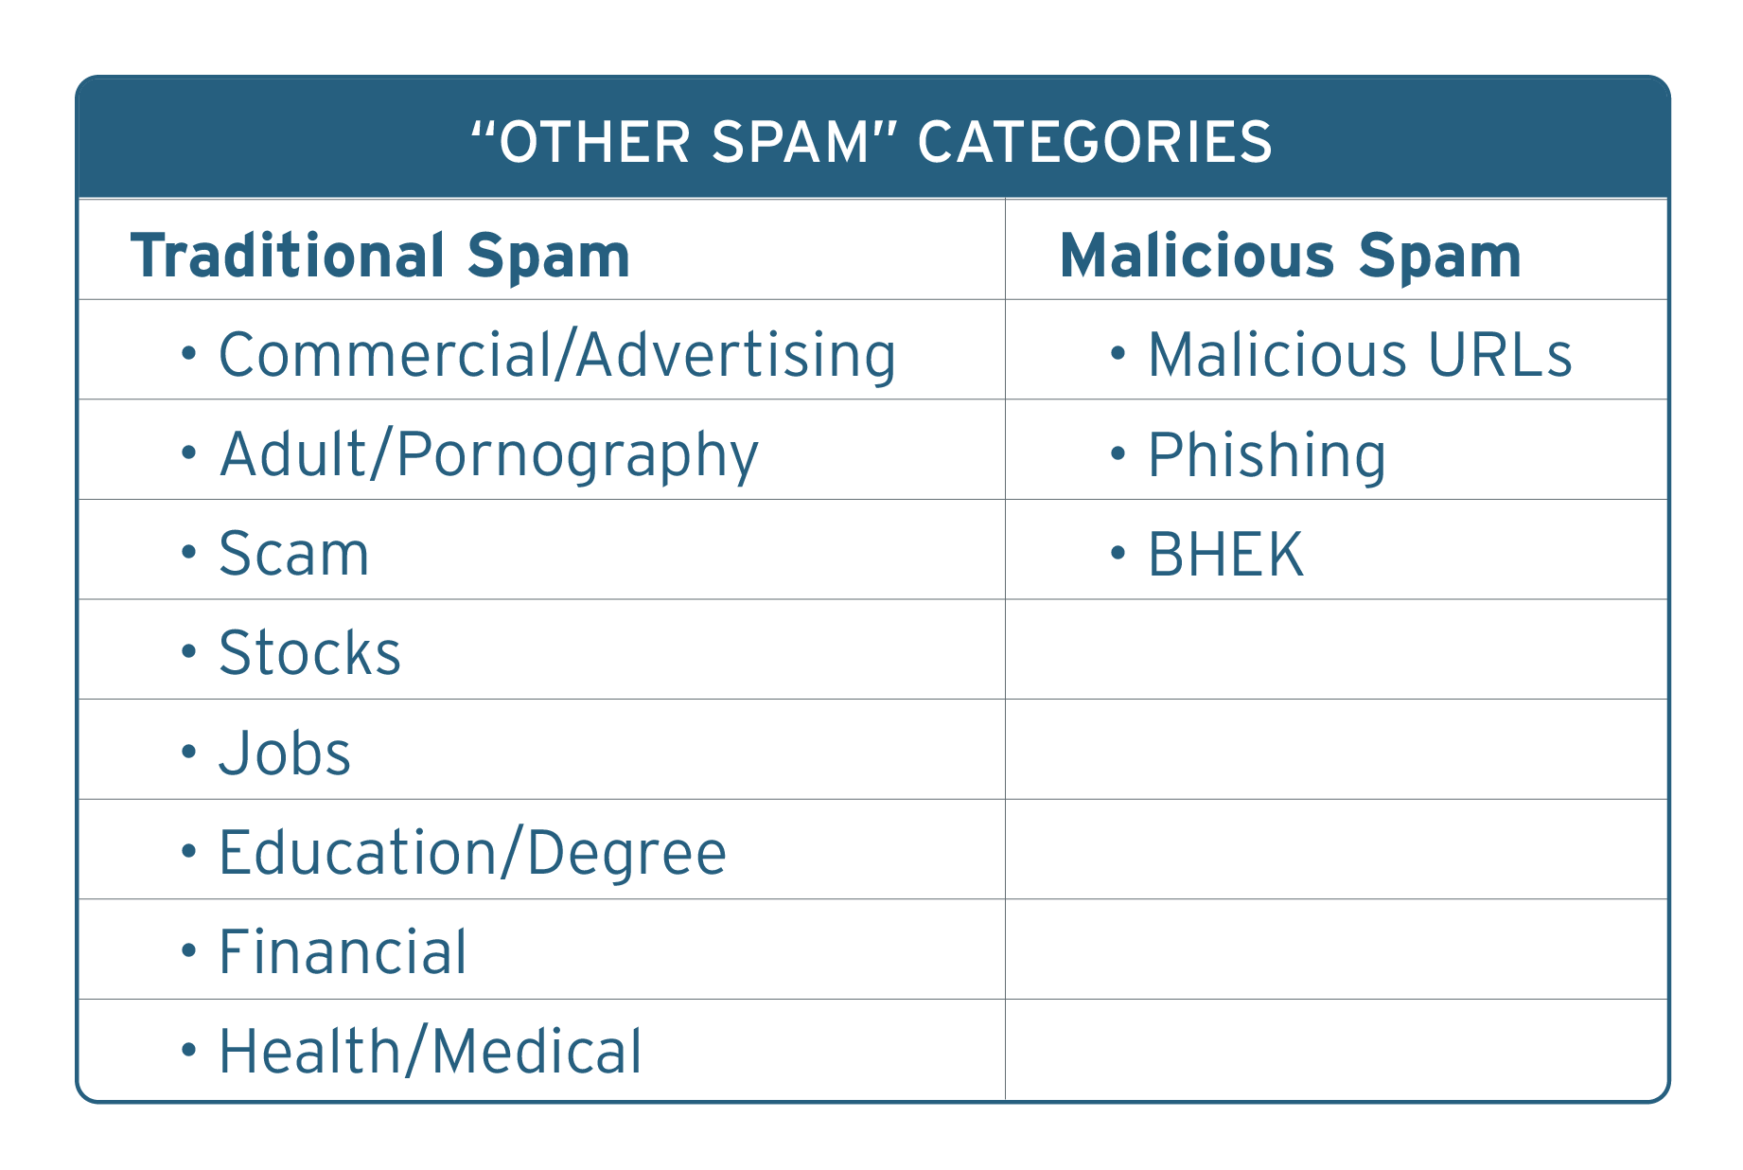

Slide 9
South African Threat Landscape

Slide 10
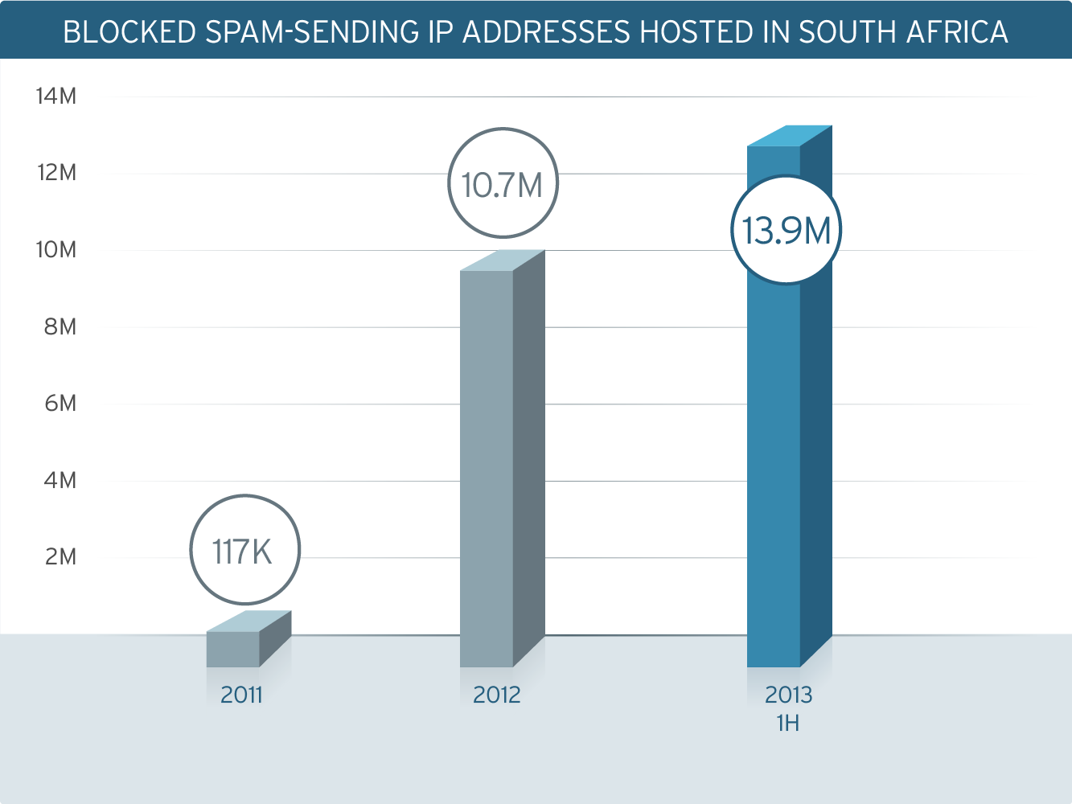
Blocked spam-sending IP
On the rise

Slide 11
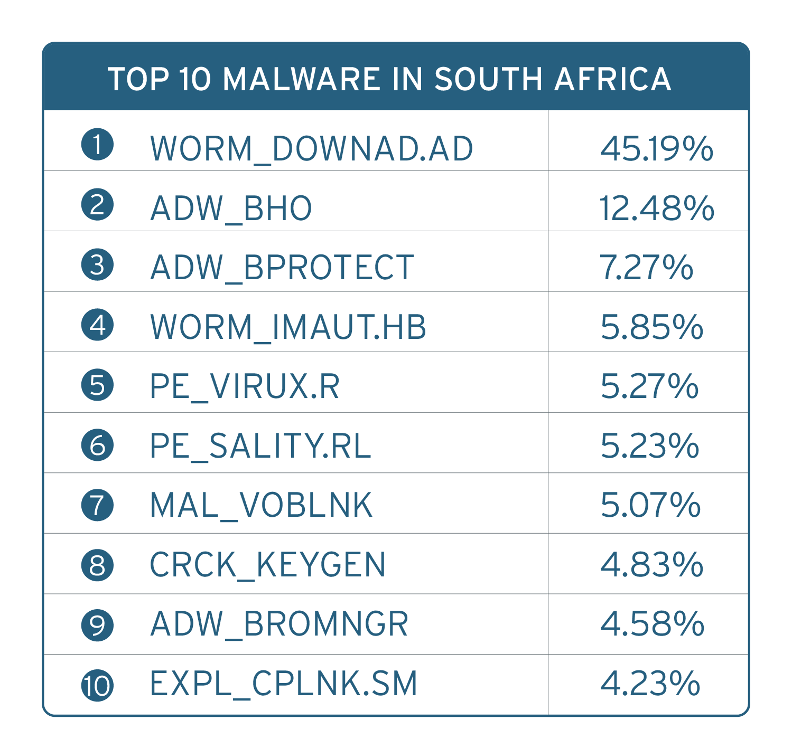
Malware detections reflect the South African landscape
Notes:
The top malware are reflective of the technological landscape
DOWNAD is often associated with legacy systems.
South Africans frequent Internet cafes. One-third reported that they went online at these locations. Unfortunately, there is a correlation between Internet café usage and the presence of file infectors (PE_VIRUX, PE_SALITY).
KEYGEN detections may imply the presence of piracy and pirated software in the country.

Slide 12
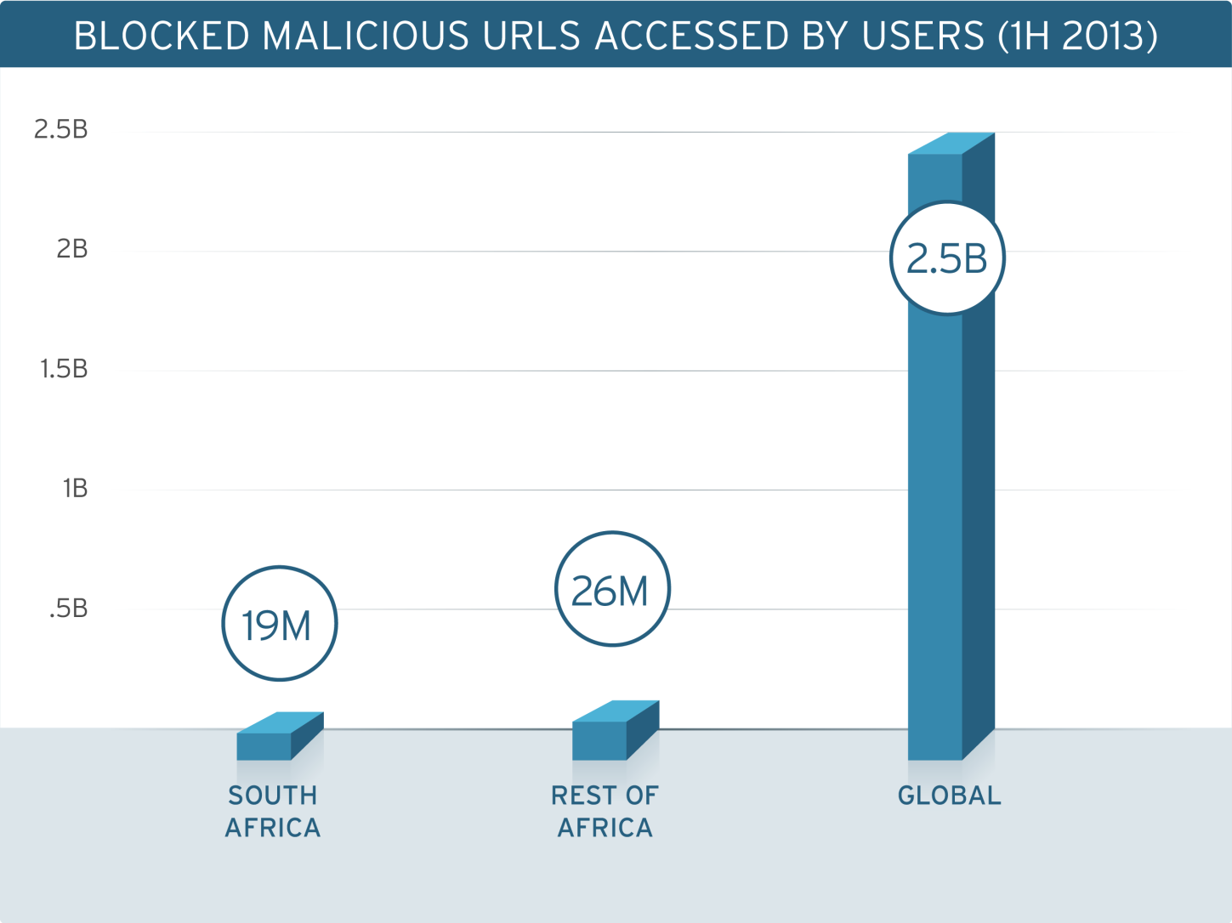
42% of all blocked malicious URLs Organic to South Africa
Notes:
*this is based on user based

Slide 13
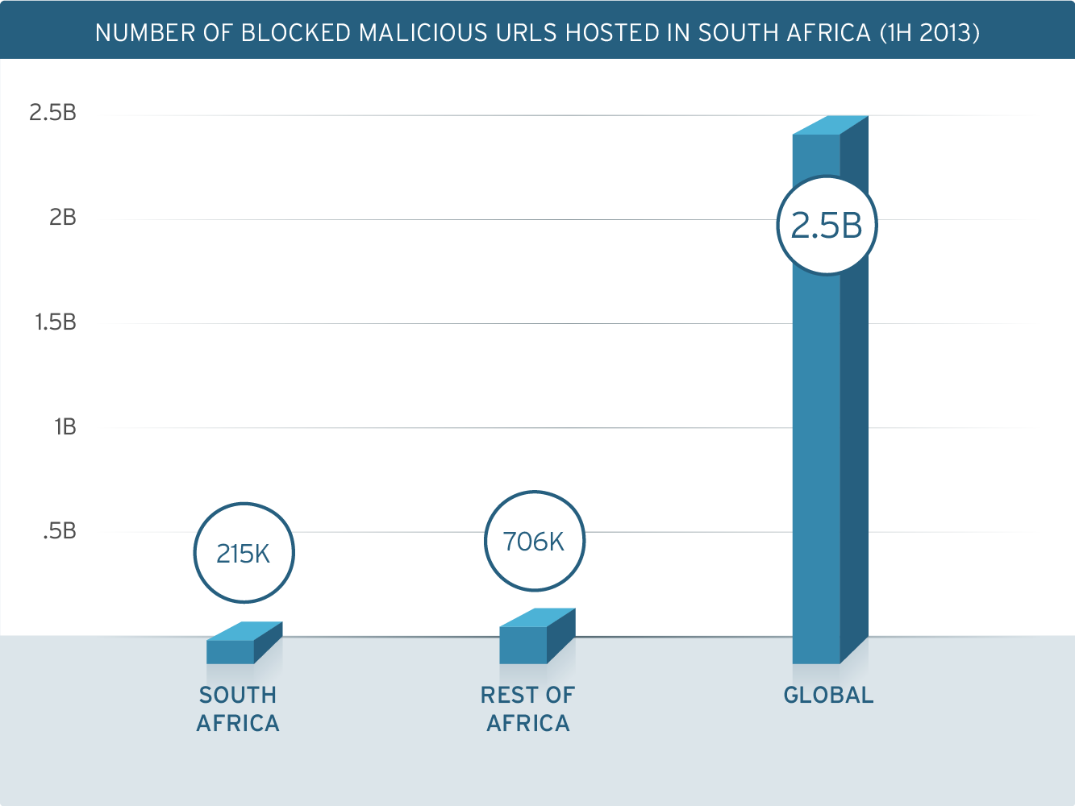
23% blocked malicious URLs hosted in Africa were from South Africa

Slide 14
Techniques & trends

Slide 15
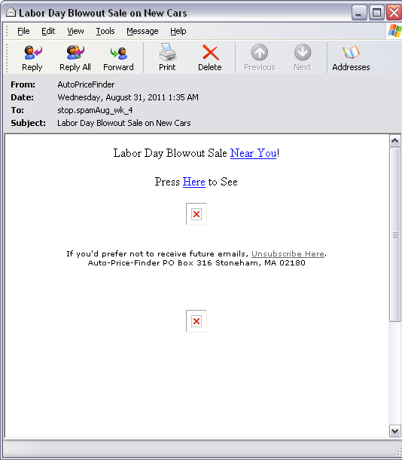
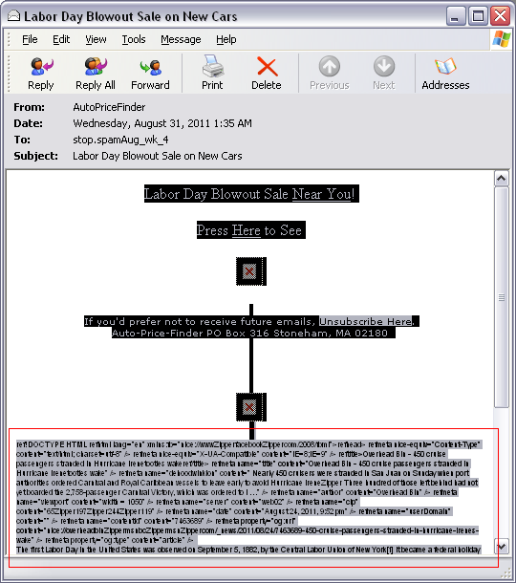
Invisible Ink
Concealment via HTTP formatting
Notes:
This technique uses HTML formatting with white font on white background to conceal words from the reader. This is not limited to using white on white. Some use very similar colors so that you can’t almost see the difference.

Slide 16
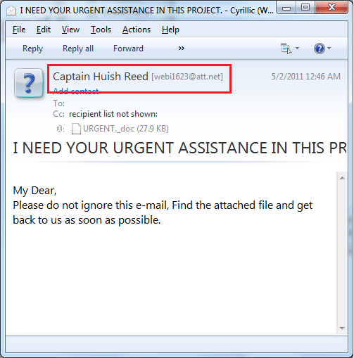
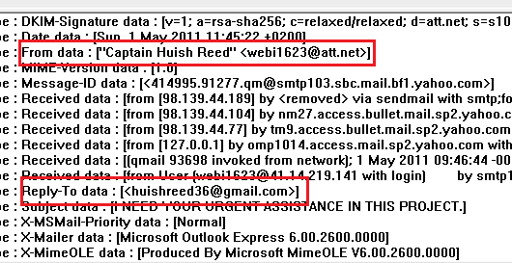
Forged Header Info
Adding fake header info to hide original source
Notes:
This technique needs an open relay mail host to make it possible for the spammer to add fake header information, thus hiding the original source of the spam mail.

Slide 17
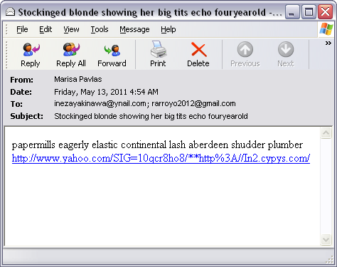
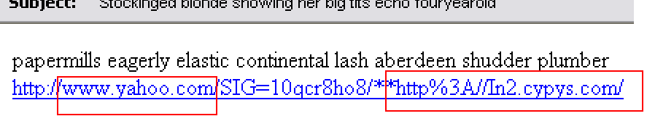
URL REDIRECTION USING POPULAR SITES
Inclusion of popular sites in links
Notes:
This technique masks the real website by putting yahoo.com, google.com, aol.com or msn.com in front of the link.

Slide 18
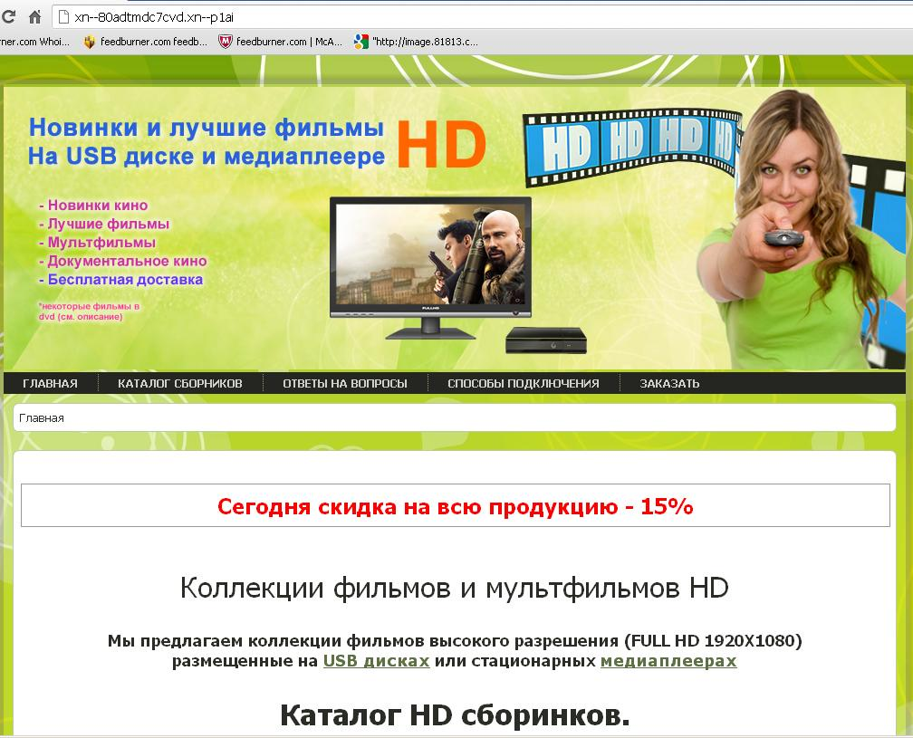
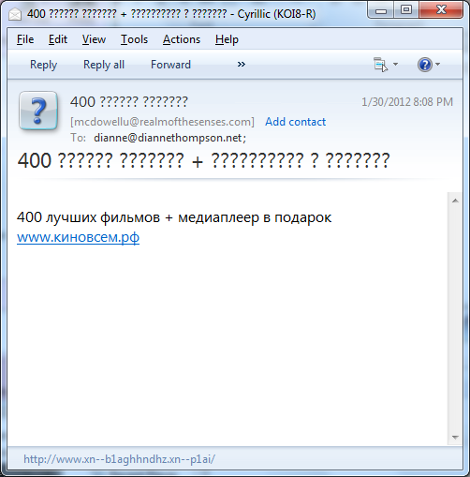
OBFUSCATING URLS (PUNYCODED URLS)
Converting Unicode characters to ACII characters
Notes:
Punycode is defined as an encoding syntax used to convert a sequence of Unicode characters to a form that contains only the basic ASCII-characters allowed in network host names.
For example, in the punycode form “xn--maana-pta.com,” the string
“xn--” and the hyphen “-” are delimeters. Between them, you
have the ASCII-characters of the field “mañana.”
The “pta” part is the Punycode representation of the non-ASCII
character “ñ.” Thus, “xn--maana-pta.com” is decoded
as “mañana.com.”
Because IDN allows non-English characters as domain names, spammers took advantage of this security flaw and began using Punycoded URLs to spread their meds portals and other malicious intent.

Slide 19
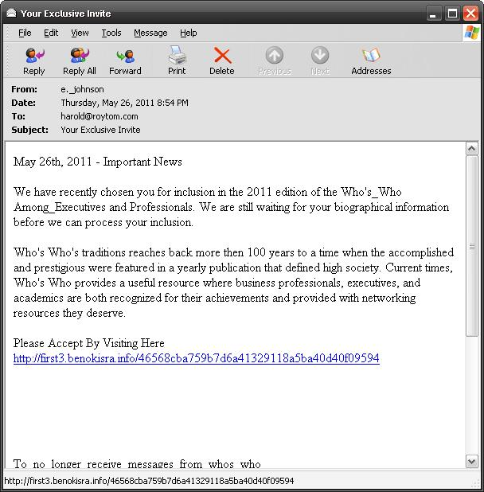
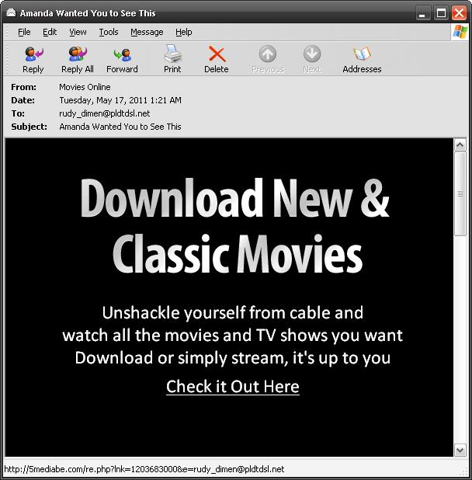
WEB BUGS
Tracking IDs to check active addresses
Notes:
A web bug is an object embedded in a web page or email. It is usually invisible to the user but it can be used to check if a user has viewed the page or email.
This has 2 types, VOLUNTARY and INVOLUNTARY.
Web bugs are usually used either to track/check on users who’ve read the email or viewed the website or to check if an address exists. Spammers leverage to the use of this technique for their spam campaigns.
Voluntary web bugs use URLs containing encrypted tracking IDs to confirm active email addresses.
Involuntary web bugs behave like voluntary web bugs, except that these use images instead of URLs.

Slide 20
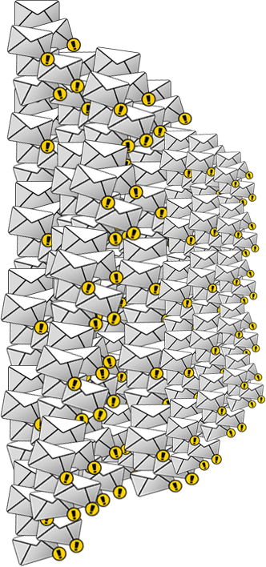
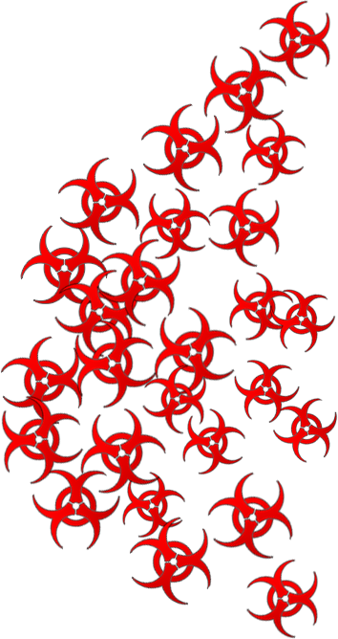
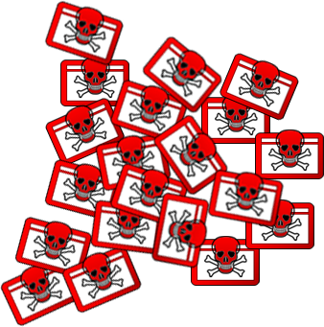

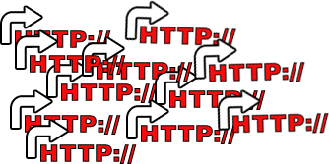

BLACKHOLE EXPLOIT KIT
Redirect URL
Exploit
Compromised
website
Payload
Spam email
Confidential | Copyright 2012 Trend Micro Inc.

Slide 21
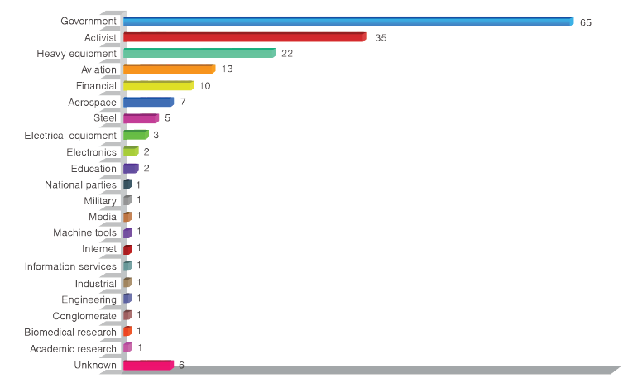
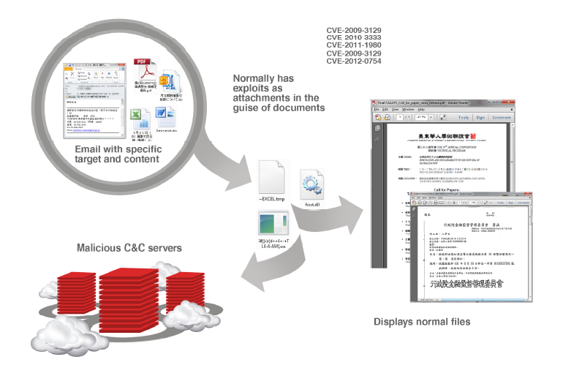
Spear-Phishing Email: Most Favored APT Attack Bait

Slide 22
The cybercriminal underground link

Slide 23
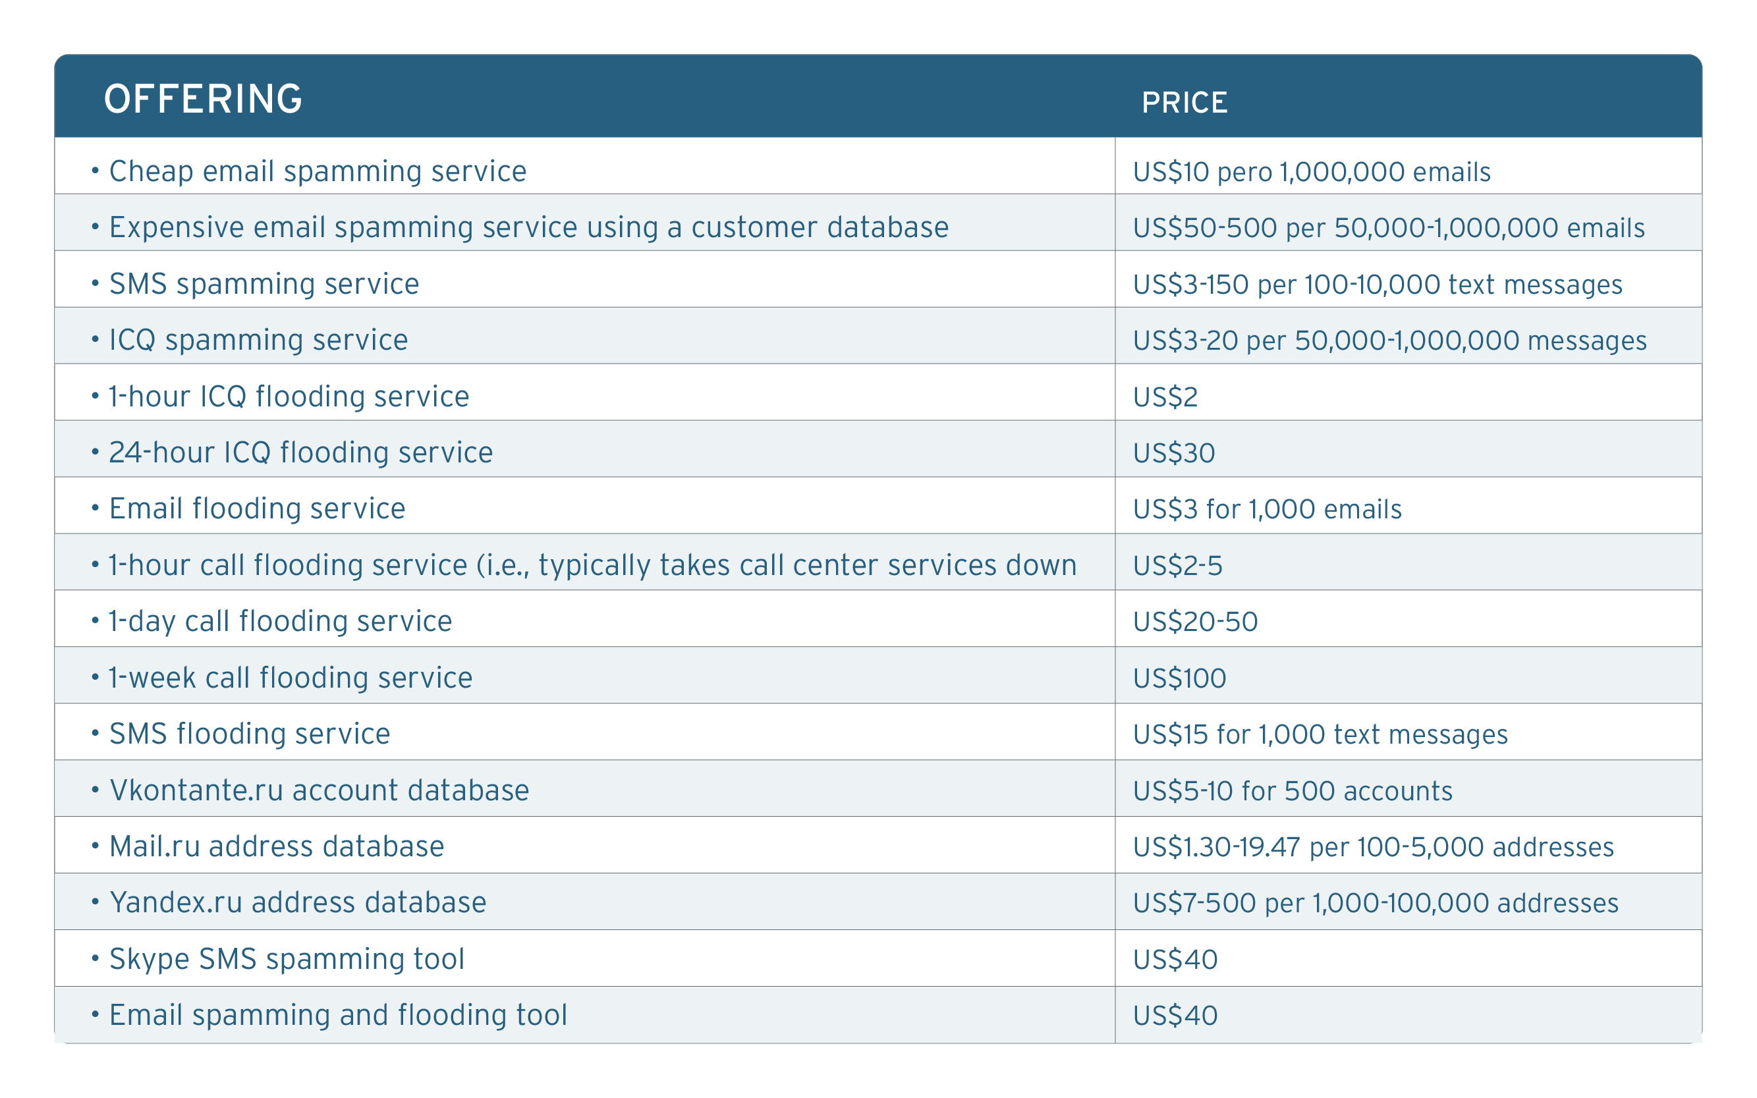
Spamming as a Services (SaaS)

Slide 24
The future of spam

Slide 25
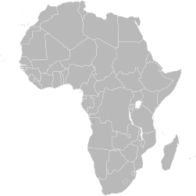
Africa, Security
Challenges
Notes:
Africa is already home to the infamous 419 scam. As cybercriminals elsewhere feel the heat from law enforcement in their home countries, they are likely to set up shop in Africa.
Why Africa? There are several key attributes to the continent that make it appealing for cybercriminals.

Slide 26
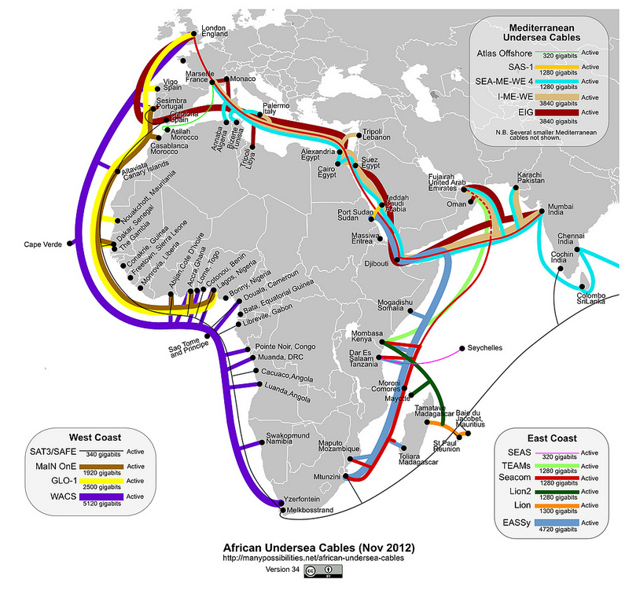
Reason # 1
Availability of Faster and More Affordable Internet Access
Why Africa?
At 2.9 billion subscriptions, it owns half of the world’s mobile population.
46% world’s internet user base
Notes:
A number of projects that aim to increase the bandwidth in Africa have been started. Once completed, these are expected to cut costs for both operators and end users.
More available bandwidth will benefit institutions and companies that rely on the Internet, but also attackers and cybercriminals.
Greater bandwidth, after all, will not only mean faster and better Internet access but also faster and better means to launch attacks.

Slide 27
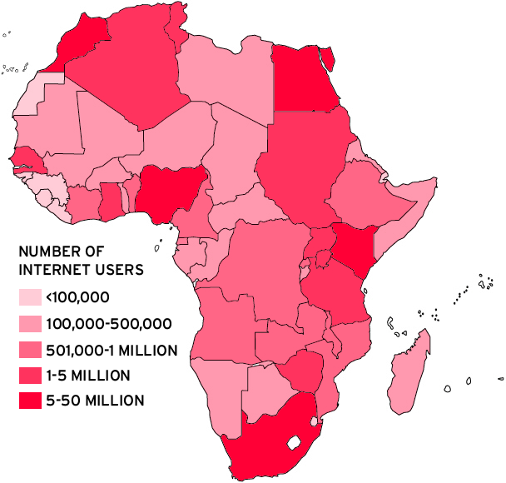
Reason # 2
Expanded Internet User Base
Why Africa?
At 2.9 billion subscriptions, it owns half of the world’s mobile population.
46% world’s internet user base
Notes:
The estimated number of Internet users in Africa as of June 2012 was 167,335,676. In 2000, this number was only 4,514,400. If the growth in volume continues, there will be millions of future Internet users—potential cybercrime victims—in the region.
The exponential growth of Africa’s user base will force ISPs to lower service prices, benefiting both end users and attackers.

Slide 28
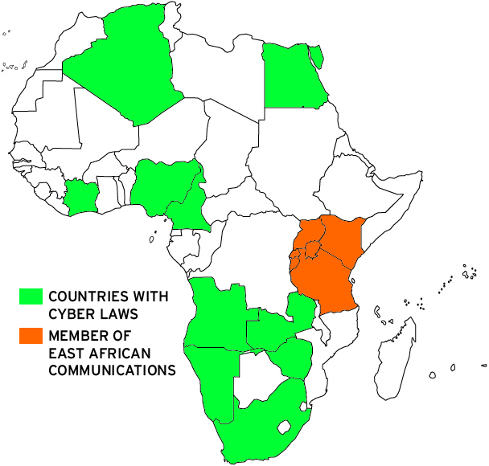
Reason # 3
Need Cybercrime Laws address modern underground technique
Why Africa?
Notes:
Cybercrime flourishes in regions with weak law enforcement, especially where criminals who may contribute to local economies do not target local residents and organizations.
Enforcing anti-cybercrime laws is difficult even in developed countries. If our research on the Chinese and Russian underground economies is any indication, cybercrime in Africa may just become a local growth industry.
Improved infrastructure and an expanding user base in Africa, coupled by lack of cyberlaws, will, however, make it easy for cybercriminals and attackers to launch malicious activities without fear of being prosecuted.

Slide 29
The number of spam will continue to decrease as solution becomes basic
The number of traditional spam will decrease because of new vectors
Criminals will design highly targeted attack using customize spam
Spam will be still be “sexy” for cybercriminals
Notes:
Decrease in No as solution becomes basic
Decrease in no of traditional spam bec of (new vector) (LE /Industry)
Criminals need to Customize --- increase in their overhead (pre target, research , due diligence)

Slide 30

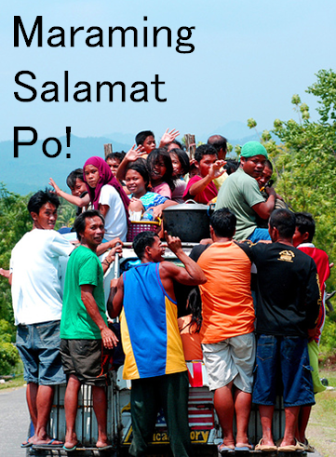


Slide 31
Backup slides

Slide 32
