Slide 1
3rd SG13 Regional Workshop for Africa on “ITU-T Standardization Challenges for Developing Countries Working for a Connected Africa” (Livingstone, Zambia, 23-24 February 2015)
Big Data: Ethics, Privacy and Standards
Shuller Habeenzu,
Director, ITMConsult,
beenzu@itmconsultzm.com

Slide 2
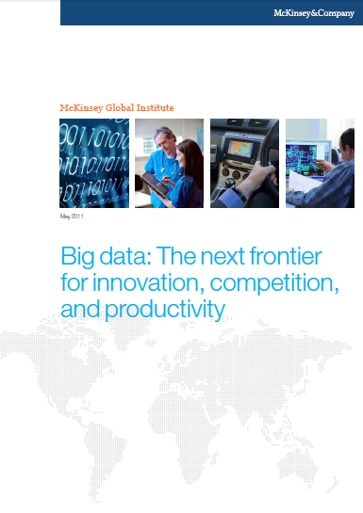
Agenda
What is big data and why is it important now?
Characteristics of Big Data
Big data : Ethics and privacy
Implications for Standardisation
Conclusion

Slide 3
What is Big Data?
“Information is the oil of the 21st century, and analytics is the combustion engine.”
Peter Sondergaard, Gartner Research
We have for the first time an economy based on a key resource [Information] that is not only renewable, but self-generating. Running out of it is not a problem, but drowning in it is.
– John Naisbitt
When we talk about “big data” we’re referring to data sets that are so large, so diverse, or so complex that the conventional tools that would ordinarily be used to manage data simply don’t work.
John Podesta
Notes:
Despite the hype, Big Data is more than just a media speak. Its ability to excerpt correctly and specifically, information needed at any opportune time is of immeasurable monetary worth - This is indeed every CIO's greatest challenge. Information is expensive, and technology continues to reduce the cost of creating, capturing, managing, and storing data. But what is the stimulus behind this current ignition within the digital sphere? Big Data leverages computational dynamism to process briskly insurmountable amounts of data to make it easily accessible to people in real time

Slide 4
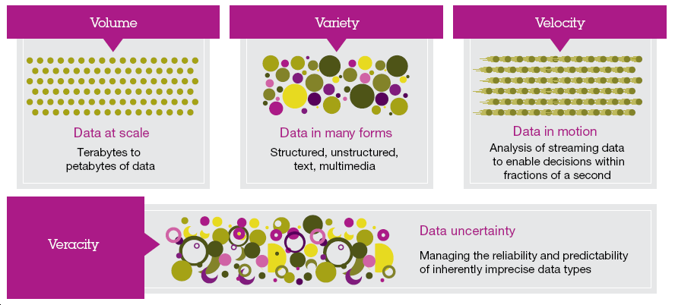
Characteristics of big data
Big data embodies new data characteristics created by today’s digitized marketplace
Source: IBM methodology
Notes:
“Four Vs”: volume (massive
and passively generated); variety (originating from both
individuals and institutions at multiple points in the data
value chain); velocity (generally operating in real time); and
veracity (referring to the uncertainty due to bias, noise or
abnormality in data).
Volume: Refers to the vast amounts of data generated every second
complexity :Growing at an increasing rate but number of sources also increasing – IoT, etc, RFID, Twitter, Facebook
Variety
Refers to the different types of data we can now use
Growth in data sources fuelling growth in data variety.
80% of data unstructured
Managing, merging and governing different varieties of data is something many organizations still grapple with
Velocity
Refers to the speed at which new data is generated and the speed at which data moves around.
velocity of decision-making — the time taken from data input to decision output — is a critical factor
Velocity is really about how fast data is being produced and changed and the speed with which data, must be received, understood, and processed.
Reacting quickly enough to deal with data velocity is a challenge for most organizations
Veracity: Data uncertainty
Managing the reliability and predictability of inherently imprecise data types
How can you act upon information if you don’t trust it. Establishing trust in big data presents a huge challenge as the sources and the variety grows.
Value :
Having access to big data is no good unless we can turn it into value
If you do not have the tools to make sense of it, that data is useless
Deriving actionable consumer insights from social media

Slide 5
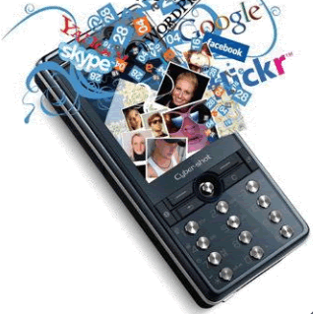
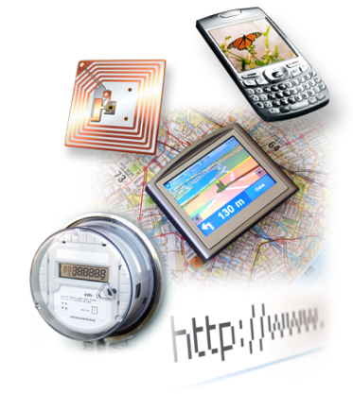
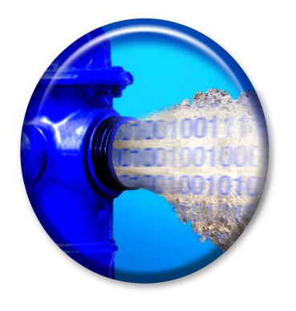
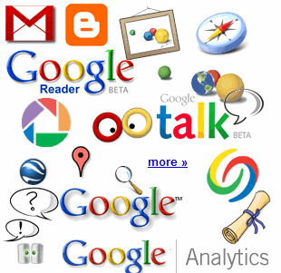
Where Is This “Big Data” Coming From ?
30 billion RFID tags today (1.3B in 2005)
4.6 billion camera phones world wide
12+ TBs of tweet data every day
100s of millions of GPS enabled devices sold annually
? TBs of data every day
2+ billion people on the Web by end 2011
25+ TBs of log data every day
76 million smart meters in 2009… 200M by 2014
Notes:
Obviously, there are many other forms and sources of data. Let’s start with the hottest topic associated with Big Data today: social networks. Twitter generates about 12 terabytes a day of tweet data – which is every single day. Now, keep in mind, these numbers are hard to count on, so the point is that they’re big, right? So don’t fixate on the actual number because they change all the time and realize that even if these numbers are out of date in 2 years, it’s at a point where it’s too staggering to handle exclusively using traditional approaches.
+CLICK+
Facebook over a year ago was generating 25 terabytes of log data every day (Facebook log data reference: http://www.datacenterknowledge.com/archives/2009/04/17/a-look-inside-facebooks-data-center/ ) and probably about 7 to 8 terabytes of data that goes up on the Internet.
+CLICK+
Google, who knows? Look at Google Plus, YouTube, Google Maps, and all that kind of stuff. So that’s the left hand of this chart – the social network layer.
+CLICK+
Now let’s get back to instrumentation: there are massive amounts of proliferated technologies that allow us to be more interconnected than in the history of the world – and it just isn’t P2P (people to people) interconnections, it’s M2M (machine to machine) as well. Again, with these numbers, who cares what the current number is, I try to keep them updated, but it’s the point that even if they are out of date, it’s almost unimaginable how large these numbers are. Over 4.6 billion camera phones that leverage built-in GPS to tag the location or your photos, purpose built GPS devices, smart metres. If you recall the bridge that collapsed in Minneapolis a number of years ago in the USA, it was rebuilt with smart sensors inside it that measure the contraction and flex of the concrete based on weather conditions, ice build up, and so much more.
So I didn’t realise how true it was when Sam P launched Smart Planet: I thought it was a marketing play. But truly the world is more instrumented, interconnected, and intelligent than it’s ever been and this capability allows us to address new problems and gain new insight never before thought possible and that’s what the Big Data opportunity is all about!
5

Slide 6
The Internet of Everything (IoE)
Enables billions of new connections between people, processes, things.
Shifts value - data access and analytics to the edge of the network (no matter how remote).
Provide fundamentally better near-real-time information and insight
Organizations that can find the intelligence in this data can create new sources of competitive advantage

Slide 7
Mobile Devices : Major Source of Data
Data
Mobile Data Call records
Depletion of airtime
Mobile Money
Social networks
Facebook :350 million photos uploaded and shared every day.
YouTube: 100 hours of video uploaded every minute
Creating a mobile sensor network that enables us to capture and analyse human behaviour as never before

Slide 8
Big Data Access
Data is the key to your success if you can reach it and use it when you need it.
Challenges
Data silos and complexity challenge
Only 15% of population in Africa have access to the internet
Data Privacy
HIPPO Principle
Evidence-based decision-making culture
Limited access to big data creates new digital divide

Slide 9
KEY ISSUES
Big data gives to much power to the enterprise, hence need for
Standards
Privacy
Ethics
Global data bases (Facebook, LinkedIn, Twitter), Google Search engine, etc

Slide 10
Big Data and Ethics
Big data puts a lot of power into the hands of enterprises to analyse and predict consumer behaviour.
But with that comes potential for misuse. How should business implement ethics into the application of big data
Facebook's controversial "mood manipulation study" - undisclosed psychological experiment on its users in 2012
2014 EBOLA crisis – challenge to get access to mobile network CDR on population movement
Need to understand and agree on rules regarding privacy, identity, ownership and reputation of Big Data
Facebook's undisclosed psychological experiment on its users in 2012.
Notes:
An example of these complex challenges can be seen in the 2014 Ebola crisis in West Africa. Despite months of talks between health officials, UN agencies, mobile network operators and governments, getting access to mobile network operators’ data on population movement was problematic.
Researchers, including one involved in Facebook experiments, are coming to grips with ethical challenges of playing around with Big Data.
The disclosures of Facebook's 'experiments' amplified ethical issues that have been lying in wait. This article from 2011 presciently observed, "The potential dark side of Big Data suggests the need for a code of ethical principles.

Slide 11
Big Data and Ethics
Big data raises new ethical questions because it create opportunities for:
Intense social change,
threatening existing distributions of power, money, rights, and obligations

Slide 12
Example: Mobile SIM Card Registration
Treasure trove for operators
Customer analytics
Ethical use guidelines
For government
Security
Who owns the data?
Who is responsible for the data?
Do customers have rights to the use of the data?

Slide 13
Four Aspects of Big Data Ethics
Big Data Ethics
Identity
Privacy
Ownership
Reputation
Notes:
three general criteria determine the
appropriateness of using data: ethics (the underlying
principles for using data); accountability (how effectively the
principles are implemented and enforced); and veracity (the
accuracy and completeness of the underlying data sets).
Identity
» Is offline existence identical to online existence?
Privacy
» Who should control access to data about you?
Ownership
» What does it mean to own data about ourselves?
Reputation
» How can we determine what is trust-worthy?

Slide 14
Snowden’s Big Data Lesson
There is no place to hide
e-mails, phone calls, text messages, and social media activity of millions of people around the worlds are collected and stored
enormous cloud servers have been breached,
both data and metadata have been fair game
Governments will continue doing what they do always – the context might change
Big data promises economic efficiency, more observation at less cost
Notes:
Using time and location data culled from social media posts or other sources, researchers say they can identify your purchases from amongst anonymized transaction data

Slide 15
Big Data : Opportunities for Development
Early warning:
Faster detection of anomalies at the onset of a crisis allows more agile responses to prevent harm.
Real-time awareness:
A fine-grained and current representation of reality informs better design and targeting of programmes and policies;
Real-time feedback:
Continuous monitoring for behaviour changes following programme implementation enables a more adaptive approach to development, in which rapid adjustments may be made until results are achieved.
Fundamental outcome: Saving Lives
How can we leverage the real-time nature of the data to save lives?

Slide 16
EBOLA and Big data -
Mexico - monitoring public response to government warning during swine-flu epidemic
Haiti – tracking cholera outbreaks during 2010 earthquake
Epidemiological mapping, to track and help combat malaria in Kenya and Namibia
Modelling mobility patterns of people in Tokyo following an earthquake and nuclear accident in 2011
Urban planners - to identify places to extend public transport
Notes:
CDRS are empirical, unlike surveys immediate availability and updated in real-time

Slide 17
EBOLA & Big data
Challenge
Responding to need to access and analyse mobile CDRs to gain insight into EBOLA spread and population flows to respond and take action in near-real-time
Barriers
Lack of widely accepted data-sharing standards and practices, private data available on an ad hoc basis
Risk of disclosing commercial interest information
Uncertain and country-specific regulatory landscape for data sharing
legal uncertainty complicates the design of data-sharing protocols.
Lack of political will among regulators and operators
Lack of standards or rules for sharing metadata across borders
Notes:
Our core assumption is that collecting useful and actionable data is one of the biggest challenges for health actors, particularly in the case of an epidemic such as Ebola. Indeed, there are very limited existing sources (e.g. census, household surveys), they are often outdated and they are seldom dynamic.
However, privacy concerns echoed by regulators have prevented such data to be accessible to the scientific community
Kenya Revenue Authority has begun to mine mobile transaction data to identify noncompliant taxpayers

Slide 18
Data Access Challenges & Opportunities
Private sector barriers to sharing Big Data:
Opportunity
Legal constraints
Reputational risk
Competitive advantage
Culture of secrecy
Lack of incentives
Technical complexity
Level of effort
Innovation
Deeper insights
Broader outlooks
Customer Engagement

Slide 19
How can we leverage big data as a public good
How can Big Data fulfill its potential as a public good?
Institutional and financial support from public sector actors
Creating incentives for corporations to share data
Creating opportunities for academic researchers to collaborate
Developing new models, technologies and policies for safe and responsible sharing and reuse of data for the public good
New types of partnerships

Slide 20
In Conclusion
Big data technologies will be transformative in every sphere of life.
Mobile and Cloud computing a clear part of the future
The knowledge discovery they make possible raises considerable questions about how our framework for privacy protection applies in a big data ecosystem.
We are building the future we will inherit. Biggest challenges will likely relate to privacy and ethics, not the technology
How we can embrace big data technologies while at the same time protecting fundamental values like privacy, fairness, and self-determination.

Slide 21
Recommendations
Establish dialogue ethics and privacy between government, mobile network operators and consumers
Establish clear, consistent, pragmatic and privacy-conscientious data anonymization rules
Adopt national laws and rules that simplify the collection and use of mobile phone metadata for the purposes of research and the public good
Harmonize laws on the sharing of metadata with common identifiers across national borders.
Innovative regulation – determine how metadata is to shared in a privacy-conscience manner
Standards, practices and legal regulation should incorporate trust mechanisms for humanitarian sharing of data

Slide 22
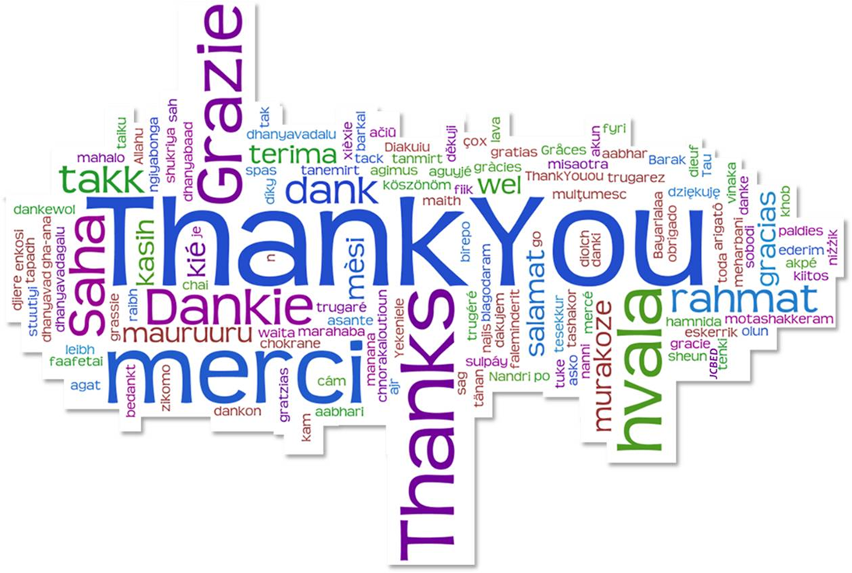
Q & A
Shuller Habeenzu,
Director, ITMConsult,
beenzu@itmconsultzm.com

