Slide 1
A Global Approach to EMF Management and Standards
11th Symposium on ICT, Environment and Climate Change
21 April 2016, Kuala Lumpur, Malaysia
Mike Wood
Vice Chairman, ITU-T SG5, WP2

Slide 2
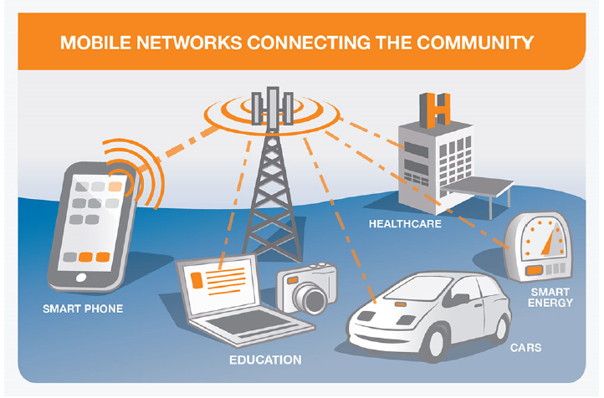

Importance of International Standards
  How global standards help
  Facilitates compliance with international standards
  Enhances communication with citizens
  Ensures consistency and safety standards
  for all communities
  Ensures communities have access to the latest
  technologies at lowest cost
  International Health Agencies (WHO, ICES, IEEE)
  - establish the human exposure safety limits & guidelines
  International Standards Organizations (ITU, IEC, IEEE)
  – establish the human exposure assessment and monitoring standards
Key Point - Todays communications systems are global
therefore a global harmonised approach for EMF standards is required

Slide 3
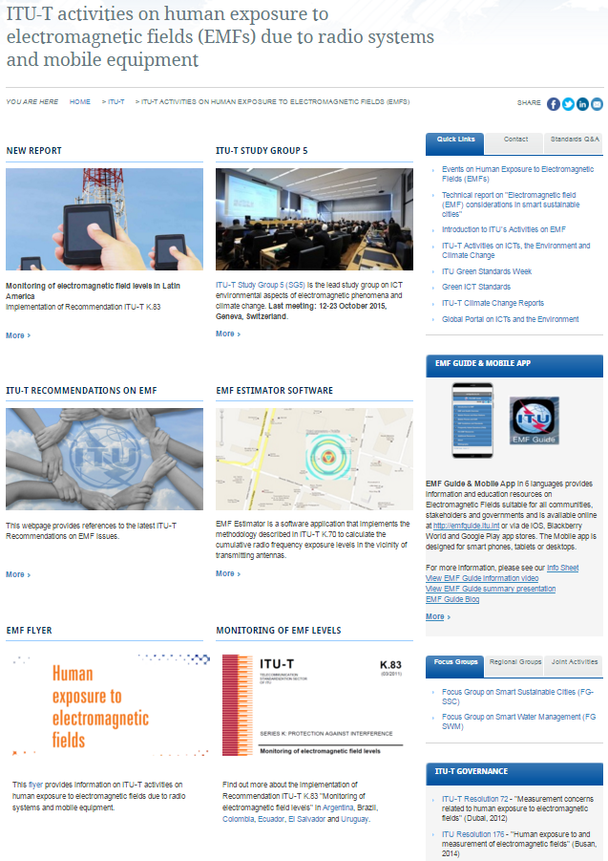
ITU’s contribution to EMF Standards
ITU-T Study Group 5 has an active group of global experts focused on EMF
Key activities & study areas
EMF measurement & monitoring standards
EMF estimator software
EMF information
EMF mobile applications – (EMF Guide)
EMF management frameworks (technical aspects)
Visit the EMF web page

Slide 4
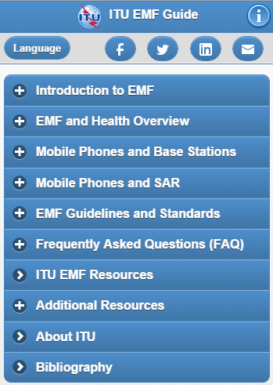
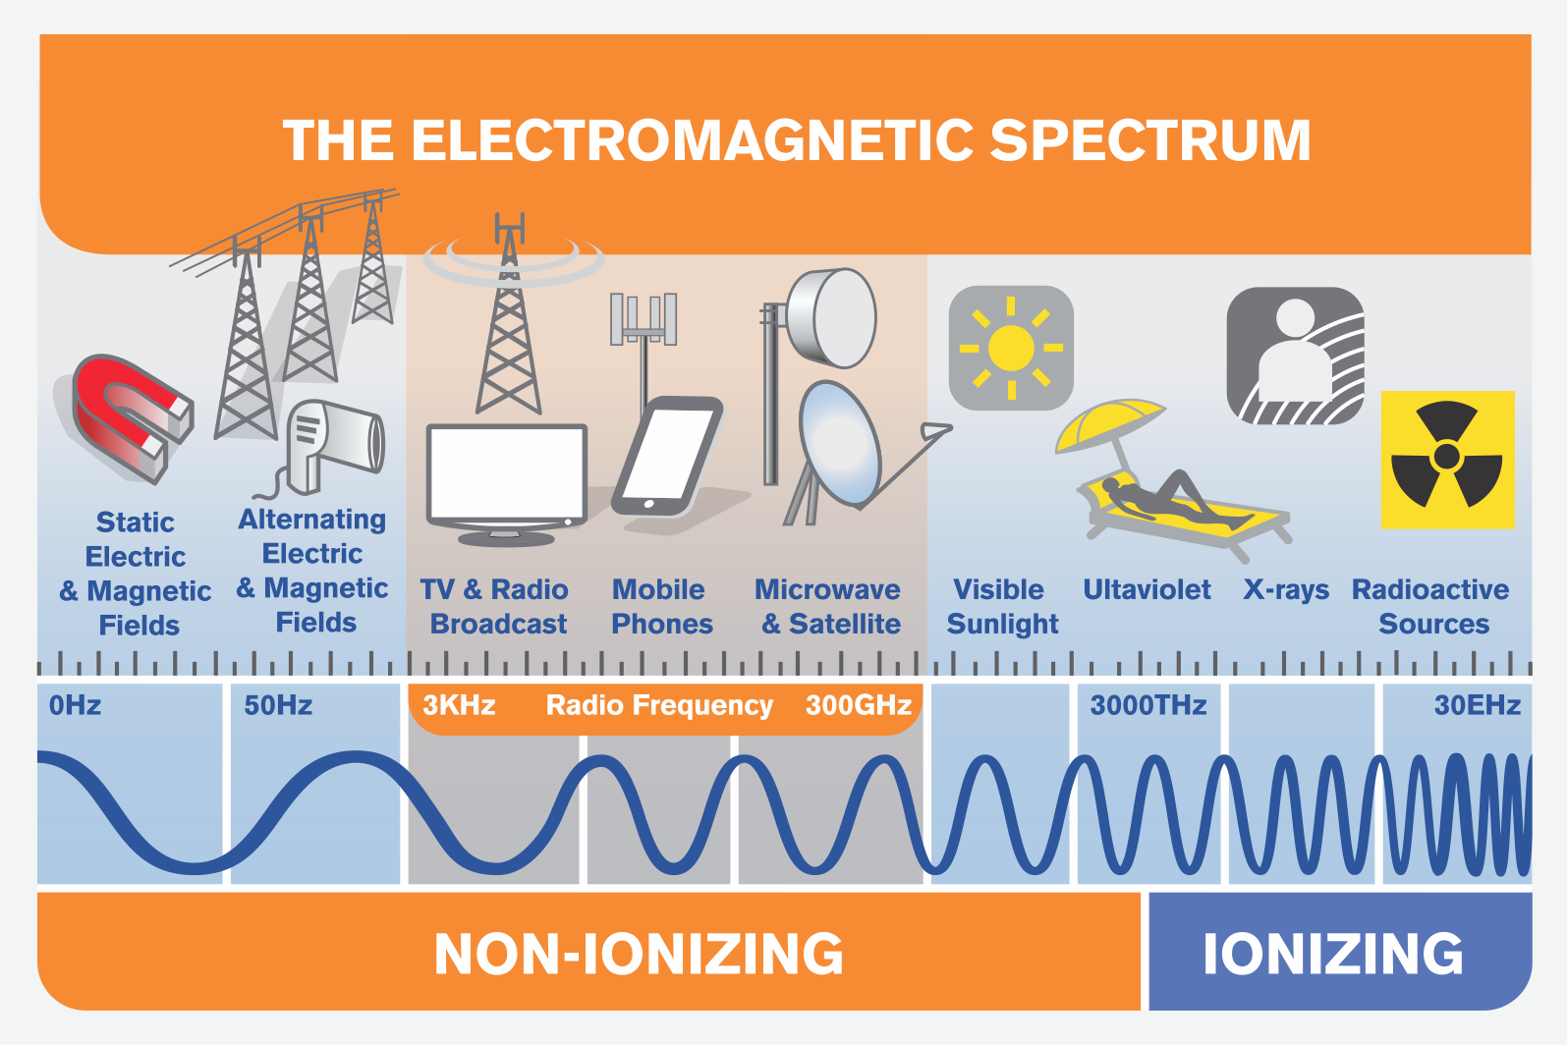



Communicating with public on EMF
Key elements for successful public communications:
  Easy to understand information
  Open and transparent dialogue
  Provide stakeholders with trusted sources of information
ITU’s Public information on EMF:
  ITU EMF Guide – key information source
  EMF Web site
The EMF Guide mobile app in 6 languages is available online at http://emfguide.itu.int

Slide 5


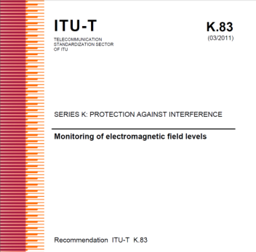
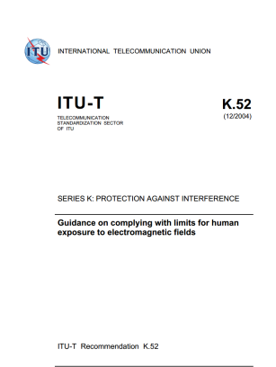
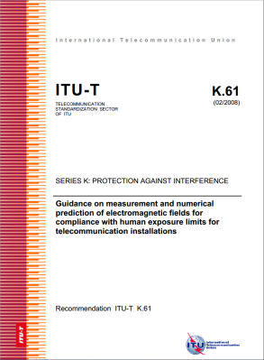
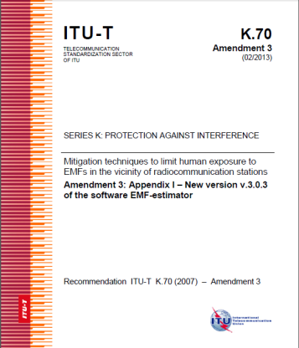
Assessment of EMF
The ITU, IEC and IEEE have developed some key standards used globally on EMF
ITU-T K.91 Guidance for assessment, evaluation and monitoring of human exposure to radio frequency electromagnetic fields
ITU-T K.100 Measurement of radio frequency electromagnetic fields to determine compliance with human exposure limits when a base station is put into service
ITU-T K.52 Guidance on complying with limits for human exposure to electromagnetic fields
ITU-T K.70 Mitigation techniques to limit human exposure to EMFs in the vicinity of radiocommunication stations – includes EMF Estimator software
IEC 62209 -1 Human exposure to radio frequency fields from hand-held and body-mounted wireless communication devices
IEC 62232 Determination of RF field strength and SAR in the vicinity of radiocommunication base stations for the purpose of evaluating human exposure
IEEE C95.3 Recommended Practice for Measurements and Computations of Radio Frequency Electromagnetic Fields with Respect to Human Exposure to Such Fields, 100 kHz to 300 GHz

Slide 6
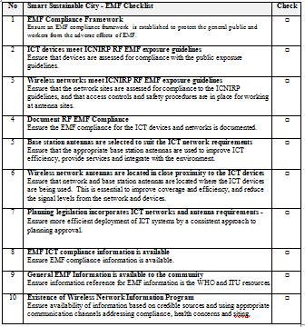
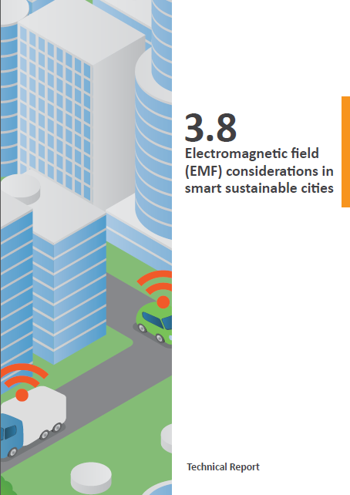
EMF Considerations for City Planners and Developers
The ITU has developed Technical Report & Checklist on the EMF Considerations in Smart Sustainable Cities
  provides guidance on implementation, and promotes efficient deployment of wireless networks in smart sustainable cities
  features a ‘Smart Sustainable City EMF Checklist’
  designed to provide an easy to use reference for city officials and planners to ensure smart sustainable city policies operate efficiently and comply with EMF exposure standards
  references WHO materials, ICNIRP Guidelines, ITU-T Recommendations and IEC Standards
Wireless networks provide vital connections for smart sustainable cities
Efficient deployment of wireless infrastructure reduces transmitted power from networks and devices, reduces EMF, and improves the efficiency of ICTs

Slide 7


Review of ITU’s EMF Standards
The ITU will review the impact and potential changes required to the ITU recommendations on EMF in the next study period
  WHO Environmental Health Criteria (EHC) - Review the outcome and recommendations from the World Health Organization health risk assessment of radiofrequency electromagnetic fields to be published as a monograph in the Environmental Health Criteria Series.
  ICNIRP Guidelines Update - Review the changes to the human-exposure guidelines set out by the International Commission on Non-Ionizing Radiation Protection (ICNIRP) when the revision is published in 2016/17.
  Technology updates – EMF exposure assessment from new and emerging technologies

Slide 8
Thank you
Questions ?

Slide 9


