Slide 1

“11th ITU Symposium on ICT, Environment and Climate Change”
21 April 2016
Kuala Lumpur
Promoting climate change mitigation in cities in the UNECE region
Domenica Carriero
Housing and Land Management Unit
Forests, Land and Housing Division, UNECE

Slide 2
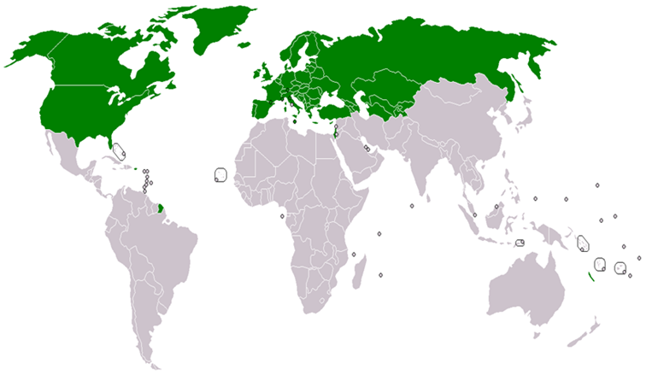

UNECE Committee on Housing and Land Management
Members:
56 countries in Europe, Central Asia and North America
1.
2.
3.
Mandate:
To improve housing, urban sustainability and land governance
1. Sustainable Housing and Real Estate Markets
2. Smart and Sustainable Urban Development
3. Land Administration and Management
4. Country Profiles on Housing and
Land Management

Slide 3

Geneva UN Charter on Sustainable Housing
Main purpose: to ensure the access to decent, affordable and healthy housing for all
Scope: to improve the sustainability of housing in the ECE region through effective policies and actions at all levels, supported by international cooperation
UNECE endorsed the Geneva UN Charter in April 2015
Environmental protection
Cultural adequacy
Economic effectiveness
Social inclusion and participation
Notes:
(a) Environmental protection
The Charter supports the following actions aimed to limit the negative impact of housing on the environment:
Reduce the carbon footprint of the housing sector by reducing energy use throughout the entire life cycle of buildings
Decrease the adverse per capita environmental impact of cities, including by paying special attention to air and water quality and waste management;
Apply building codes and standards for energy efficiency and the environmental safety of new and existing residential buildings;
Retrofit and renovate existing housing stock in an environmentally friendly, energy-efficient, affordable and cost-efficient way;
Adopt green housing policies and integrate them into sustainable urban and territorial development policies

Slide 4





1. Sustainable housing: Capacity building
2009
2010
2011
2014 2016
Regional workshops as part of Sustainable Energy Forums
Minsk, Belarus ( 2011)
Tbilisi, Georgia (2013)
Hammamet, Tunisia (2014)
Yerevan, Armenia (2015)
Baku, Azerbaijan (2016) coming
1.
National workshops (2014 to 2016)
Armenia
Republic of Moldova
Serbia
Tajikistan
Albania
Green Homes
UNECE EE Action Plan
Good practices on EE in buildings
National Action Plans on Sustainable Housing and Land Management (2014-2016)
Armenia
Republic of Moldova
Serbia
Tajikistan
National Action Plan
Country Profiles

Slide 5
1. Sustainable housing: Standards on Energy Efficiency in Buildings
Cooperation: Committee on Housing and Land Management and Committee on Sustainable Energy and Working Party 6
1. Proposal for developing a study on standards for EE in buildings (ECE/HBP/2014/4) accepted by the Committee on Housing and Land Management
4. Establishment of a UNECE Joint Task Force on Energy Efficiency Standards in Buildings
2. Survey on building standards and regulations
3. Expert Consultation on EE standards in buildings
2014
2015
2016

Slide 6













2. Sustainable urban development: United Smart Cities
IDENTITY CARD
What: project
When: 2014-2020
Why: survey «Challenges and Priorities in the ECE region»
Who: UNECE with partners

Slide 7
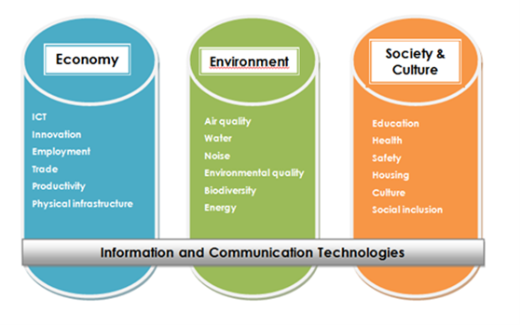
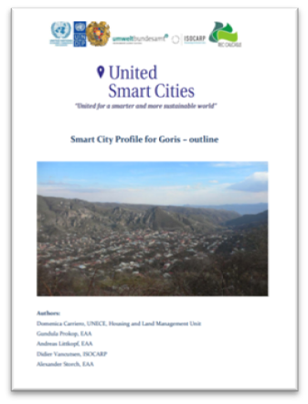
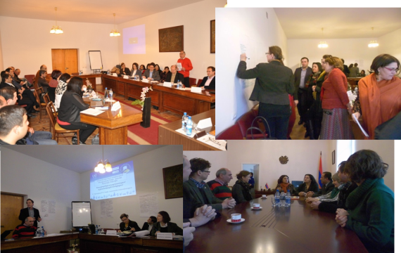
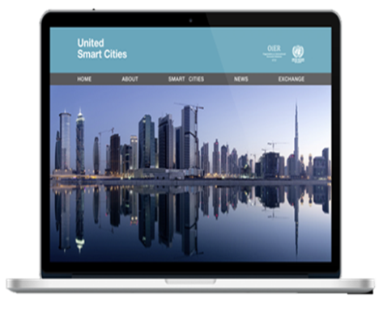
2. Sustainable urban development: United Smart Cities - activities
Activity 1
Activity 2
Activity 3
Activity 4
Methodology
Pilot cities
City assessment
Implementation of the reccommendations
Monitoring
Benchmarking
Activity 5
Capacity building
Outputs
Indicators
Smart sustainable city profiles
City action plan
Online platform
Stakeholders’ training, workshops, meetings and events

Slide 8
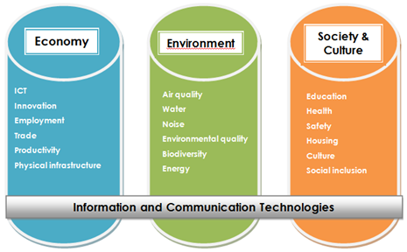
2. Sustainable urban development: the UNECE/ITU Smart Sustainable Cities Indicators
Developed by a consortium of partners – framework of the ITU-T SG5
Endorsed by the Committee on Housing and Land Management on 15 December 2015 (ECE/HBP/2015/4)
Approach
3 main areas
18 topics
72 indicators (core & additional)
Notes:
Benefits of using indicators in the context of the United Smart Cities Project:
Helpful tool to:
set priorities
measure changes
evaluate the current status of a city
serve as a starting point for action
The benefits of using indicators are several. First of all, they can help assess the strengths and weaknesses of a city. By analyzing the performance of a city against the indicators, it is easier to recognize which areas are most critical or in which areas the city is performing well. Second, they can be used to set priorities. Once the strengths and the weaknesses of a city are identified, the indicators can help to prioritize, i.e. to choose the most critical issues for the sustainable growth of the city, and to define measures to address them. Lastly, indicators can also be seen as a good monitoring tool to evaluate the changes in the city’s performance over a certain period of time and after several actions have been implemented.

Slide 9



Thank you for your attention!
Domenica Carriero
Housing and Land Management Unit, UNECE
Email: domenica.carriero@unece.org
Tel.: +41 (0) 22 917 16 72
Website: www.unece.org/housing
Follow us:
@UNECE Housing and Land Management

